Slide 1
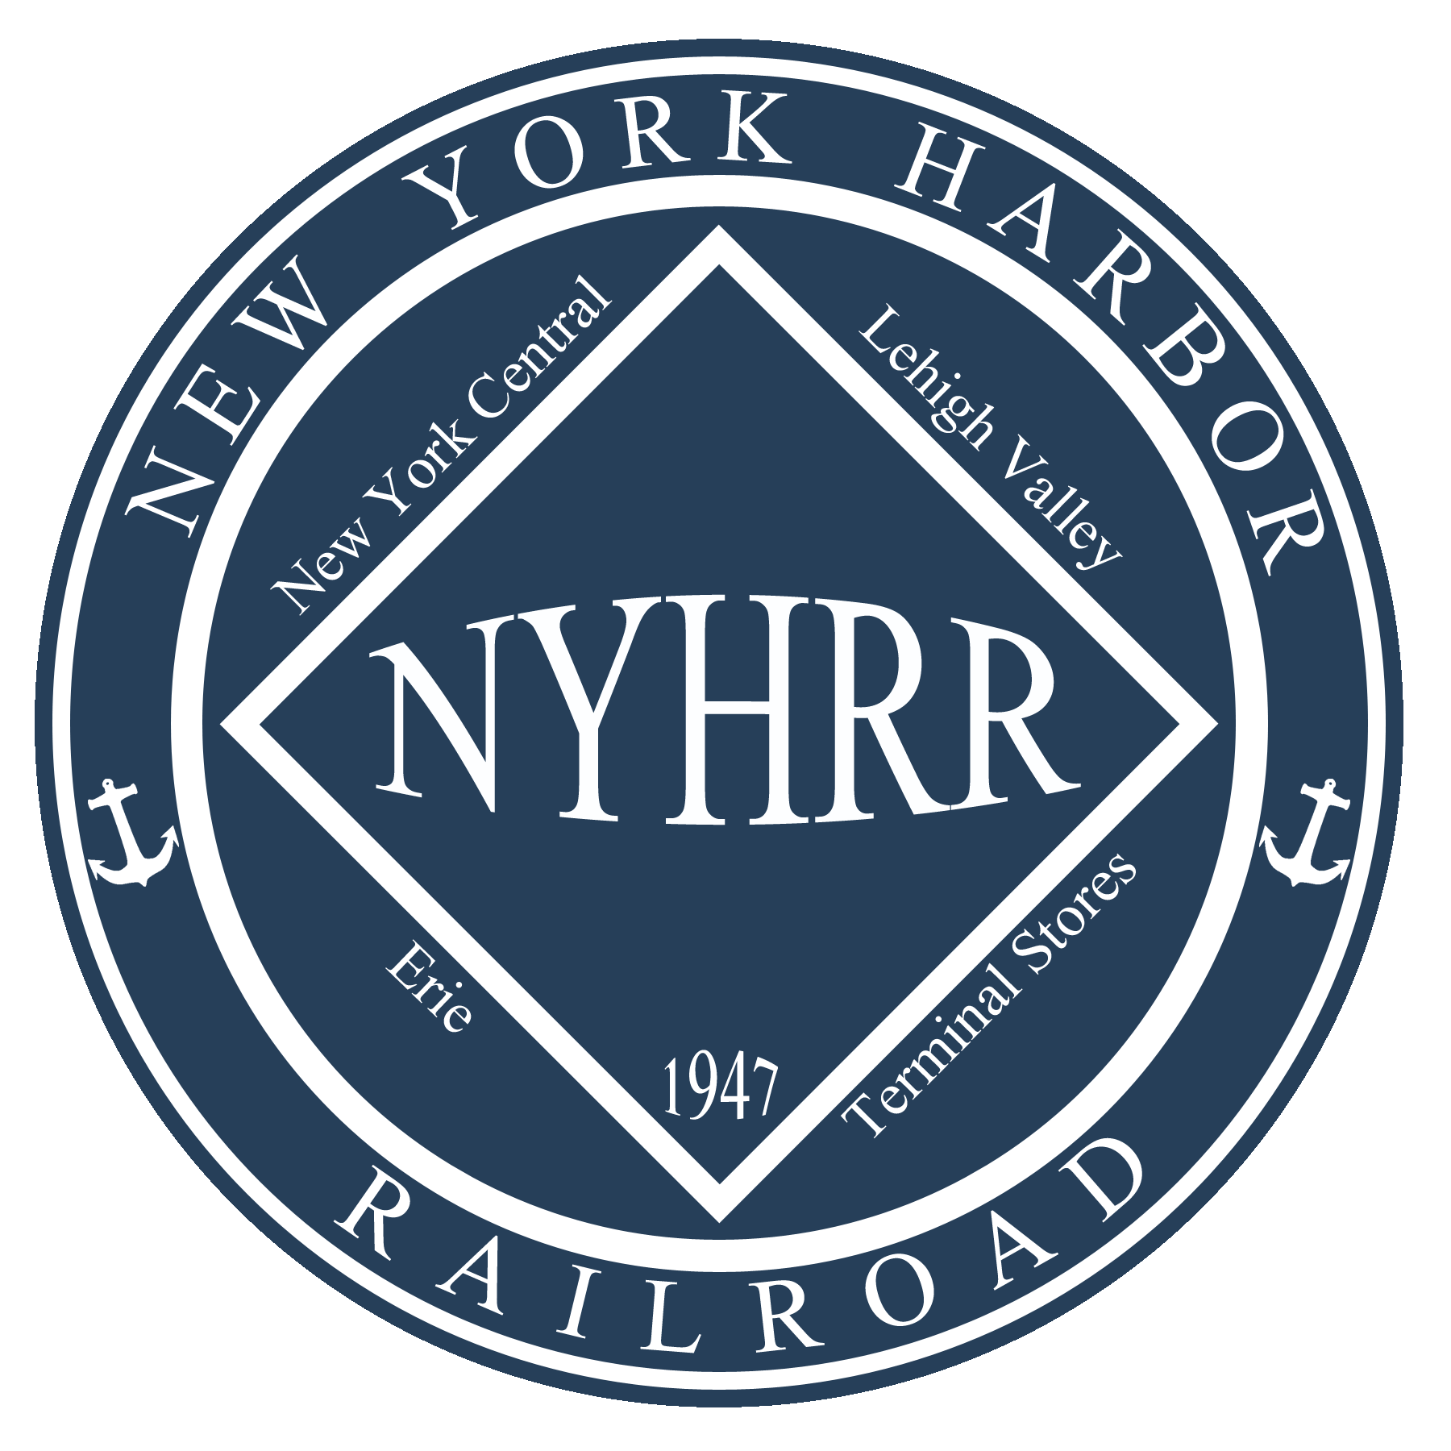
The New York Harbor
13 years in, lessons learned.
David Ramos
Dramos_1701@yahoo.com

Slide 2
The New York Harbor 13 years in, lessons learned.
What was I thinking?
Answer: I was not.
Actually, I knew that I liked Switching layouts. With the 20 X 22 foot footprint, I did not have the space to do a large traditional layout.
I was always interested in Harbor since I was a small child growing up in Manhattan and watching the boats working the East River.
Then I read an article in the Diamond by Thom Flagg and Vince Lee about the Erie’s 28th Street Yard.
I was hooked and the planning phase began!

Slide 3
The New York Harbor 13 years in, lessons learned.
Look out here is a Lesson Learned!
Appreciate the people willing to give up family time to help you in your quest!
OK but what does that mean!
Be ready!
Tools and Supplies
Have a Plan
Be willing to listen to other ideas. Sometimes we are too close.

Slide 4
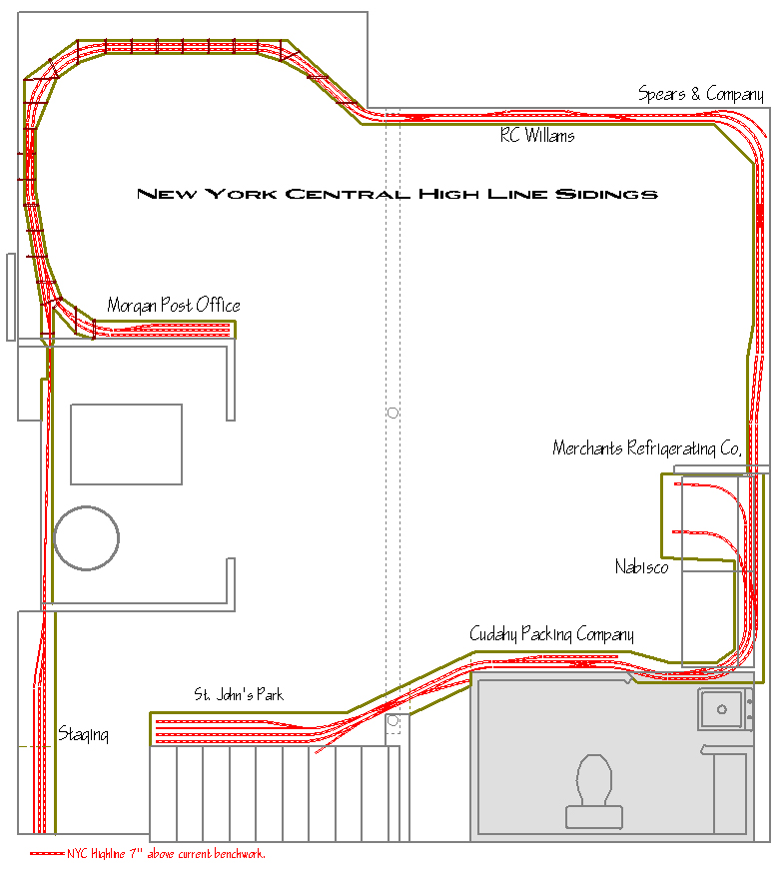
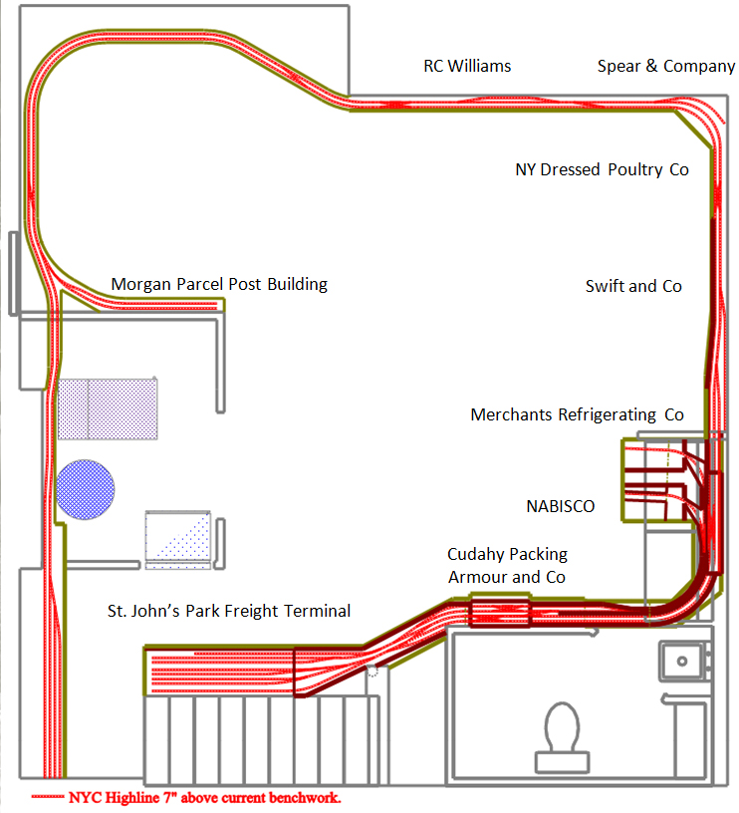
The New York Harbor 13 years in, lessons learned.

Slide 5
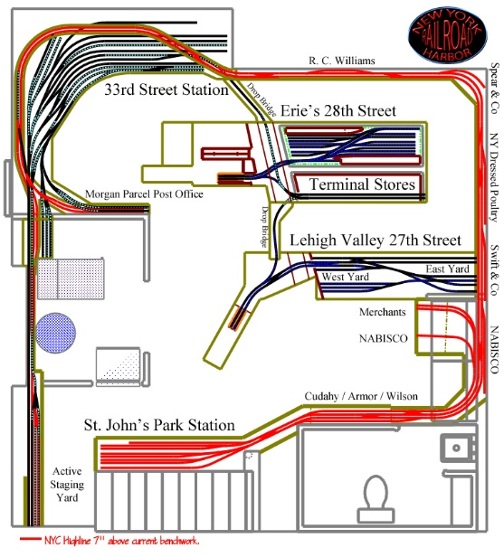
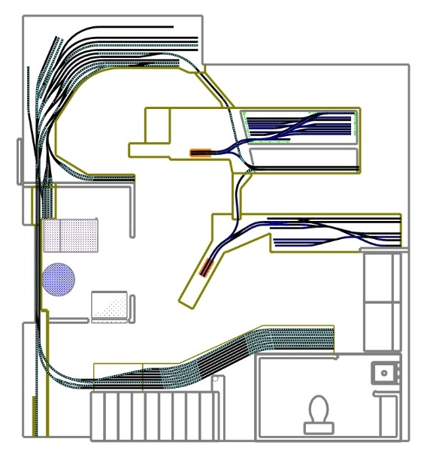
The New York Harbor 13 years in, lessons learned.

Slide 6
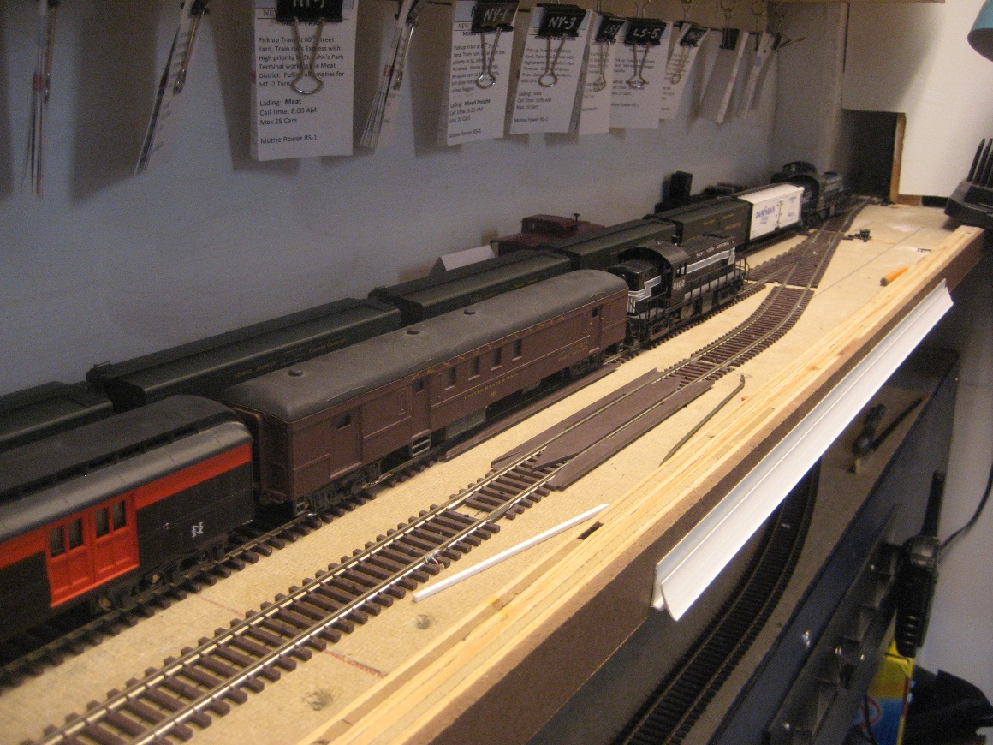
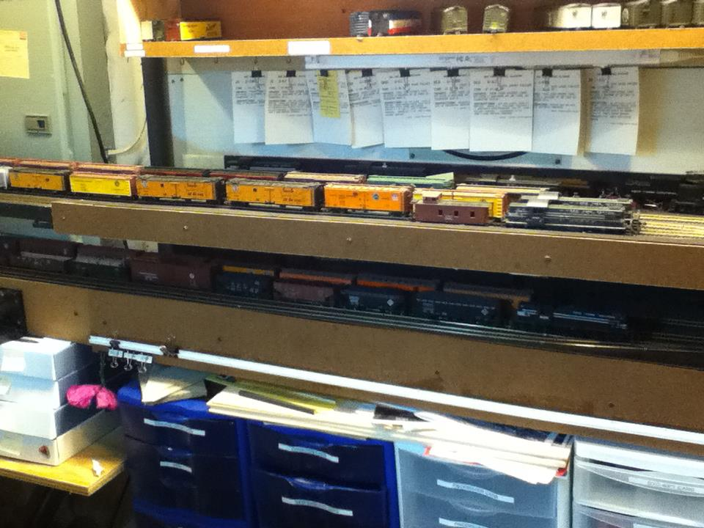
The New York Harbor 13 years in, lessons learned.
Mole to Staging
In this version of my mole staging both lines where located above and below each other. A major limitation to this staging was only one train could come in at any one time and there was a considerable stress in getting equipment on and off the layout

Slide 7
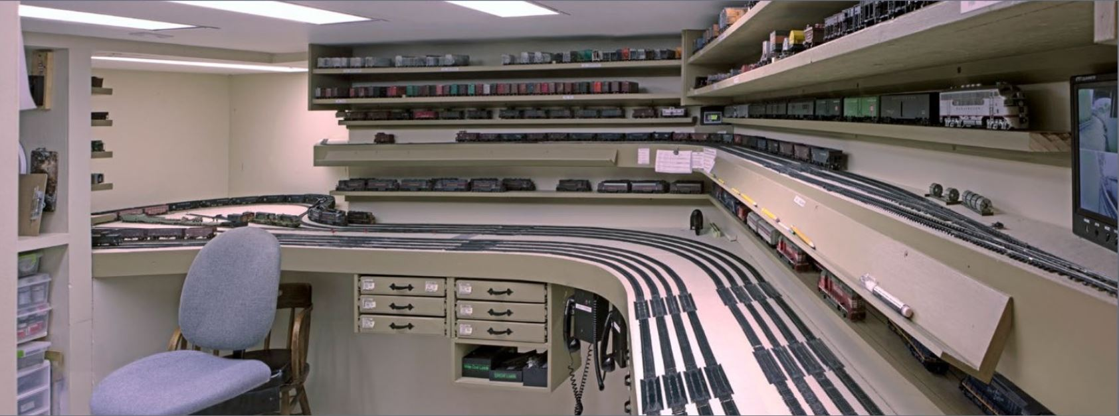
The New York Harbor 13 years in, lessons learned.
Mole to Staging
This is the way to do a mole yard! This is Lee Nicholas’ Utah Colorado Western Mole yard. From the Model Railroad Hobbyist Magazine. March 2013.

Slide 8
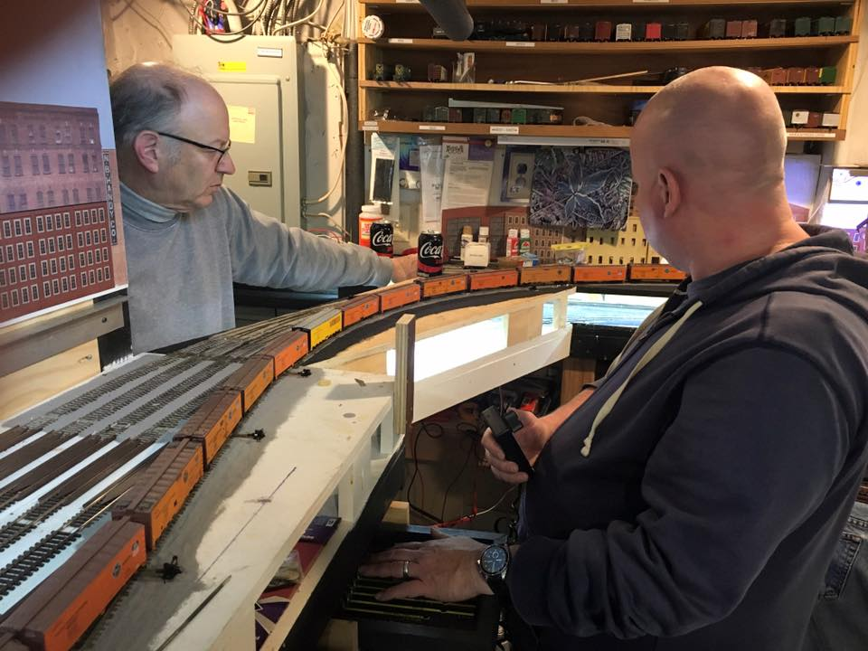
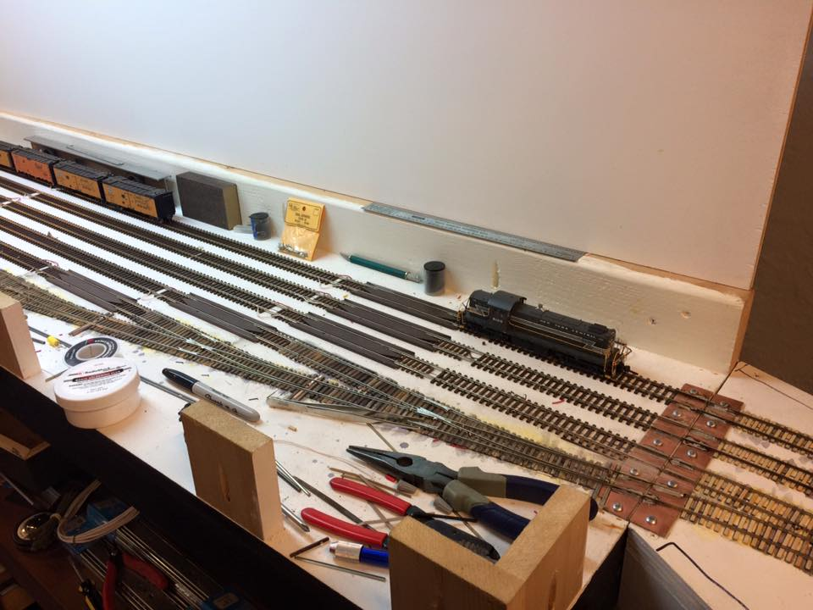
The New York Harbor 13 years in, lessons learned.
New Staging
Rebuilding was painful but I had plenty of help. Here is the new Lower Staging and Upper Staging going in.

Slide 9
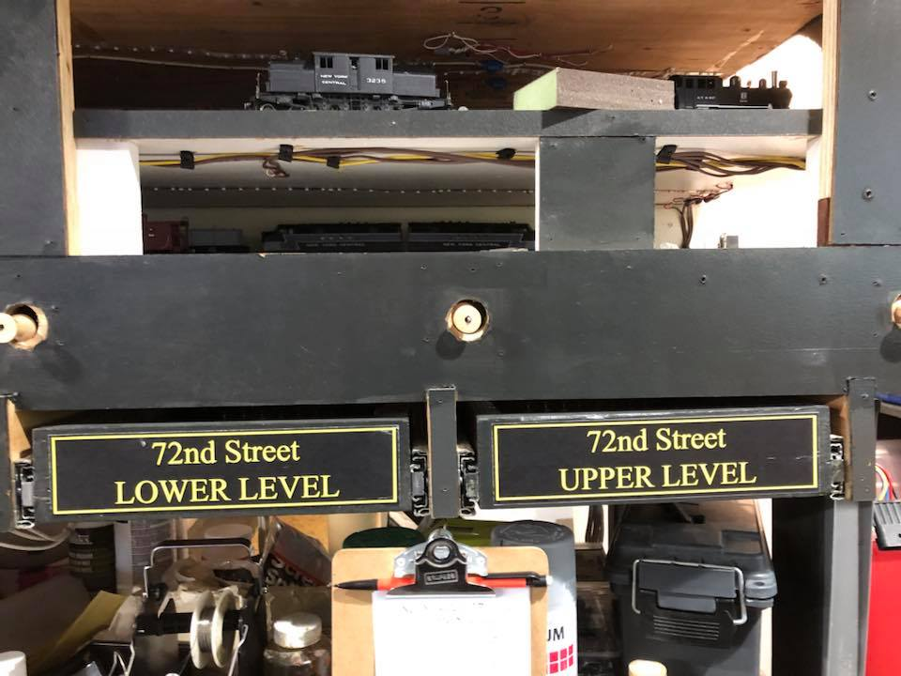
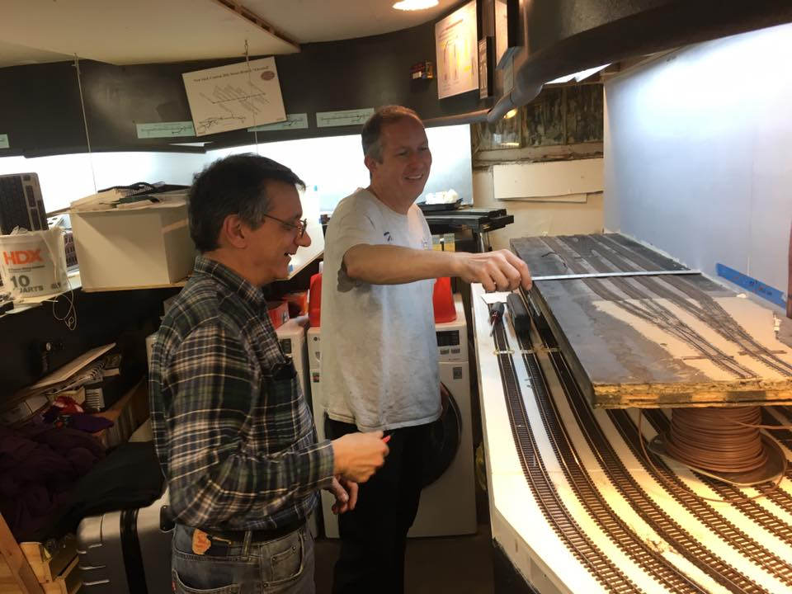
The New York Harbor 13 years in, lessons learned.
New Staging
Reinstalling the original Highline sections and making everything work

Slide 10
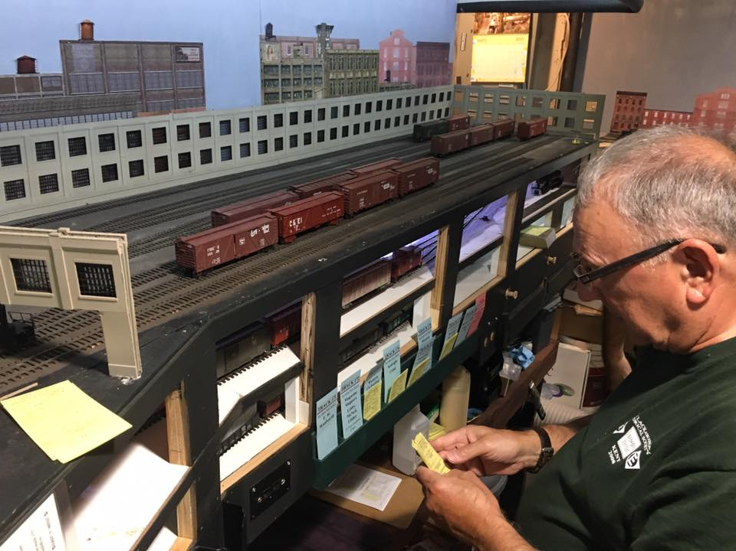
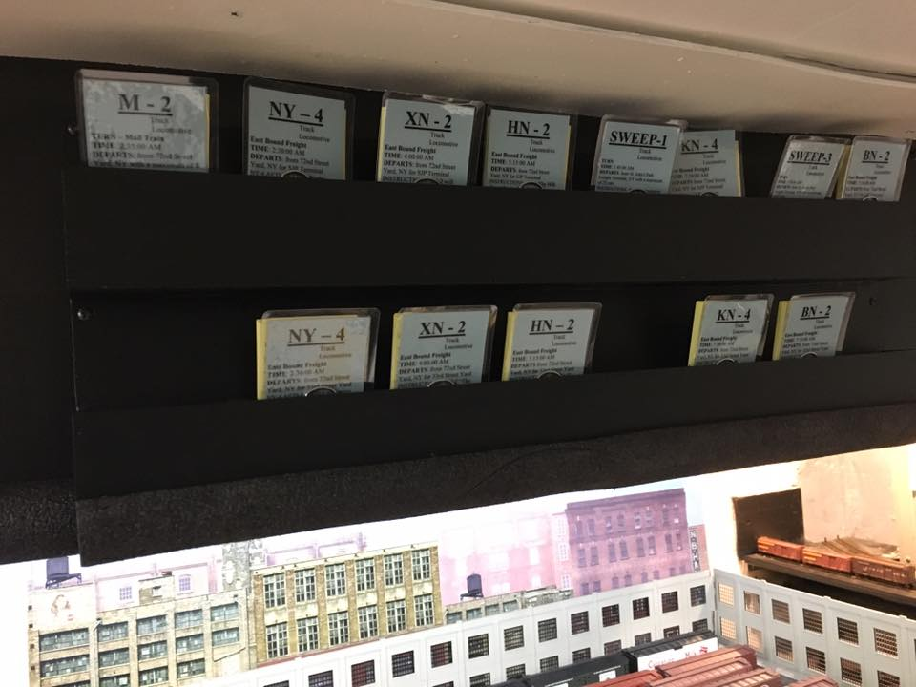
The New York Harbor 13 years in, lessons learned.
New Staging
Back and up and running.

Slide 11
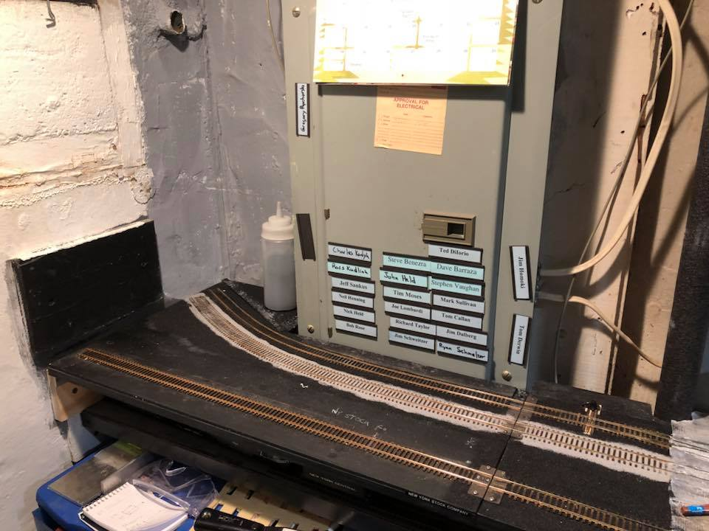
The New York Harbor 13 years in, lessons learned.
New Scenery Going In
One of the sore point was at the bottom of the stairs. I could not cover the electrical panel permanently. The section of bench work is removable to increase access to the panel.

Slide 12
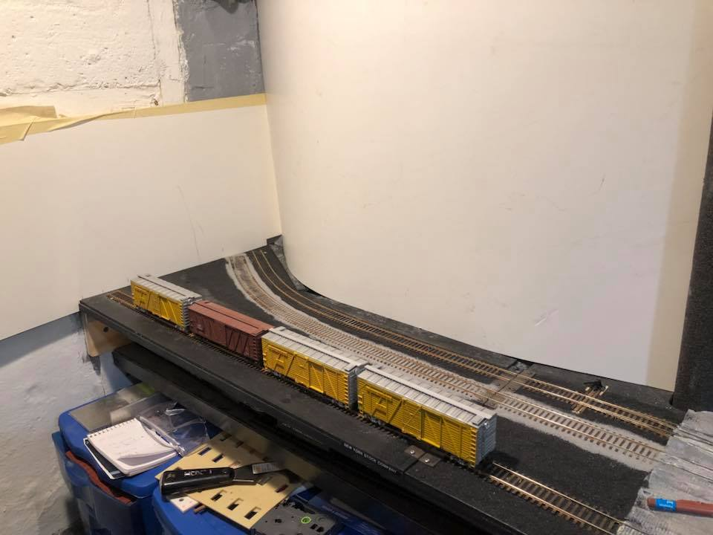
The New York Harbor 13 years in, lessons learned.
New Scenery Going In
Here I am using a sheet of PVC to cover the panel. It pulls off with little effort.

Slide 13
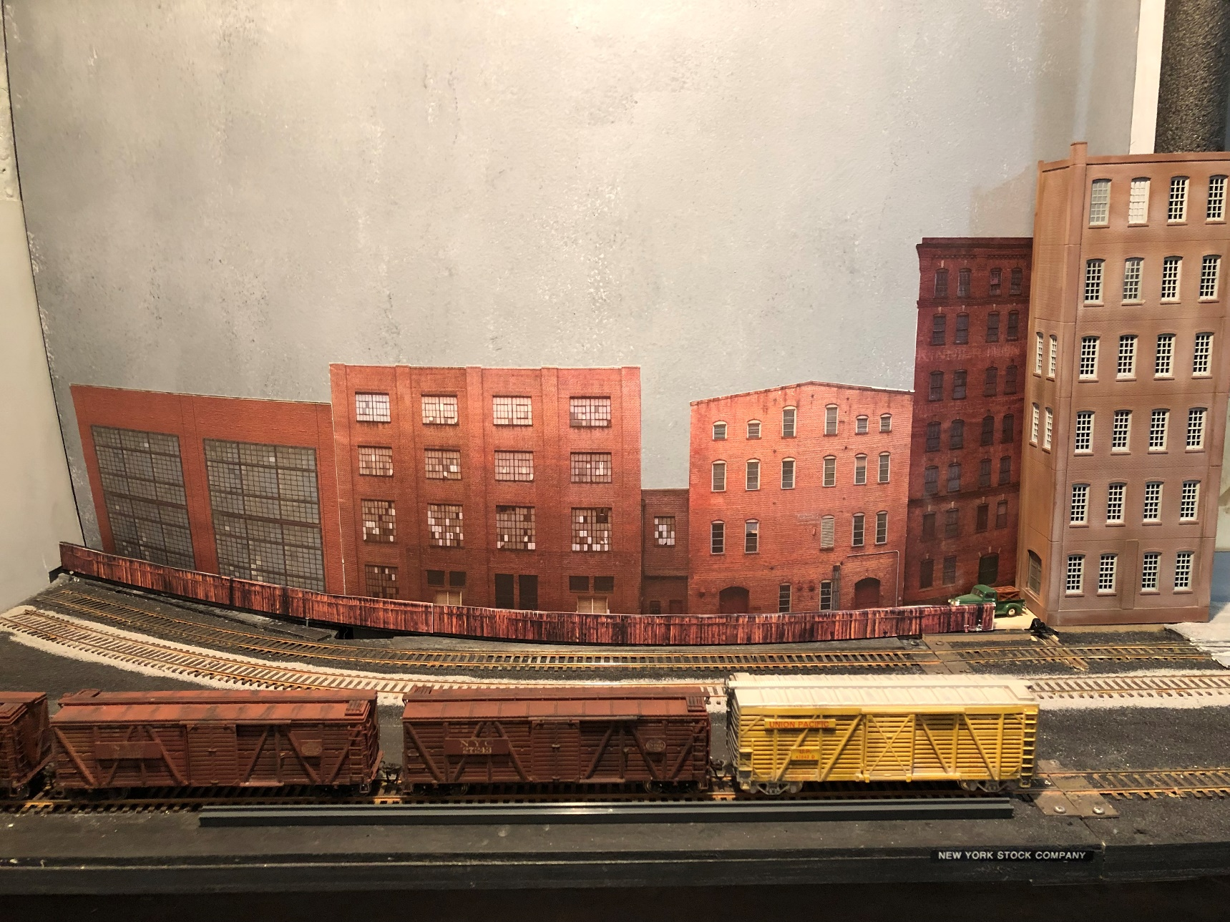
The New York Harbor 13 years in, lessons learned.
New Scenery Going In
Adding a paper fence that is glued to Lucite covers the base and I have used transfer tape to attached paper buildings to the new backdrop.

Slide 14
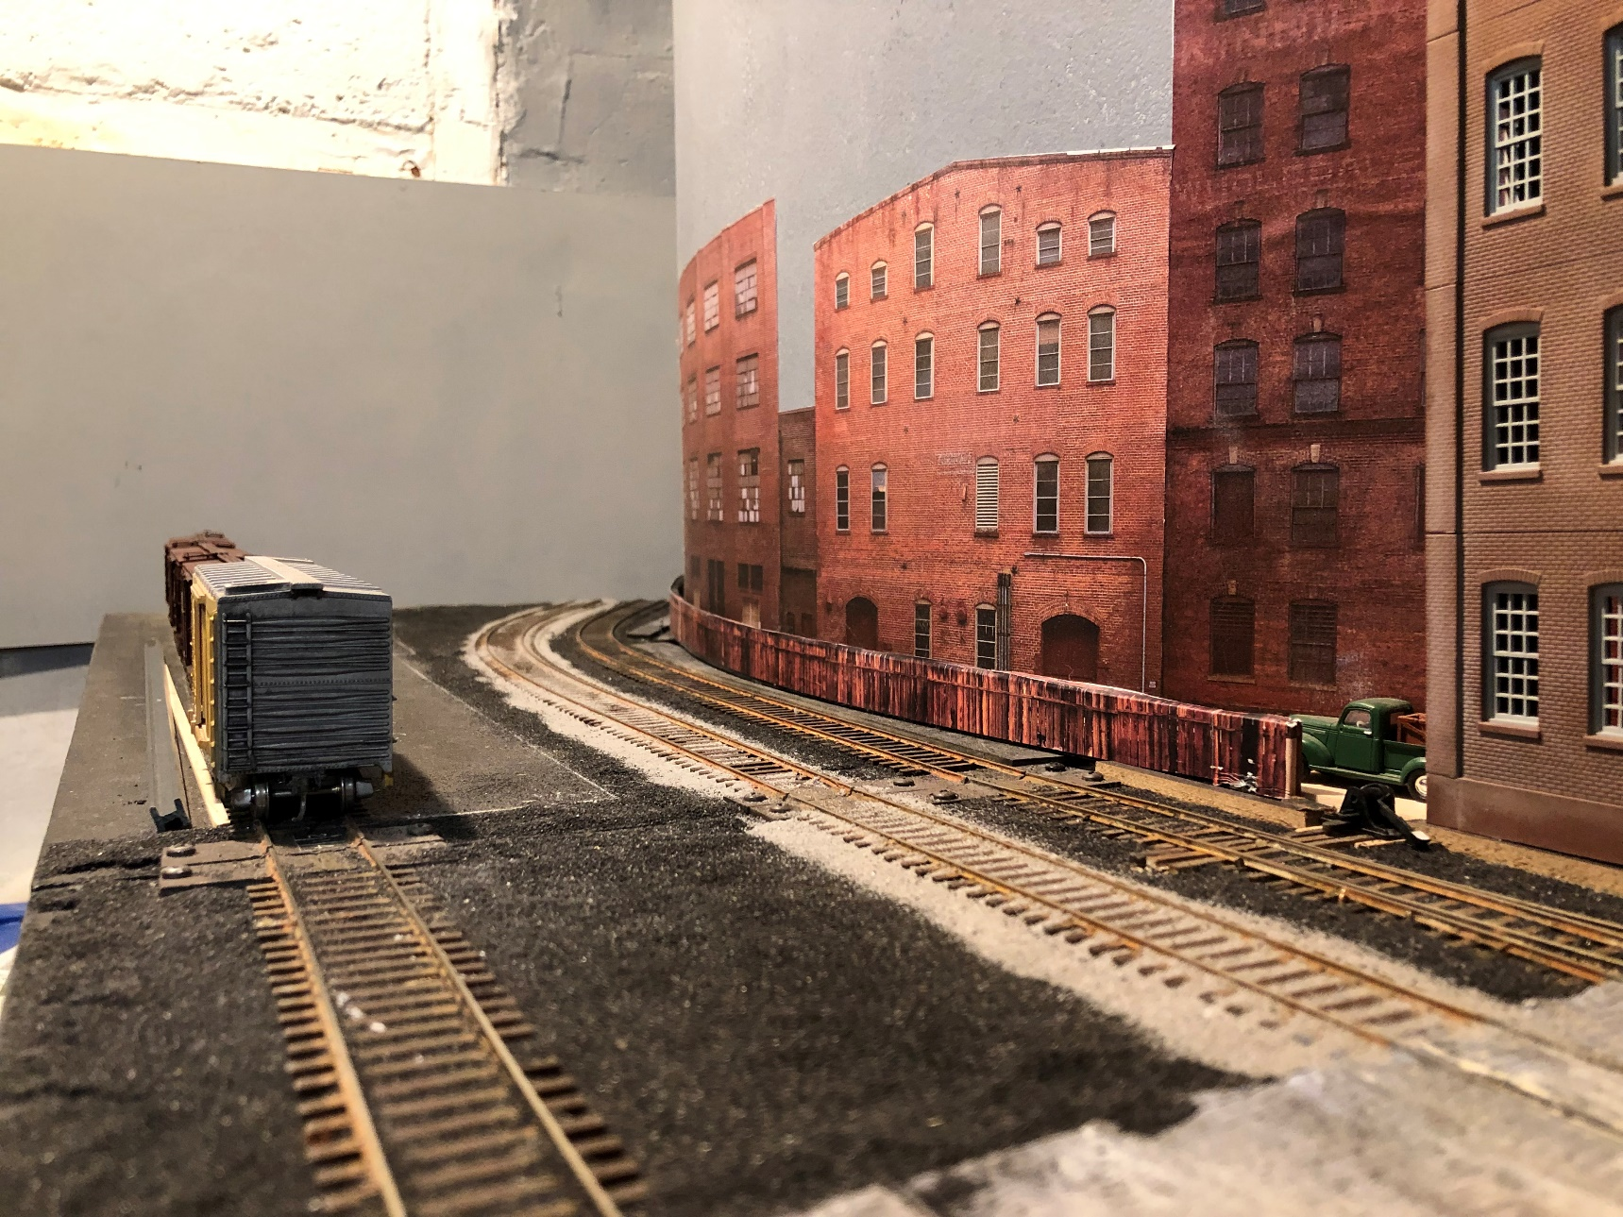
The New York Harbor 13 years in, lessons learned.
New Scenery Going In
Image of the street view of the new backdrop. This is the home of the New York Stock Company.

Slide 15
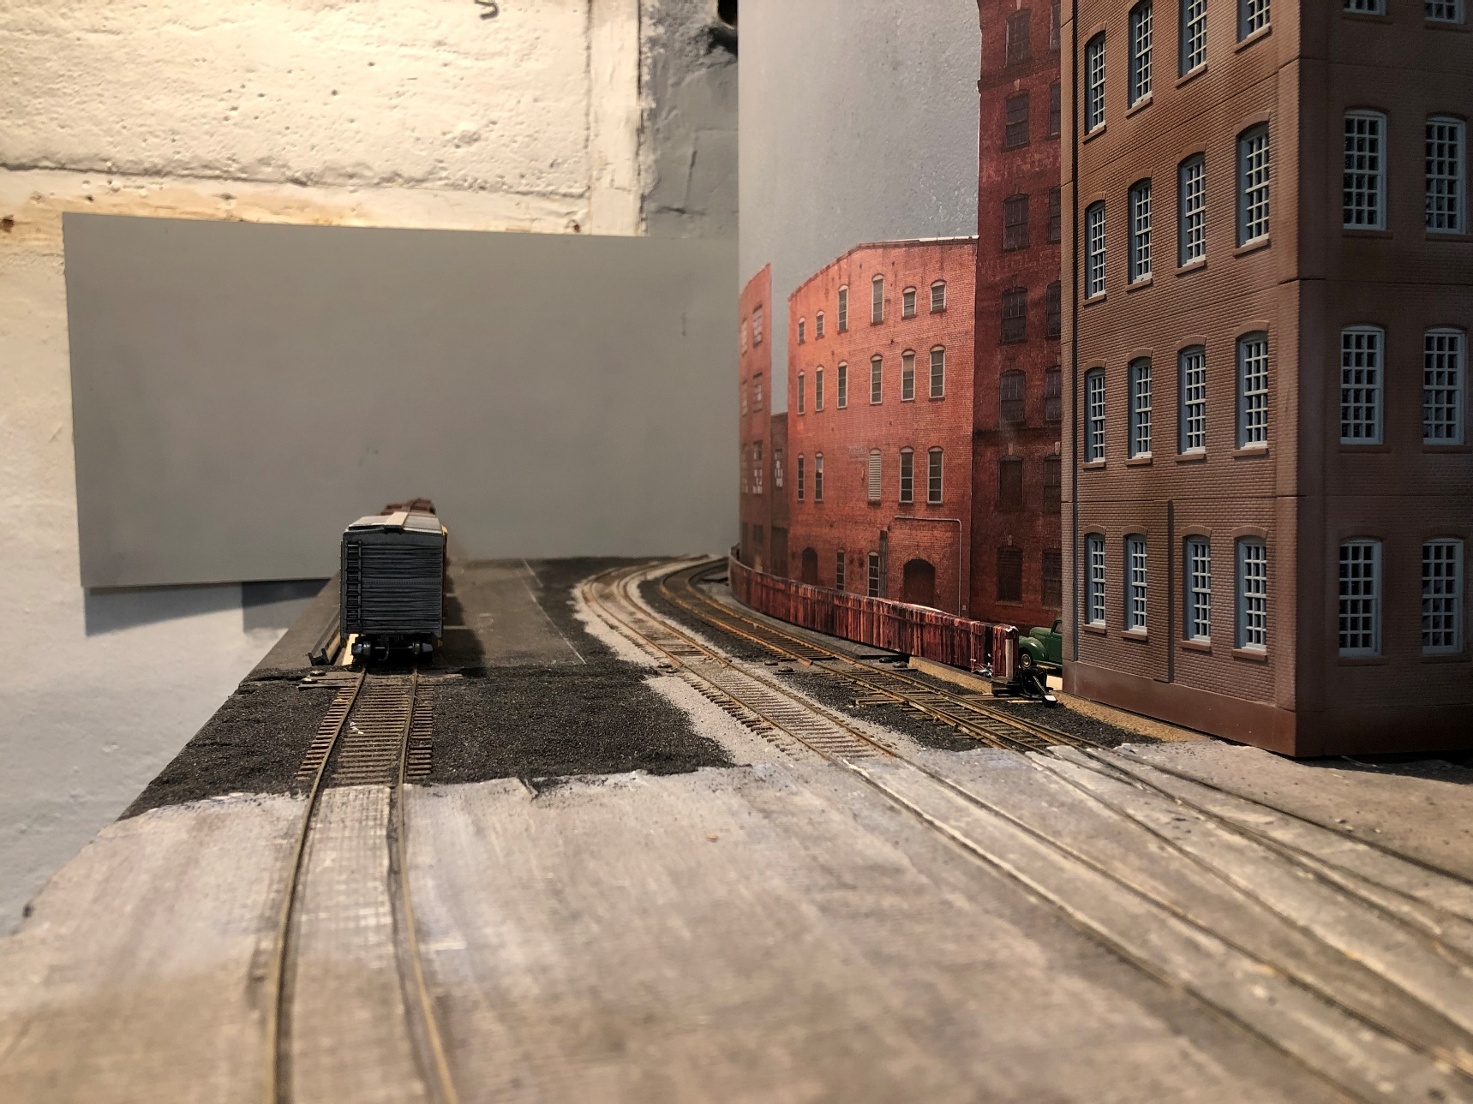
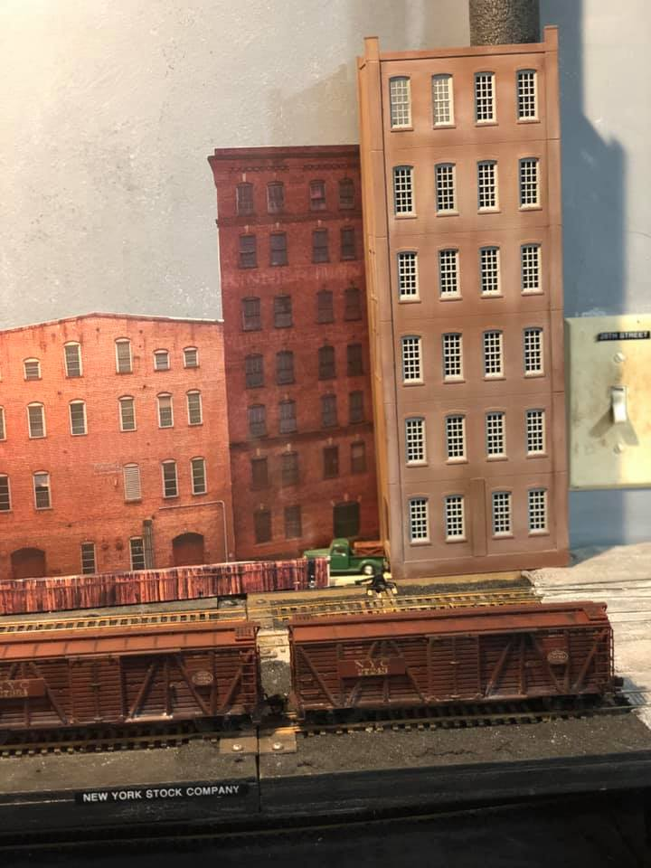
The New York Harbor 13 years in, lessons learned.
New Scenery Going In
Adding a model building to the photo backdrop.

Slide 16
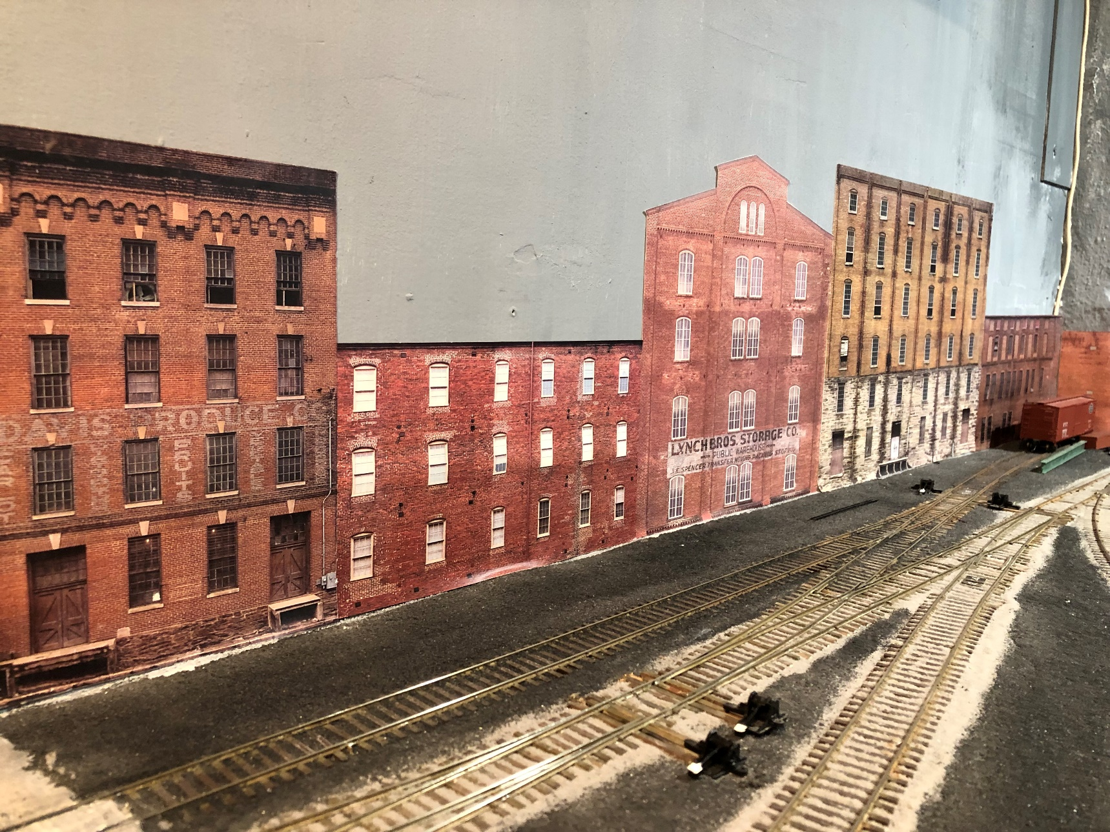
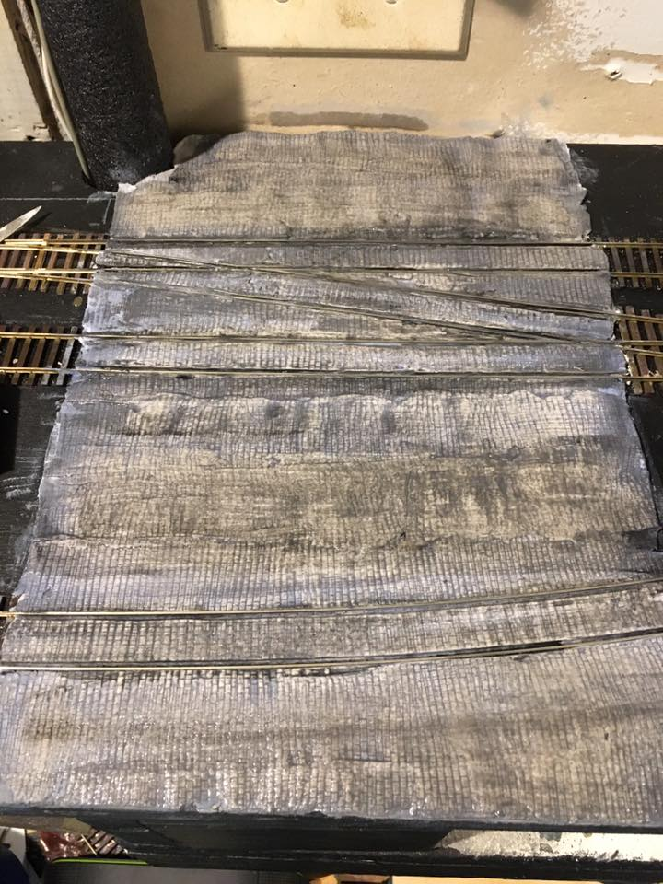
The New York Harbor 13 years in, lessons learned.
New Scenery Going In
Cobblestone and more paper buildings.

Slide 17
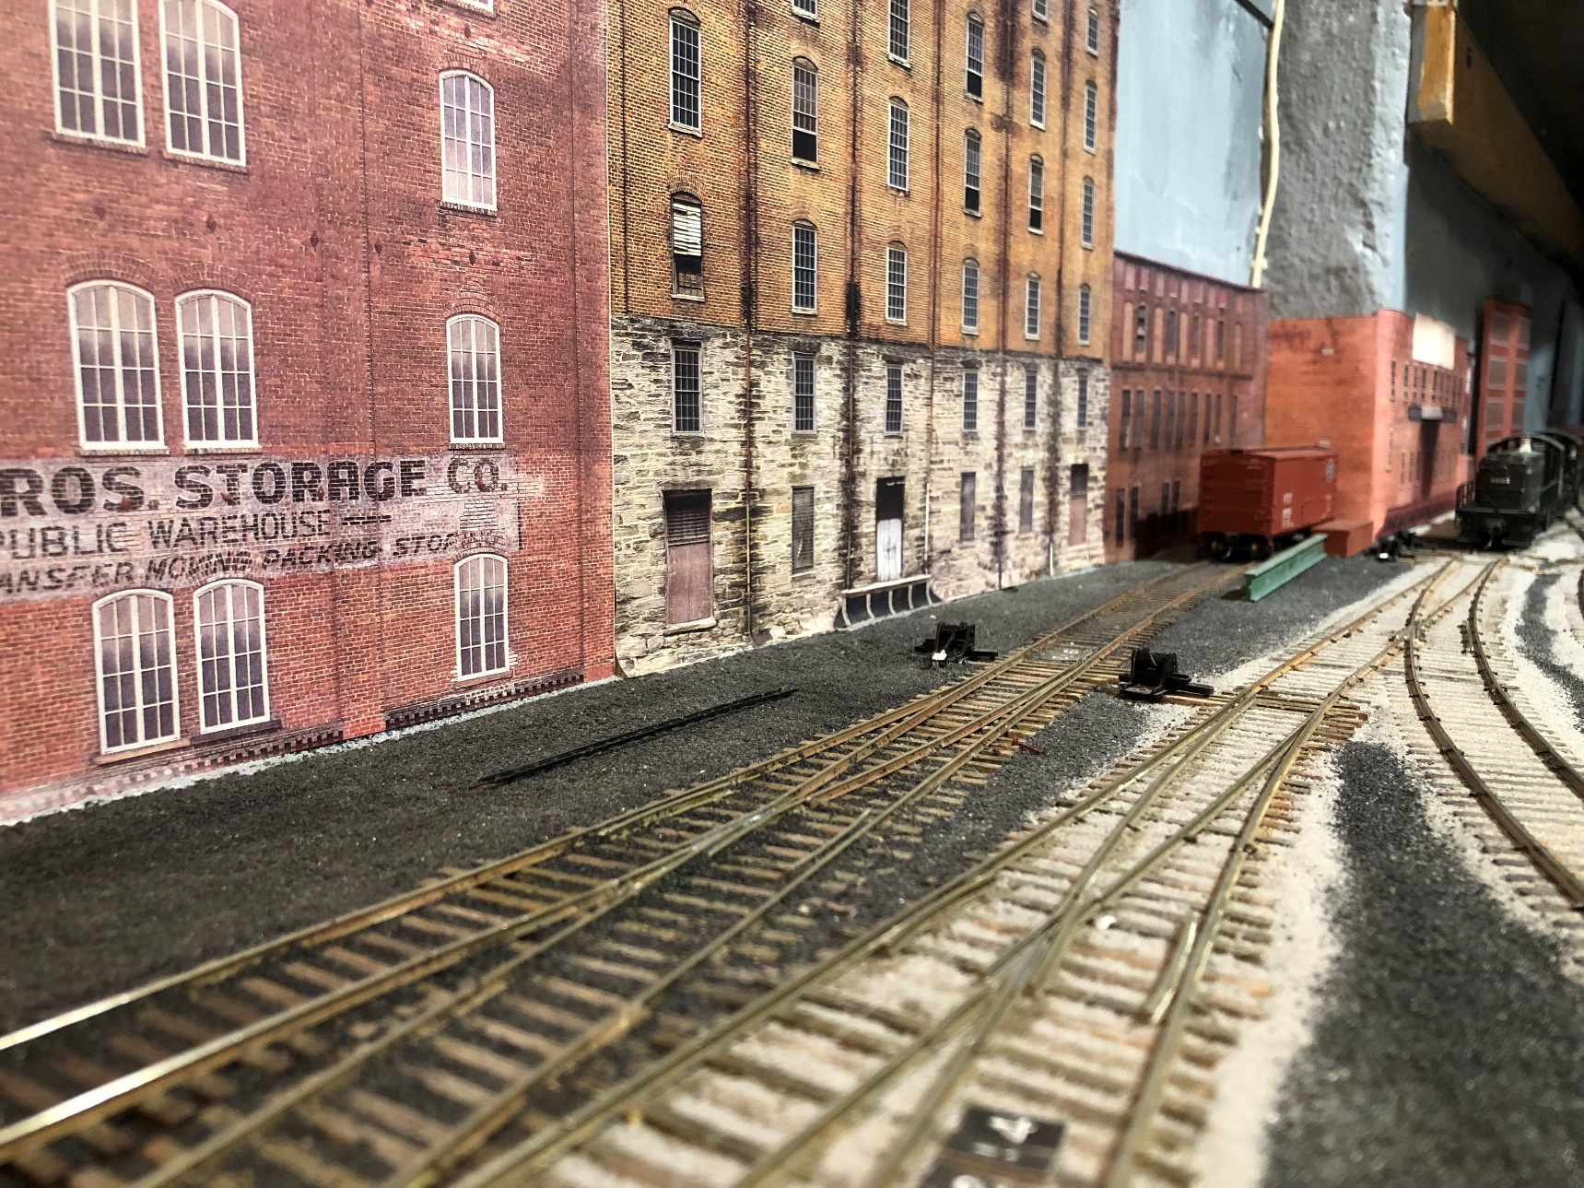
The New York Harbor 13 years in, lessons learned.
New Scenery Going In
Cab view heading up the Highline.

Slide 18
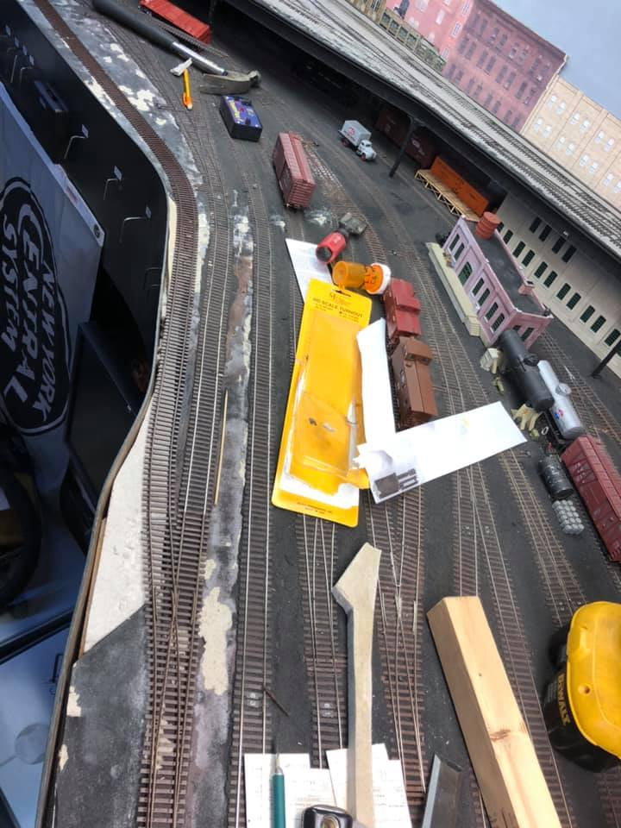
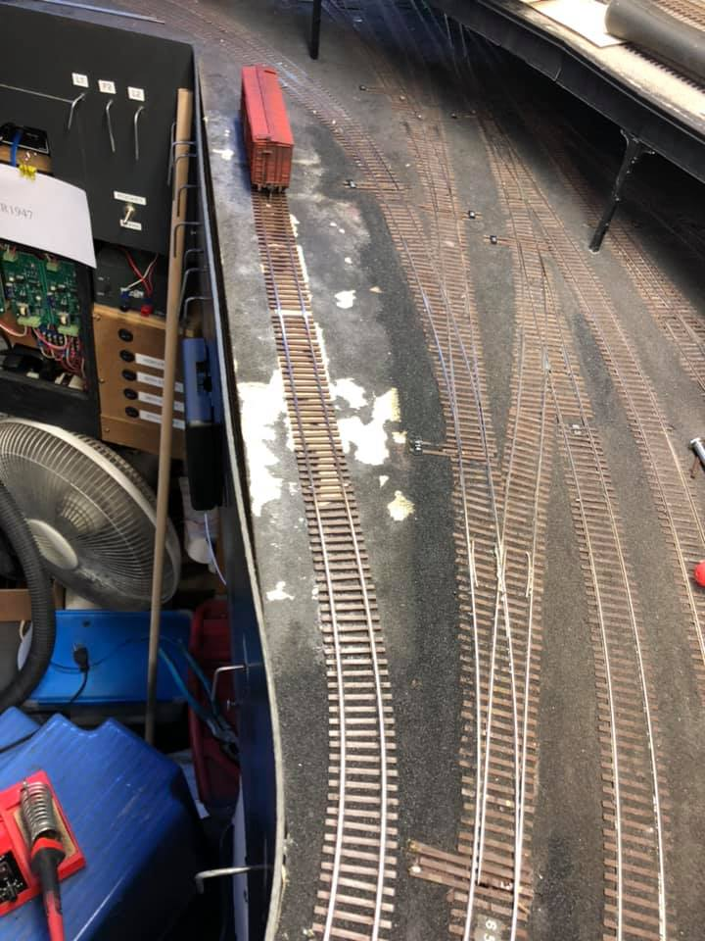
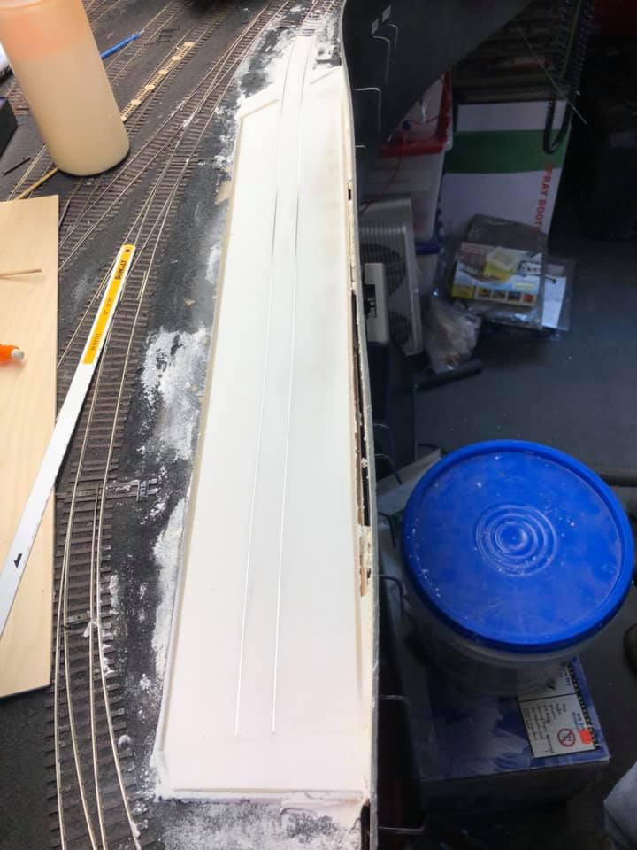
The New York Harbor 13 years in, lessons learned.
New Scenery Going In
New York Hay Exchange Going in.

Slide 19
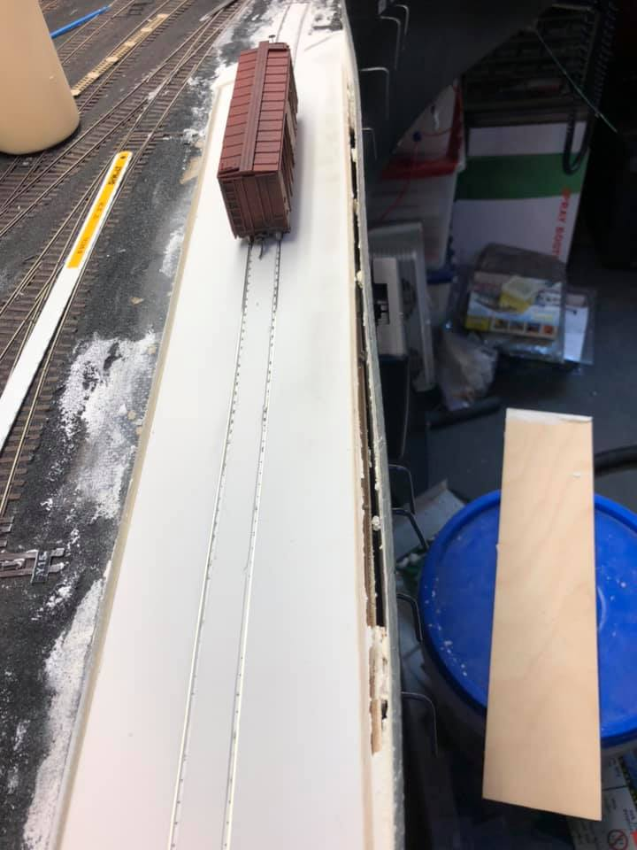
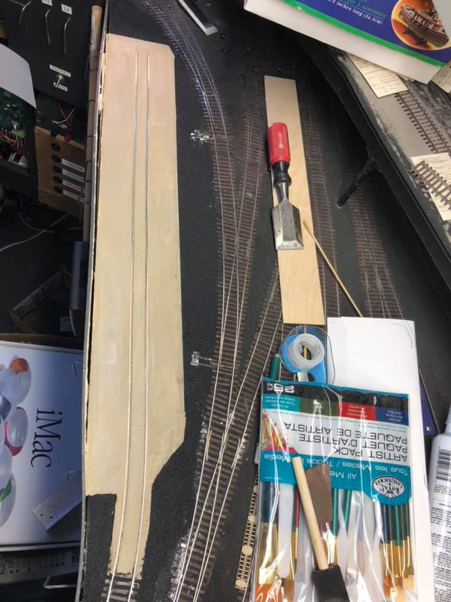
The New York Harbor 13 years in, lessons learned.
New Scenery Going In
New York Hay Exchange is a new siding that I put in at 33rd street. There is suppose to be building going in but during operations the mock up got in the way of the crews. So I will be building a photo building.

Slide 20
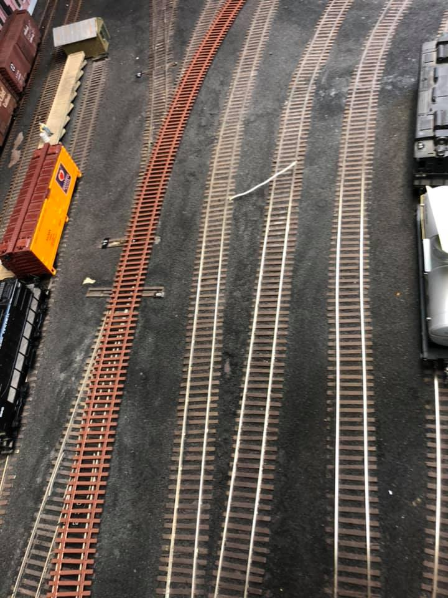
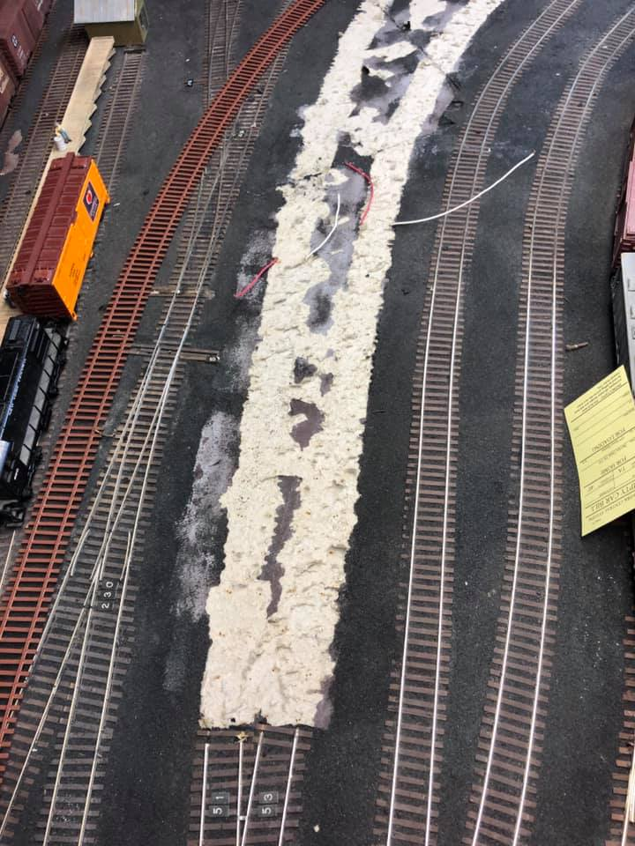
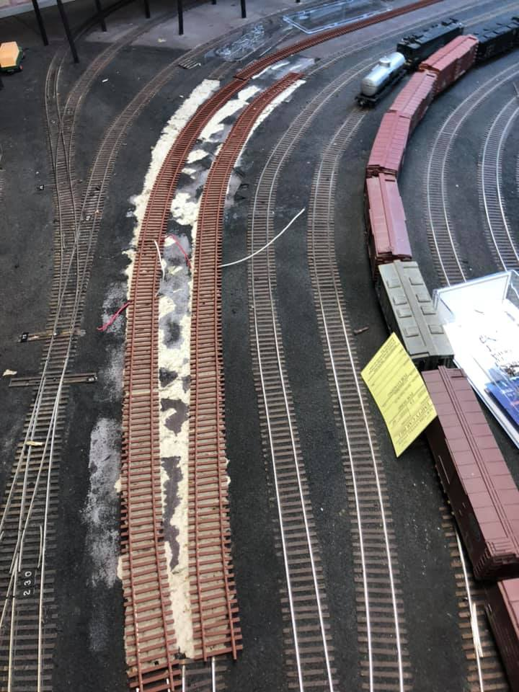
The New York Harbor 13 years in, lessons learned.
New Scenery Going In
I also recently reworked a couple of sidings to make room for a moving overhead crane

Slide 21
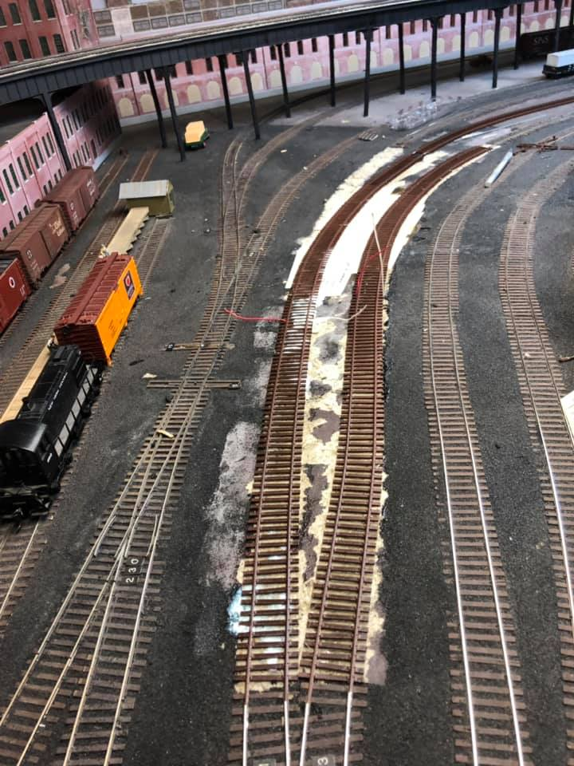
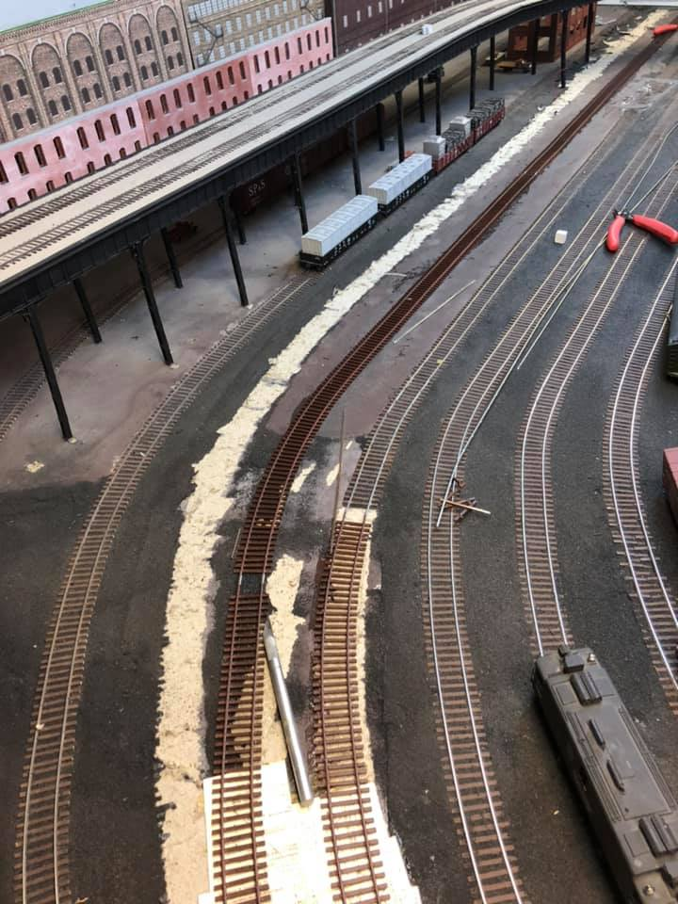
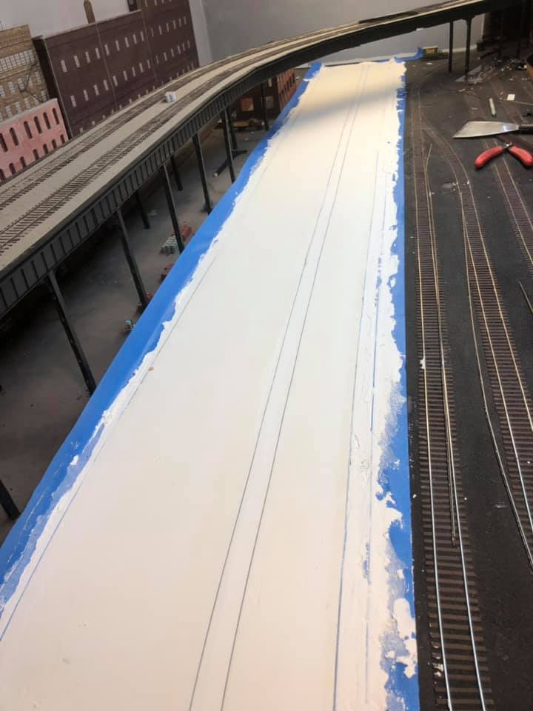
The New York Harbor 13 years in, lessons learned.
New Scenery Going In
I also recently reworked a couple of sidings to make room for a moving overhead crane

Slide 22
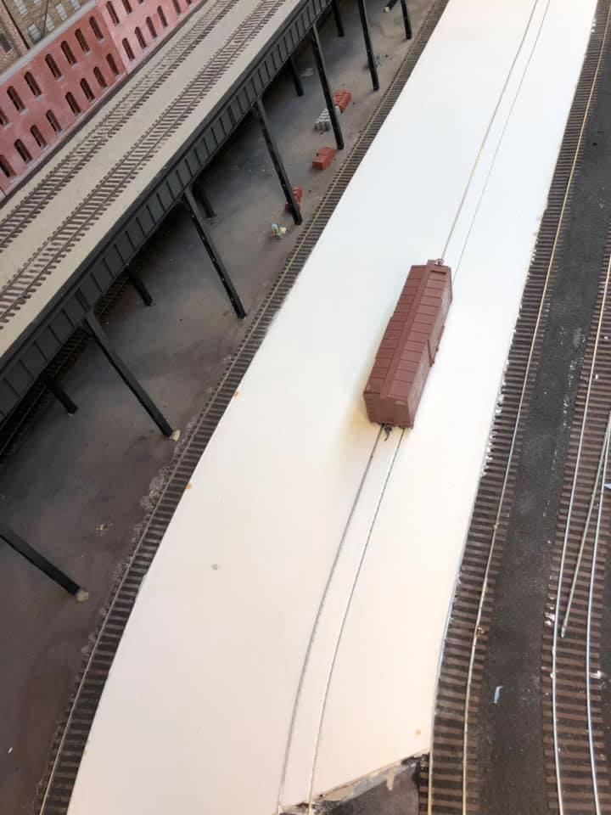
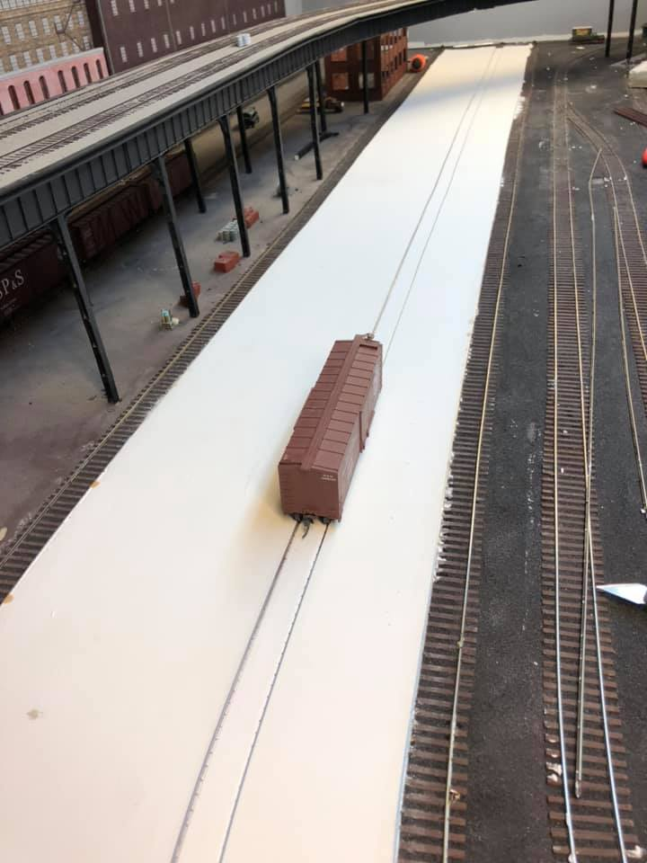
The New York Harbor 13 years in, lessons learned.
New Scenery Going In
I also recently reworked a couple of sidings to make room for a moving overhead crane

Slide 23
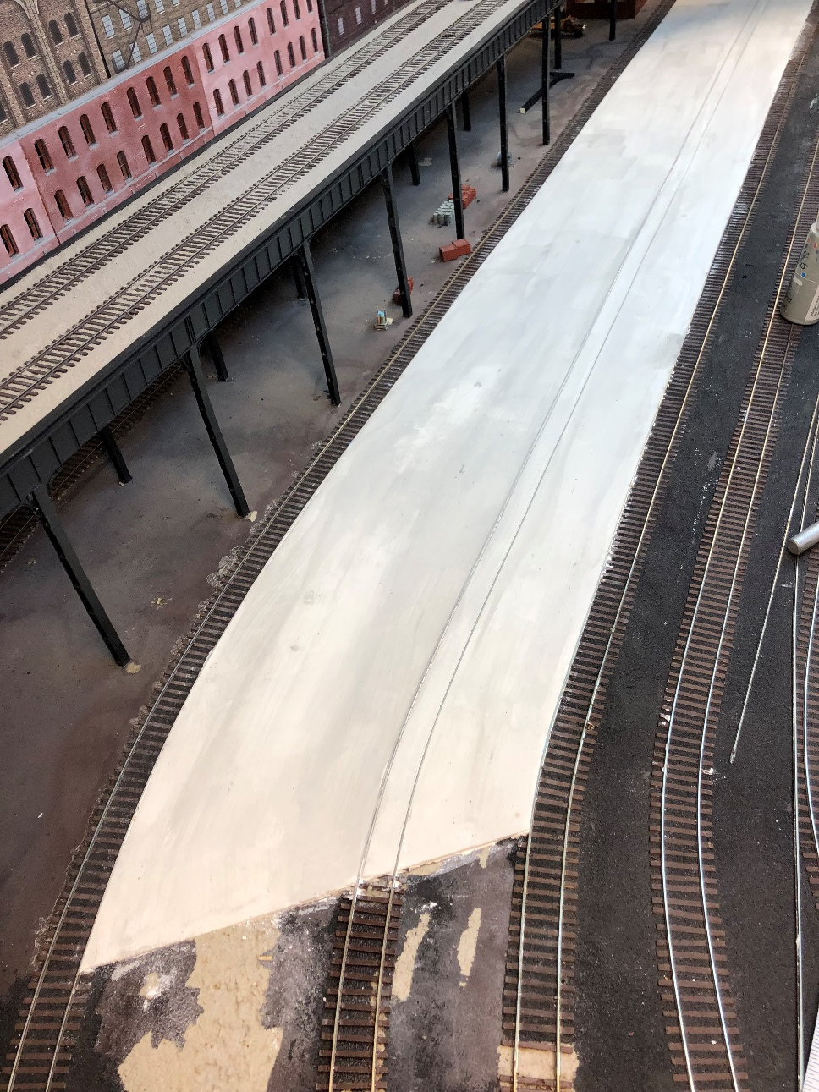
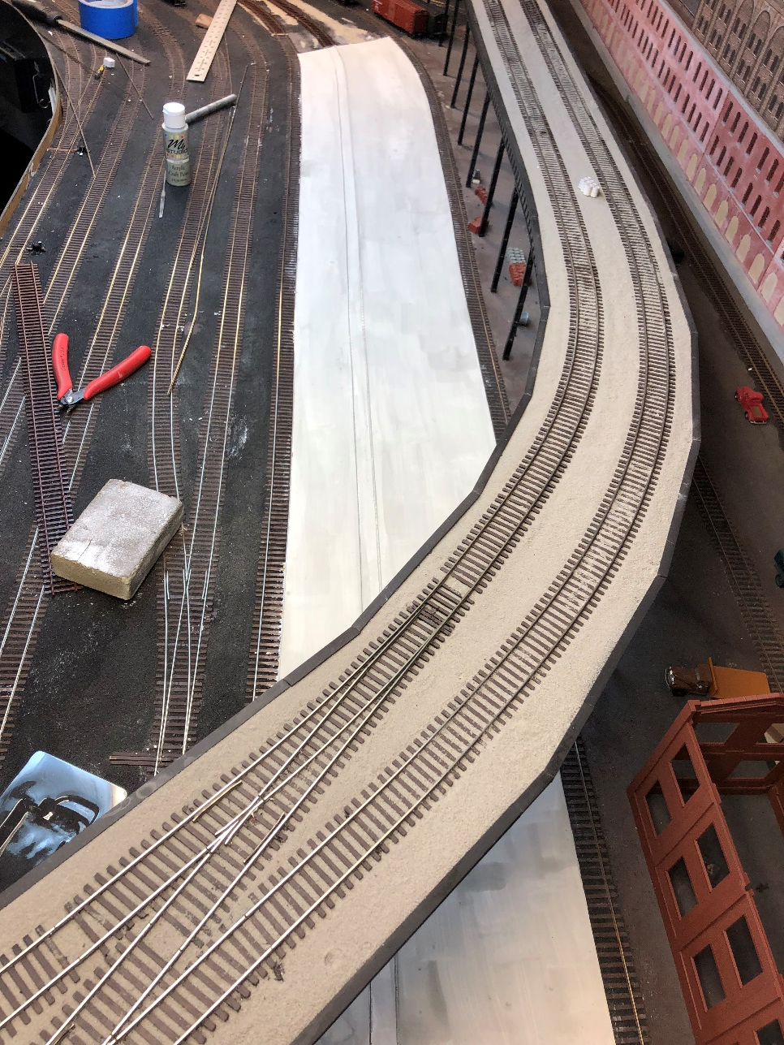
The New York Harbor 13 years in, lessons learned.
New Scenery Going In
Here is a photo of the plaster work that has the first coat of Grey acrylic craft paint. There is going to be a raised platform that will be under the Highline ending in the freight house that is under construction on the bottom right.

Slide 24
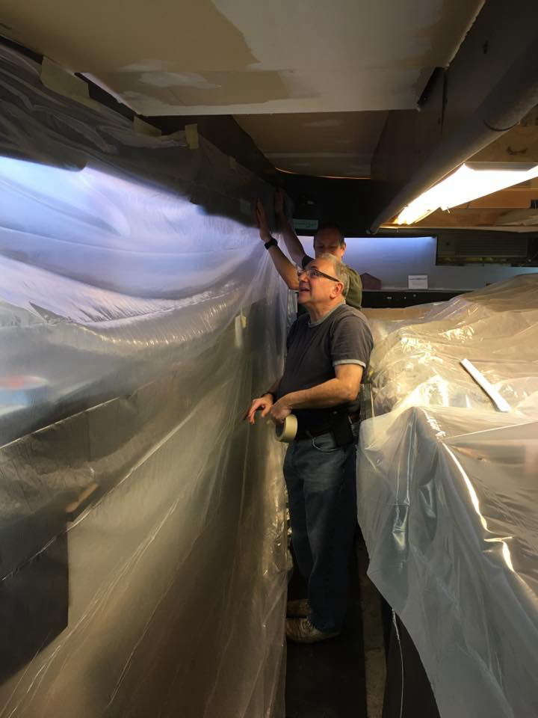
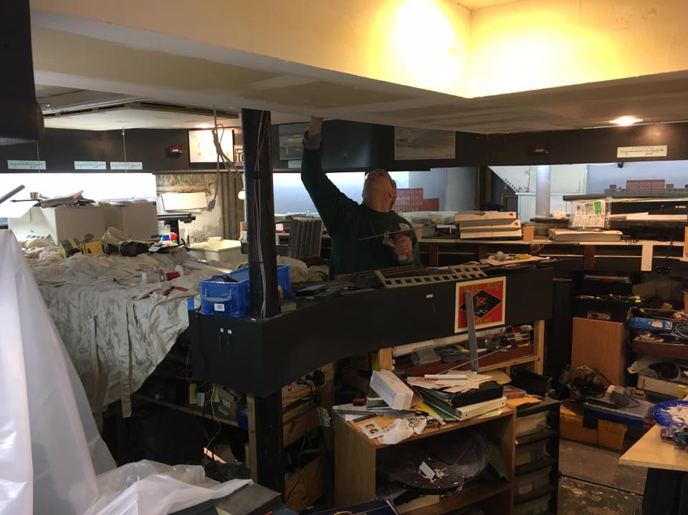
The New York Harbor 13 years in, lessons learned.
Room Prep!
After YEARS of resistance, my crew made me do it!

Slide 25
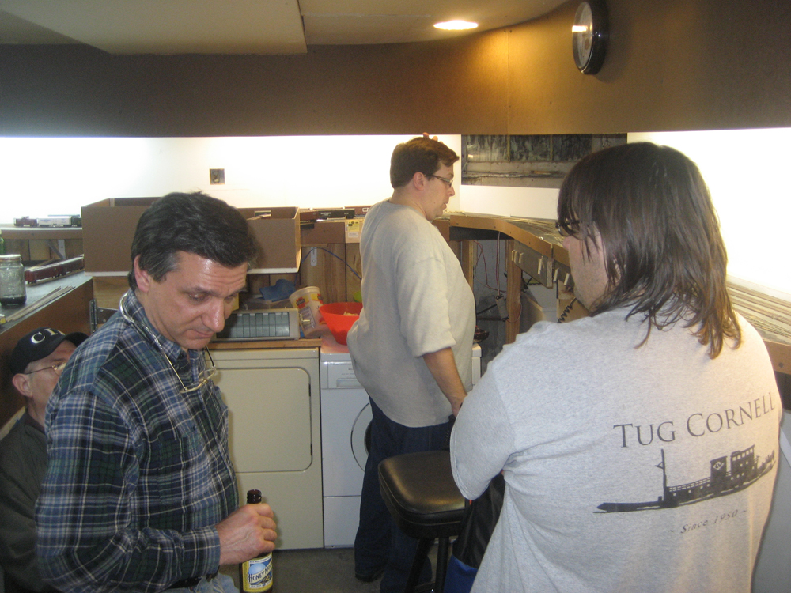
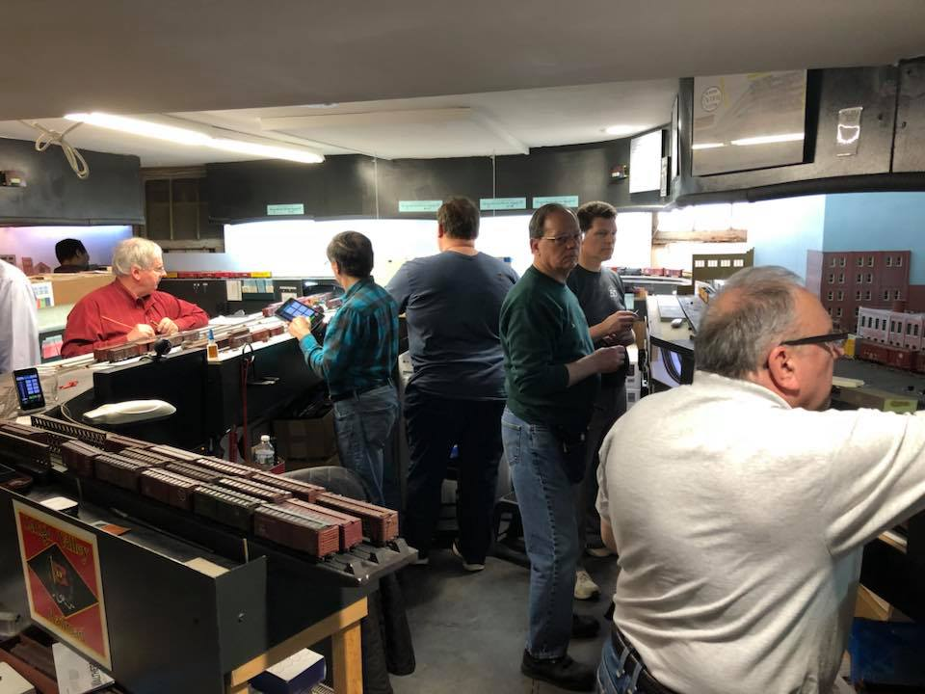
The New York Harbor 13 years in, lessons learned.
Room Prep!
December 4th 2009
NER Op Session 2018

Slide 26
The New York Harbor 13 years in, lessons learned.
Look out here yet another Lesson Learned!
Paint and a finish room makes a world of difference
Chose a valance and fascia color that relates to either the railroad or the region!
Keep the room as clean as you can!

Slide 27
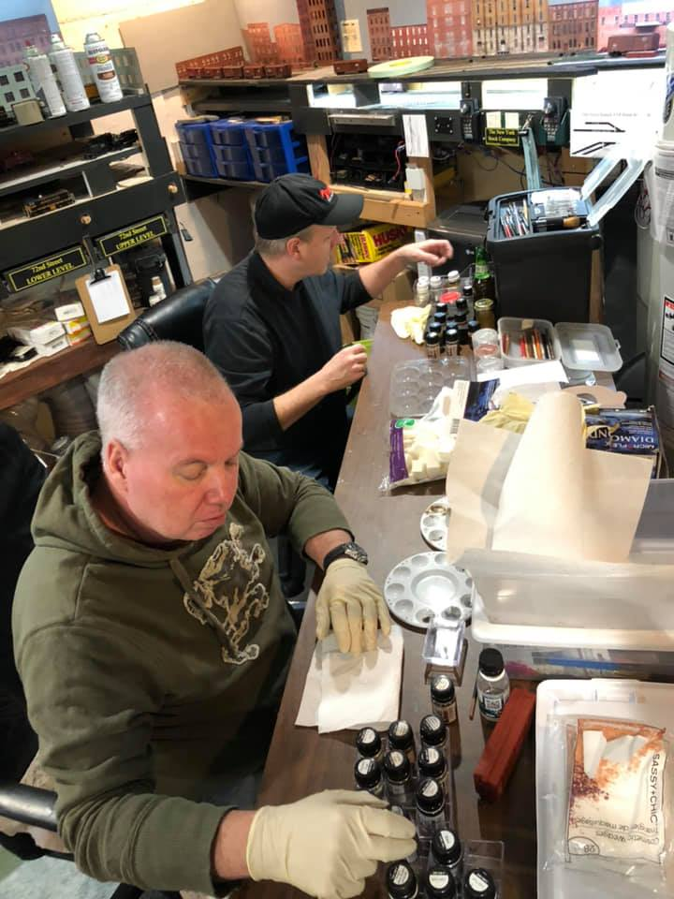
The New York Harbor 13 years in, lessons learned.
Weathering
Adding weathering to the rolling sock and buildings can make the layout pop!

Slide 28
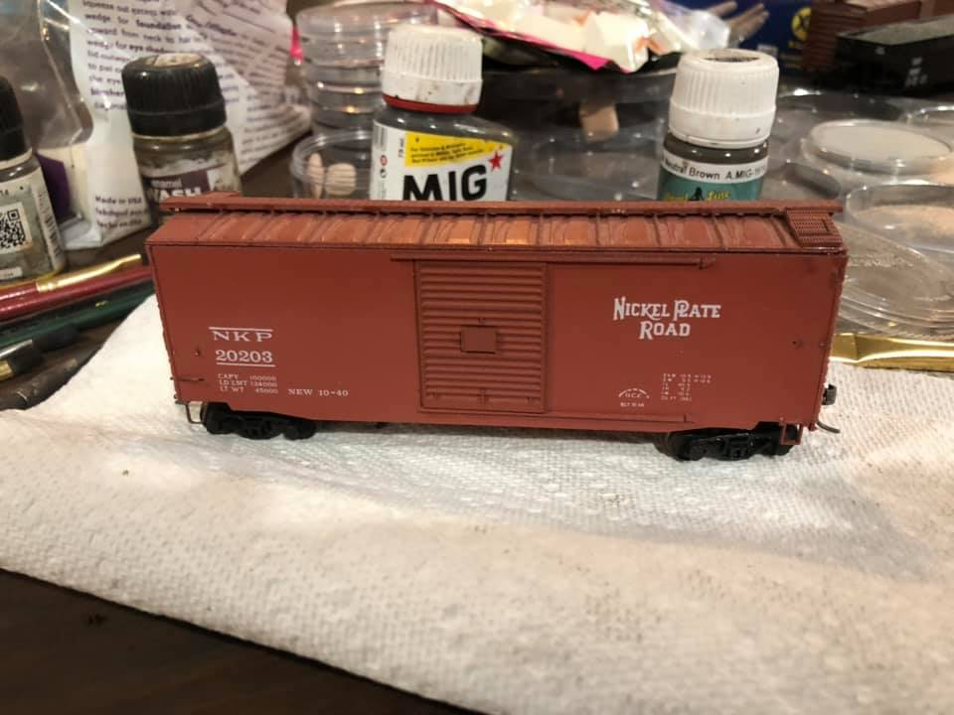
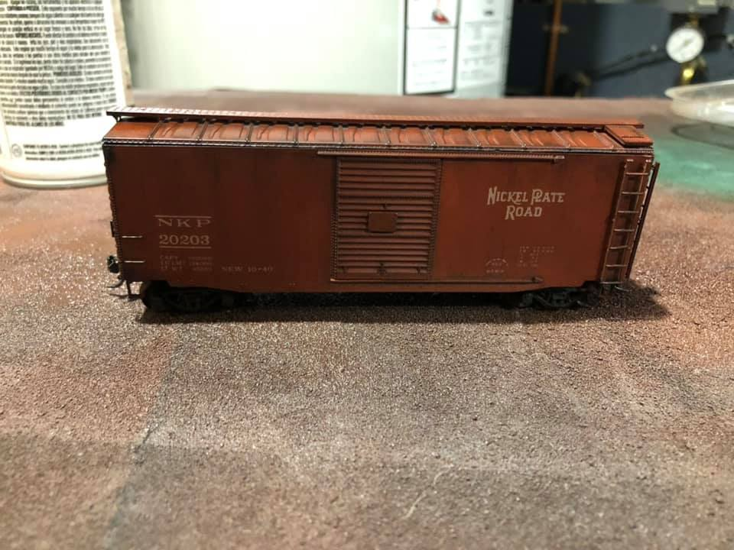
The New York Harbor 13 years in, lessons learned.
Weathering

Slide 29
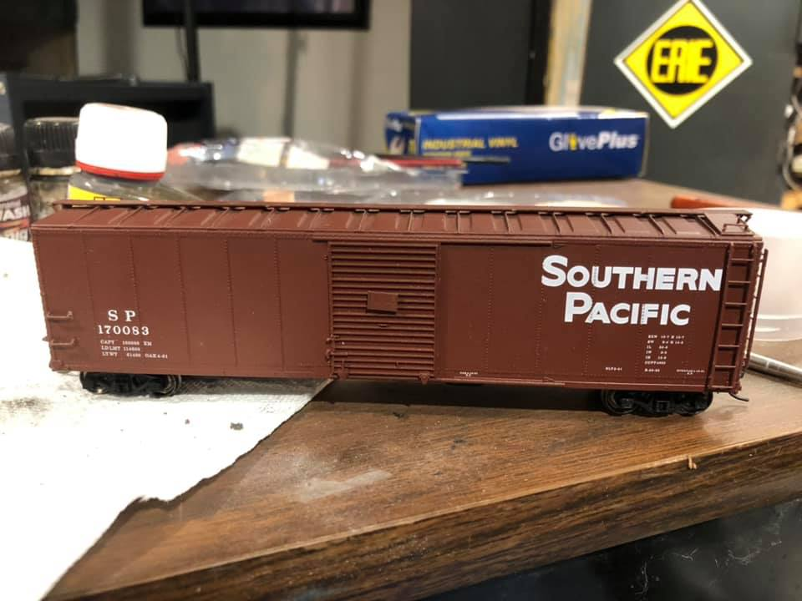
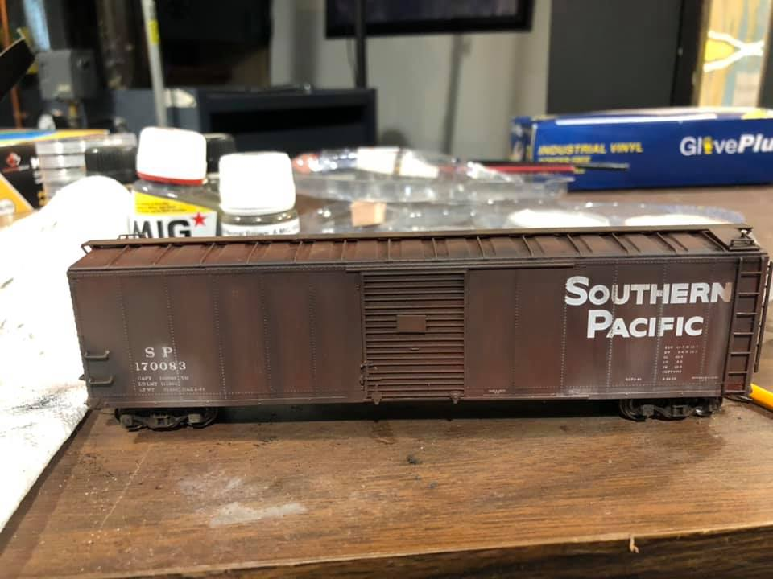
The New York Harbor 13 years in, lessons learned.
Weathering

Slide 30
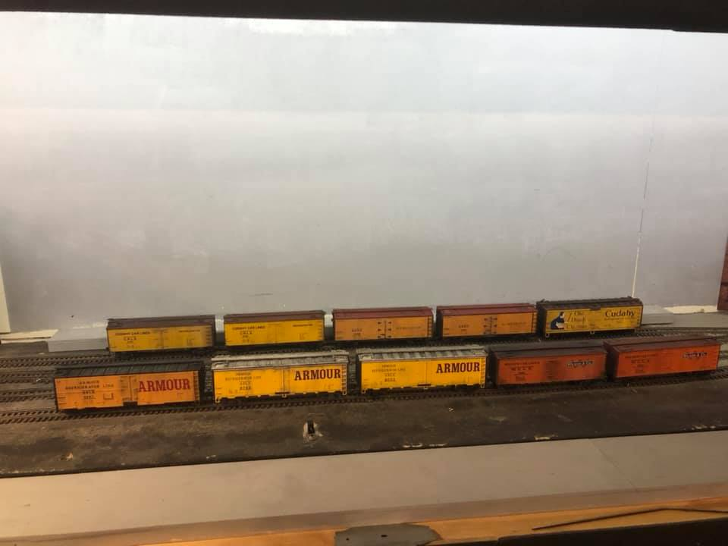
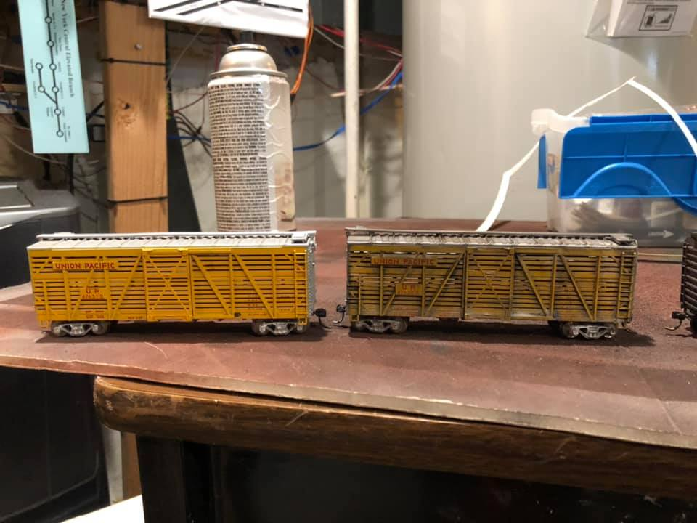
The New York Harbor 13 years in, lessons learned.
Weathering

Slide 31
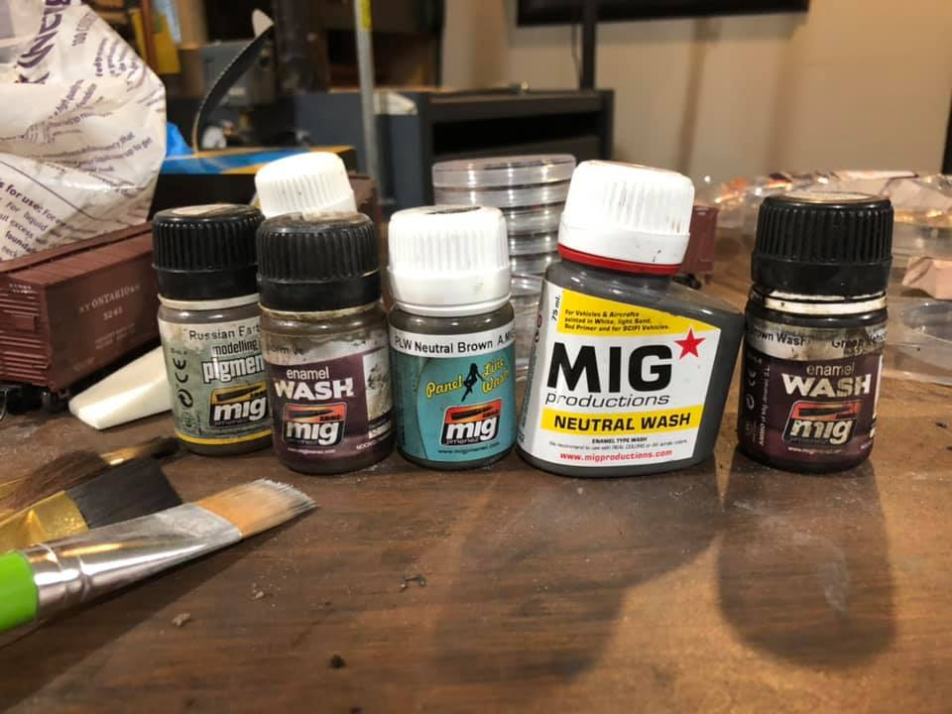
The New York Harbor 13 years in, lessons learned.
Weathering

Slide 32
The New York Harbor 13 years in, lessons learned.
Finding Documents!
Ralph Heiss found on EBay these LVRR railroad maps of 27th Street. Interesting that the Avenue is listed as 13th Avenue. That avenue is actually 12th Avenue Route 9A

Slide 33
The New York Harbor 13 years in, lessons learned.
Finding Documents!
Ralph Heiss found on EBay these LVRR railroad maps of 27th Street. This is a drawing of proposed changes to the facility as part lease.

Slide 34
The New York Harbor 13 years in, lessons learned.
Finding Documents!
Ralph Heiss found on EBay these LVRR railroad maps of 27th Street. Here are both maps stitched together.

Slide 35
The New York Harbor 13 years in, lessons learned.
Finding Documents!
Ralph Heiss found on EBay these LVRR railroad maps of 27th Street. Here are both maps stitched together.

Slide 36
The New York Harbor 13 years in, lessons learned.
The Model of 27th Street!
Here is my version of the Lehigh Valley’s 27th Street.

Slide 37
The New York Harbor 13 years in, lessons learned.
Improved Signage

Slide 38
The New York Harbor 13 years in, lessons learned.
Improved Signage

Slide 39
The New York Harbor 13 years in, lessons learned.
Improved Signage

Slide 40
The New York Harbor 13 years in, lessons learned.
Operating Session

Slide 41
The New York Harbor 13 years in, lessons learned.
Operating Session

Slide 42
The New York Harbor 13 years in, lessons learned.
Operating Session

Slide 43
The New York Harbor 13 years in, lessons learned.
Operating Session

Slide 44
The New York Harbor 13 years in, lessons learned.
Operating Session

Slide 45
The New York Harbor 13 years in, lessons learned.
Operating Session

Slide 46
The New York Harbor 13 years in, lessons learned.
Operating Session

Slide 47
The New York Harbor 13 years in, lessons learned.
Operating Session

Slide 48
The New York Harbor 13 years in, lessons learned.
Operating Session

Slide 49
The New York Harbor 13 years in, lessons learned.
Operating Session

Slide 50
The New York Harbor 13 years in, lessons learned.
Operating Session

Slide 51
The New York Harbor 13 years in, lessons learned.
Operating Session

Slide 52
The New York Harbor 13 years in, lessons learned.
New Electronics

Slide 53
The New York Harbor 13 years in, lessons learned.
New Electronics

Slide 54
The New York Harbor 13 years in, lessons learned.
New Electronics

Slide 55
The New York Harbor 13 years in, lessons learned.
If they don’t Make it don’t let that stop you!
Thanks to Tom Matthews, I obtained a Alps MD1000 printer and I have started making my own decals for those “I need these” cars. I just needed to build a Windows XP PC. Not that easy to do anymore since Microsoft no longer supports the OS an goes out of it’s way to hide the needed updated!

Slide 56
The New York Harbor 13 years in, lessons learned.
If they don’t Make it don’t let that stop you!

Slide 57
The New York Harbor 13 years in, lessons learned.
If they don’t Make it don’t let that stop you!

Slide 58
The New York Harbor 13 years in, lessons learned.
If they don’t Make it don’t let that stop you!

Slide 59
The New York Harbor 13 years in, lessons learned.
Questions?

Slide 60
The New York Harbor 13 years in, lessons learned.

Slide 61
The New York Harbor 13 years in, lessons learned.
Thank you for coming!

Slide 62
The New York Harbor
13 years in, lessons learned.

