Slide 1
Adapting Prototype Waybills
Video Credit
Fast Moving Loud NS Freight Train
BaltimoreAndOhioRR on Youtube.com

Slide 2
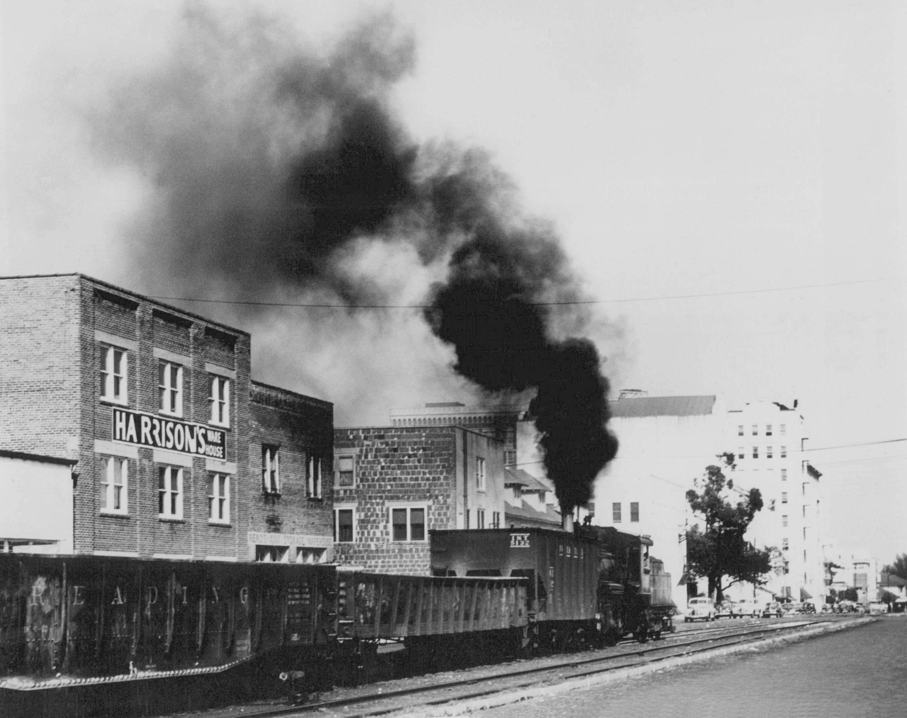
Adapting Prototype Waybills

Slide 3
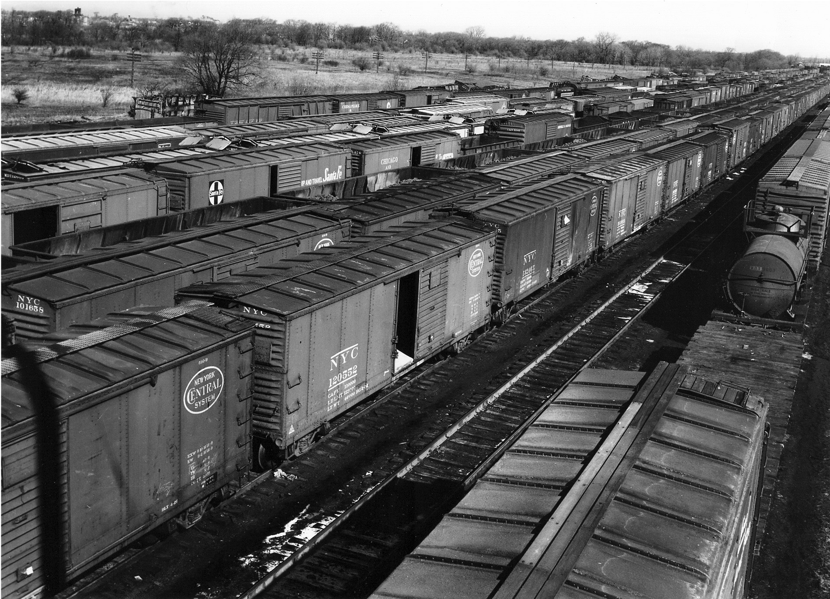
Adapting Prototype Waybills

Slide 4
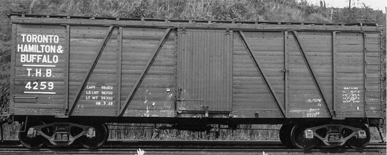
Adapting Prototype Waybills

Slide 5
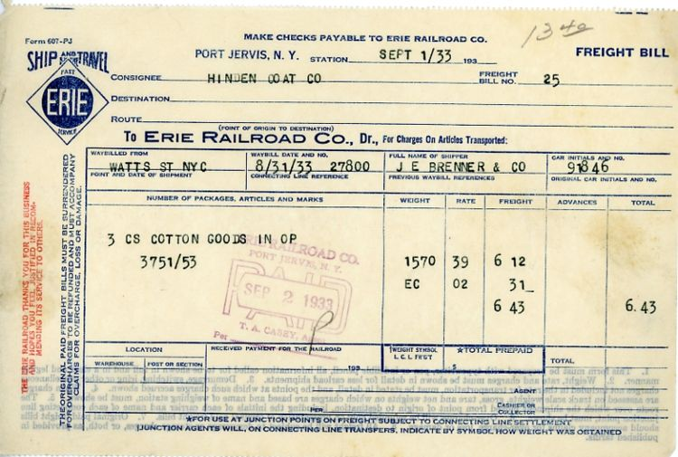
Adapting Prototype Waybills

Slide 6
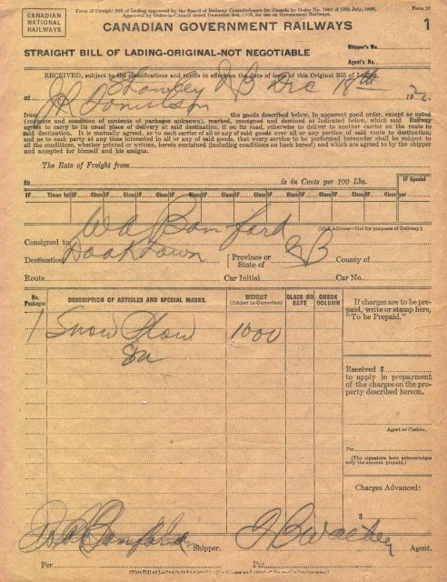
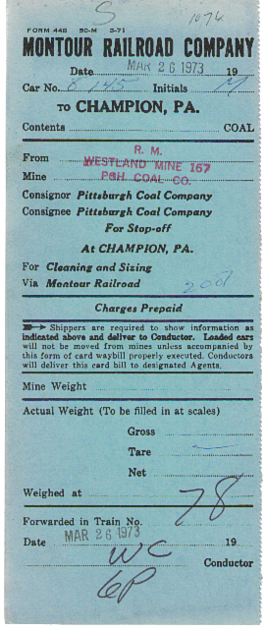
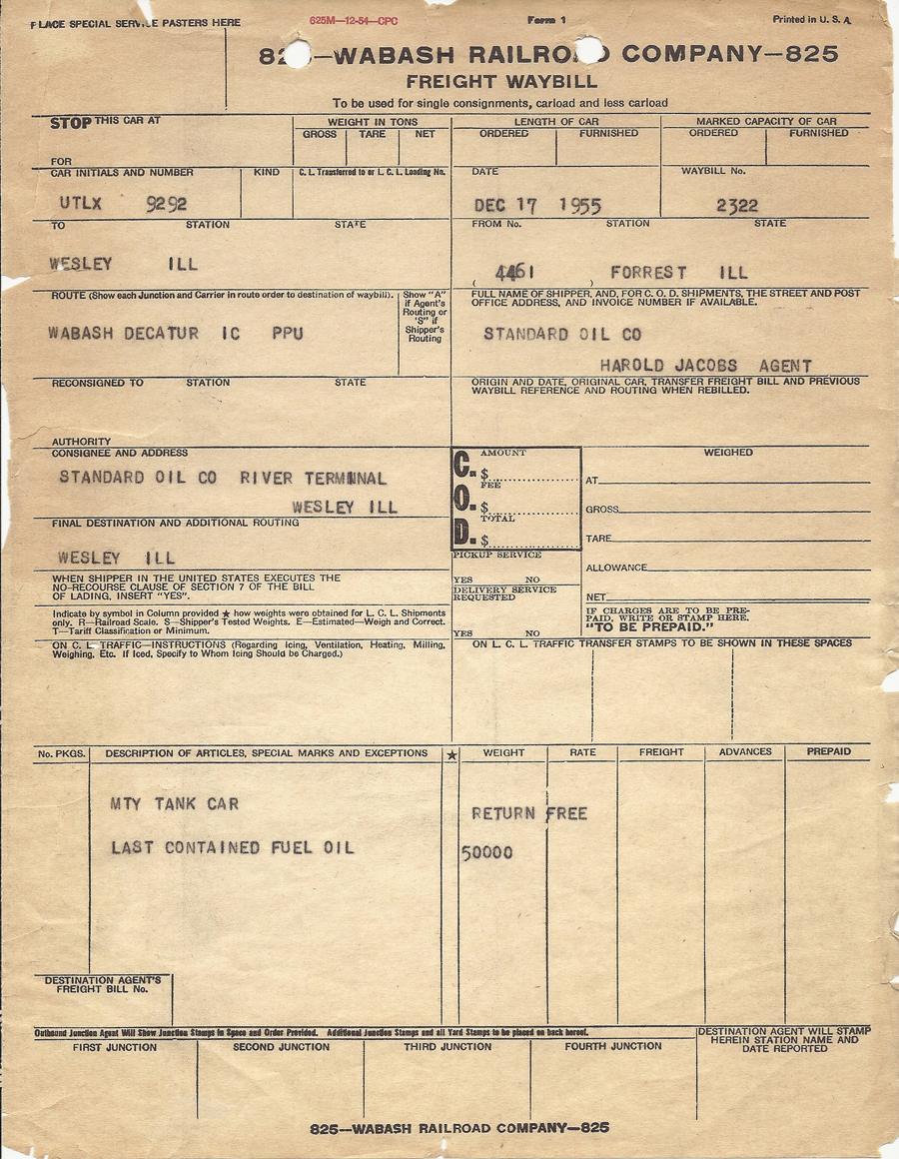
Adapting Prototype Waybills

Slide 7
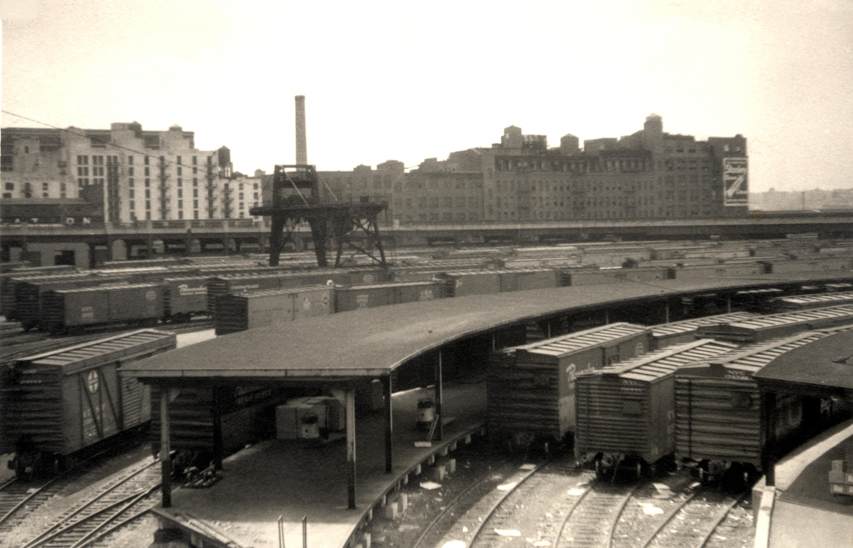
Adapting Prototype Waybills

Slide 8
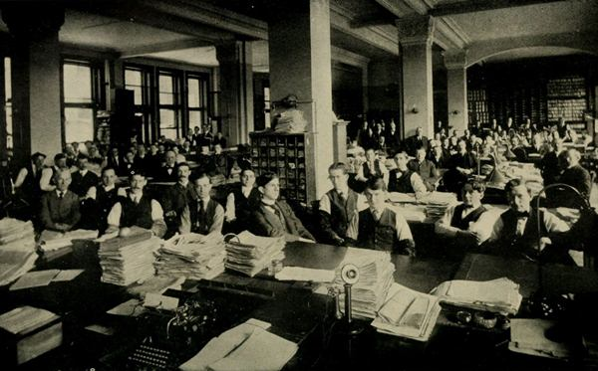
Adapting Prototype Waybills
Photo from The Modern Railroad ebook

Slide 9
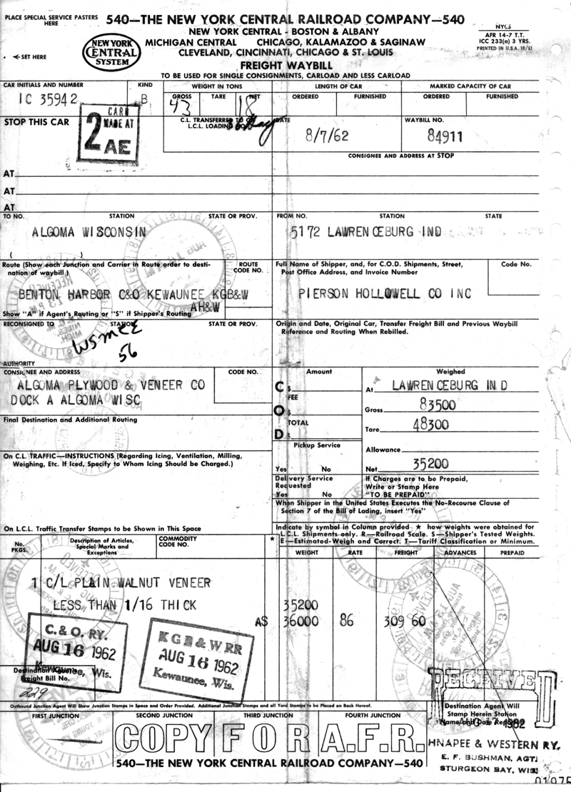
Adapting Prototype Waybills
What information can we learn from this waybill?
The car carrying the lading is IC 35942
This is a “B” class car
The date is August 7th, 1962
Waybill number is 84911
The car is originating in Lawrenceburg Indiana
It was shipped by Pierson Hollowell Co INC
The car is billed to Algoma Wisconsin
The receiver is Algoma Plywood & Veneer Co at Dock A
The Car is carrying a carload of Plain Walnut Veneer less than 1/16” thick
The originating Railroad is the New York Central.
On August 16 C&O transferred it to the Kewaunee Green Bay & Western
It was received at Dock A on August 17 1962.
Total time from pickup to delivery 10 days
1962 NYCRR Waybill

Slide 10
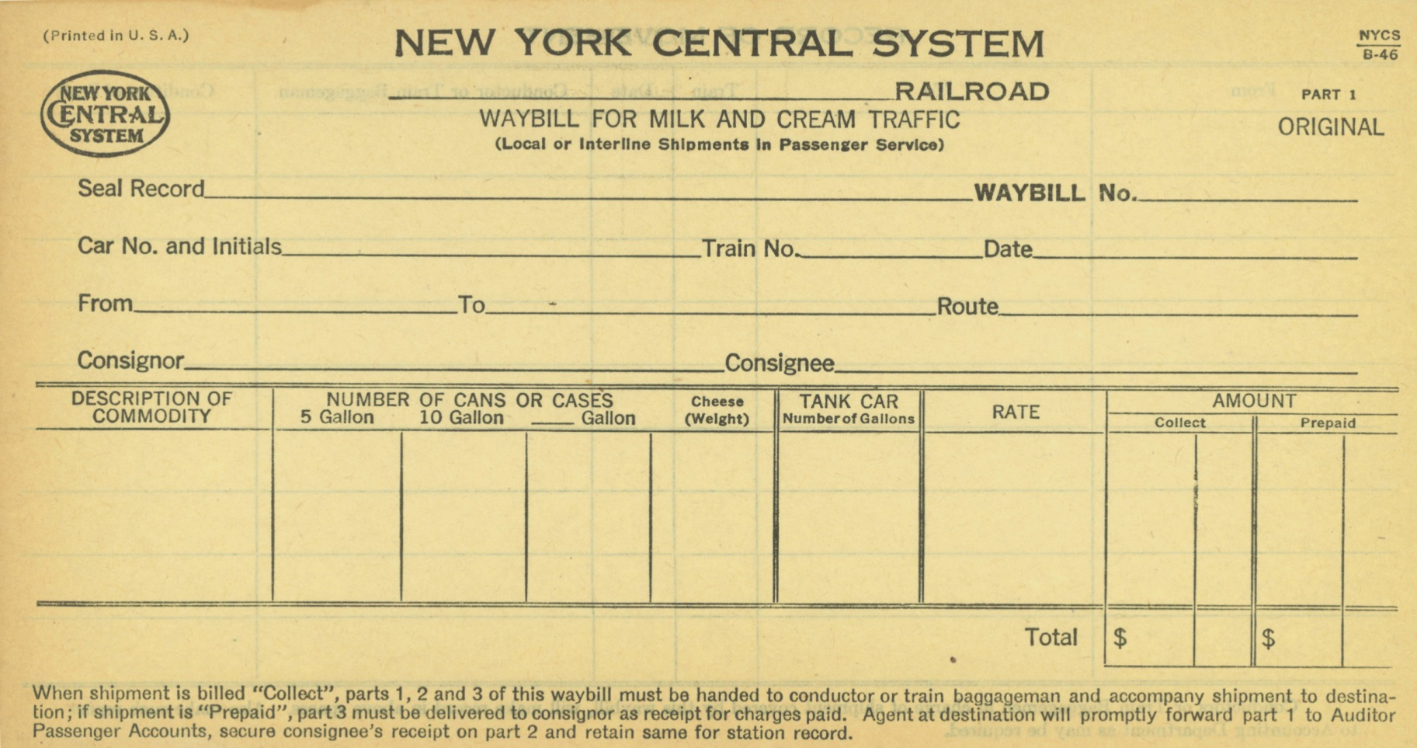
Adapting Prototype Waybills
Are all way bills the same?

Slide 11
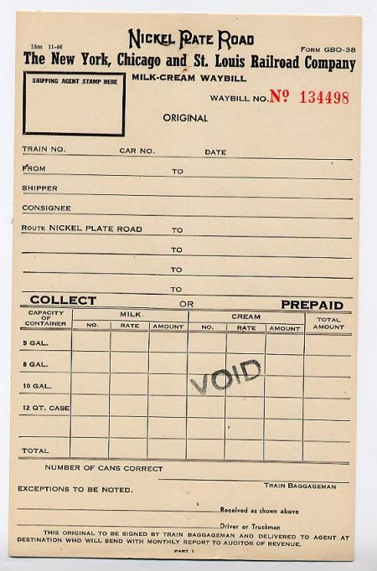
Adapting Prototype Waybills

Slide 12
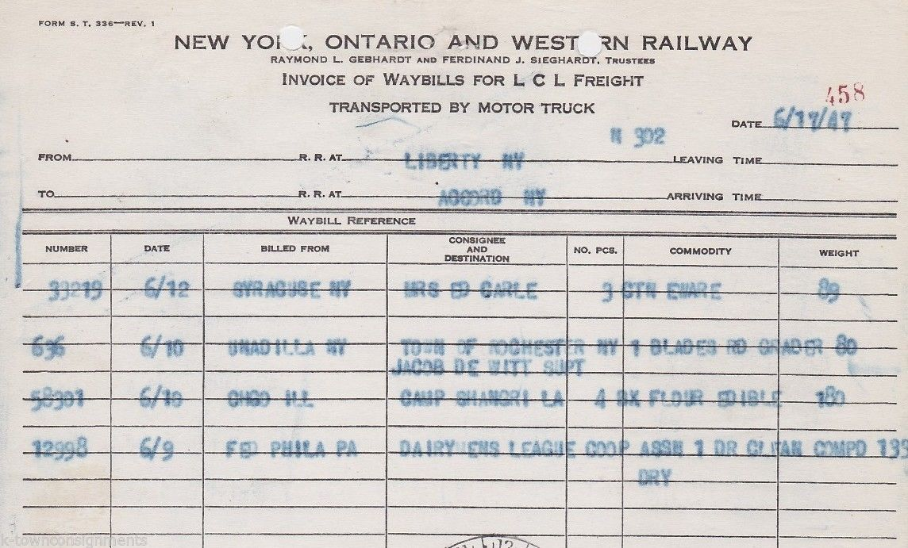
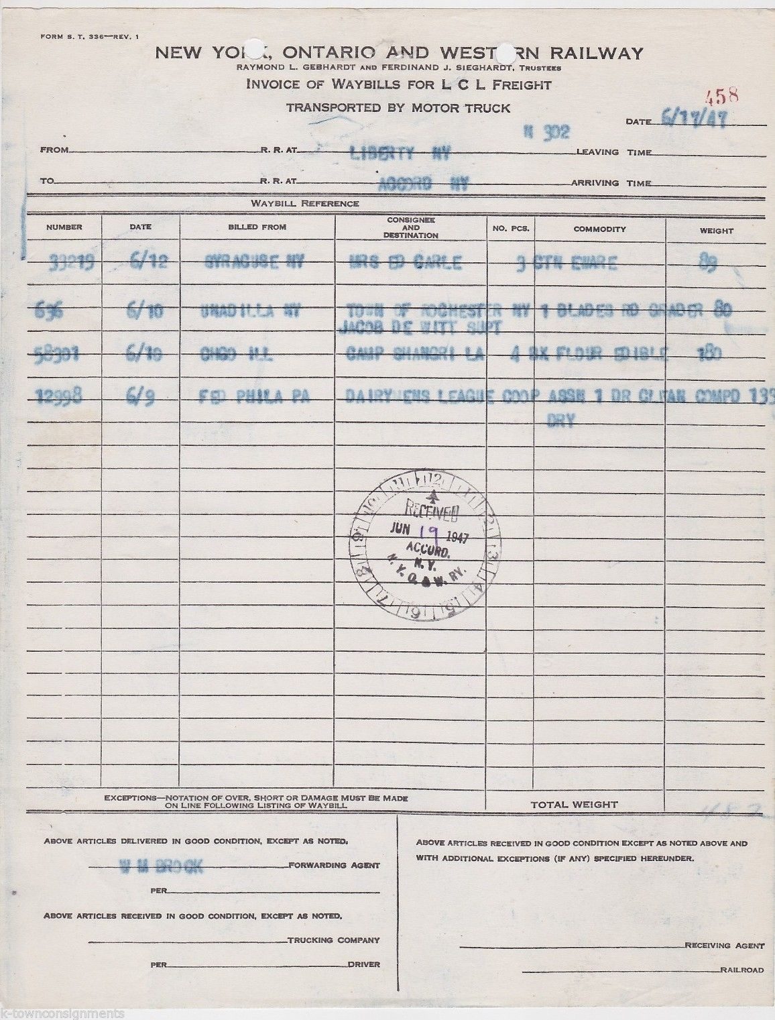
Adapting Prototype Waybills

Slide 13
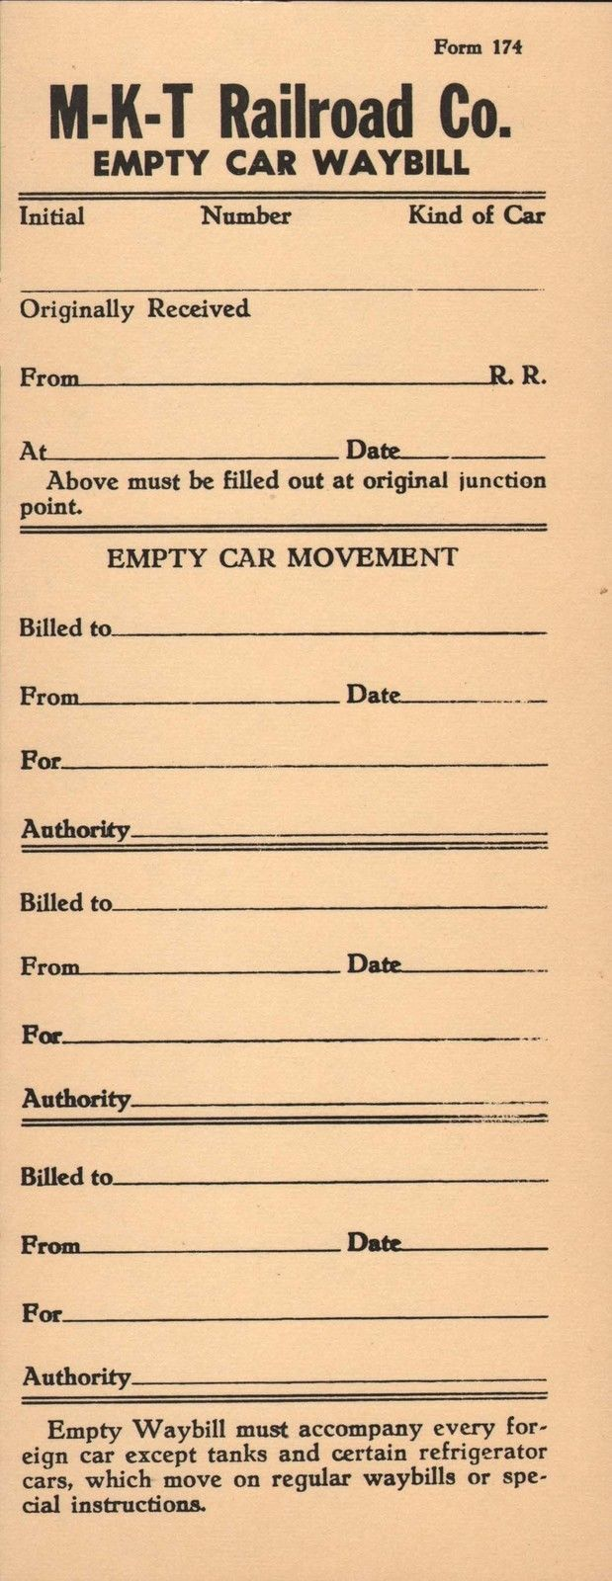
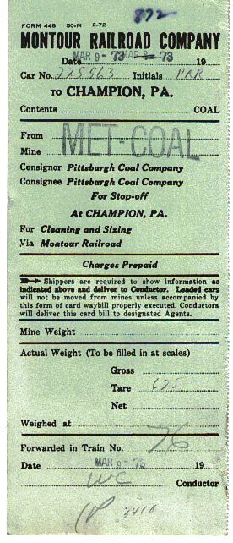
Adapting Prototype Waybills

Slide 14
Adapting Prototype Waybills
How do we adapted the prototype waybills to our model railroad with out a office of clerks?

Slide 15
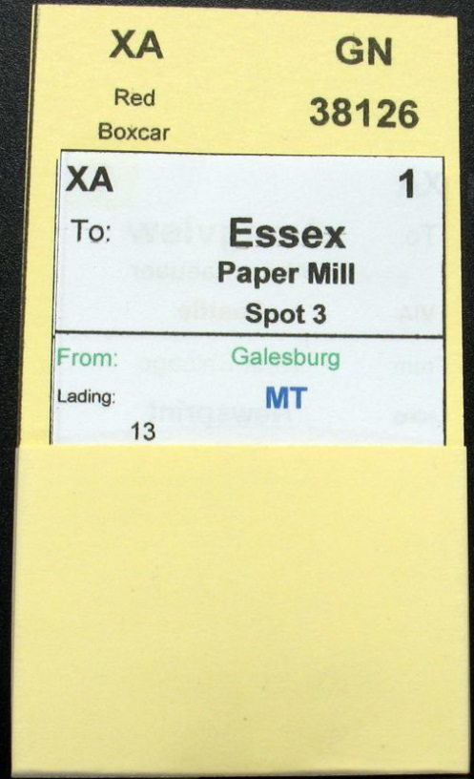
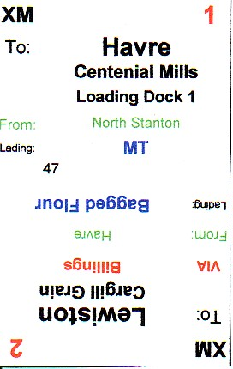
Adapting Prototype Waybills
The current de facto system is using the Old Line Graphic car card and waybill system.
Old Line Graphics
Don McFall
oldlinegraphics@verizon.net
Old Line Graphics
1604 Woodwell Road
Silver Spring, MD 20906-2048
Phone 301-460-9193

Slide 16
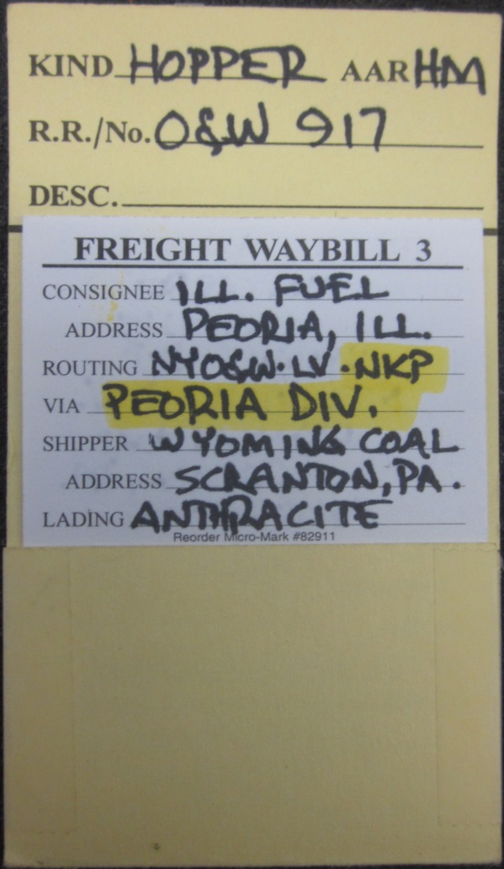
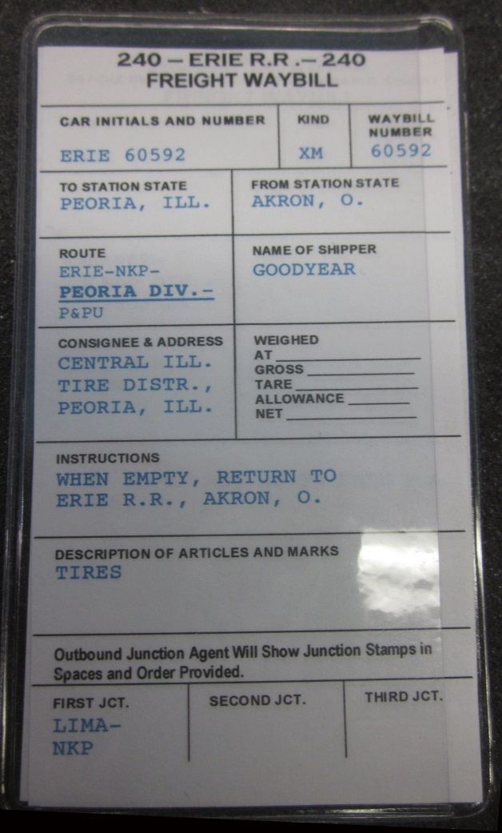
Adapting Prototype Waybills
Going a different way!
What if instead of using car card and waybills we just drop the car card portion?
Here is a solution that is used by Ted Pamperin on his C&O Railroad and Tony Koester on his Nickel Plate.

Slide 17
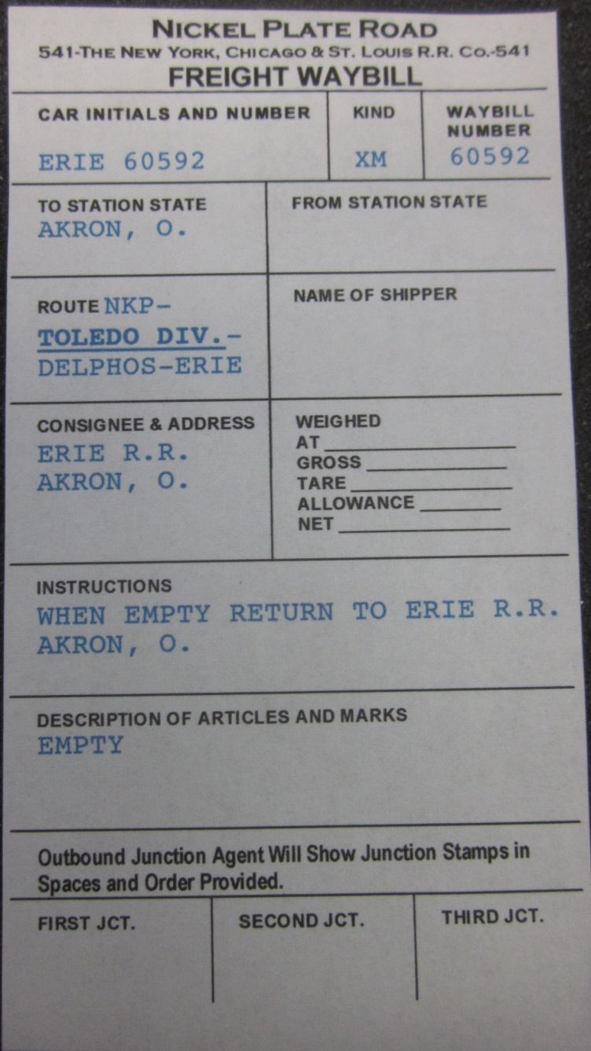
Adapting Prototype Waybills

Slide 18
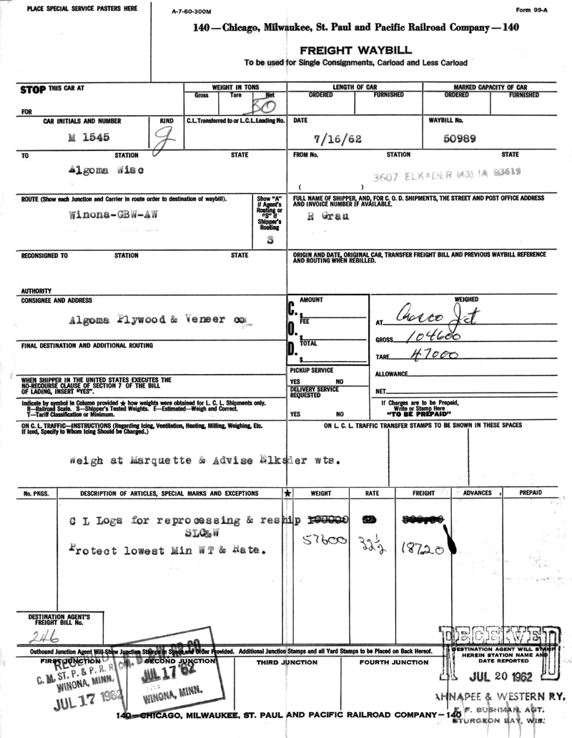
Adapting Prototype Waybills

Slide 19
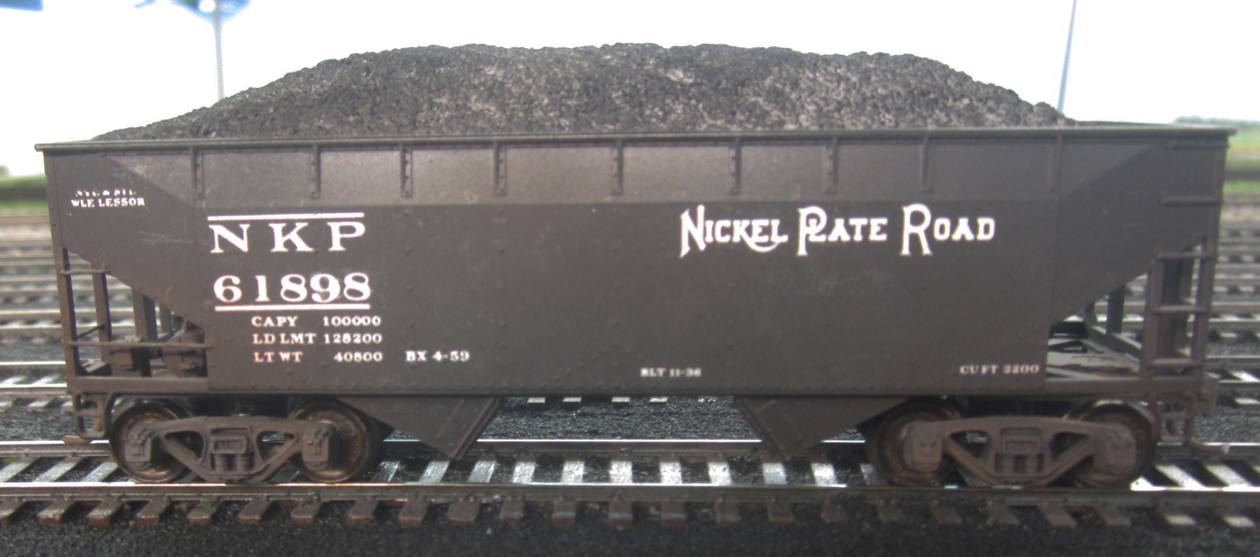
Adapting Prototype Waybills

Slide 20
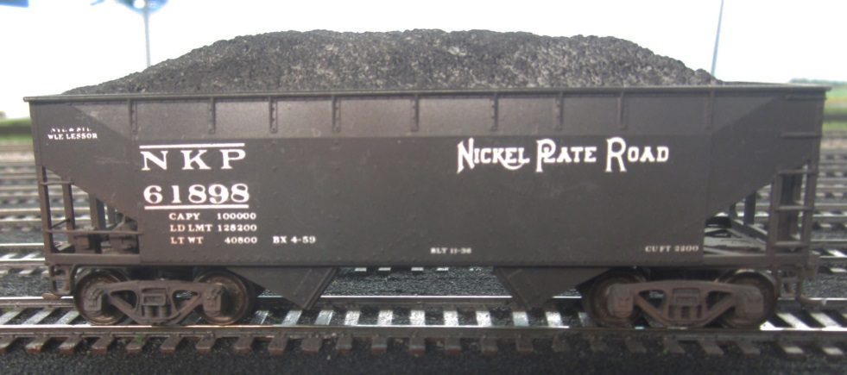
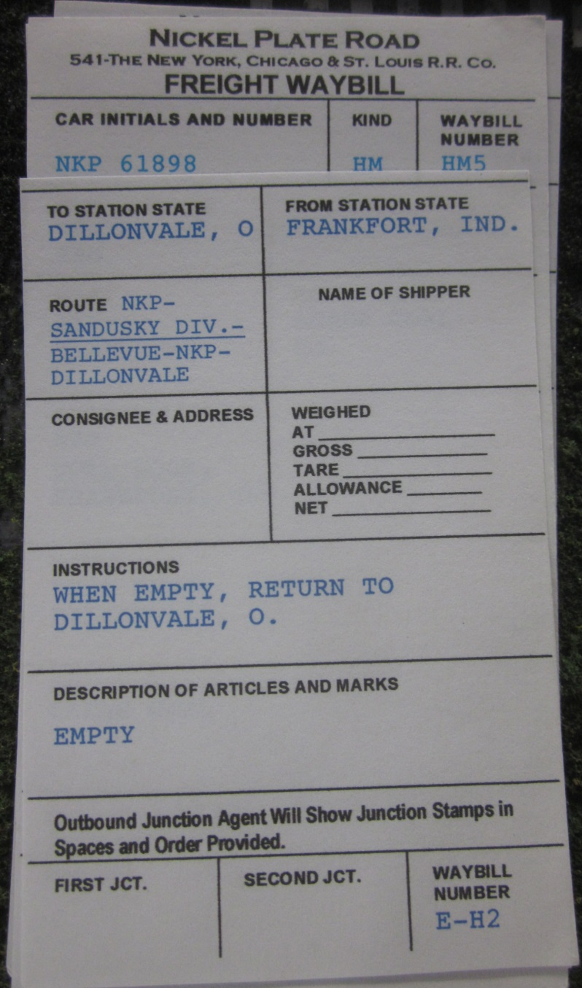
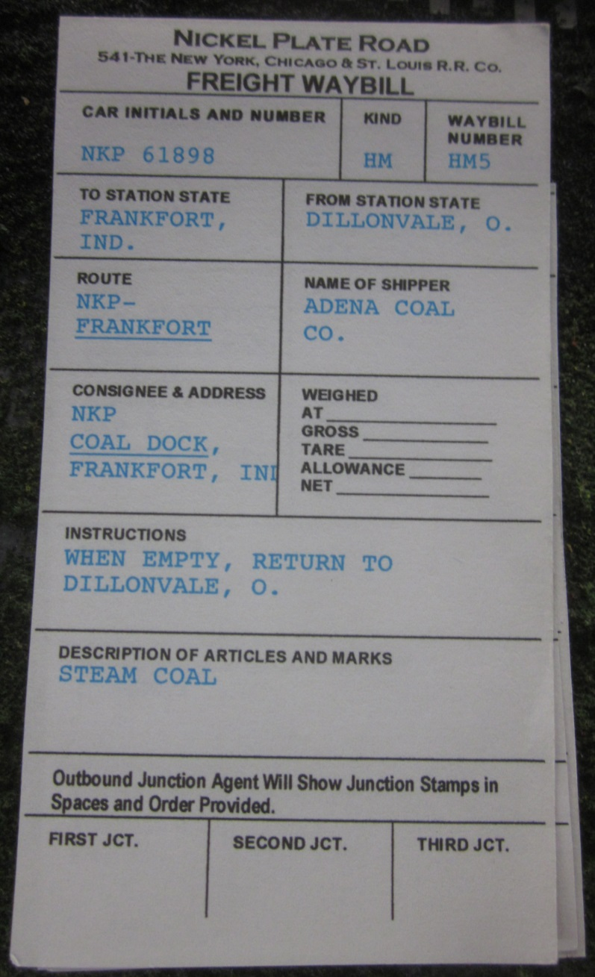
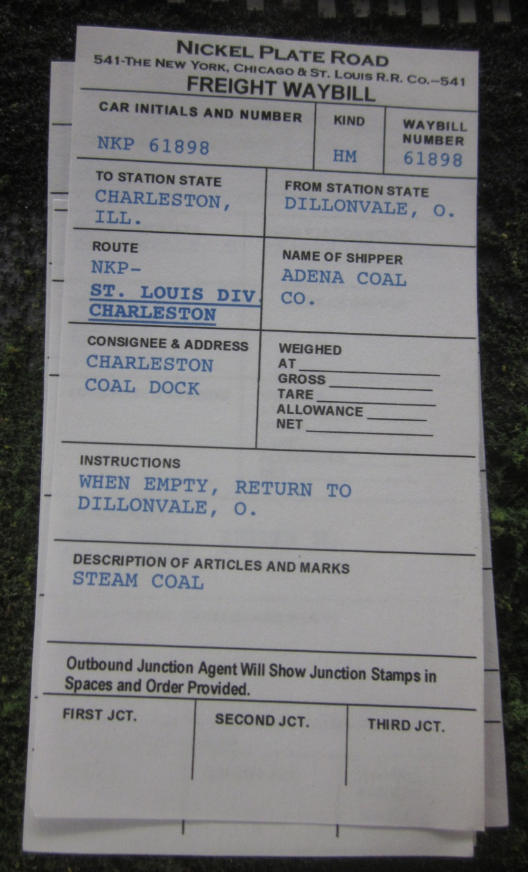
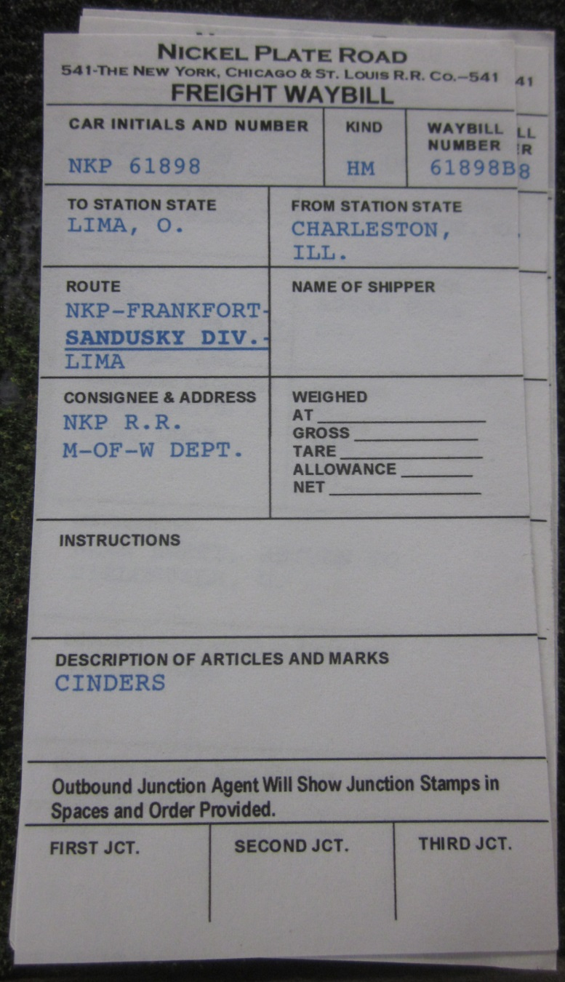
Adapting Prototype Waybills

Slide 21
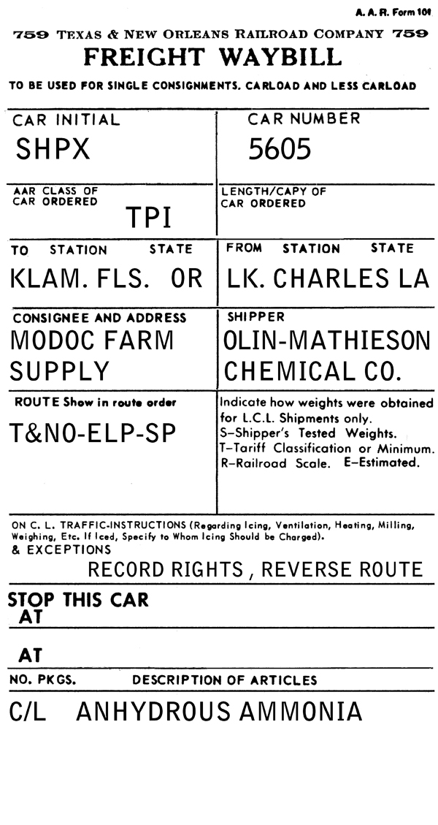
Adapting Prototype Waybills
Anthony Thompson has a different approach.
http://modelingthesp.blogspot.com/2010/12/waybills.html

Slide 22
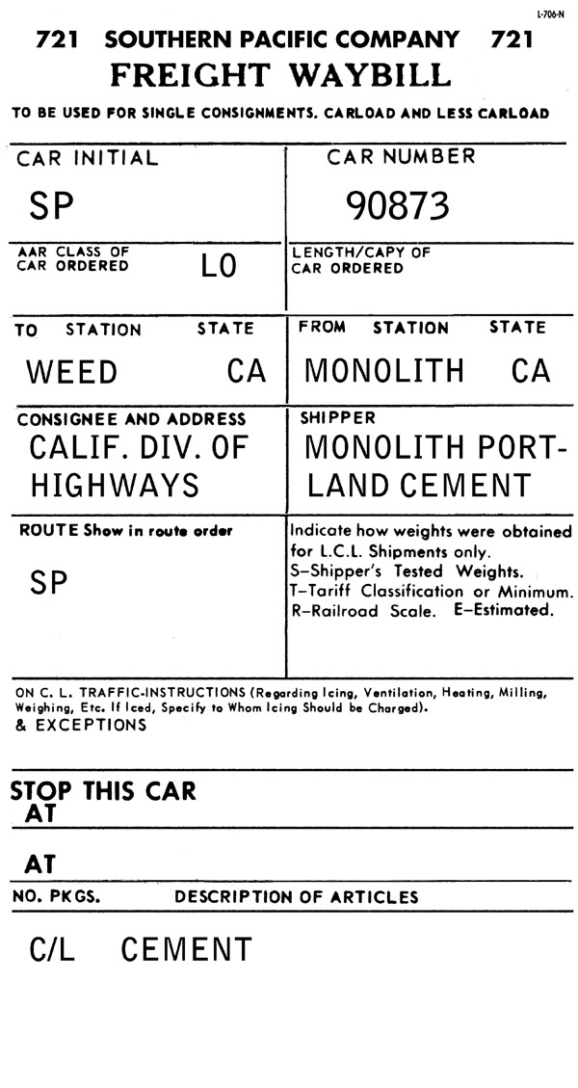
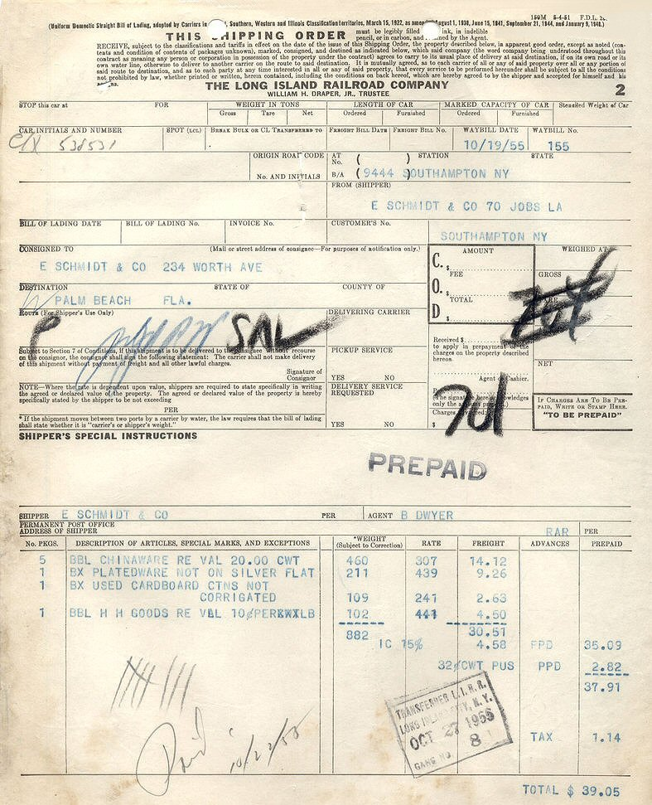
Adapting Prototype Waybills

Slide 23
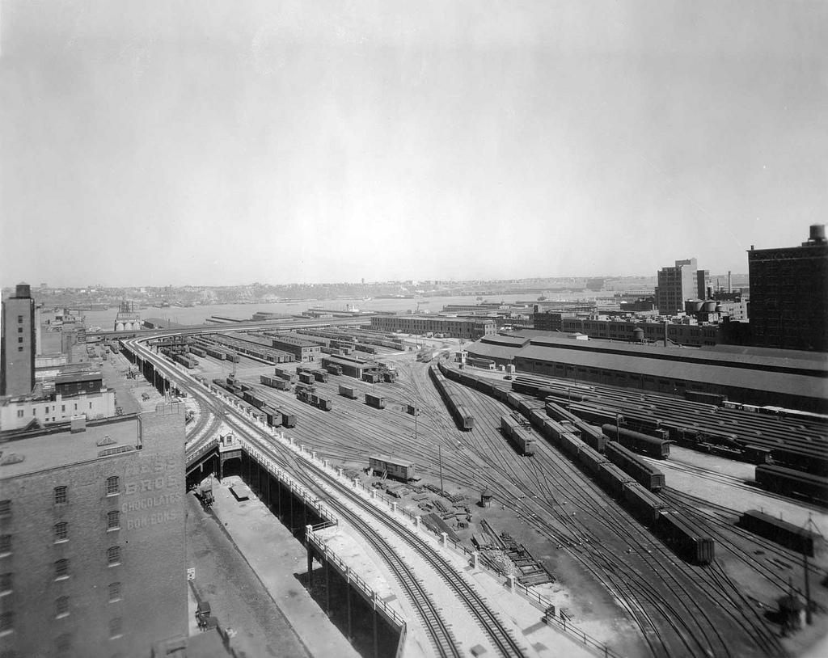
Adapting Prototype Waybills
Working with waybills on the New York Harbor Railroad.

Slide 24
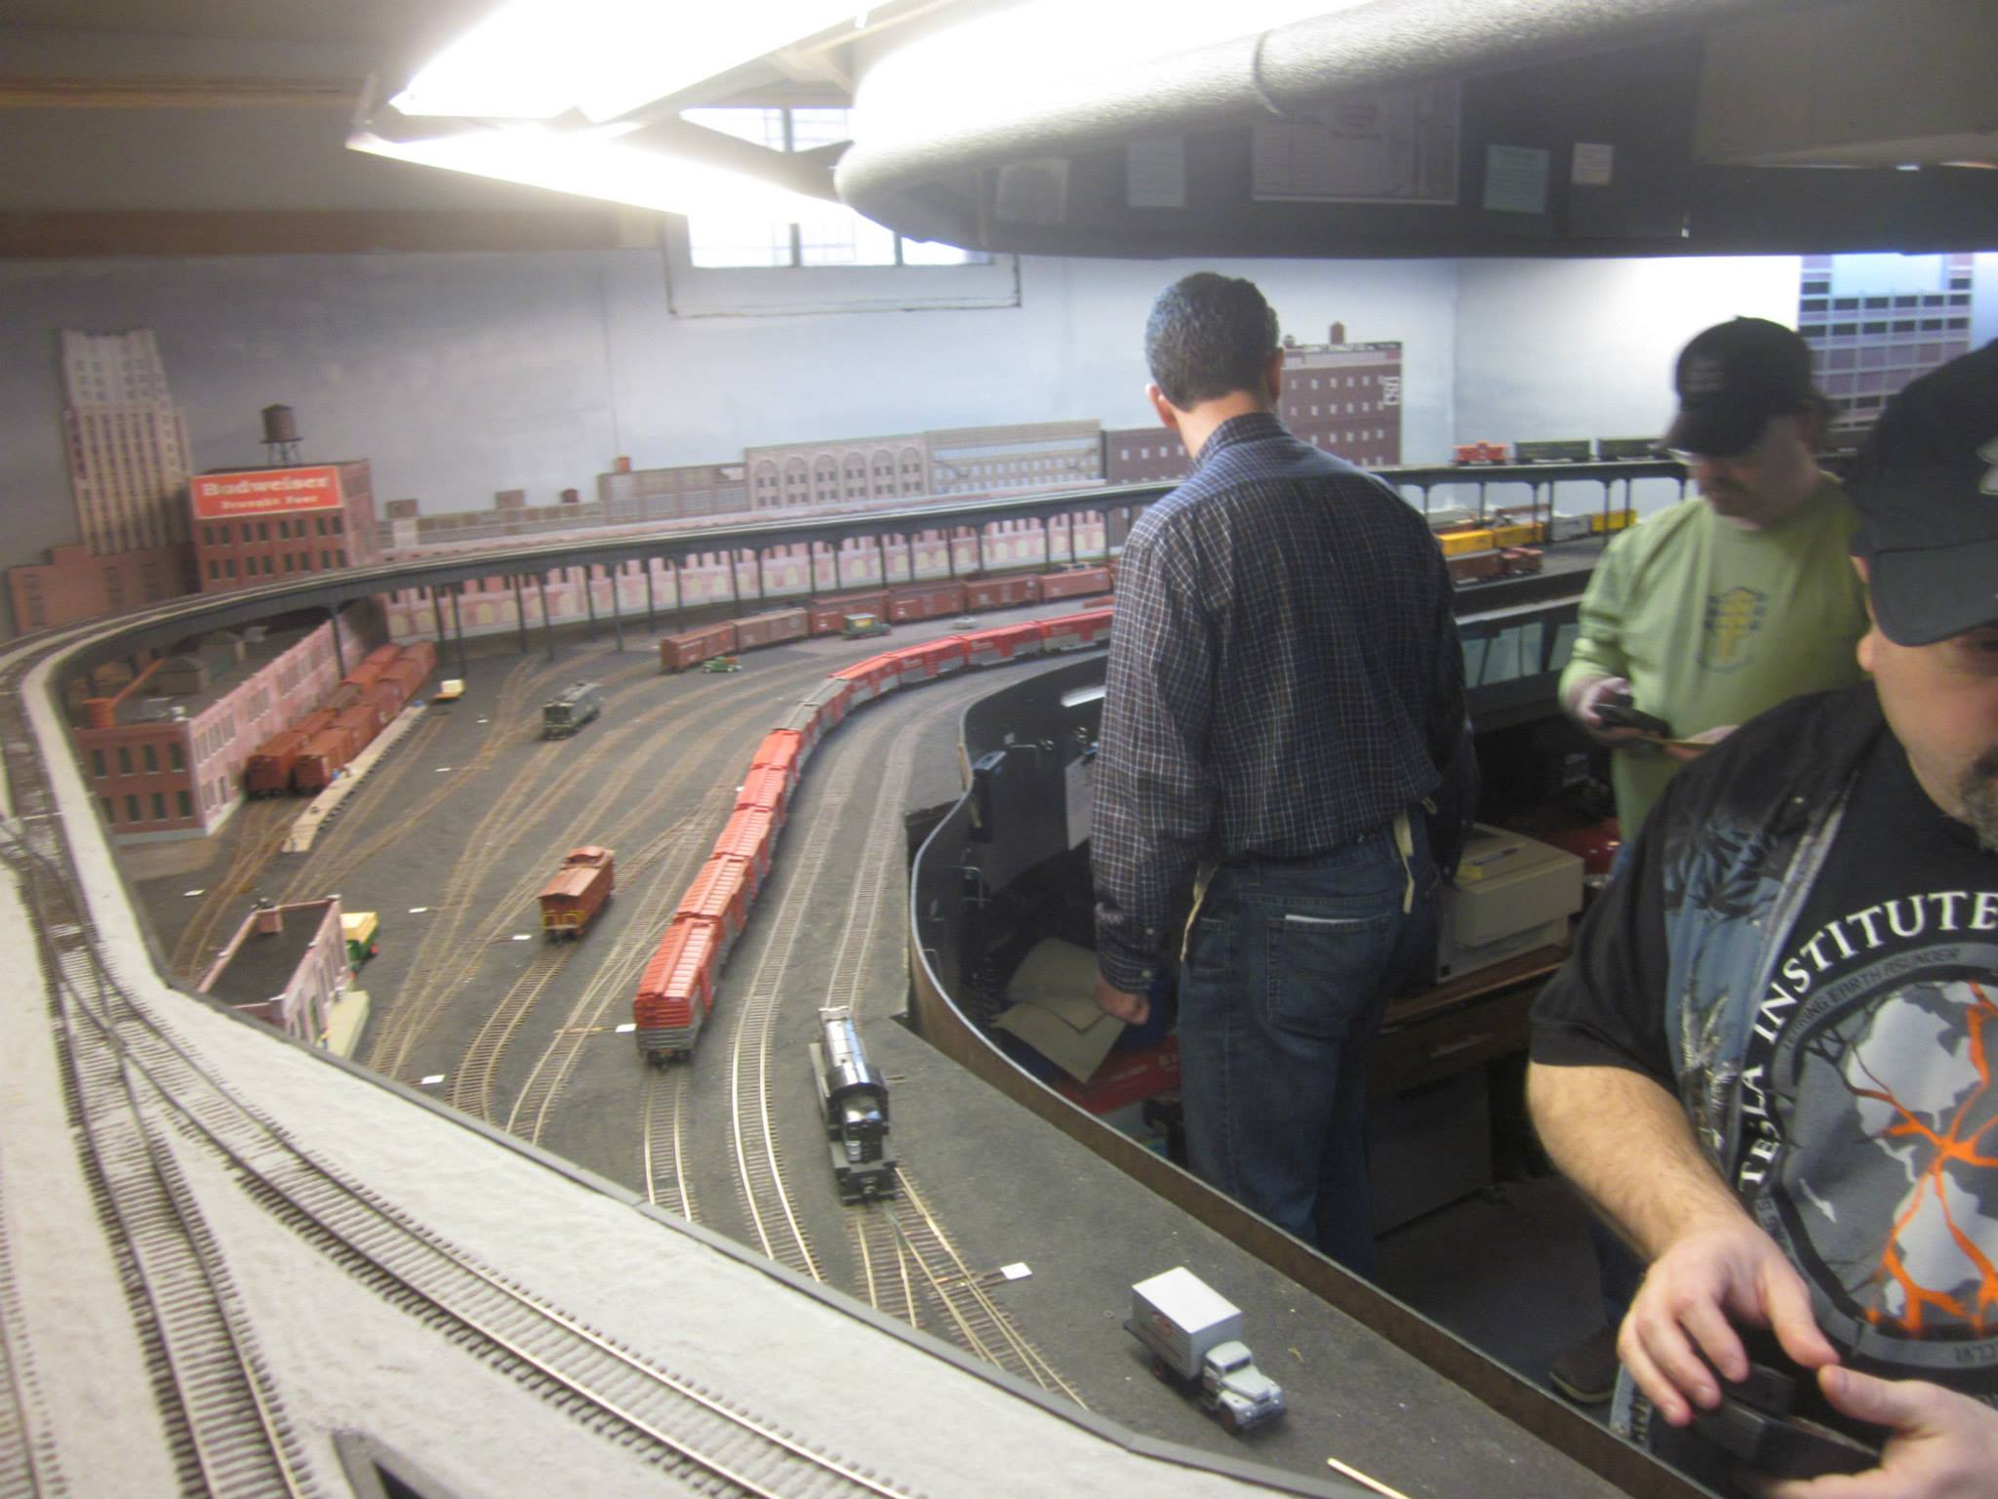
Adapting Prototype Waybills
Working with waybills on the New York Harbor Railroad.

Slide 25
Adapting Prototype Waybills
The Structure of the New York Harbor Railroad
J. T. Stanley Soap Works
33rd Street Station
Active
Staging
Terminal Stores
30th Street Branch
(Elevated)
St John’s Park
Freight Station

Slide 26
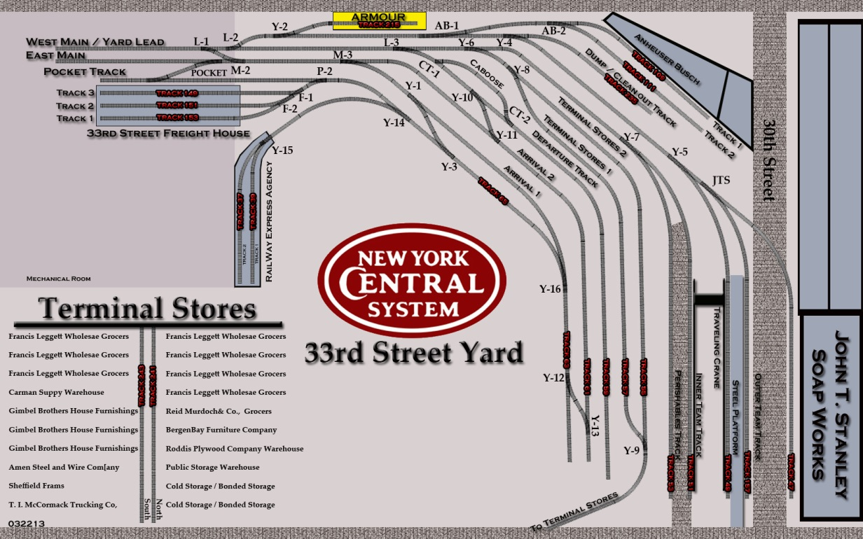
Adapting Prototype Waybills

Slide 27
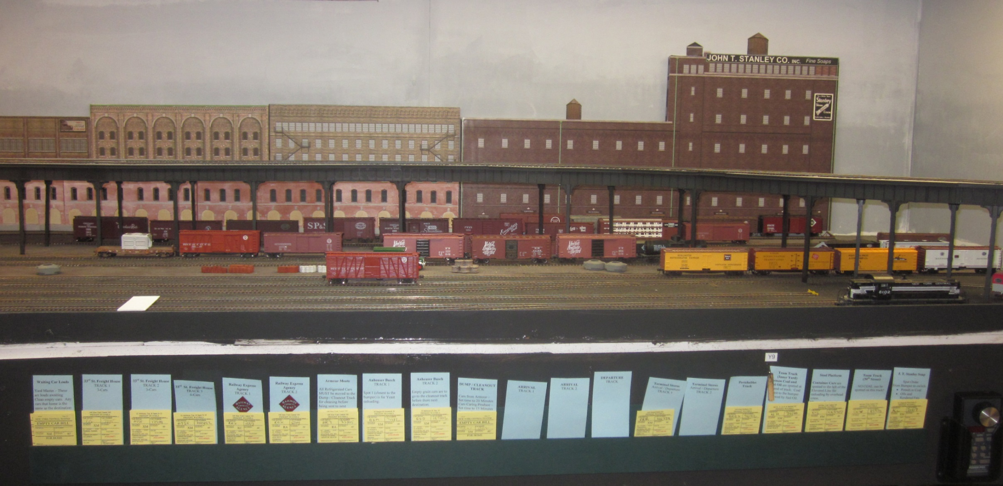
Adapting Prototype Waybills

Slide 28
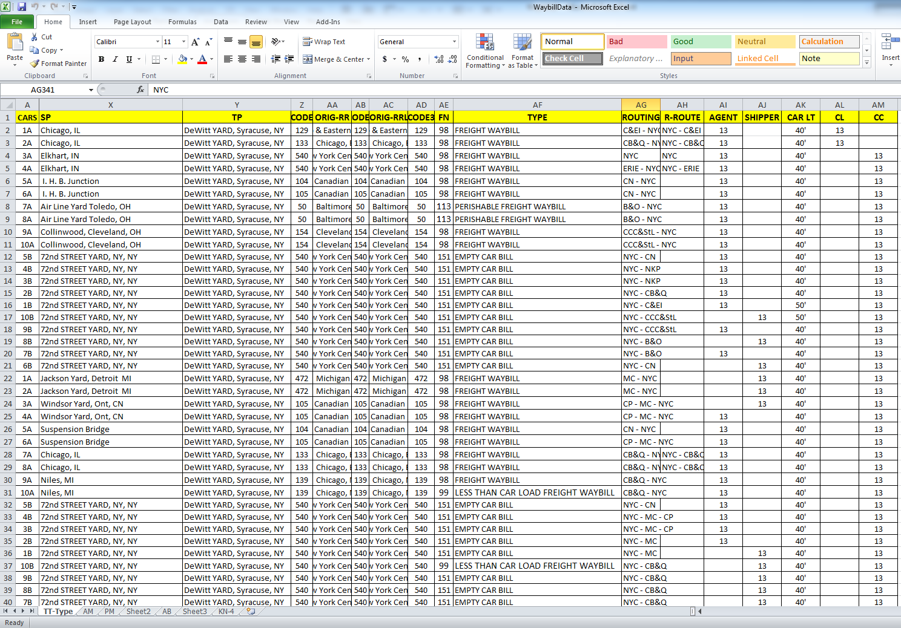
Adapting Prototype Waybills

Slide 29
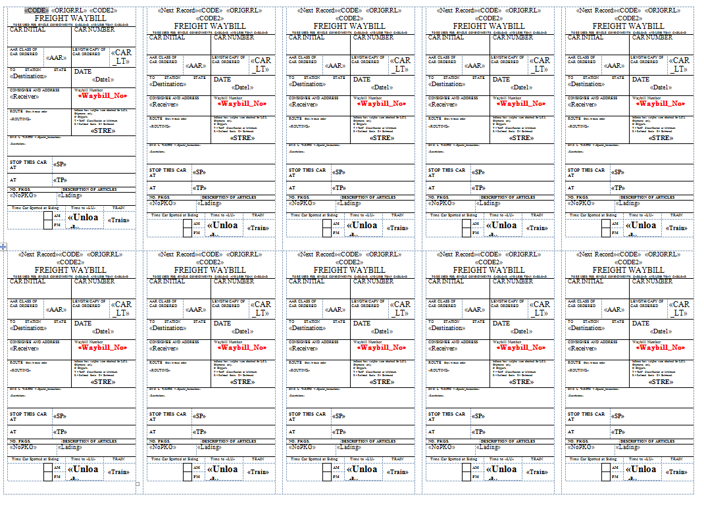
Adapting Prototype Waybills

Slide 30
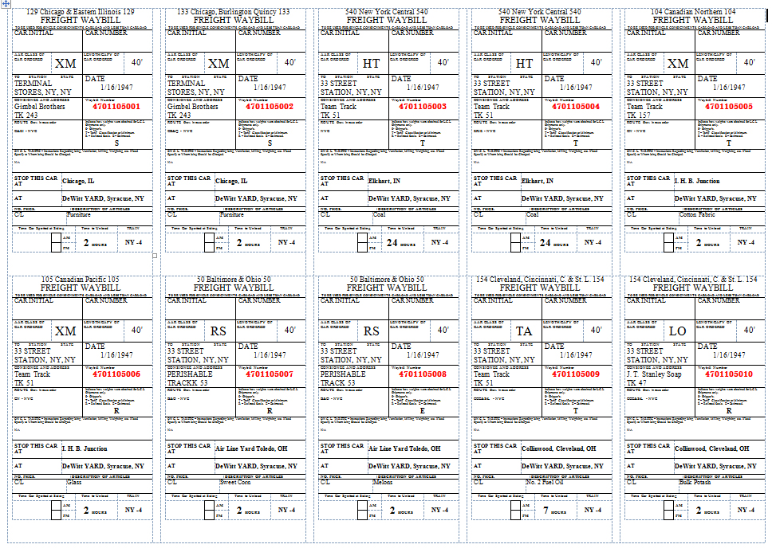
Adapting Prototype Waybills

Slide 31
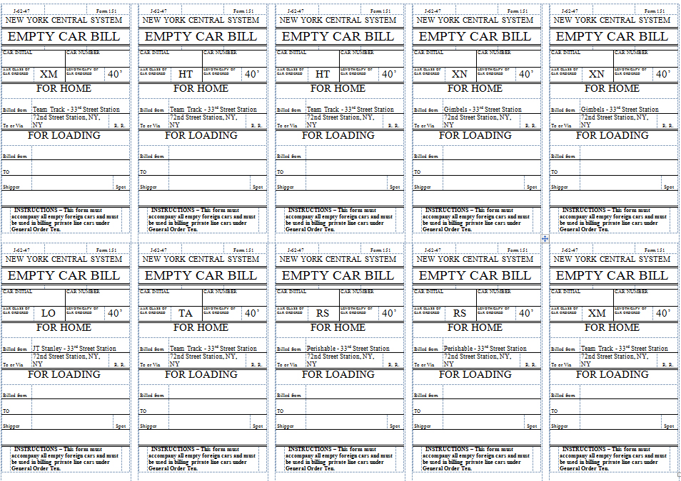
Adapting Prototype Waybills

Slide 32
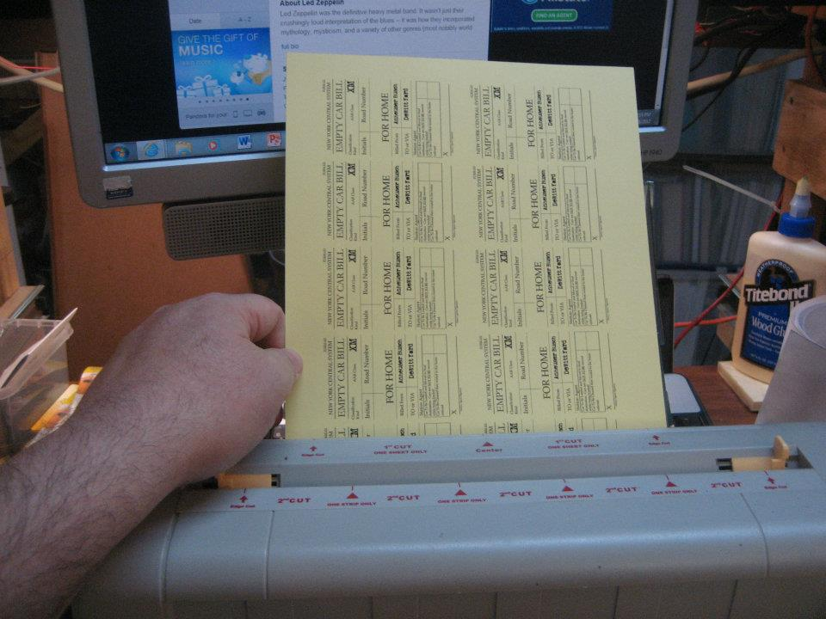
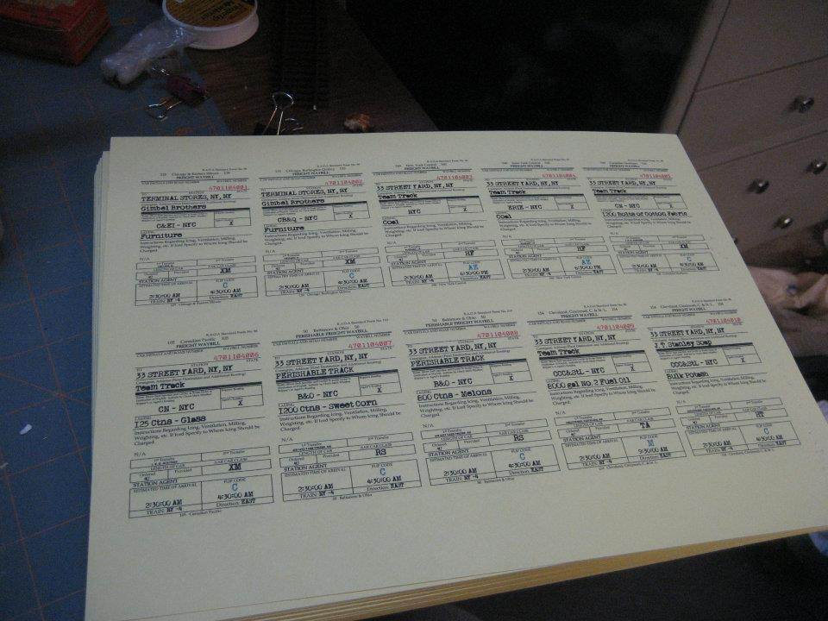
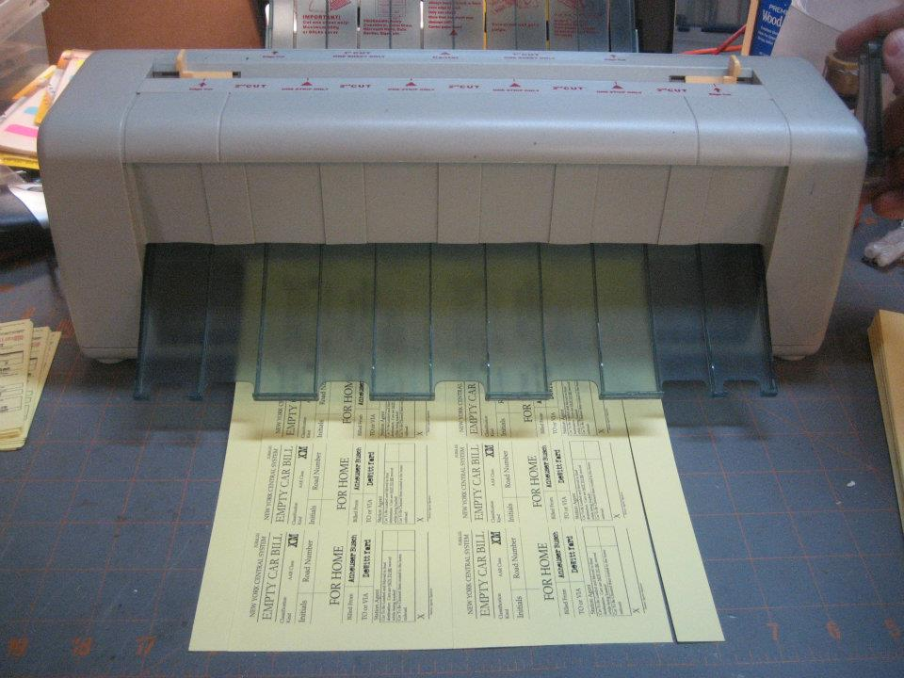
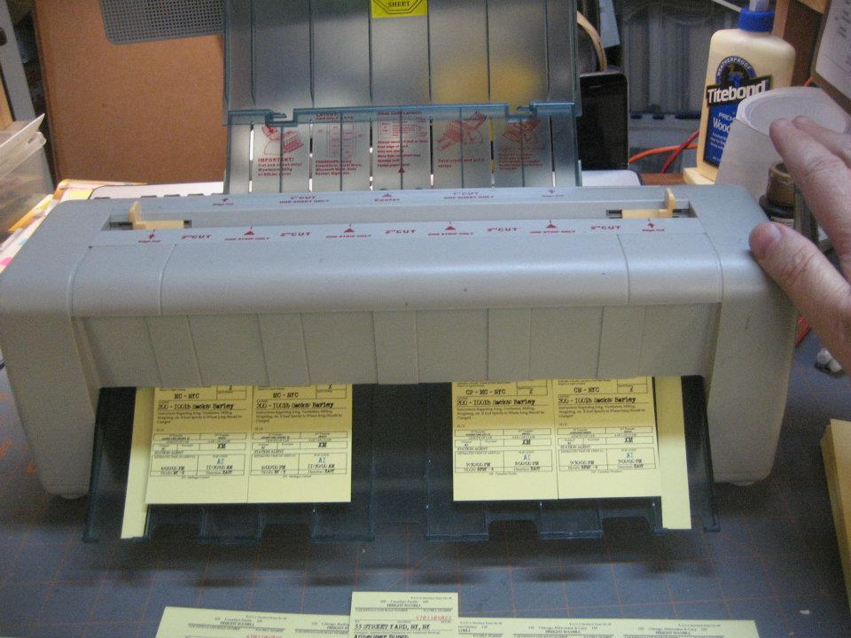
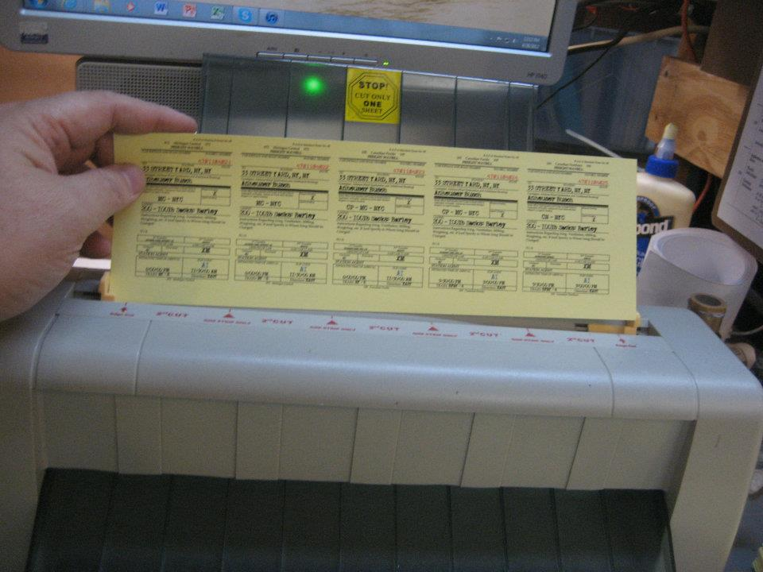
Adapting Prototype Waybills

Slide 33
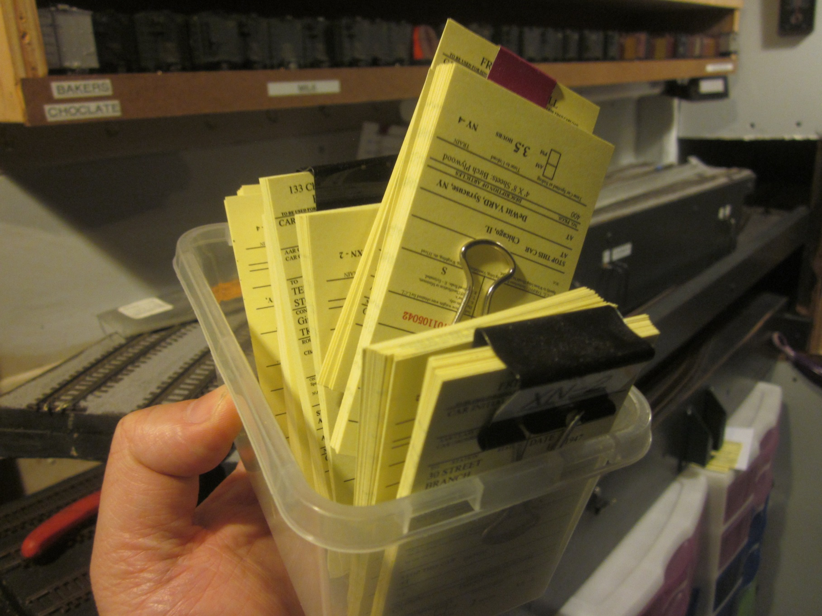
Adapting Prototype Waybills

Slide 34
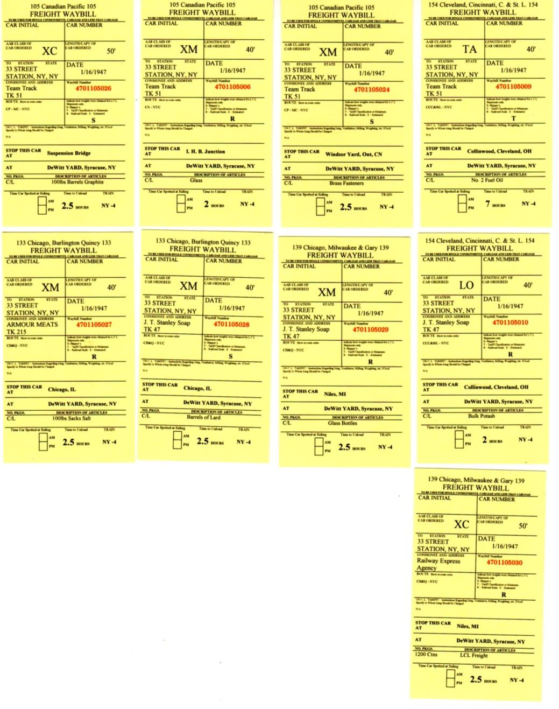
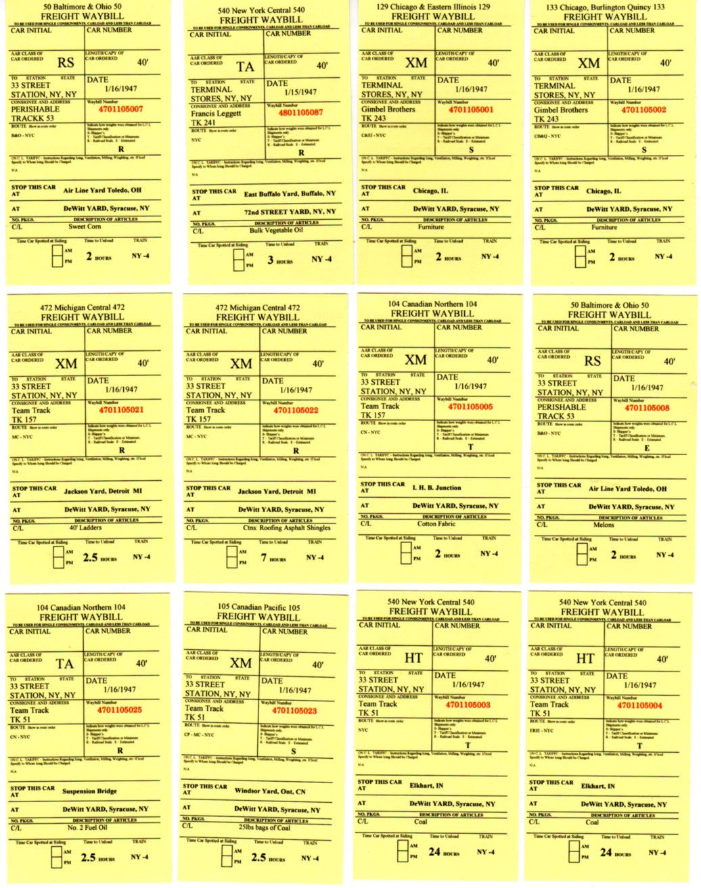
Adapting Prototype Waybills
NY - 4

Slide 35
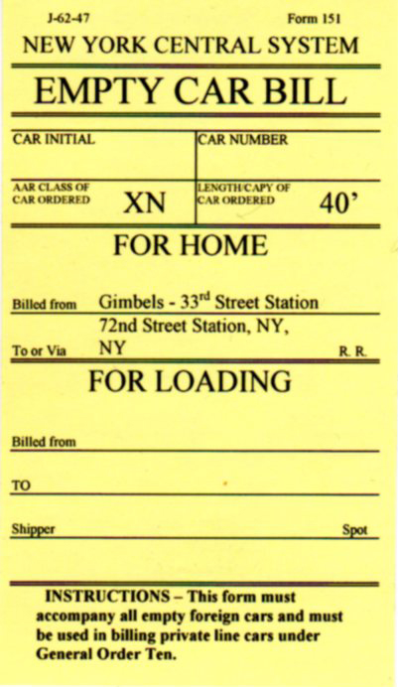
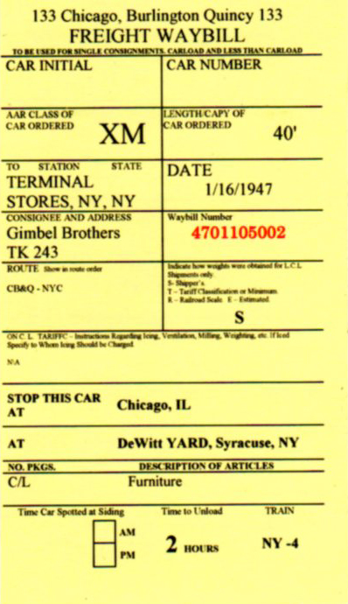
Adapting Prototype Waybills

Slide 36
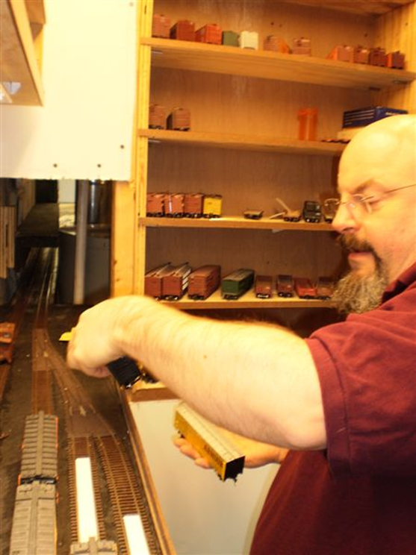
Adapting Prototype Waybills
How are waybills assigned on the New York Harbor Railroad.

Slide 37
Adapting Prototype Waybills
In the early 1900’s the Railway Accounting Officers Association published a set of accounting procedures that standardized most of the paper work.

Slide 38
Adapting Prototype Waybills
Here is a selection of railroads and the Railway Accounting Officers Association (R.A.O.A) codes from the book Railway Accounting Procedures. These codes were used on every waybill starting in the early 1900’s. Before the R.A.O.A standardized all of the railroads’ paperwork, each railroad had their own forms. The book is available via eBay as an electronic book from the Internet Archive at: http://www.archive.org/details/cu31924014038578.
In this book, you will find all of the standard forms used by every railroad.
AAR | Railroad
534 | New Mexico Central
535 | New Orleans & Northeastern
536 | New Orleans Great North.
537 | New Orleans Terminal
538 | New Orleans, Texas & Mexico
539 | N. Y. & Long Branch
540 | New York Central
541 | N. Y., Chicago & St. Louis
542 | New York Dock
543 | N. Y., N. H. & Hartford
544 | N. Y., Ontario & West.
545 | N. Y., Phila. & Norfolk
546 | N. Y., Susquehanna & Western
547 | N. Y., Westchester & Boston
548 | Niagara, St. Catharines & Toronto
549 | Norfolk & Portsmouth Belt Line
550 | Norfolk & Western
551 | Norfolk Southern
552 | Norfolk Terminal
553 | North Louisiana & Gulf
554 | Northampton & Bath
555 | Northeast Oklahoma
556 | Northern Alabama
557 | Northern Ohio T. & L.
558 | Northern Pacific
559 | Northwestern Pacific
560 | Norwood & St. Lawrence
561 | New England Steamship Co.
562 | Napierville Junction
563 | Northern Electric
564 | Northern Ohio
565 | New York & Pennsylvania
566 | Natchez & Southern
567 | Northwestern R. R. of S. C.

Slide 39
Adapting Prototype Waybills
Questions?
Cost?
Ream of card stock will do 10 sessions: $14.00 ($1.40 per session)
Business Card paper cutter: $100.00
Time?
Initial Spreadsheet Setup 3 Months
Printing Time 30 Min
Cutting Time 30 Min
Setup (staging) 45 Min – 1 1/2 Hours

Slide 40
Adapting Prototype Waybills

