Slide 1

Do It Yourself DCC++
A full-featured DCC system using an Arduino an Arduino Motor Shield and connecting it to a model railroad for less than $100.
Presented by David Ramos
dramos_1701@yahoo.com

Slide 2

Do It Yourself DCC++
Evolution
How did we get here?
Our first trainset
DC Block control
DC Tethered Throttles
Early Analogue Command Control
DCC – Digital Command Control

Slide 3
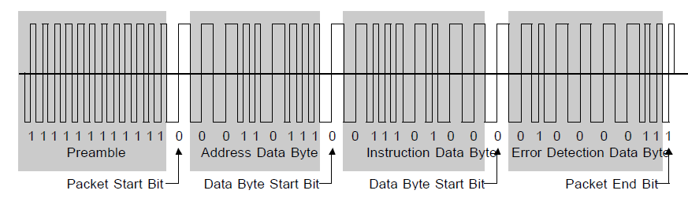
Do It Yourself DCC++
Image from: http://trains4africa.co.za/?p=1451

Slide 4


Do It Yourself DCC++
Traditional DCC Suppliers
Yes there are many others!

Slide 5
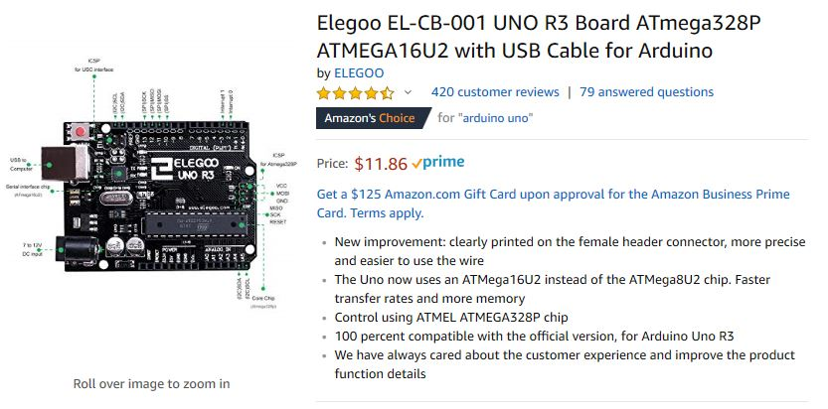
Do It Yourself DCC++
Let’s go shopping!
Parts List:
Arduino Uno R3
Build Price:
$11.86

Slide 6
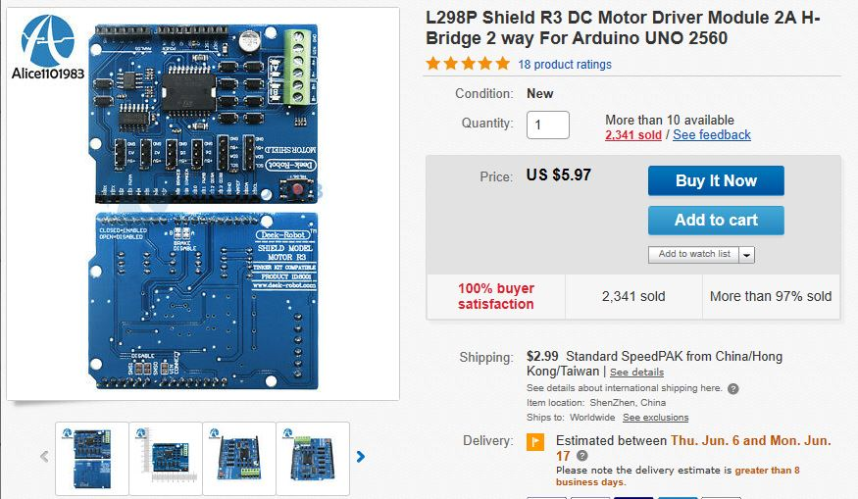
Do It Yourself DCC++
Let’s go shopping!
Parts List:
R3 Power Shield
Build Price:
$20.82

Slide 7
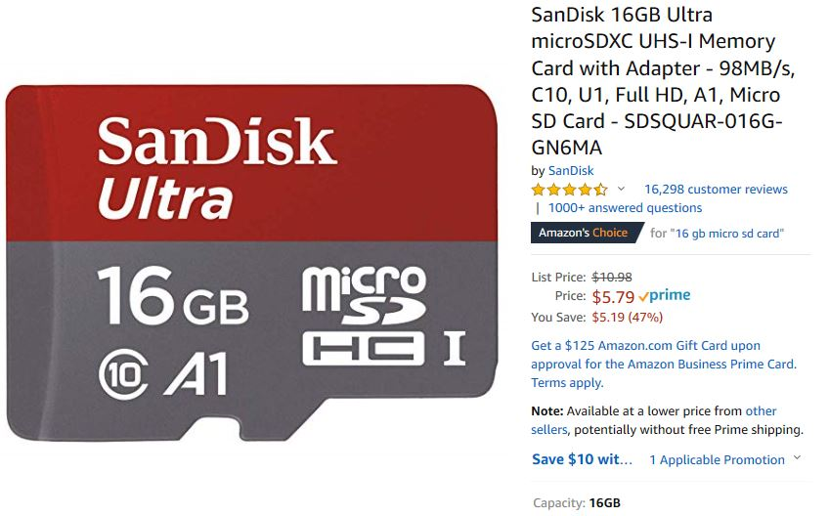
Do It Yourself DCC++
Let’s go shopping!
Parts List:
Micro SD Card
Build Price:
$26.61

Slide 8
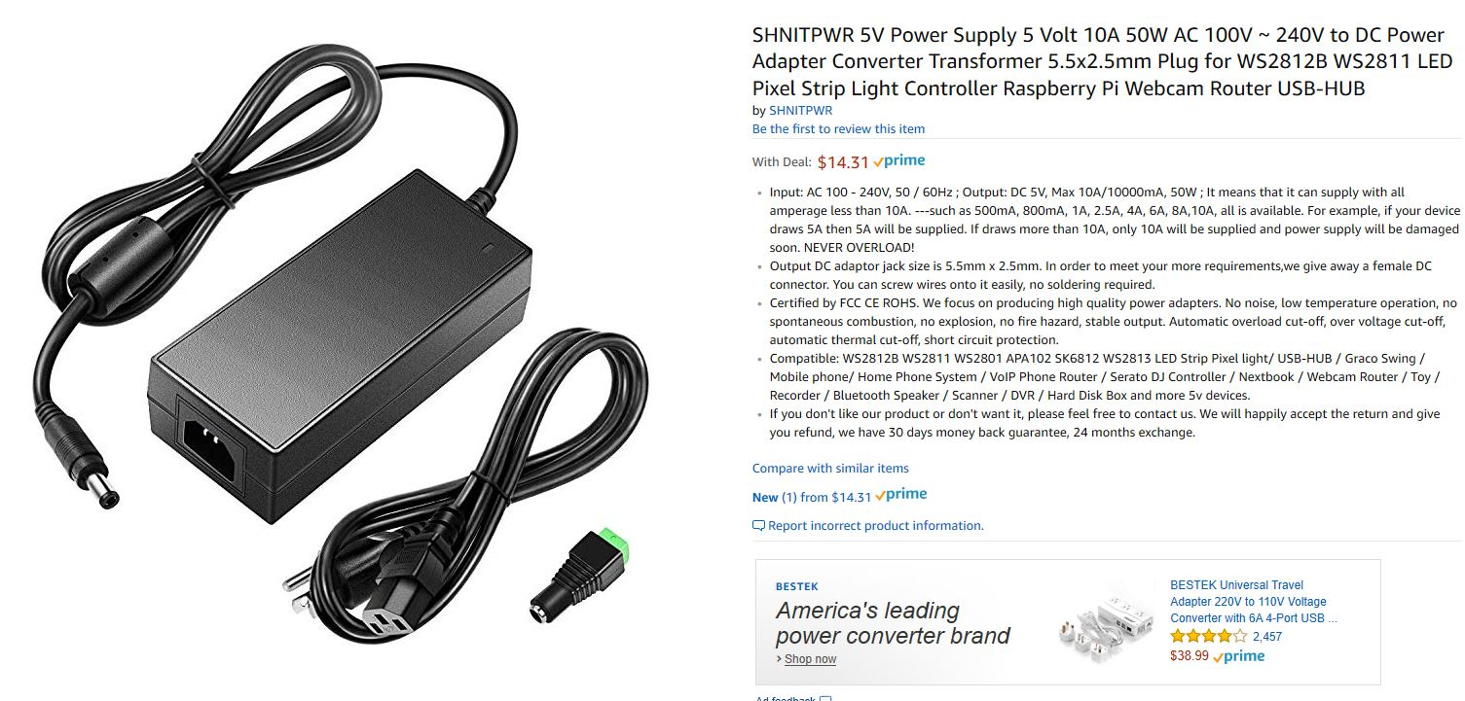
Do It Yourself DCC++
Let’s go shopping!
Parts List:
Power Supply 14 Volt 5 Amps
Build Price:
$40.95

Slide 9
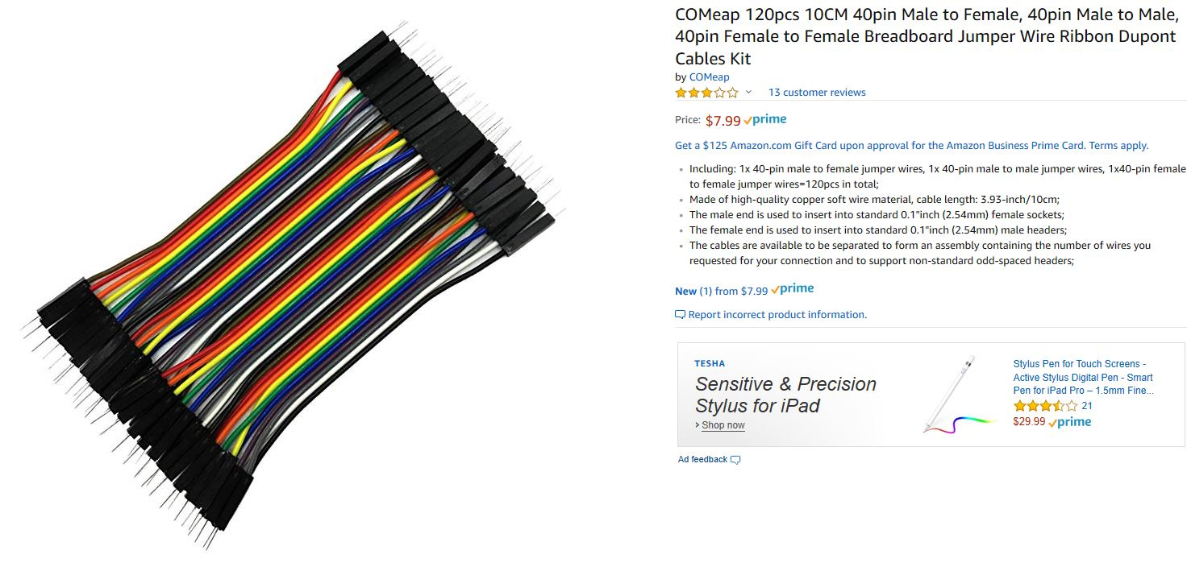
Do It Yourself DCC++
Let’s go shopping!
Parts List:
Jumper Wire for Arduino
Build Price:
$48.94

Slide 10
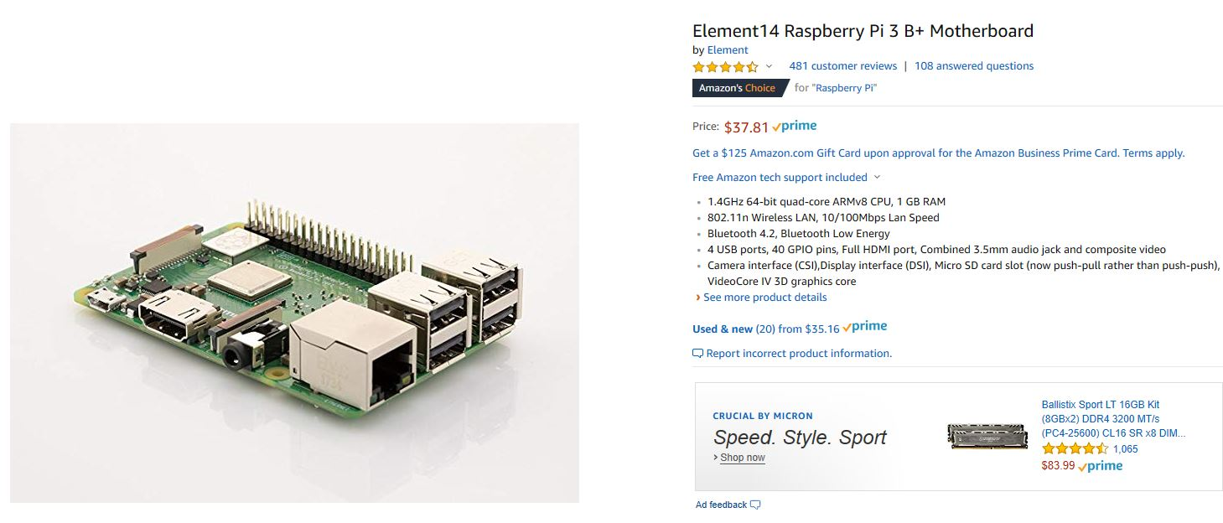
Do It Yourself DCC++
Let’s go shopping!
Parts List:
Raspberry Pi 3 B+
Build Price:
$86.75

Slide 11
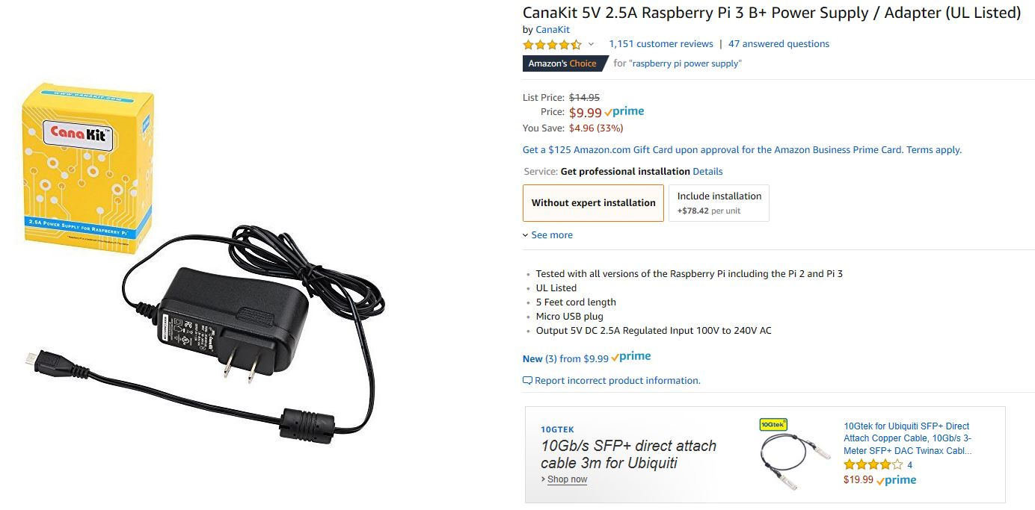
Do It Yourself DCC++
Let’s go shopping!
Parts List:
Raspberry Pi 3 B+ Power Supply
Build Price:
$96.74

Slide 12
Do It Yourself DCC++
Let’s go shopping!
Parts List:
Amazon
EBay
EBay
Amazon
Amazon
Amazon
Amazon
Amazon
Arduino Uno R3 $11.86
R3 Power Shield $5.97
Shipping $2.99
Micro SD Card $5.71
Power Supply 14 Volt 5 Amps $14.31
Jumper Wire for Arduino $7.99
Raspberry Pi 3 B+ $37.81
Raspberry Pi 3 B+ Power Supply $9.99
Build Price: $96.74

Slide 13
Do It Yourself DCC++
Free Software and stuff to make it work
Arduino Programing Software
https://www.arduino.cc/en/Main/Software
GitHub – Repository of the DCC ++ Firmware for the Arduino
https://github.com/DccPlusPlus/BaseStation
JMRI – Repository for the Raspberry Pi JMRI Software
https://mstevetodd.com/jmri-raspberrypi-access-point
Windows Disk Imager – Needed to Program the Raspberry Pi
https://sourceforge.net/projects/win32diskimager/
Apple Disk Imager: ApplePi v2
https://www.tweaking4all.com/hardware/raspberry-pi/applepi-baker-v2/
NOOBS for Raspberry Pi
https://www.raspberrypi.org/downloads/noobs/

Slide 14
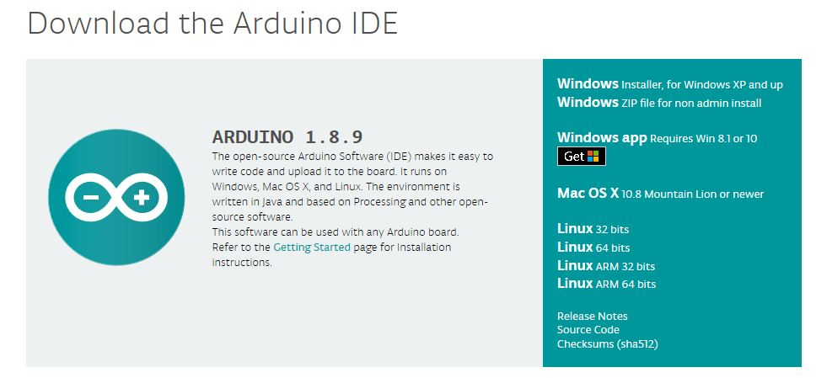
Do It Yourself DCC++
Free Software and stuff to make it work
Arduino Programing Software
https://www.arduino.cc/en/Main/Software

Slide 15
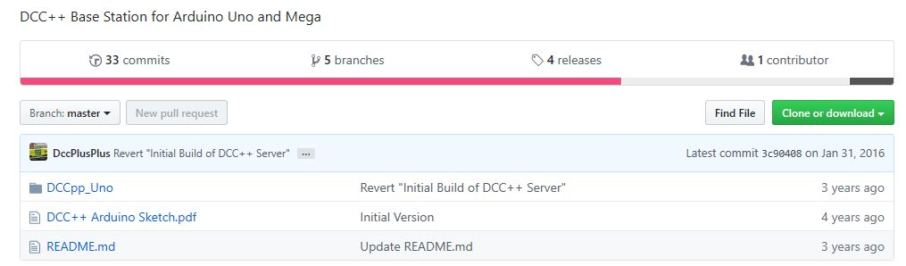
Do It Yourself DCC++
Free Software and stuff to make it work
GitHub – Repository of the DCC ++ Firmware for the Arduino
https://github.com/DccPlusPlus/BaseStation
https://github.com/DccPlusPlus/BaseStation/wiki/What-is-DCC--Plus-Plus

Slide 16
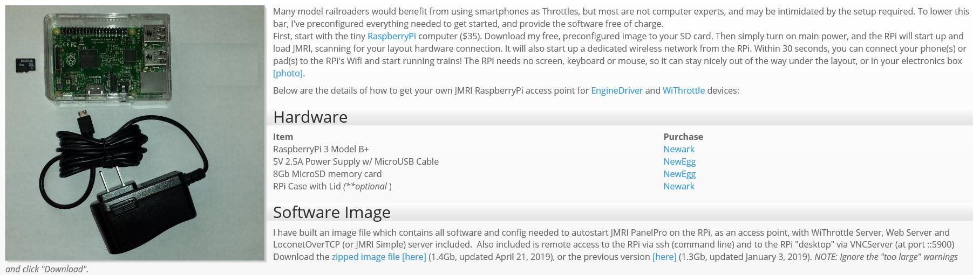
Do It Yourself DCC++
Free Software and stuff to make it work
JMRI – Repository for the Raspberry Pi JMRI Software
https://mstevetodd.com/jmri-raspberrypi-access-point

Slide 17
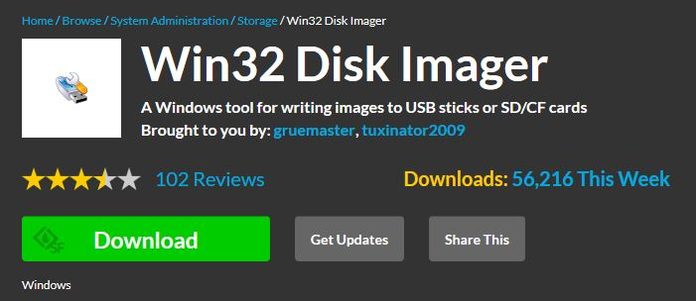
Do It Yourself DCC++
Free Software and stuff to make it work
Windows Disk Imager – Needed to Program the Raspberry Pi
https://sourceforge.net/projects/win32diskimager/

Slide 18
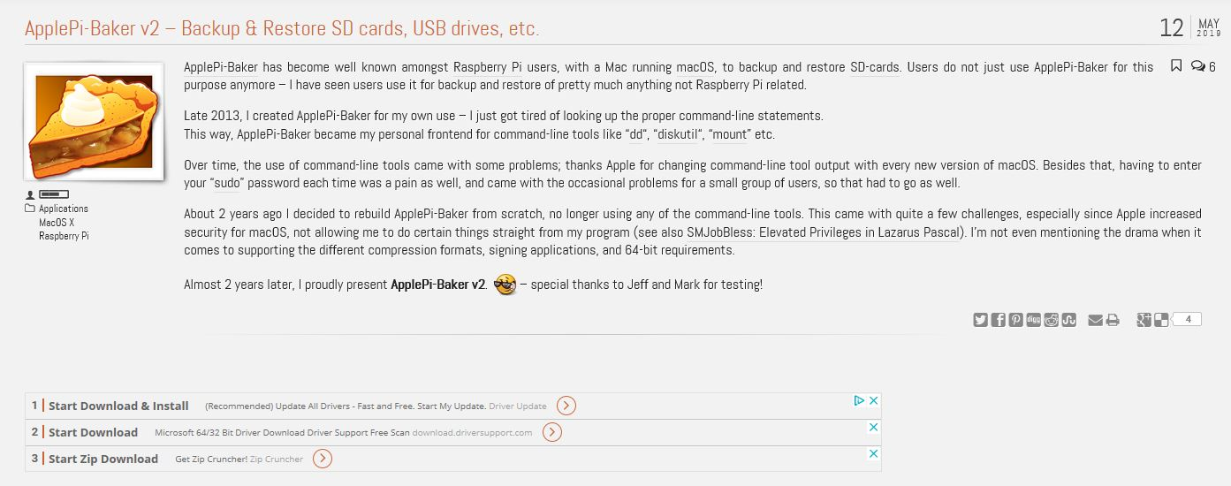
Do It Yourself DCC++
Free Software and stuff to make it work
Apple Disk Imager: ApplePi v2
https://www.tweaking4all.com/hardware/raspberry-pi/applepi-baker-v2/

Slide 19
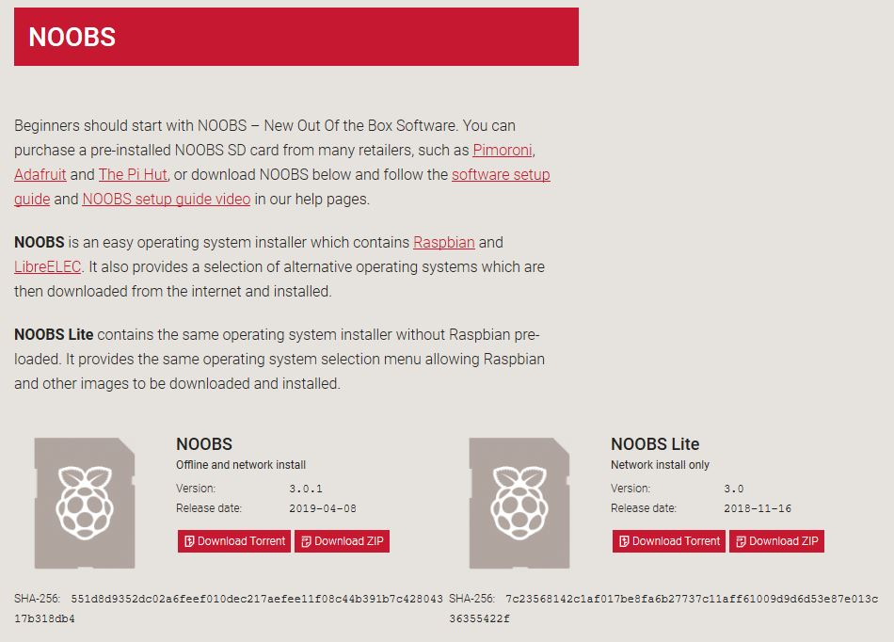
Do It Yourself DCC++
Free Software and stuff to make it work
NOOBS for Raspberry Pi
https://www.raspberrypi.org/downloads/noobs/

Slide 20
Do It Yourself DCC++
How to Videos on YouTube
Excellent Beginners how to guide by: Steve Todd
https://www.youtube.com/watch?v=l1pgvCKT410
More detailed four part series.
https://www.youtube.com/watch?v=-nsVdpMhiTU

Slide 21
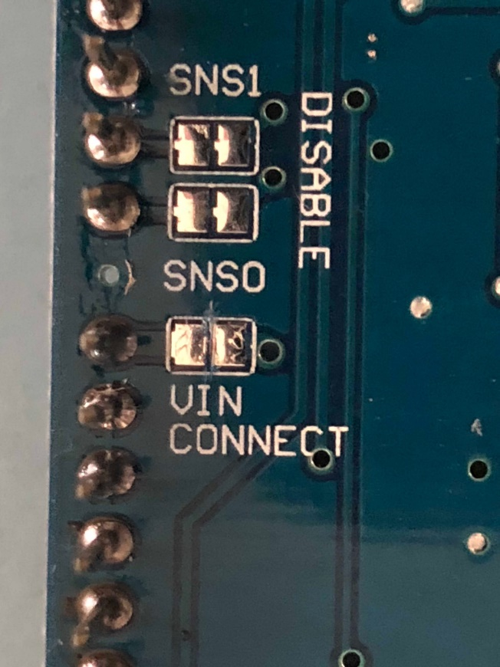
Do It Yourself DCC++
Starting the Build
Step 1: Install Arduino IDE on your laptop or desktop.
Step 2: Download from GitHub the DCC++ firmware for the Arduino.
Step 3: Connect the Arduino to your computer.
Step 4: Using the Arduino IDE, push the code to the Arduino
Step 5: Cut the trace on the back of the Power Shield
  This is done to protect the CPU on the Arduino since it is designed to handle 12 Volts and this project requires 14 Volts!

Slide 22
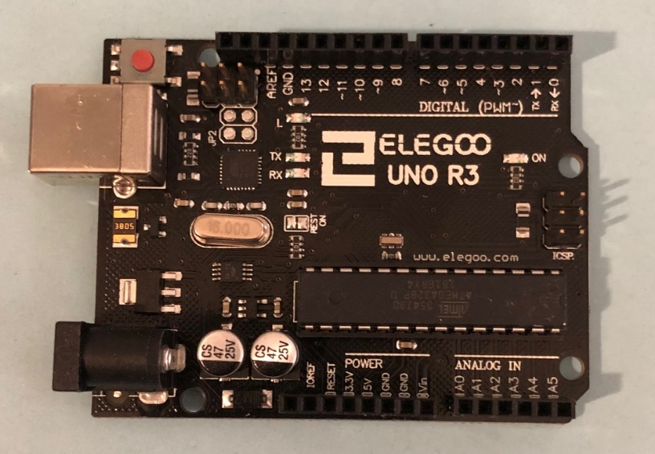
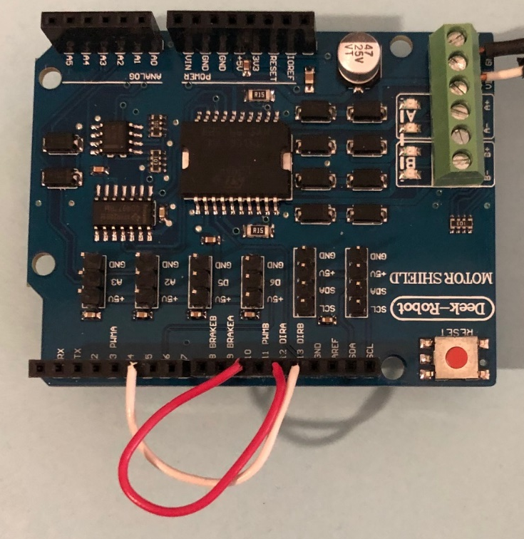
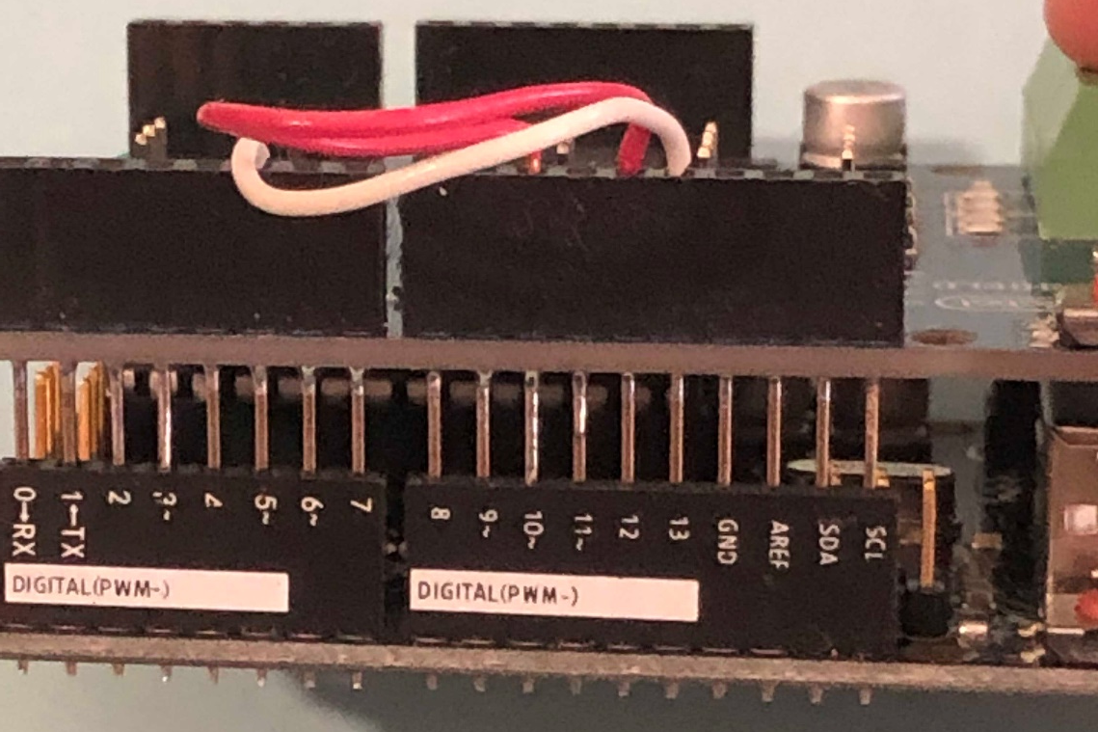
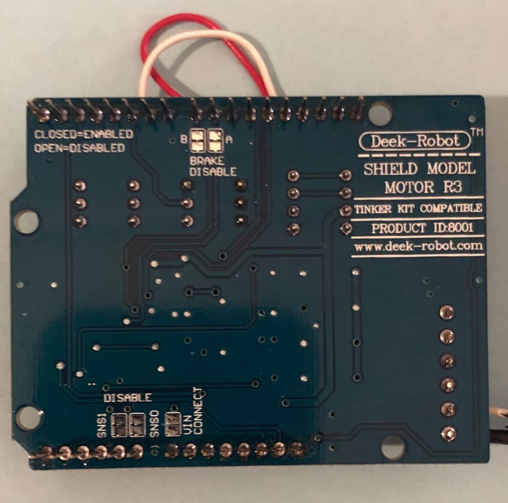
Do It Yourself DCC++
Starting the Build
Step 6: Connect the Power Shield to the Arduino

Slide 23
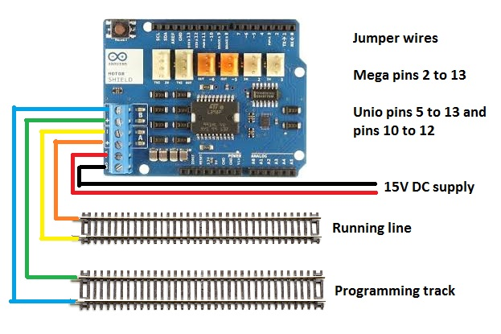
Do It Yourself DCC++
Starting the Build
Image from: http://www.motorhomesites.org.uk/dcc-arduino-with-jmri-raspberry-pi/

Slide 24
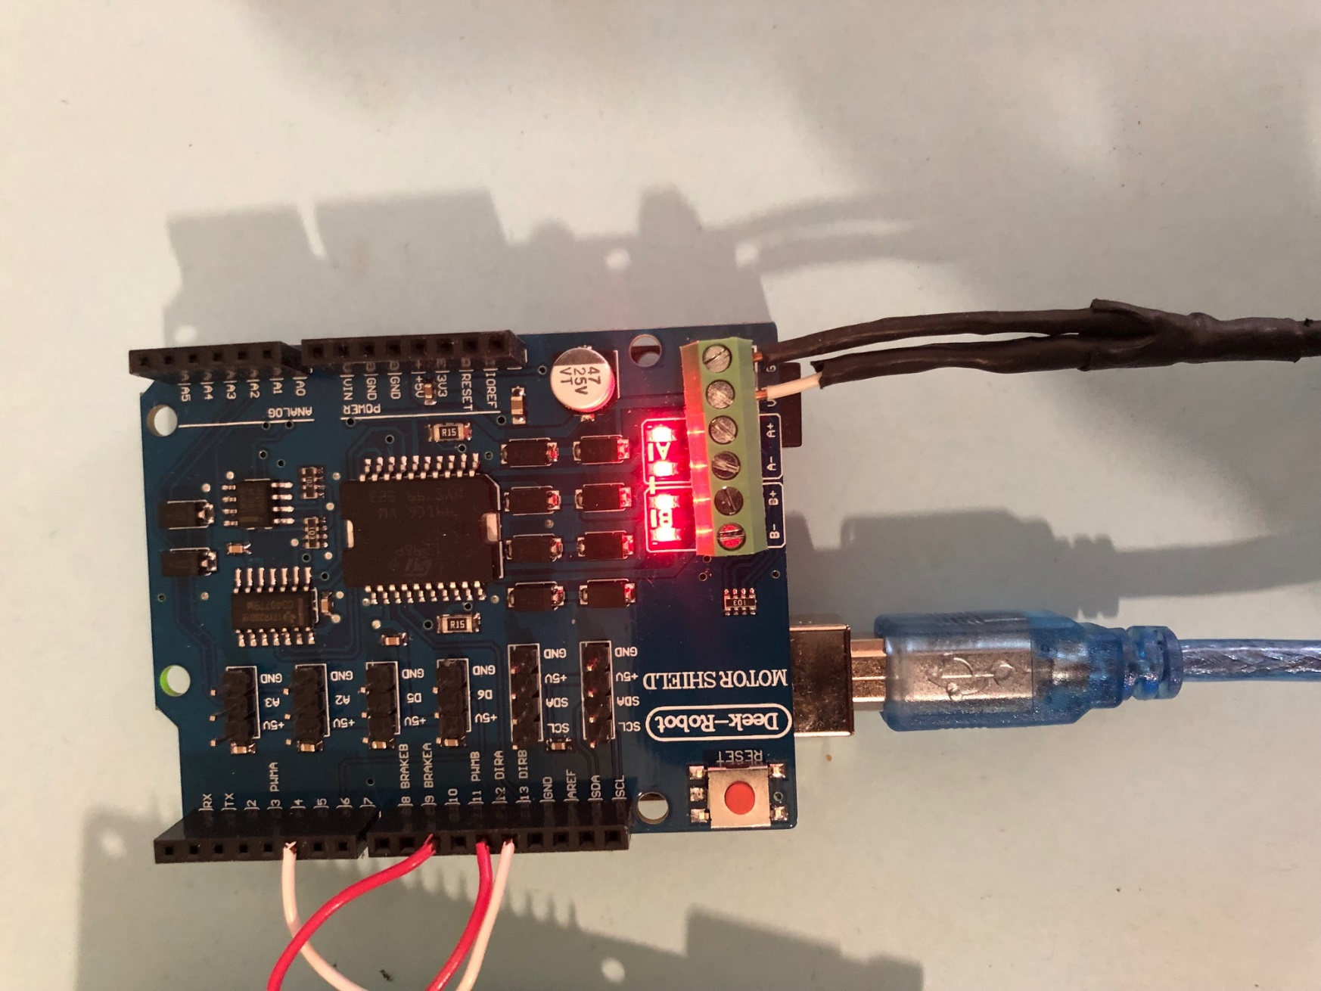
Do It Yourself DCC++
Starting the Build
There are two jumper that you will need to put in.
Jumper #1 Pin 10 and 12
This provides the DCC Logic to be transmitted to the Mail Track Power.
Jumper #2 Pin 5 and Pin 13
This provides the DCC Logic to be transmitted to the Programing track.
The Blue USB connector needs to go to either a Computer, Laptop or a Raspberry Pi Running JMRI.
Programing
Main

Slide 25
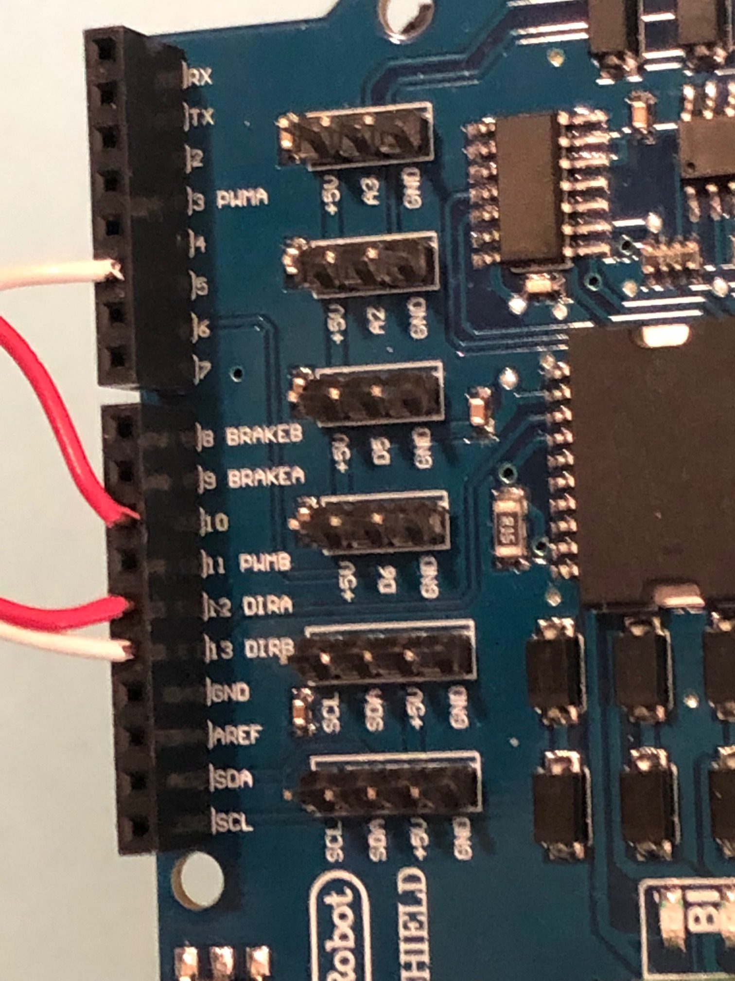
Do It Yourself DCC++
Starting the Build
There are two jumper that you will need to put in.
Jumper #1 Pin 10 and 12
This provides the DCC Logic to be transmitted to the Mail Track Power.
Jumper #2 Pin 5 and Pin 13
This provides the DCC Logic to be transmitted to the Programing track.
The Blue USB connector needs to go to either a Computer, Laptop or a Raspberry Pi Running JMRI.
Programing
Main

Slide 26
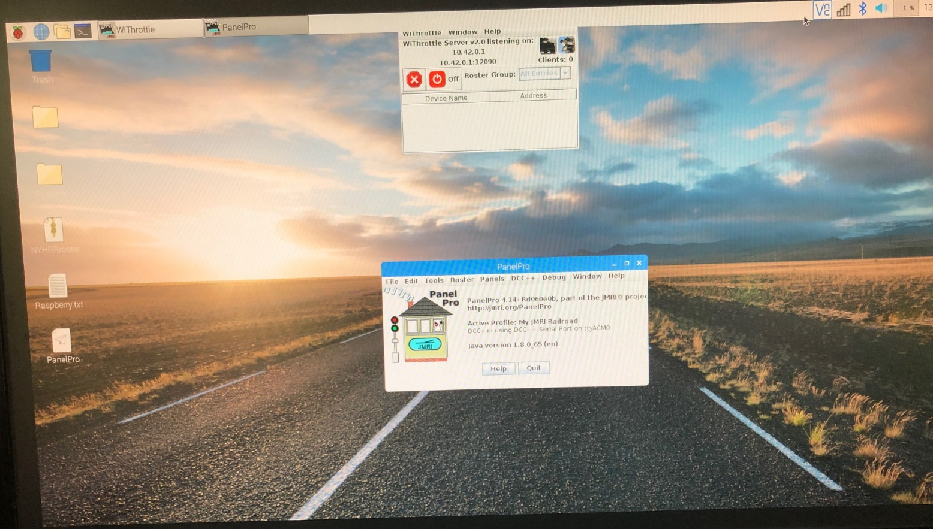
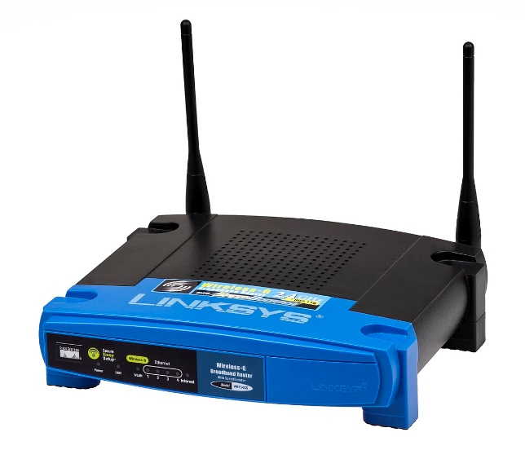
Do It Yourself DCC++
JMRI
There are a few paths you can take at this point.
You can use an existing Laptop or computer to connect to the DCC++ or you can program a Raspberry Pi to do the job. Here is what goes next.
With the Laptop or desktop you will need either a router or software to turn then computer in to a wireless access point. You will need to install JMRI and set it up to talk to the DCC++ over a USB cable.

Slide 27
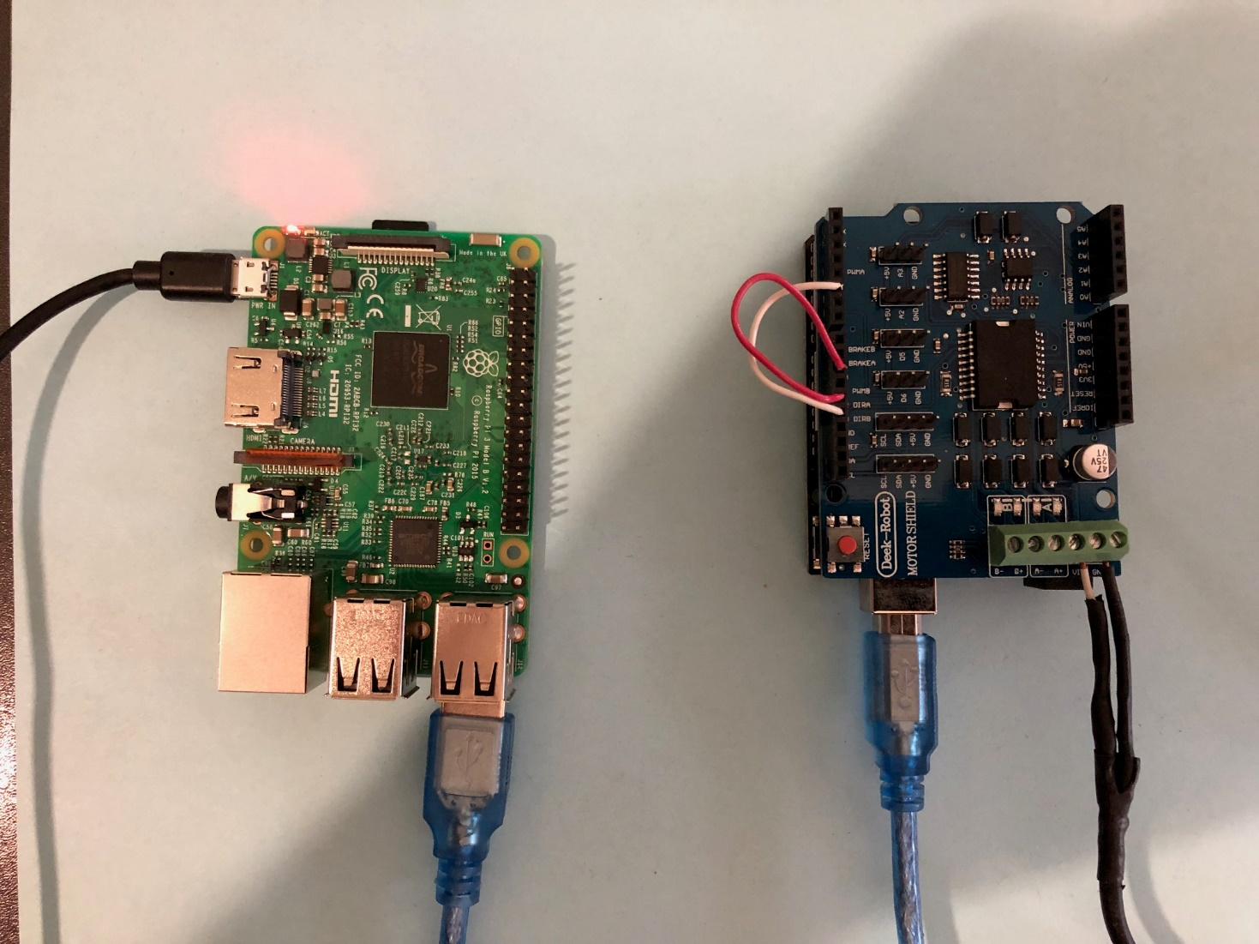
Do It Yourself DCC++
JMRI
There are a few paths you can take at this point.
With the Raspberry Pi there will be some configuring task and software that you will need to do.
For this task you will need an install image to setup the Raspberry Pi. Not to worry a complete solution is available at the JMRI website. You will need the image file and a software to configure the Micro SD card.
Windows based PC should use Windows 32 Disk Imager and Mac OS users will need to use ApplePi-Baker V2.
Both of these programs take the file and convert it to a bootable file that will program the Raspberry Pi!

Slide 28
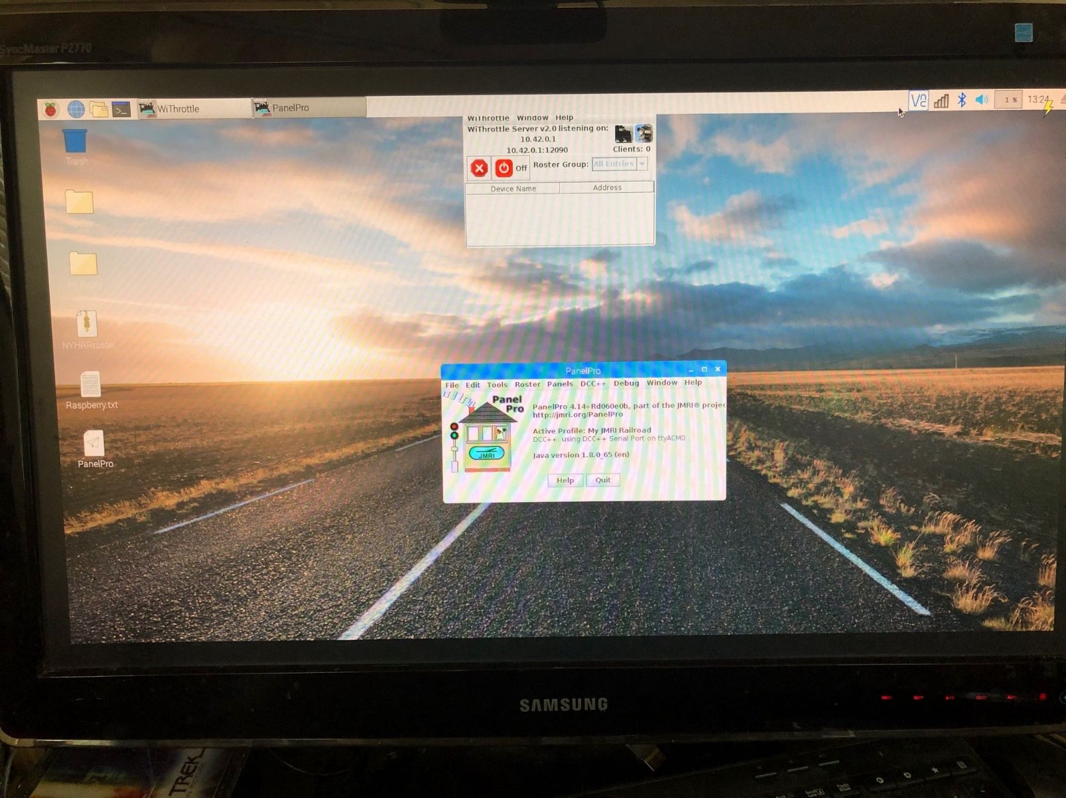
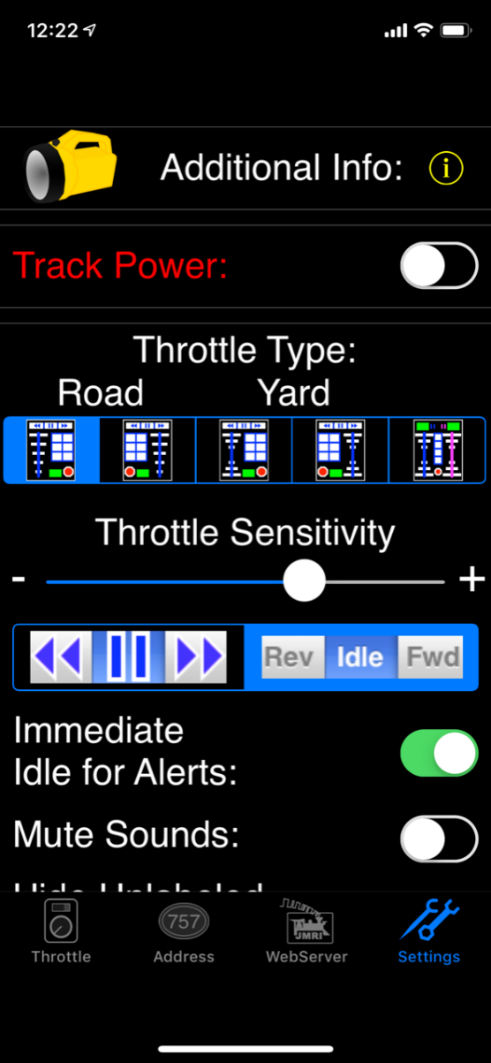
Do It Yourself DCC++
The Wi-Fi SSID: JMRI-LVRR
Password: LVRR1925
Ready For Testing

Slide 29
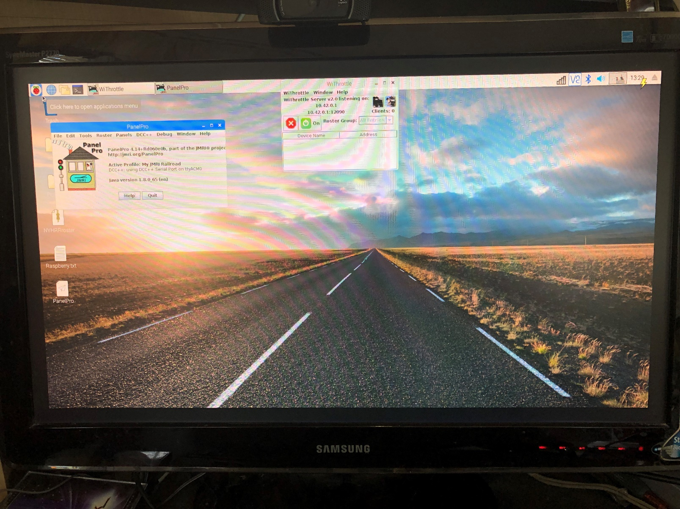
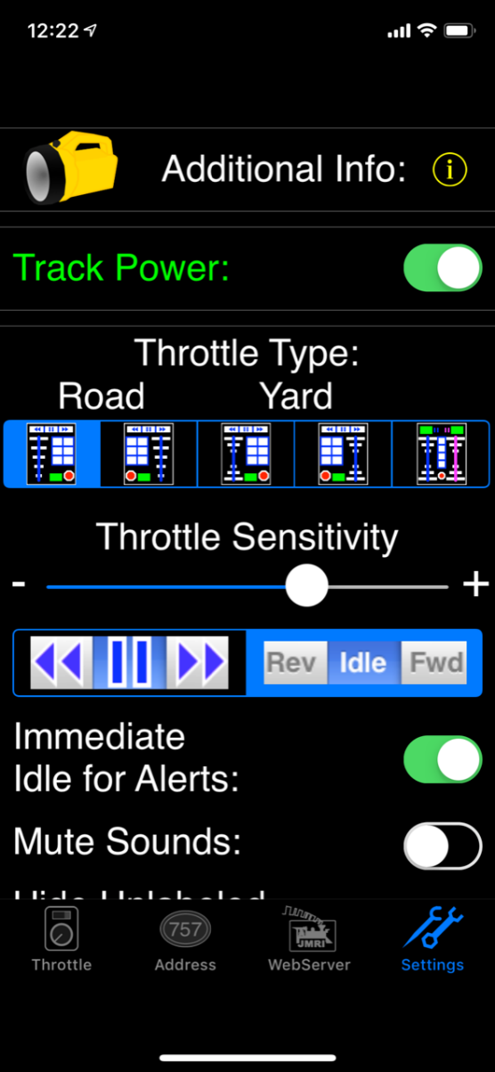
Do It Yourself DCC++
The Wi-Fi SSID: JMRI-LVRR
Password: LVRR1925
Ready For Testing

Slide 30
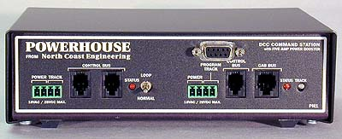
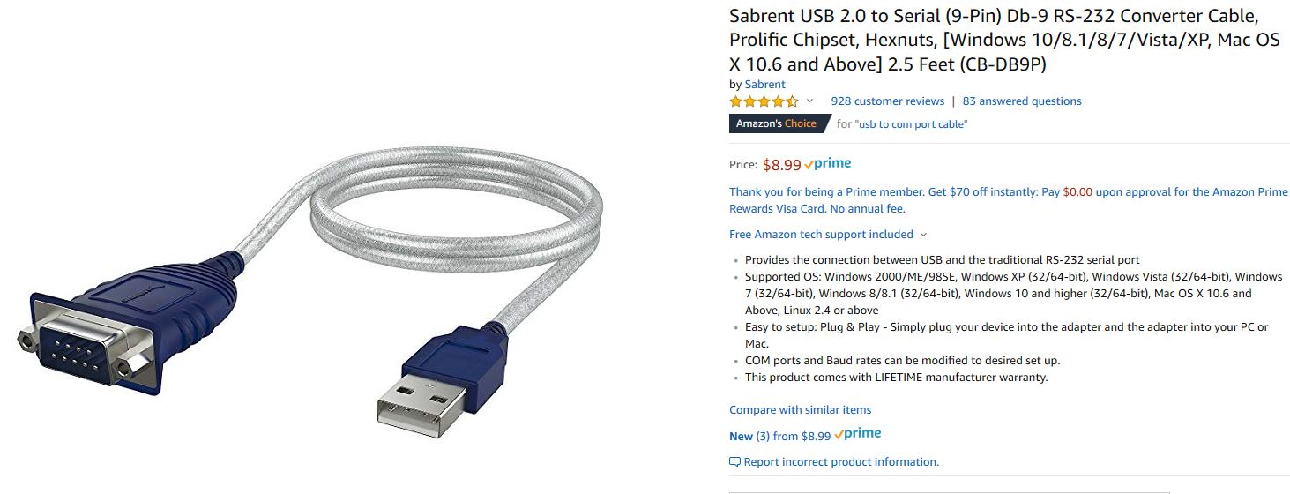
Do It Yourself DCC++
What If?
If you have a DCC system like an NCE system already you can use the Raspberry Pi to add Wi-Fi throttles to your layout.
You will need a USB to Com Port male cable.

Slide 31
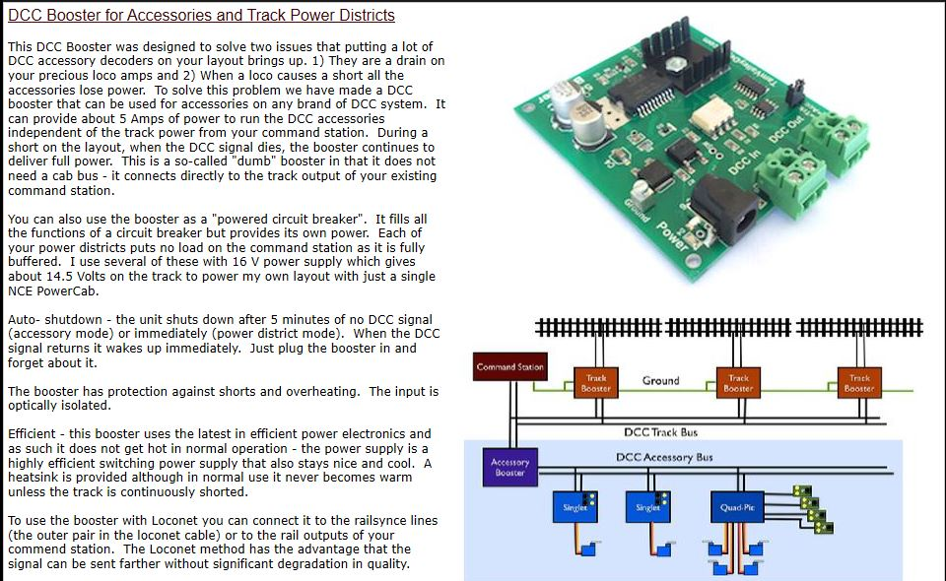
Do It Yourself DCC++
Additional Boosters?
Tam Valley Depot makes and excellent Stand alone DCC booster system that will let you expand the scope of your railroad.
Booster Cost: $54.95
Power Supply: $16.95

Slide 32
Do It Yourself DCC++
Questions?

Slide 33
Do It Yourself DCC++
Go out and build one!

