Slide 1
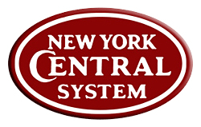
Researching, modeling
and operating the
New York Central Railroad's
High Line In HO Scale
Photo’s From
Friend of the High Line
Mike MacDonald’s Photo Bucket Site
Presented By: David Ramos
May 17, 2014

Slide 2
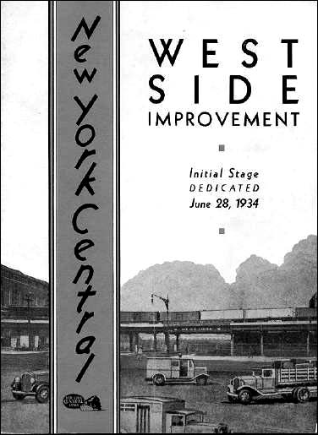
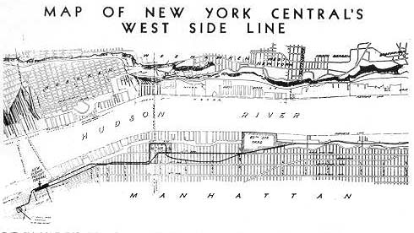
Researching, modeling and operating the New York Central Railroad’s High Line In HO Scale
What is the High Line?
The “High Line” is the elevated portion of the 30th Street Branch of the New York Central Railroad in New York City. The Elevated portion of the 30th Street Branch or High Line begins its run at 33rd Street and heads south to St’ Johns Park Terminal. This was built as a grade elimination project as part of the West Side Improvement Project.

Slide 3
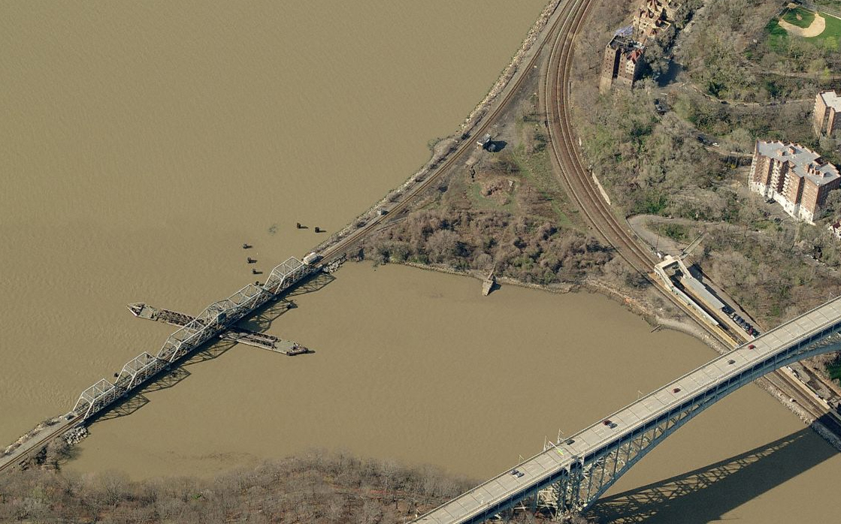
Researching, modeling and operating the New York Central Railroad’s High Line In HO Scale
The Beginning of the 30th Street Branch
Spuyten Duyvil pivot bridge. The beginning of the New York Central’s 30th Street Branch (2010 Photo Bing Maps)
The New York Central employed a “Wye” at this location.
First tracks built in September 29, 1849
Johnson’s Ironworks 1853- 1924

Slide 4
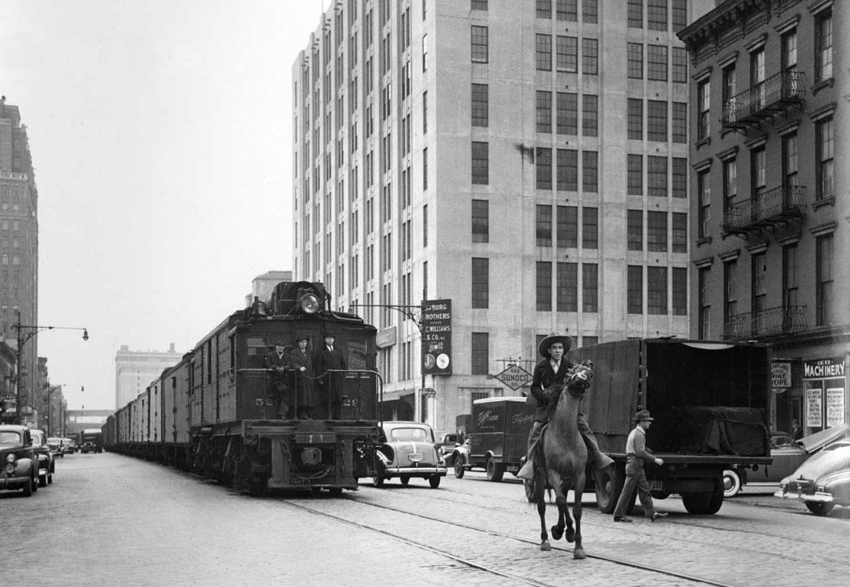
Researching, modeling and operating the New York Central Railroad’s High Line In HO Scale
What was before the High Line?
Before the West Side Improvement Project the New York Central ran at street level through Manhattan from 72st Yard to the original St. John’s Park Terminal.

Slide 5
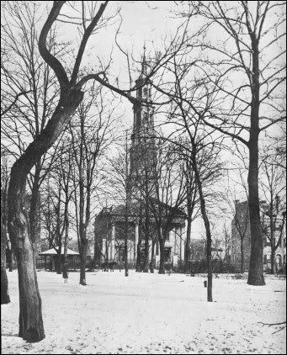
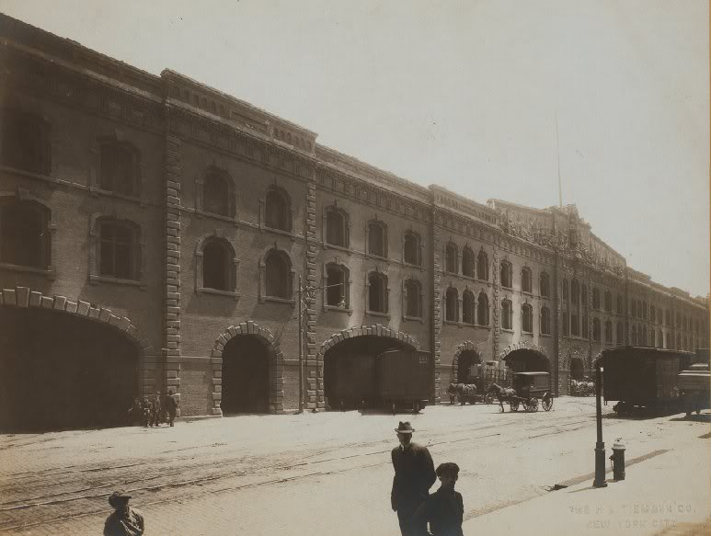
Researching, modeling and operating the New York Central Railroad’s High Line In HO Scale
St John's Park Freight Terminal Late 1800’s
As the city grew, the expanding warehouse district began to encroach on the neighborhood, and its seclusion was shattered in 1851 when the Hudson River Railroad ran tracks along Hudson St. Rich homeowners moved elsewhere, and St John’s Chapel went into financial difficulty. In 1866, Trinity parish sold the park to Commodore Cornelius Vanderbilt for $400,000, who built a freight terminal on the site for the Hudson River Railroad.

Slide 6
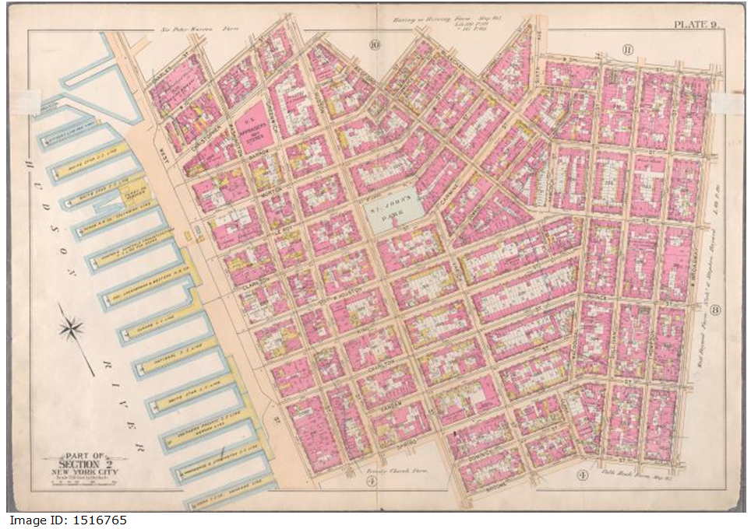
Researching, modeling and operating the New York Central Railroad’s High Line In HO Scale
George W. and Walter S. Bromley Insurance Map 1897 NYPL Digital Collection

Slide 7
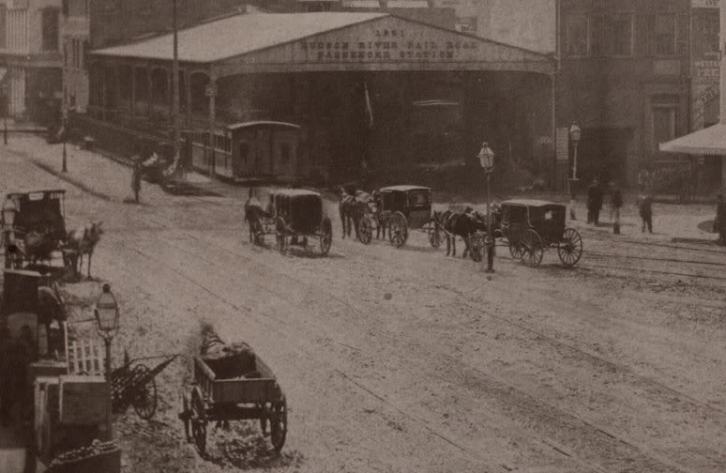
Researching, modeling and operating the New York Central Railroad’s High Line In HO Scale
Hudson River Railroad Passenger Station at Chambers Street Built 1851

Slide 8
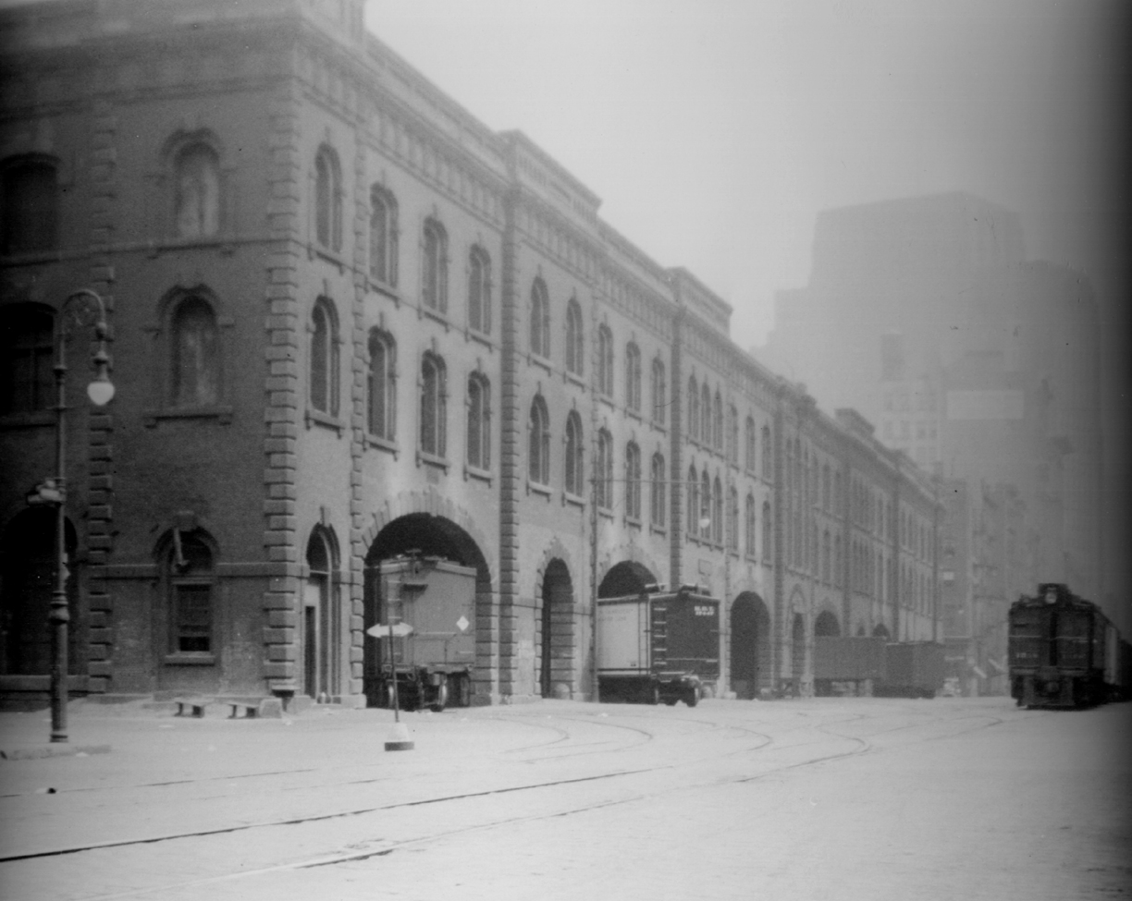
Researching, modeling and operating the New York Central Railroad’s High Line In HO Scale
Original St John's Park Freight Terminal - 1920’s
NYC
DES-3

Slide 9
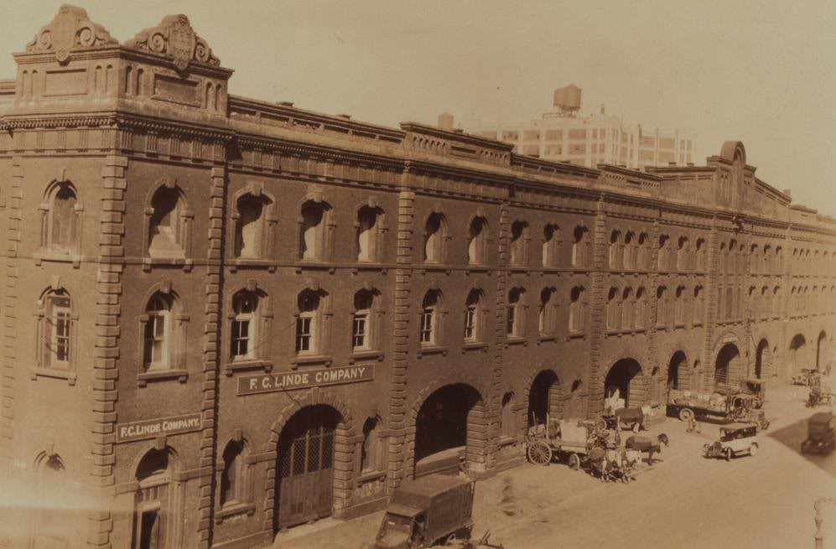
Researching, modeling and operating the New York Central Railroad’s High Line In HO Scale
Original St John's Park Freight Terminal

Slide 10
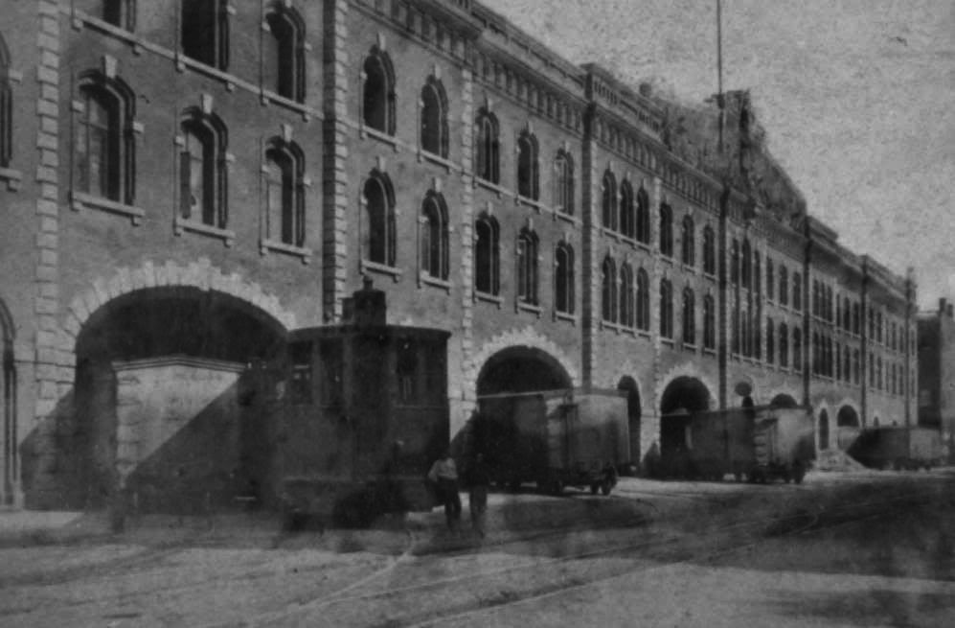
Researching, modeling and operating the New York Central Railroad’s High Line In HO Scale
Original St John's Park Freight Terminal

Slide 11
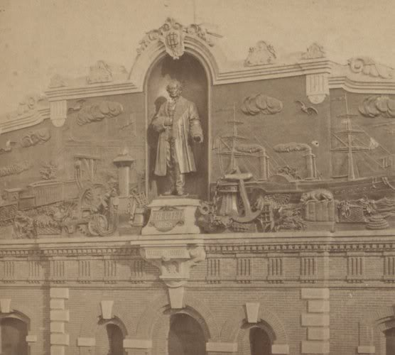
Researching, modeling and operating the New York Central Railroad’s High Line In HO Scale
Original St John's Park Freight Terminal
Here is a photo of the decorative relief along the top of St. John’s Park. That is a statue of Commodore Cornelius Vanderbilt surrounded by symbols of his empire. At his feet is a plaque the reads “Erected 1868”

Slide 12
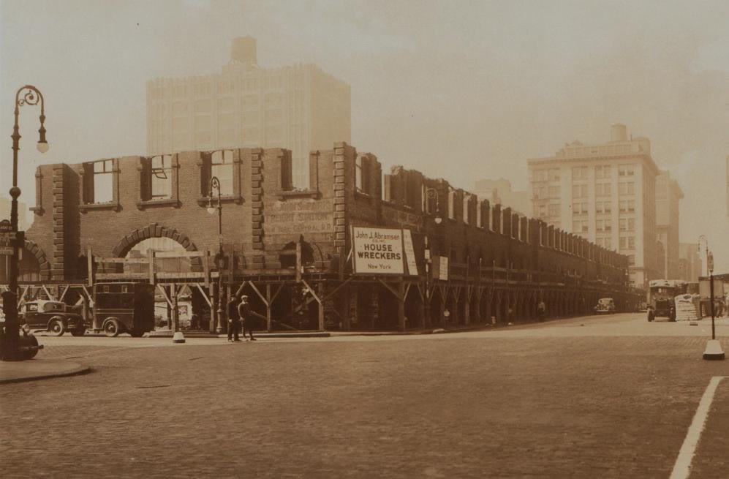
Researching, modeling and operating the New York Central Railroad’s High Line In HO Scale
Original St John's Park Freight Terminal Demolition

Slide 13
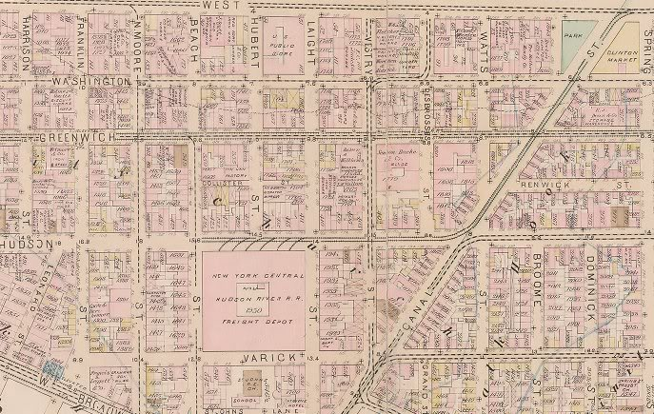
Researching, modeling and operating the New York Central Railroad’s High Line In HO Scale
Before the High Line.

Slide 14
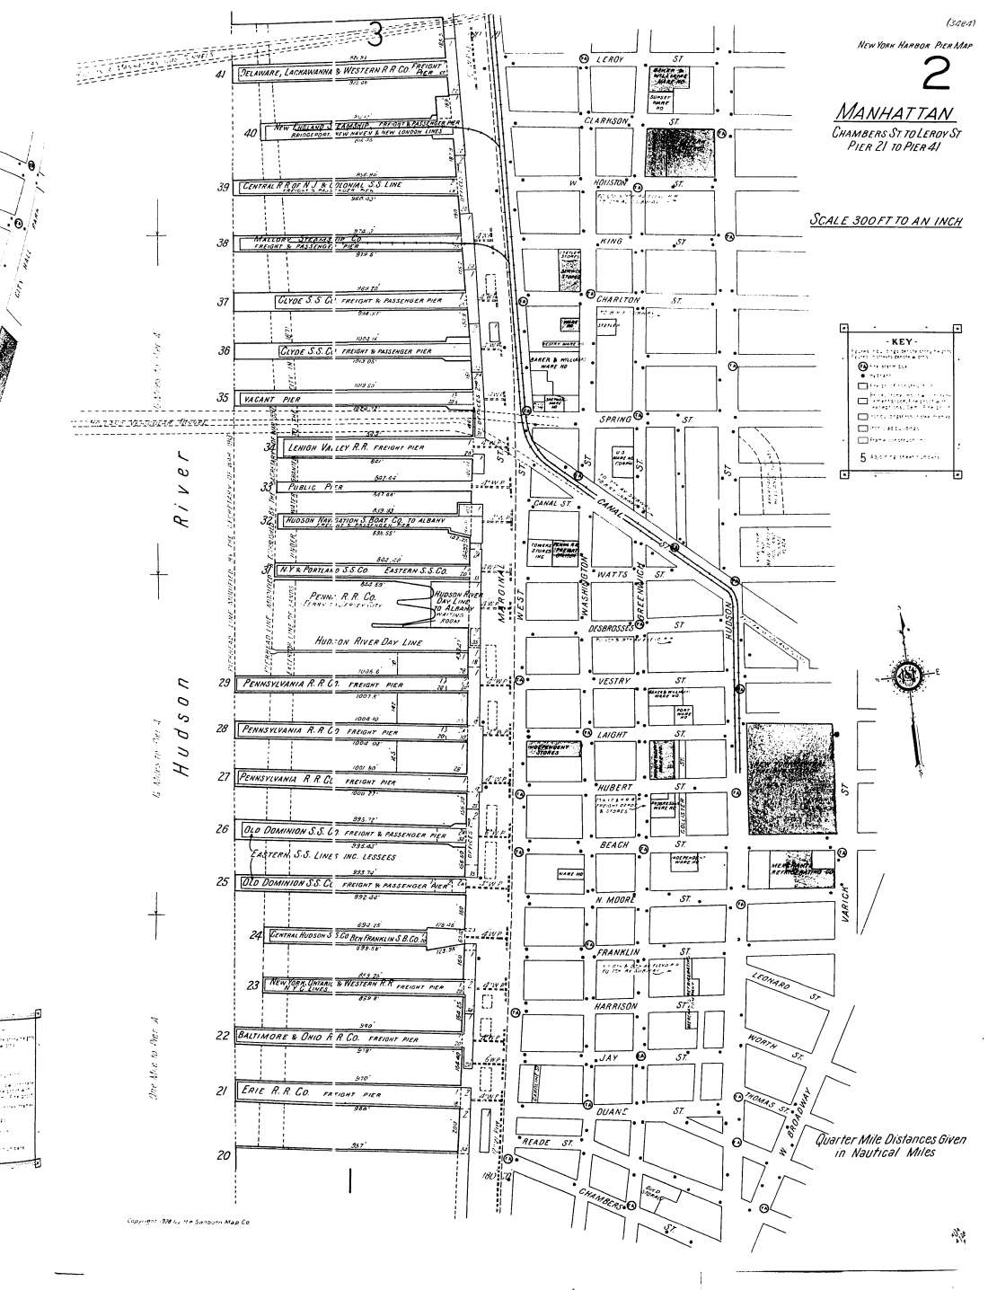
Researching, modeling and operating the New York Central Railroad’s High Line In HO Scale
Before the High Line.
New St. John’s Park Freight Terminal
Sanborn Maps Showing the pre High Line Route of the New York Central.
Original St. John’s Park Freight Terminal

Slide 15
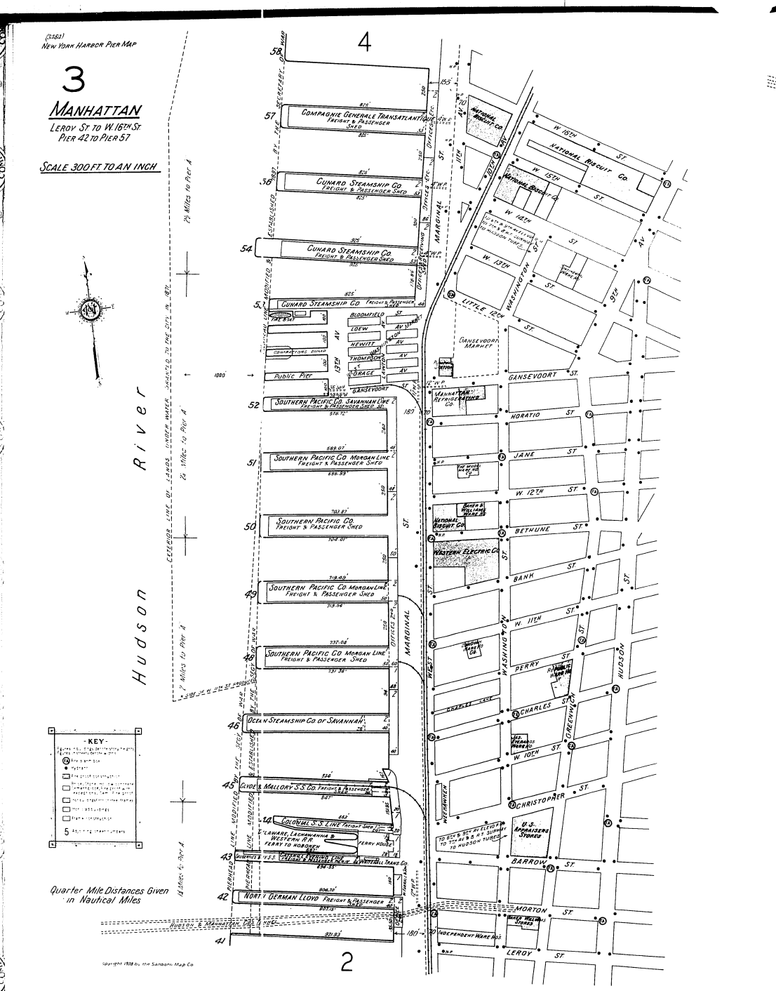
Researching, modeling and operating the New York Central Railroad’s High Line In HO Scale
Before the High Line.
Sanborn Maps Showing the pre High Line Route of the New York Central.
In this map there is no tracks turning eastward into NABISCO.

Slide 16
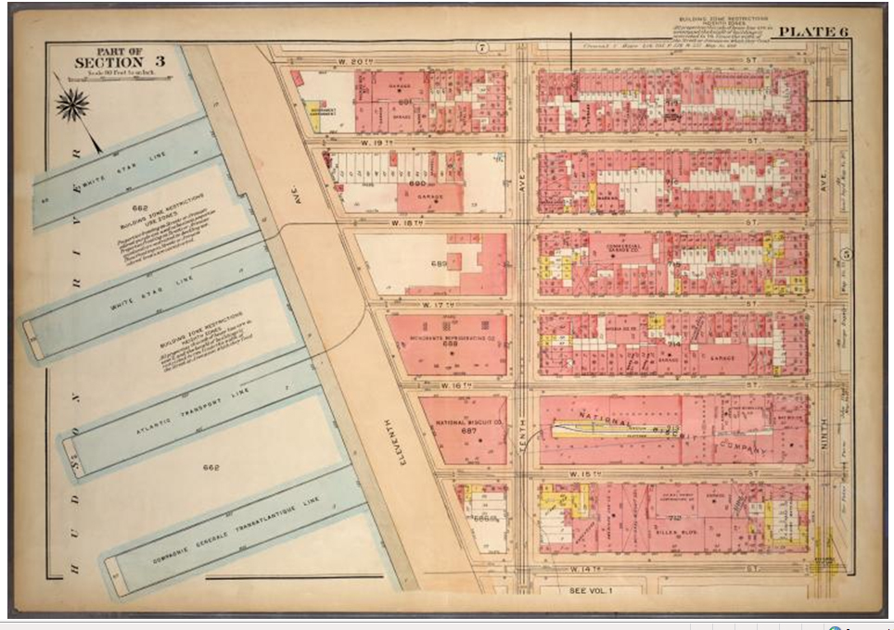
Researching, modeling and operating the New York Central Railroad’s High Line In HO Scale
Before the High Line.
Note the tracks turning into NABISCO.
George W. and Walter S. Bromley Insurance Map 1920-22 NYPL Digital Collection

Slide 17
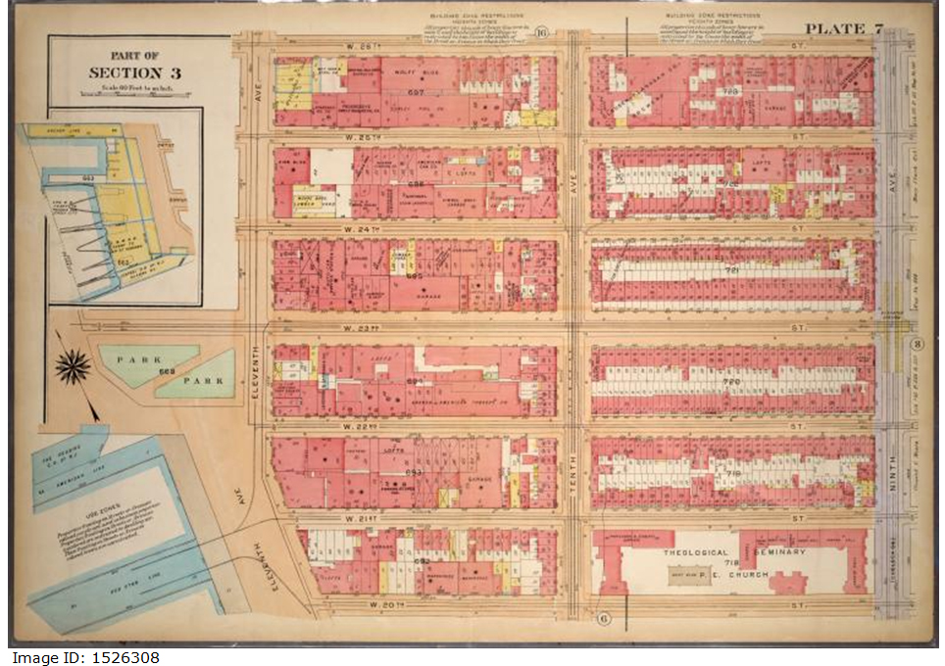
Researching, modeling and operating the New York Central Railroad’s High Line In HO Scale
Before the High Line.
George W. and Walter S. Bromley Insurance Map 1920-22 NYPL Digital Collection

Slide 18
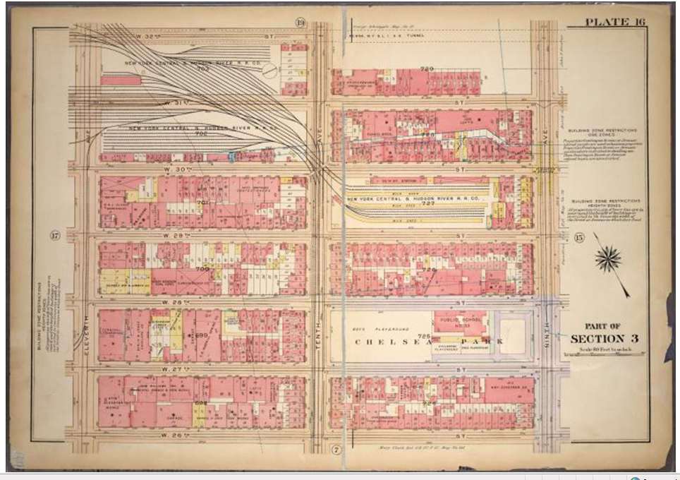
Researching, modeling and operating the New York Central Railroad’s High Line In HO Scale
Before the High Line.
Milk Shed
George W. and Walter S. Bromley Insurance Map 1920-22 NYPL Digital Collection

Slide 19
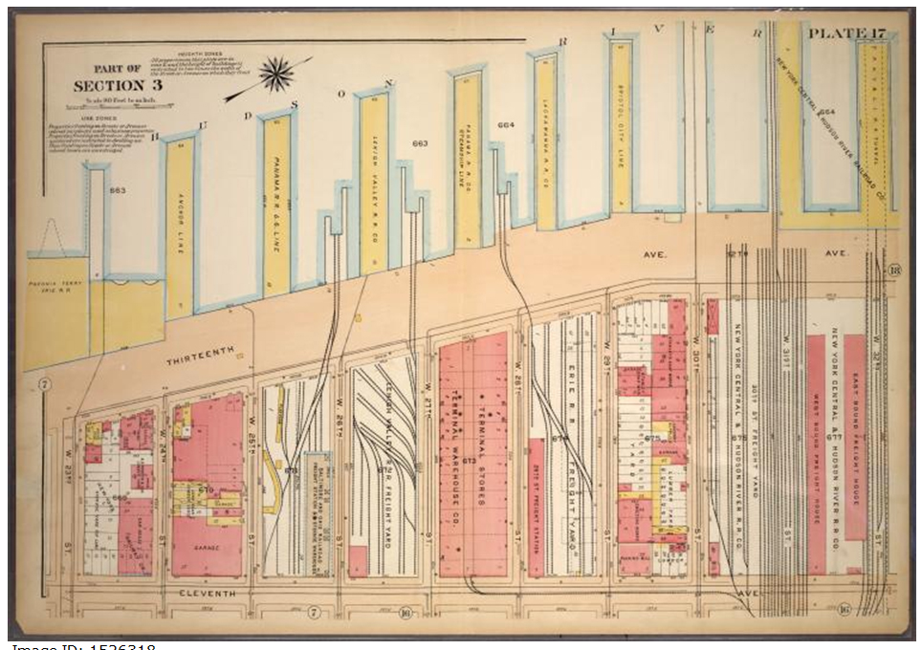
Researching, modeling and operating the New York Central Railroad’s High Line In HO Scale
Before the High Line.
George W. and Walter S. Bromley Insurance Map 1920-22 NYPL Digital Collection

Slide 20
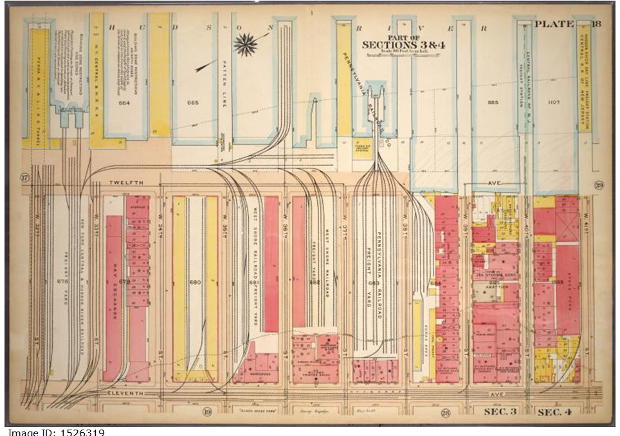
Researching, modeling and operating the New York Central Railroad’s High Line In HO Scale
Before the High Line.
George W. and Walter S. Bromley Insurance Map 1920-22 NYPL Digital Collection

Slide 21
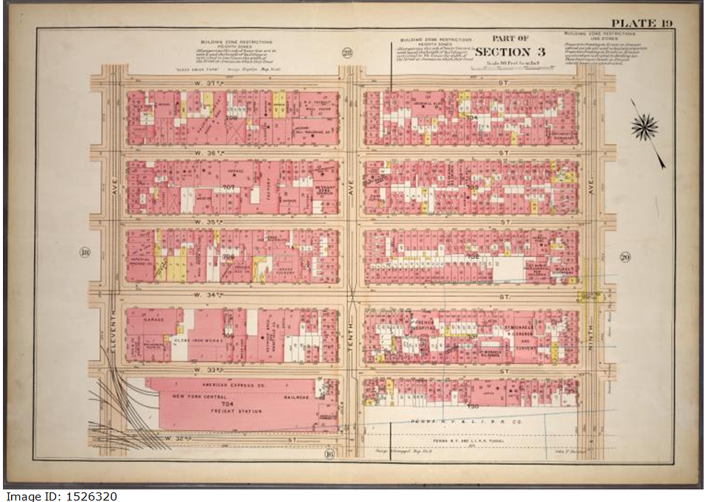
Researching, modeling and operating the New York Central Railroad’s High Line In HO Scale
Before the High Line.
George W. and Walter S. Bromley Insurance Map 1920-22 NYPL Digital Collection

Slide 22
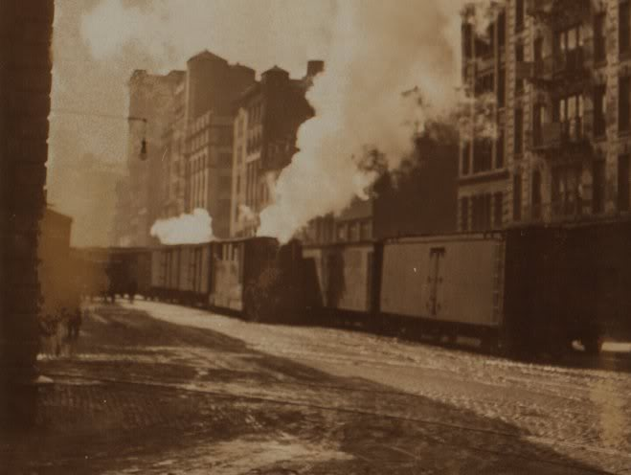
Researching, modeling and operating the New York Central Railroad’s High Line In HO Scale
Before the High Line.
St. John’s Park
Leaving St. John’s Park

Slide 23
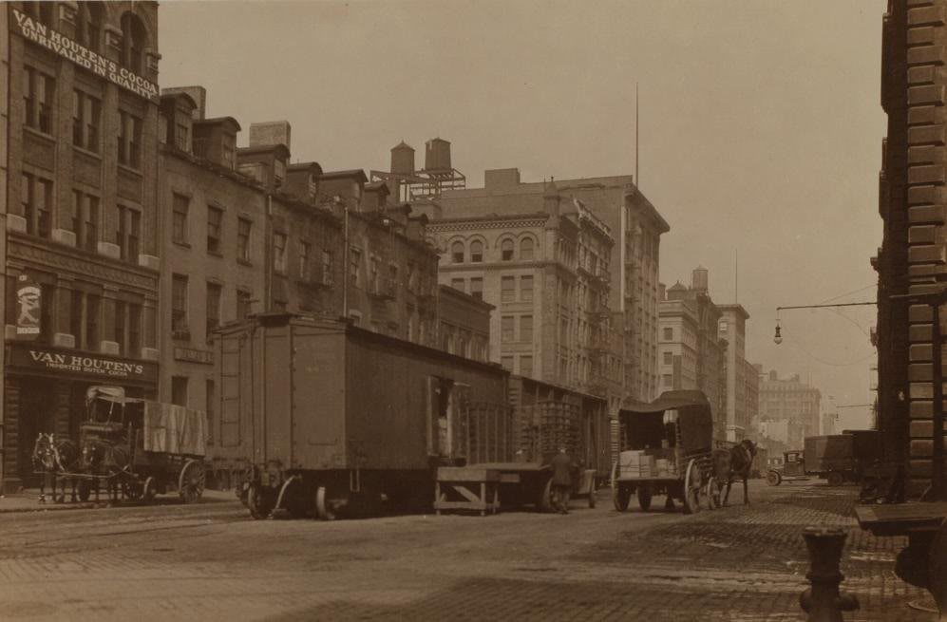
Researching, modeling and operating the New York Central Railroad’s High Line In HO Scale
Before the High Line.
St. John’s Park Freight Terminal
Hudson Street

Slide 24
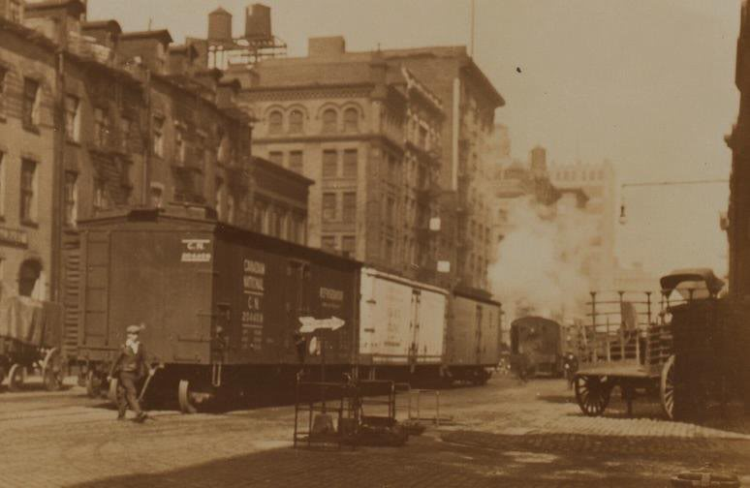
Researching, modeling and operating the New York Central Railroad’s High Line In HO Scale
Before the High Line.
St. John’s Park Freight Terminal
Hudson Street

Slide 25
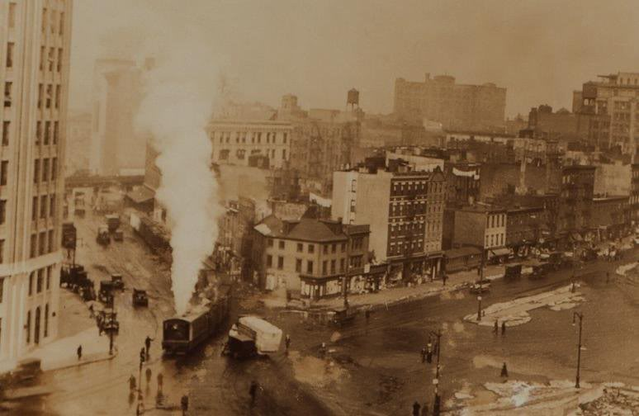
Researching, modeling and operating the New York Central Railroad’s High Line In HO Scale
Before the High Line.
Making the turn off of Canal St.

Slide 26
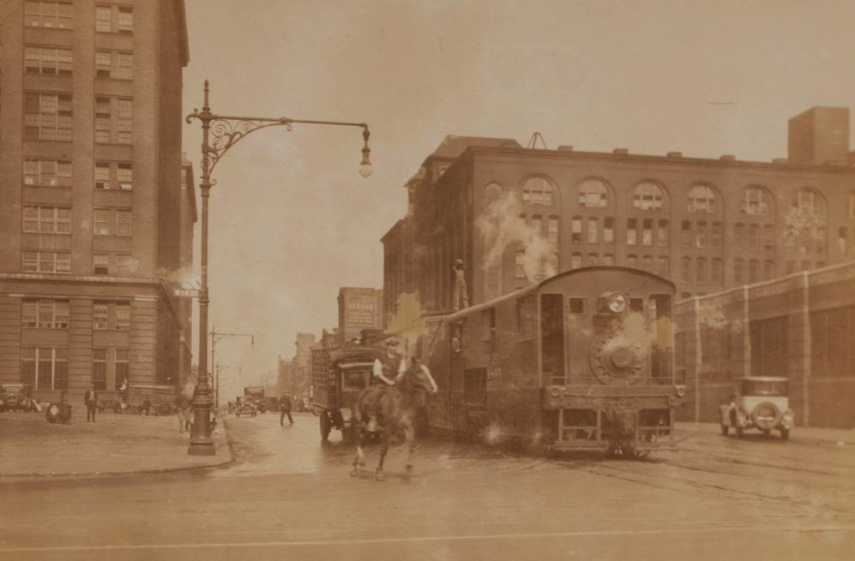
Researching, modeling and operating the New York Central Railroad’s High Line In HO Scale
Before the High Line.
Brakeman
NYCRR Cowboy
Steam Dummy at 14th Street and 10th Ave

Slide 27
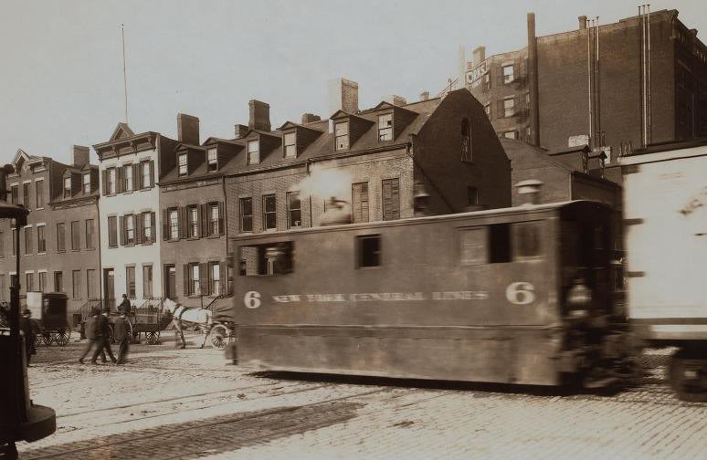
Researching, modeling and operating the New York Central Railroad’s High Line In HO Scale
Before the High Line.

Slide 28
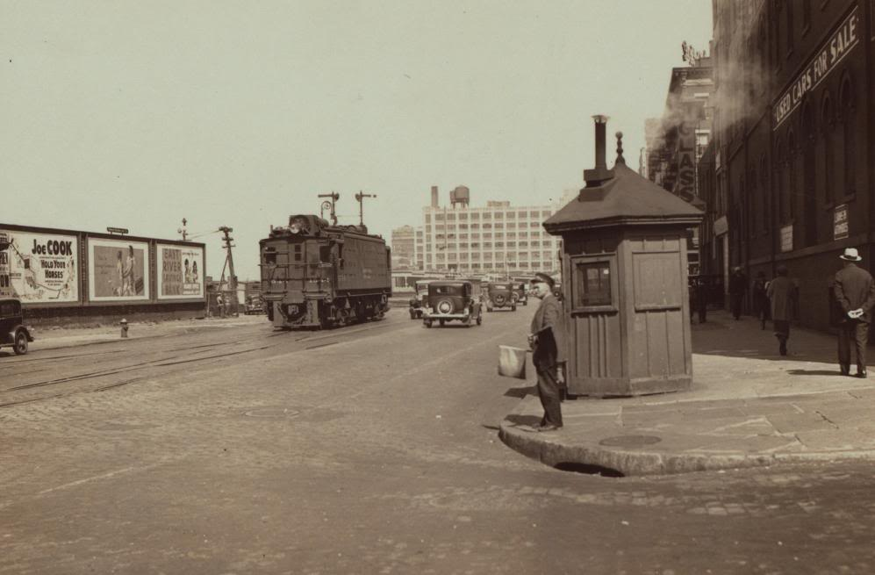
Researching, modeling and operating the New York Central Railroad’s High Line In HO Scale
Before the High Line.

Slide 29
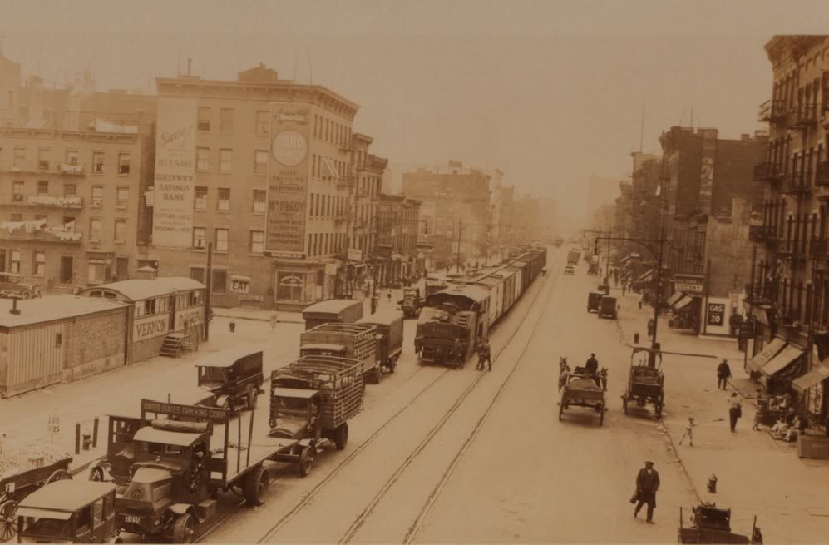
Researching, modeling and operating the New York Central Railroad’s High Line In HO Scale
Before the High Line.

Slide 30
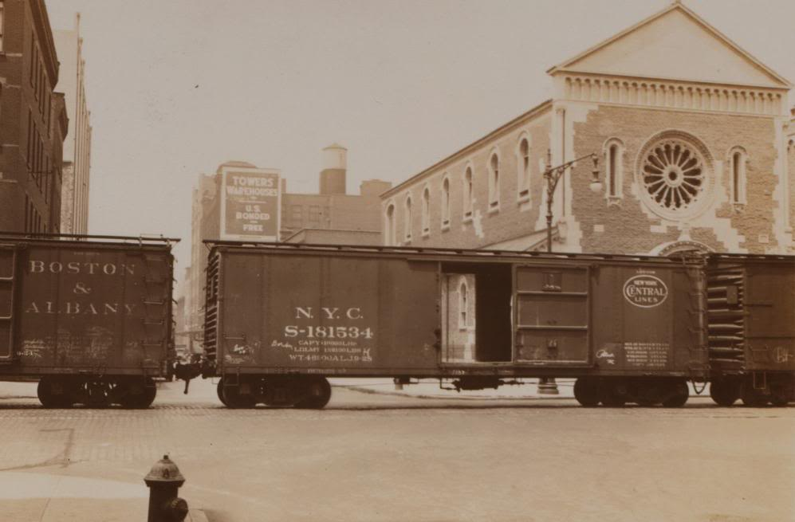
Researching, modeling and operating the New York Central Railroad’s High Line In HO Scale
Before the High Line.
19th Street and 10th Avenue

Slide 31
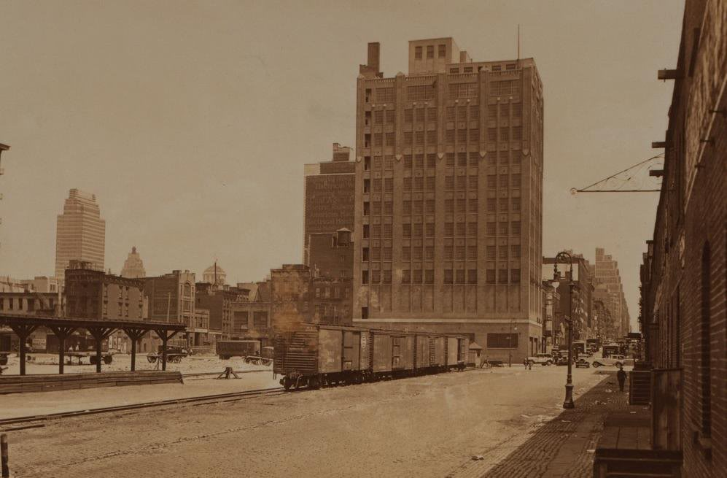
Researching, modeling and operating the New York Central Railroad’s High Line In HO Scale
Before the High Line.
23rd Street

Slide 32
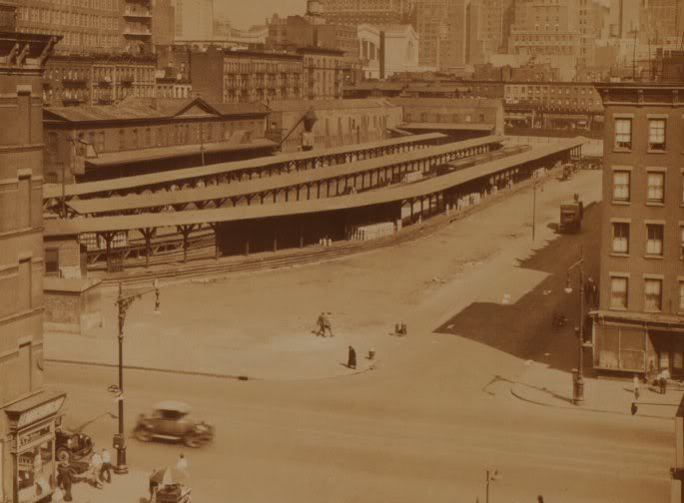
Researching, modeling and operating the New York Central Railroad’s High Line In HO Scale
Before the High Line.
Milk Shed
Milk Cans
29th Street
10th Avenue

Slide 33
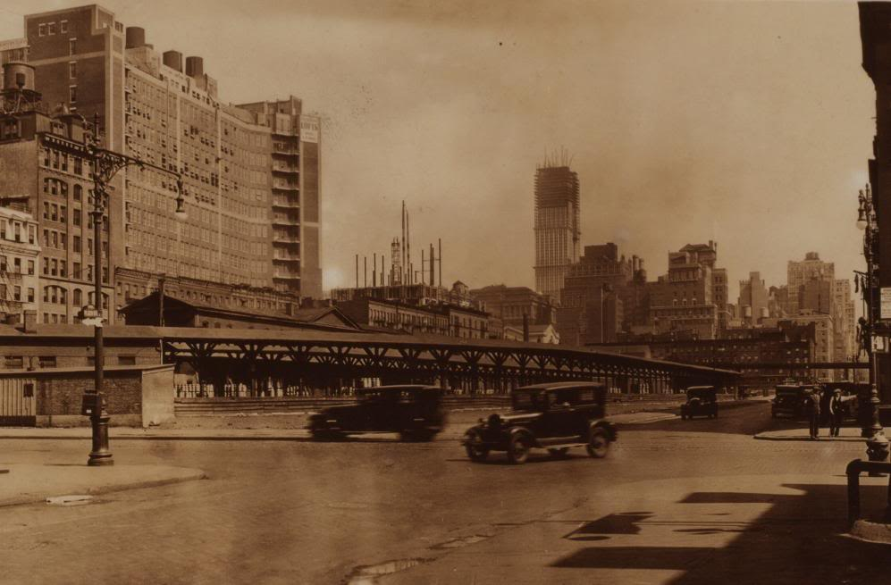
Researching, modeling and operating the New York Central Railroad’s High Line In HO Scale
Before the High Line.
1930
The Empire State building started construction in 1930 and was opened May 1st, 1931.

Slide 34
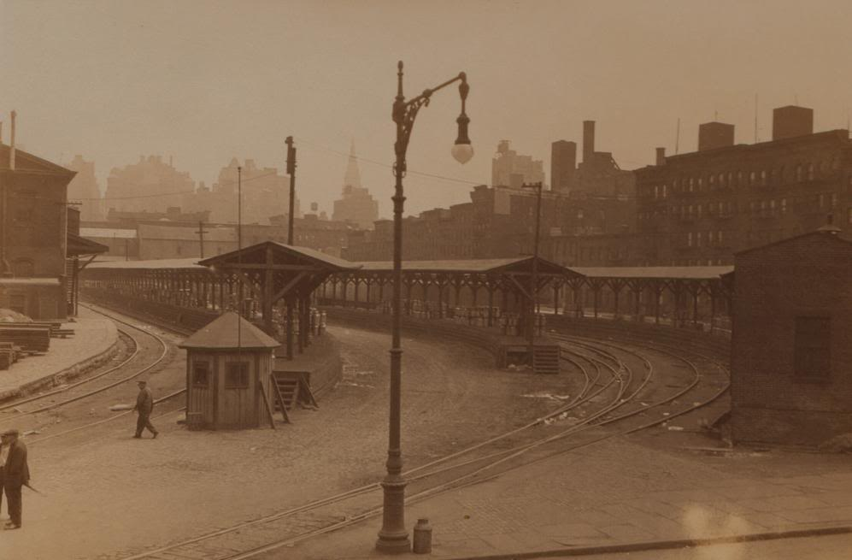
Researching, modeling and operating the New York Central Railroad’s High Line In HO Scale
Before the High Line.

Slide 35
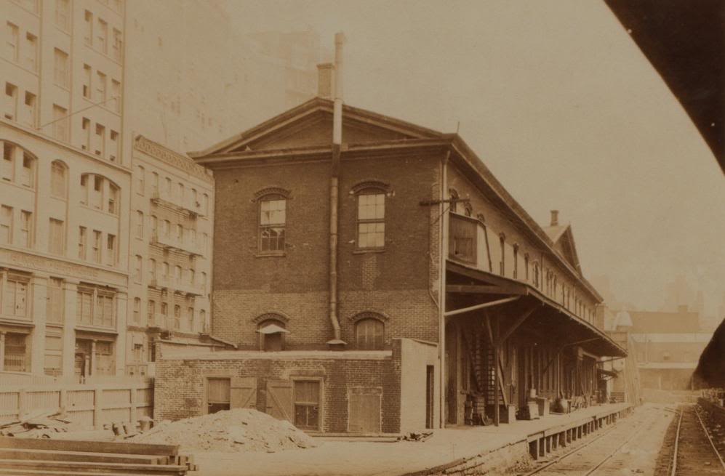
Researching, modeling and operating the New York Central Railroad’s High Line In HO Scale
Before the High Line.

Slide 36
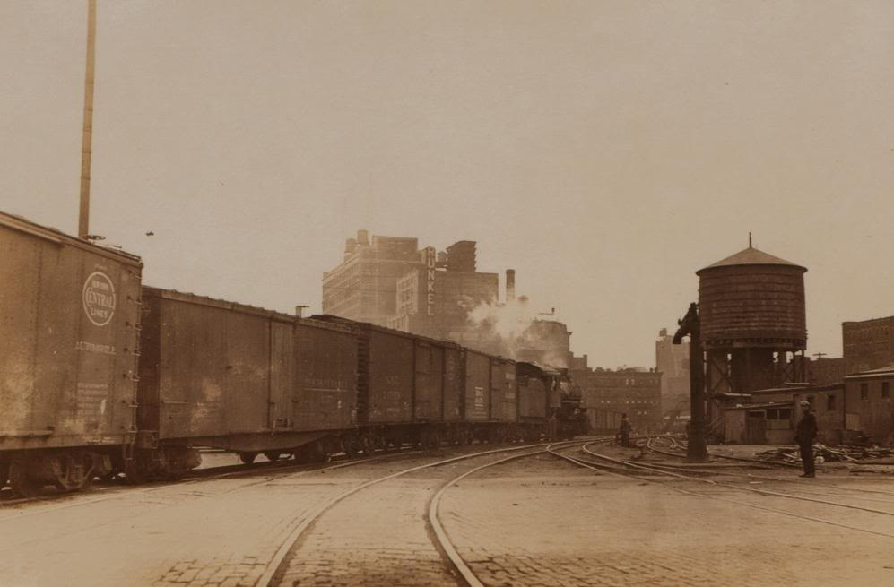
Researching, modeling and operating the New York Central Railroad’s High Line In HO Scale
Before the High Line.
Turning East off of 11th Ave

Slide 37
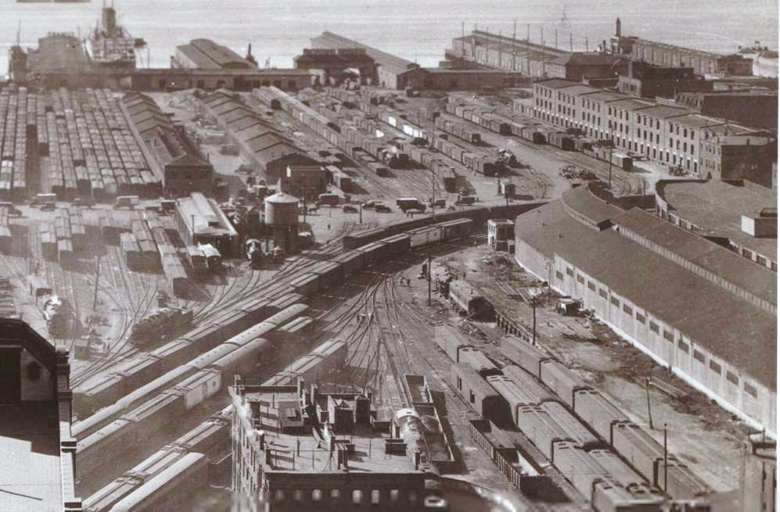
Researching, modeling and operating the New York Central Railroad’s High Line In HO Scale
9 steam engines!
Before the High Line.
Steam power
Turntable

Slide 38
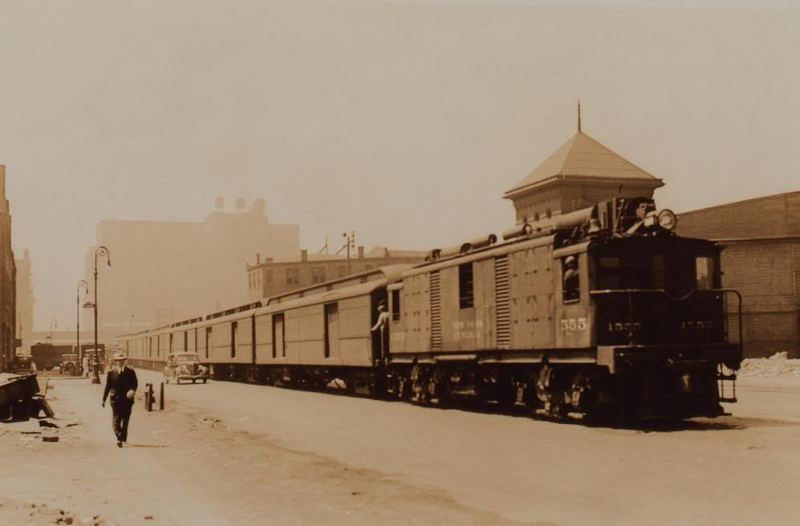
Researching, modeling and operating the New York Central Railroad’s High Line In HO Scale
Before the High Line.
Mail Train

Slide 39
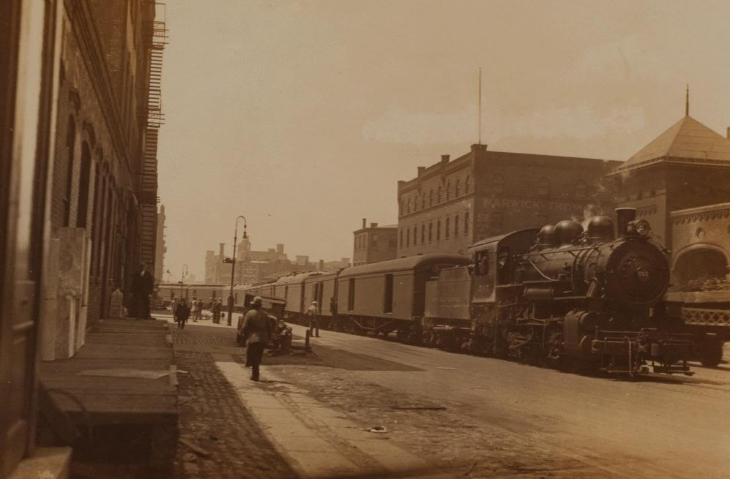
Researching, modeling and operating the New York Central Railroad’s High Line In HO Scale
Before the High Line.
35th Street

Slide 40
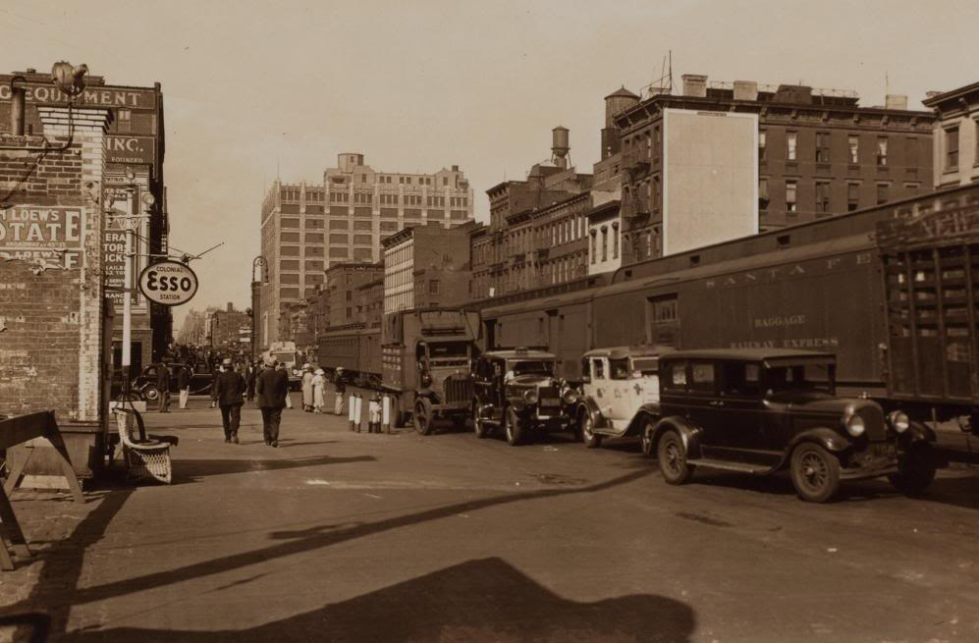
Researching, modeling and operating the New York Central Railroad’s High Line In HO Scale
Before the High Line.
11th Ave and 42nd Street

Slide 41
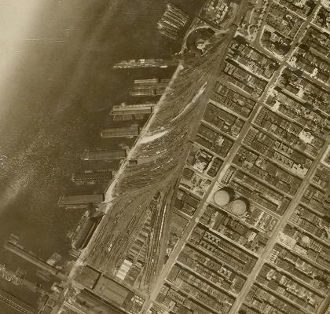
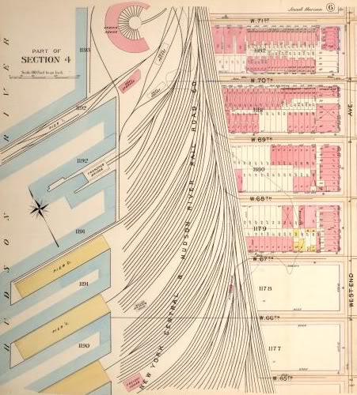
Researching, modeling and operating the New York Central Railroad’s High Line In HO Scale
Before the High Line.
72nd Street Yard

Slide 42
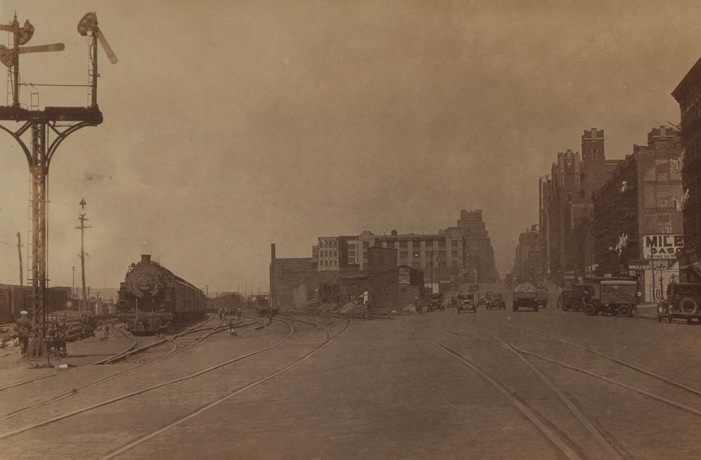
Researching, modeling and operating the New York Central Railroad’s High Line In HO Scale
Before the High Line.
72nd Street Yard at 60th Street

Slide 43
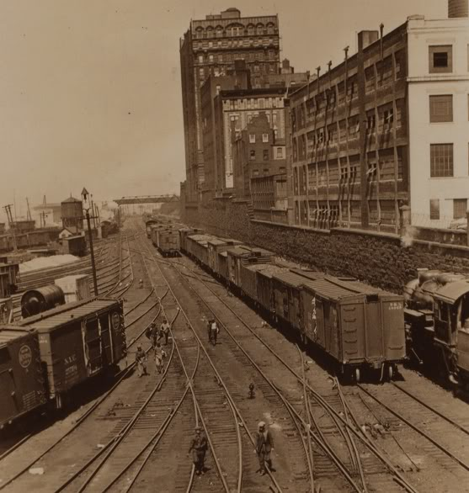
Researching, modeling and operating the New York Central Railroad’s High Line In HO Scale
Before the High Line.
Hopper on a fueling Trestle for the steam locomotives

Slide 44
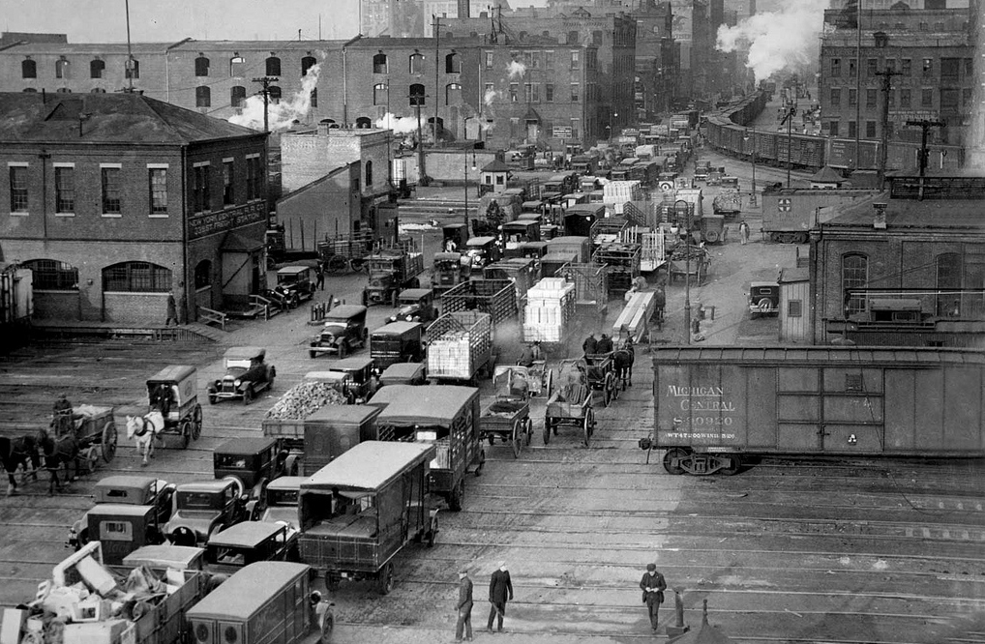
Researching, modeling and operating the New York Central Railroad’s High Line In HO Scale
Why Build the High Line?
31st Street and 11th Avenue

Slide 45
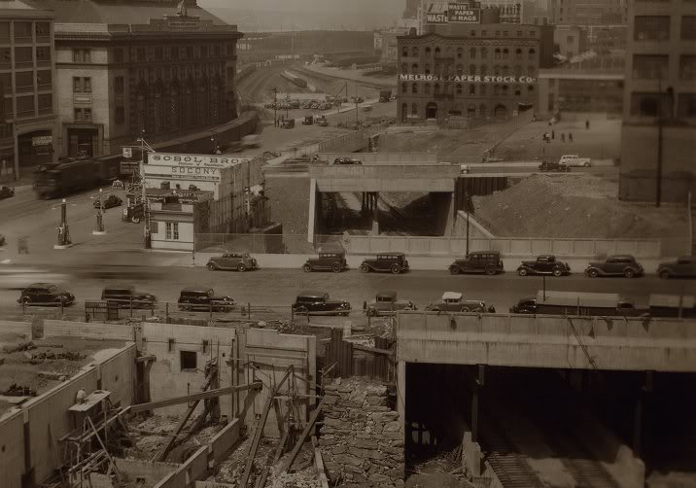
Researching, modeling and operating the New York Central Railroad’s High Line In HO Scale
Building the High Line.

Slide 46
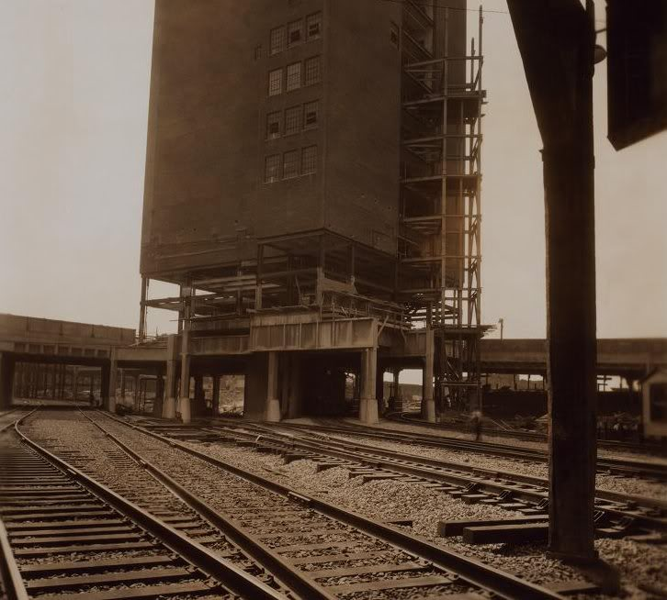
Researching, modeling and operating the New York Central Railroad’s High Line In HO Scale
Building the High Line.

Slide 47
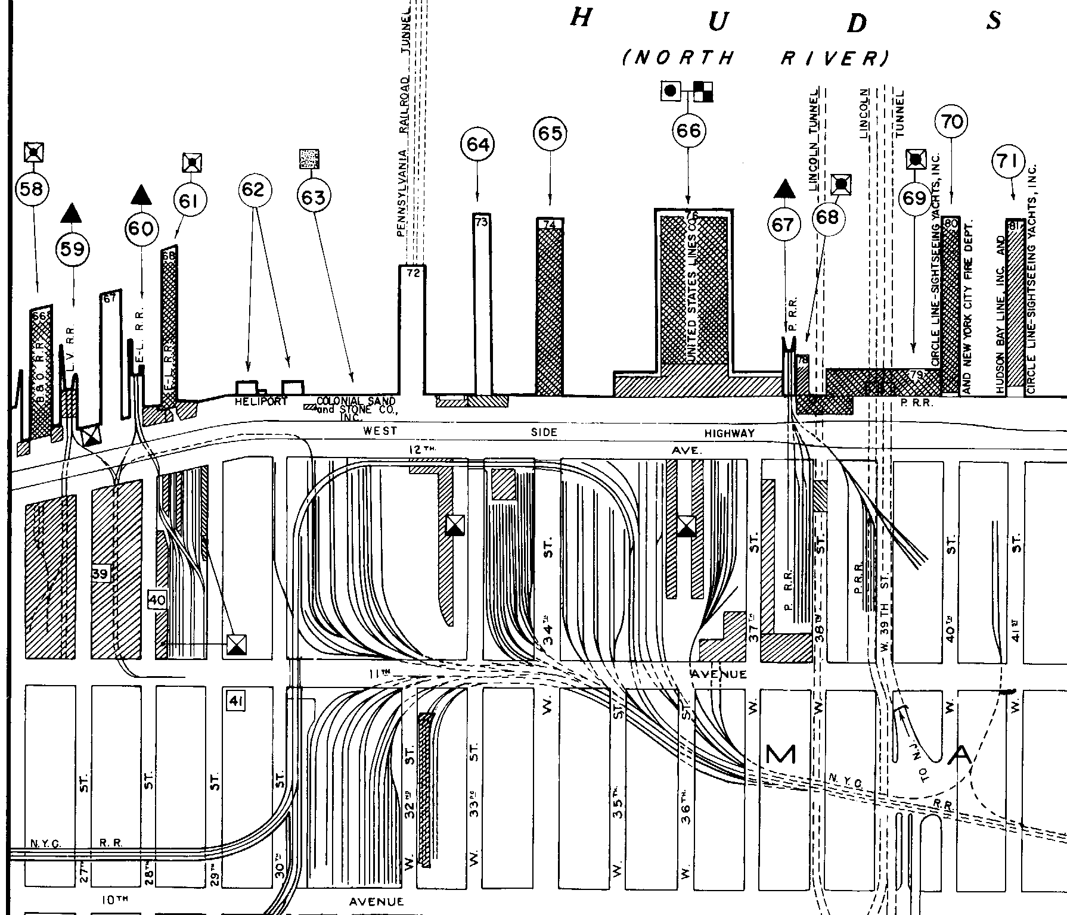
Researching, modeling and operating the New York Central Railroad’s High Line In HO Scale
South or Railroad East
Building the High Line.
New Terminal Stores Connection
PRR Yard
Terminal Stores
Slaughter House
Erie 28th St.
Lehigh Valley
High Line
33rd Street Yard
Spur to Morgan Post Office

Slide 48
Researching, modeling and operating the New York Central Railroad’s High Line In HO Scale
Building the High Line.
Spur to Slaughter House

Slide 49
Researching, modeling and operating the New York Central Railroad’s High Line In HO Scale
Building the High Line.

Slide 50
Researching, modeling and operating the New York Central Railroad’s High Line In HO Scale
Building the High Line.

Slide 51
Researching, modeling and operating the New York Central Railroad’s High Line In HO Scale
Building the High Line.

Slide 52
Researching, modeling and operating the New York Central Railroad’s High Line In HO Scale
Building the High Line.
Looking East with 30th Street to the Right

Slide 53
Researching, modeling and operating the New York Central Railroad’s High Line In HO Scale
Building the High Line.

Slide 54
Researching, modeling and operating the New York Central Railroad’s High Line In HO Scale
Building the High Line.

Slide 55
Researching, modeling and operating the New York Central Railroad’s High Line In HO Scale
Building the High Line.

Slide 56
Researching, modeling and operating the New York Central Railroad’s High Line In HO Scale
Building the High Line.
Morgan Post Office
Over 8,000 RPO and Express cars delivered yearly.
Longer ties
For third rail

Slide 57
Researching, modeling and operating the New York Central Railroad’s High Line In HO Scale
Building the High Line.

Slide 58
Researching, modeling and operating the New York Central Railroad’s High Line In HO Scale
Building the High Line.
Track plan of the Morgan Post office and the spur leading to it off the High Line.

Slide 59
Researching, modeling and operating the New York Central Railroad’s High Line In HO Scale
Building the High Line.

Slide 60
Researching, modeling and operating the New York Central Railroad’s High Line In HO Scale
Building the High Line.

Slide 61
Researching, modeling and operating the New York Central Railroad’s High Line In HO Scale
Building the High Line.

Slide 62
Researching, modeling and operating the New York Central Railroad’s High Line In HO Scale
Building the High Line.

Slide 63
Researching, modeling and operating the New York Central Railroad’s High Line In HO Scale
Building the High Line.

Slide 64
Researching, modeling and operating the New York Central Railroad’s High Line In HO Scale
Building the High Line.

Slide 65
Researching, modeling and operating the New York Central Railroad’s High Line In HO Scale
Building the High Line.
No Connection to the High Line.
Merchants Refrigerating
Reefer Unloaded in the street

Slide 66
Researching, modeling and operating the New York Central Railroad’s High Line In HO Scale
Building the High Line.
NABISCO Buildings

Slide 67
Researching, modeling and operating the New York Central Railroad’s High Line In HO Scale
Building the High Line.

Slide 68
Researching, modeling and operating the New York Central Railroad’s High Line In HO Scale
The Completed High Line.
St. John’s Park Freight Terminal

Slide 69
Researching, modeling and operating the New York Central Railroad’s High Line In HO Scale
Building the High Line.
B&W images provided by Thomas Flagg.

Slide 70
Researching, modeling and operating the New York Central Railroad’s High Line In HO Scale
The Completed High Line.
Even though the High Line cut right through Bell Labs it was not serviced by the railroad

Slide 71
Researching, modeling and operating the New York Central Railroad’s High Line In HO Scale
The Completed High Line.
Cudahy and Armour

Slide 72
Researching, modeling and operating the New York Central Railroad’s High Line In HO Scale
The Completed High Line.
Merchants Refrigerating
Photo by Tom Flagg and Gerry Weinstein

Slide 73
Researching, modeling and operating the New York Central Railroad’s High Line In HO Scale
The Completed High Line.

Slide 74
Researching, modeling and operating the New York Central Railroad’s High Line In HO Scale
The Completed High Line.

Slide 75
Researching, modeling and operating the New York Central Railroad’s High Line In HO Scale
The Completed High Line.
Photo by Tom Flagg and Gerry Weinstein.

Slide 76
Researching, modeling and operating the New York Central Railroad’s High Line In HO Scale
The Completed High Line.
Morgan Post Office

Slide 77
Researching, modeling and operating the New York Central Railroad’s High Line In HO Scale
The Completed High Line.
The High Line and 33rd Street Yard

Slide 78
Researching, modeling and operating the New York Central Railroad’s High Line In HO Scale
The Completed High Line.
The High Line and 33rd Street Yard

Slide 79
Researching, modeling and operating the New York Central Railroad’s High Line In HO Scale
Did the original 10th Avenue Line and the High Line run at the same time?
NABISCO
YES
10th Avenue

Slide 80
Researching, modeling and operating the New York Central Railroad’s High Line In HO Scale
Operations on the High Line.

Slide 81
Researching, modeling and operating the New York Central Railroad’s High Line In HO Scale
Operations on the High Line.

Slide 82
Researching, modeling and operating the New York Central Railroad’s High Line In HO Scale
Operations on the High Line.

Slide 83
Researching, modeling and operating the New York Central Railroad’s High Line In HO Scale
Operations on the High Line.
Industries on the High Line
High Line Sidings and Buildings | St. Johns Park Freight Terminal
Morgan Parcel Post Building | Borden
RC Williams | Colod Corp
Spear & Company | Libby, McNeil & Libby
Merchants Refrigerating Co | Sealright Corp
National Biscuit Co (3 Sidings) | Shannon Bros.
Cudahy Packing | Magazine Shippers Assn.
Armour and Co | Universal Car loading and Distribution
Wilson and Co | F W Woolworth
NYC Cold Storage Warehouse | Western Car loading
NY Dressed Poultry Co.
Swift and Co
Gansevoort Public Market
Manhattan Refrigerated Company

Slide 84
Researching, modeling and operating the New York Central Railroad’s High Line In HO Scale
Operations on the High Line in HO Scale.
RC Williams
Spear & Company
NY Dressed Poultry Co
Morgan Parcel Post Building
Swift and Co
Merchants Refrigerating Co
NABISCO
NABISCO
Cudahy Packing
Armour and Co
St. John’s Park Freight Terminal

Slide 85
Researching, modeling and operating the New York Central Railroad’s High Line In HO Scale
Operations on the High Line in HO Scale.

Slide 86
Researching, modeling and operating the New York Central Railroad’s High Line In HO Scale
Operations on the High Line in HO Scale.
2014
Temporary High Line over 33rd Street Yard

Slide 87
Researching, modeling and operating the New York Central Railroad’s High Line In HO Scale
Operations on the High Line in HO Scale.
2014
Temporary High Line over 33rd Street Yard

Slide 88
Researching, modeling and operating the New York Central Railroad’s High Line In HO Scale
Operations on the High Line in HO Scale.
Looking Down 29th Street

Slide 89
Researching, modeling and operating the New York Central Railroad’s High Line In HO Scale
Operations on the High Line in HO Scale.
Spear
NY Dressed Poultry
Swift
NABISCO
Merchants
Refrigerating
Main
NABISCO

Slide 90
Researching, modeling and operating the New York Central Railroad’s High Line In HO Scale
Operations on the High Line in HO Scale.
Cudahy Packing
Armour

Slide 91
Researching, modeling and operating the New York Central Railroad’s High Line In HO Scale
Operations on the High Line in HO Scale.
St. John’s Park Freight Terminal

Slide 92
Researching, modeling and operating the New York Central Railroad’s High Line In HO Scale
Waybill Only Operations on the High Line in HO Scale.
Model Waybill
Prototype Waybill

Slide 93
Researching, modeling and operating the New York Central Railroad’s High Line In HO Scale
What information can be found on a prototype Waybill?
Shipping Railroad
Car Road Name
Car Road Number
Destination
Routing
Consignee
Lading
Railroad Transfer Stamps
Car Type
Date / Waybill Number
Shipper
Receiver Stamp
1
2
3
9
10
4
5
11
6
7
8
12

Slide 94
Researching, modeling and operating the New York Central Railroad’s High Line In HO Scale
“A” Side
“B” Side
Alternate “A” Side

Slide 95
Researching, modeling and operating the New York Central Railroad’s High Line In HO Scale
Loads can be generated inside a Yard or industry that will need a car to pick it up. On the New York Harbor the “FOR LOADING” portion of the “B” side is then filed out and placed into a load’s waiting bill box.
NYC 1642239
NYC 164239
The Yard master will then assign a car to the waybill and maneuver the empty car to the appropriate location to be load or clean if needed so it can be loaded.
Once the car is spotted at where it is to be loaded this side is crossed out and the car information is transferred to the other side.
With the car information transferred the time that the car was placed at the location is added and the clock starts for loading.
7:00
x
This car starts loading at 7:00 AM and will take 5 hours to load. This means that the car will be ready to send to Buffalo at 12:00 noon.

Slide 96
Researching, modeling and operating the New York Central Railroad’s High Line In HO Scale
This waybill is waiting for a car to be assigned to it so it can be placed on either a scheduled train or a extra.
PRR
2319
With the assigning of this waybill to a Pennsylvania Railroad Mill Gondola Number 2319, it is placed on the active staging track and is ready to go out on Train JS-2 to 33rd Street Yard.
PRR 2319
Once the car is place at the Steel Platform the arrival time is noted on the waybill. Then the clock starts to when the waybills actions are completed.
This car was placed at the siding a 3:30 PM. After 6:00 PM or 2 ½ Hours later the car has been unloaded and this waybill has been completed. The waybill is crossed our and the car information is transferred to the “B” side.
3:30
x

Slide 97
Researching, modeling and operating the New York Central Railroad’s High Line In HO Scale
Current High Line Re-Construction.
The original High Line structures on the layout over 33rd Street was torn down on January 2010. I have started, with the much help from my work crews, to rebuild the High Line into a prototypic structure. The following is showing the progress of that work.

Slide 98
Researching, modeling and operating the New York Central Railroad’s High Line In HO Scale
Current High Line Re-Construction.
1/8” Styrene

Slide 99
Researching, modeling and operating the New York Central Railroad’s High Line In HO Scale
Current High Line Re-Construction.
High Line Heading North (Railroad West)
33rd Street Yard

Slide 100
Researching, modeling and operating the New York Central Railroad’s High Line In HO Scale
Current High Line Re-Construction.
New High Line Structure
33rd Street Yard
As of November 17,2010
Erie’s 28th Street Car Float

Slide 101
Researching, modeling and operating the New York Central Railroad’s High Line In HO Scale
Current High Line Re-Construction.

Slide 102
Researching, modeling and operating the New York Central Railroad’s High Line In HO Scale
Current High Line Re-Construction.
Jay Held creating the channel to run the sub-buss.
Track Feeders

Slide 103
Researching, modeling and operating the New York Central Railroad’s High Line In HO Scale
Current High Line Re-Construction.
To St. John’s Park
To the Morgan Post Office
33rd Street Yard
To Staging
High Line

Slide 104
Researching, modeling and operating the New York Central Railroad’s High Line In HO Scale
Current High Line Re-Construction.
Art Sand used as
cinder ballast
Prototype Leg to be cast for the High Line There is a set of legs ever 30’ to 40’

Slide 105
Researching, modeling and operating the New York Central Railroad’s High Line In HO Scale
Current High Line Re-Construction.
New plate girder detail added
This is the removable section of the High Line for access to the gas meter.
As of November 17,2010

Slide 106
Researching, modeling and operating the New York Central Railroad’s High Line In HO Scale
Current High Line Re-Construction.
High Line Active Staging deck going in.
As of November 17,2010

Slide 107
Researching, modeling and operating the New York Central Railroad’s High Line In HO Scale
Current High Line Re-Construction.
Removable active staging deck.

Slide 108
Researching, modeling and operating the New York Central Railroad’s High Line In HO Scale

Slide 109
Researching, modeling and operating the New York Central Railroad’s High Line In HO Scale

Slide 110
Researching, modeling and operating the New York Central Railroad’s High Line In HO Scale
Special Thanks to my work and operations crews! No Really
Craig Bisgeier
Tom Callan
Ted DiIorio
Neil Henning
Jay Held
Ralph Heiss
Ted Pamperin
Phil Monat
Ray Lewis
Special Thanks to……

Slide 111
Researching, modeling and operating the New York Central Railroad’s High Line In HO Scale
….
Ron Parisi
Thom Flagg
Anthony Thompson
Rail Marine SIG
OP-SIG
Friends of the High Line (New York Central Construction Photo’s)
Mike MacDonald’s Photo Bucket Site (Old New York Photos)
Bob’s Photos
Bing Maps

Slide 112
Researching, modeling and operating the New York Central Railroad’s High Line In HO Scale
QUESTIONS?

Slide 113
Researching, modeling and operating the New York Central Railroad’s High Line In HO Scale
Thank You!
Operating the first Friday of the month!
Dramos_1701@yahoo.com http://www.hyhrr.com

Slide 114
FIN

