Slide 1
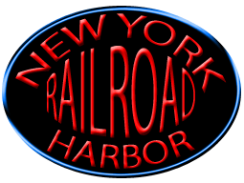
The New York Harbor Railroad:
Prototype to operating layout

Slide 2
Or …

Slide 3
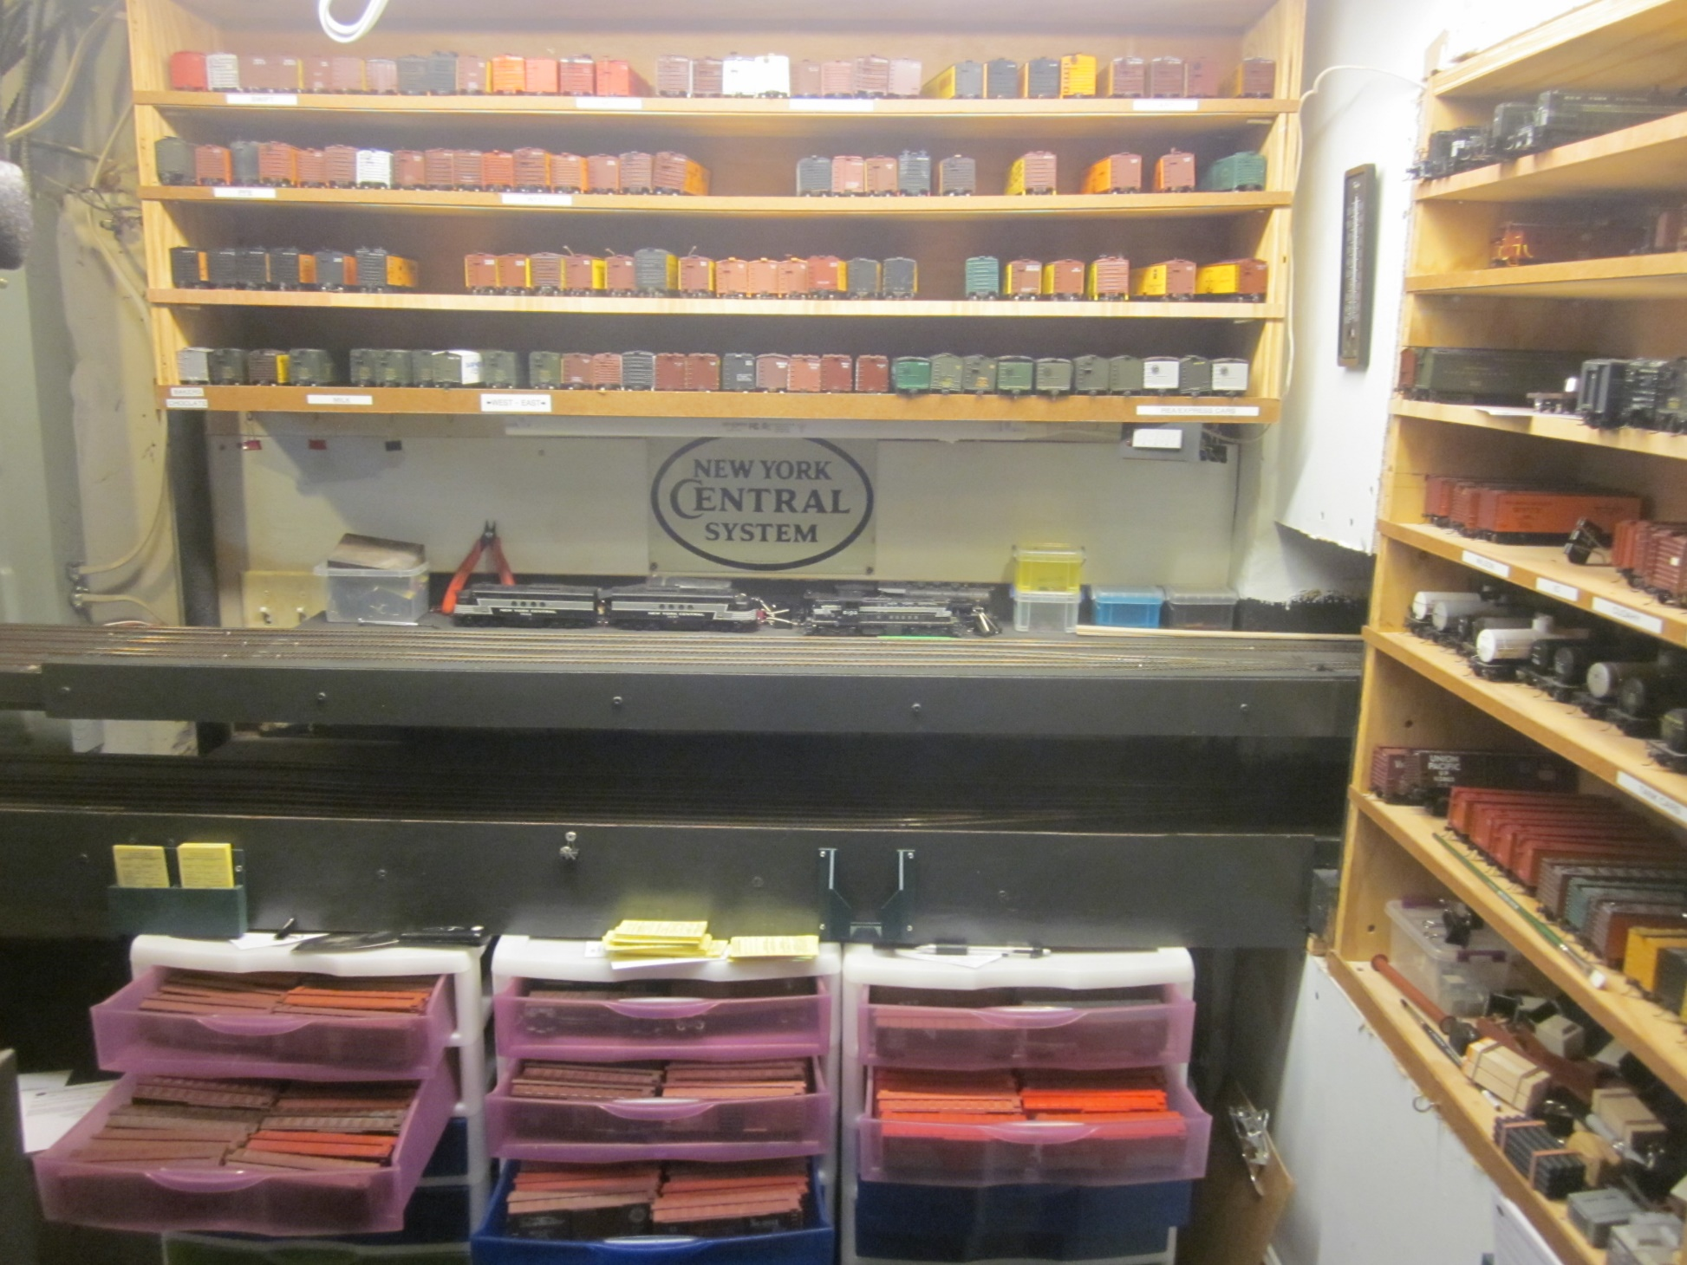
Why I bought
800 freight cars!
A look into designing and building a layout for operations and following the prototype practices from equipment to paperwork. The New York Harbor represents four independent layouts in one basement that work together as the prototype did in mid-town Manhattan in 1947.

Slide 4
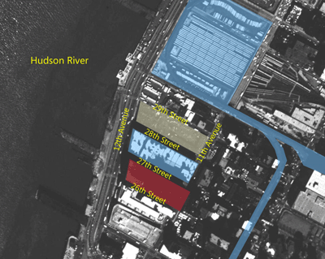
The Location!
2008

Slide 5
The Location!

Slide 6
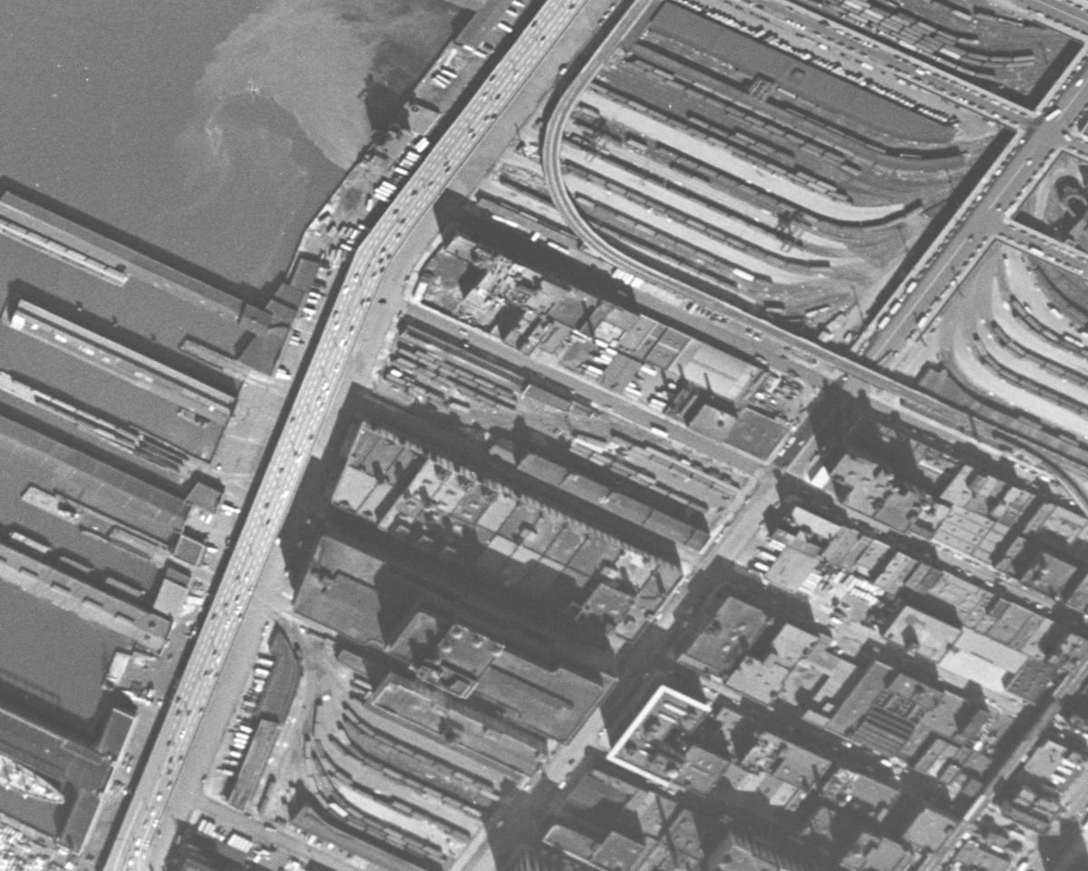
The Location!
Hudson River
12th Ave
NYC 33rd Street Station
Miller Expressway
11th Ave
Float Bridge
J.T. Stanley Soap Works
High Line
28th Street Yard
Terminal Stores
Starrett-Lehigh
1954
B&O

Slide 7
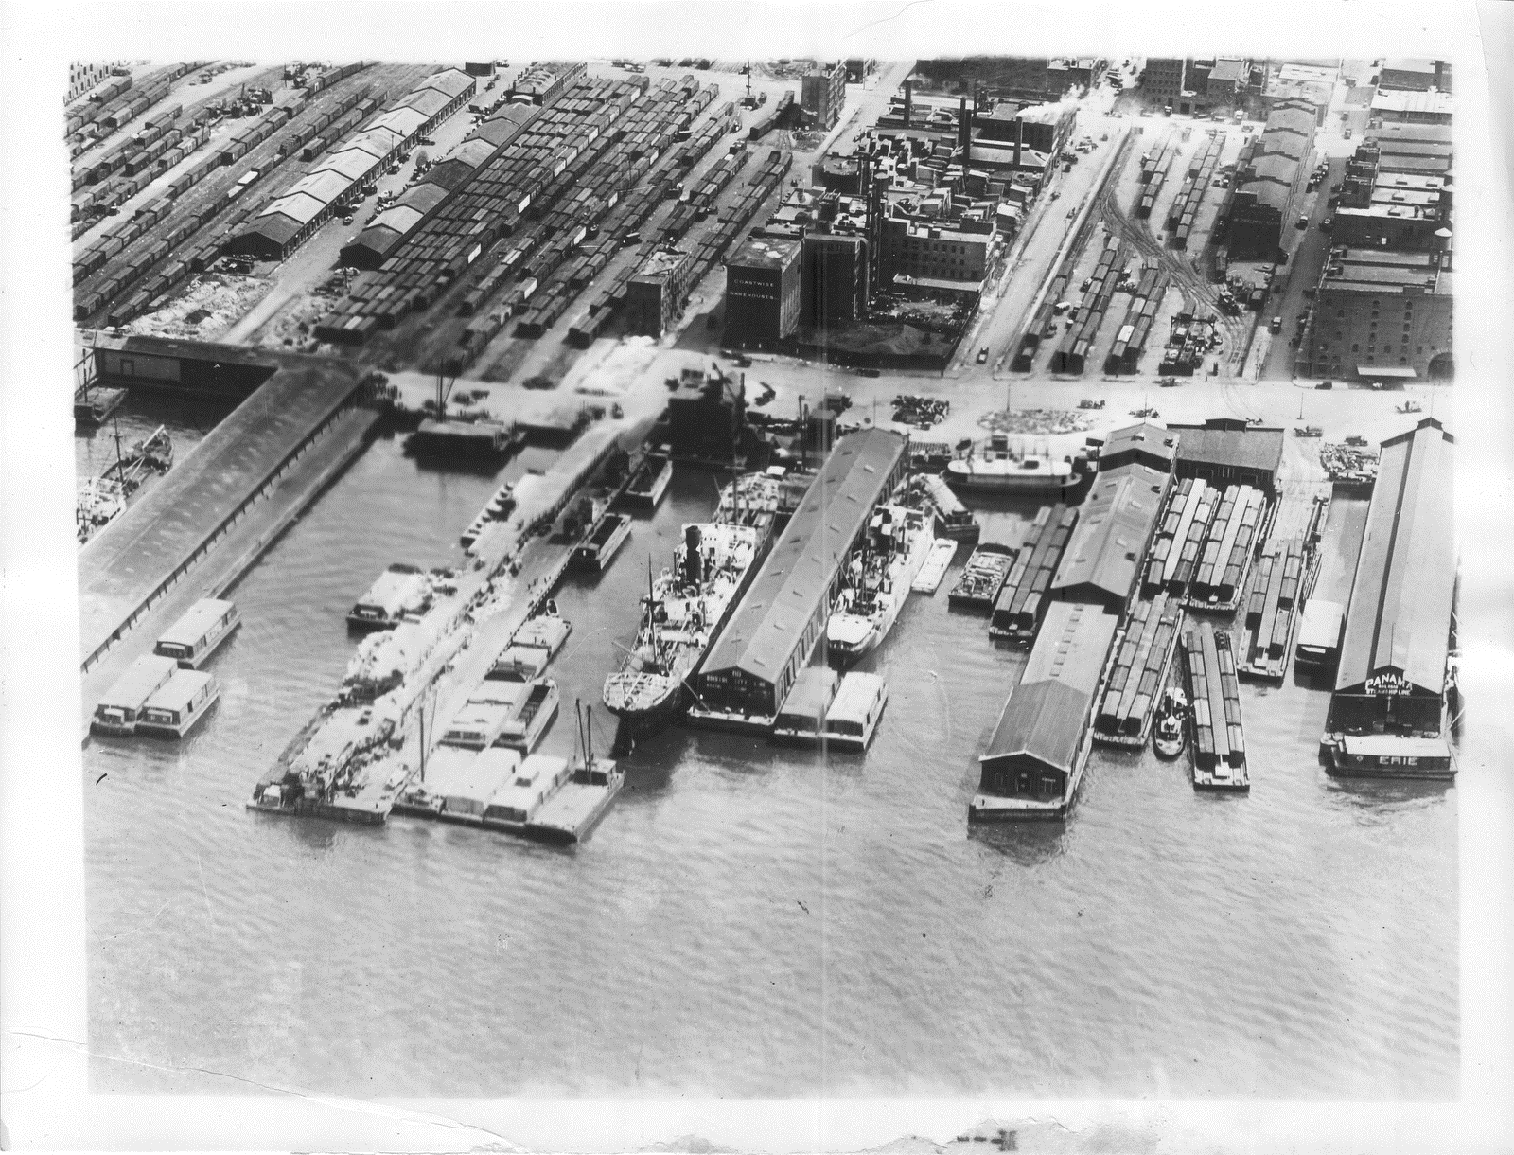
The Location!
1920’s

Slide 8
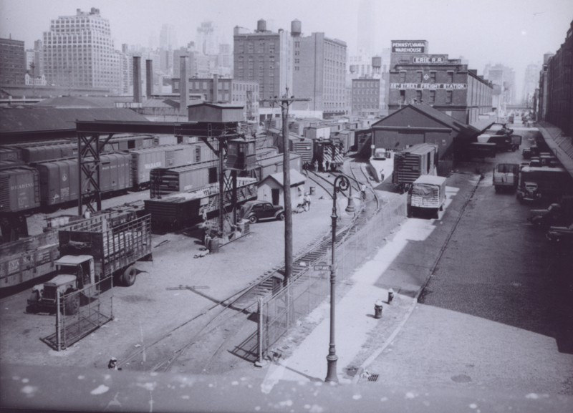
The Location!
1943

Slide 9
The Location!
EL Val Map 1964 Thomas Flagg

Slide 10
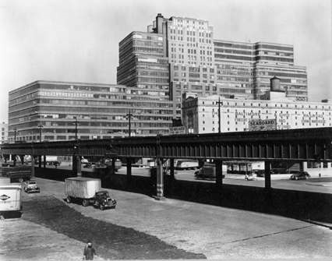
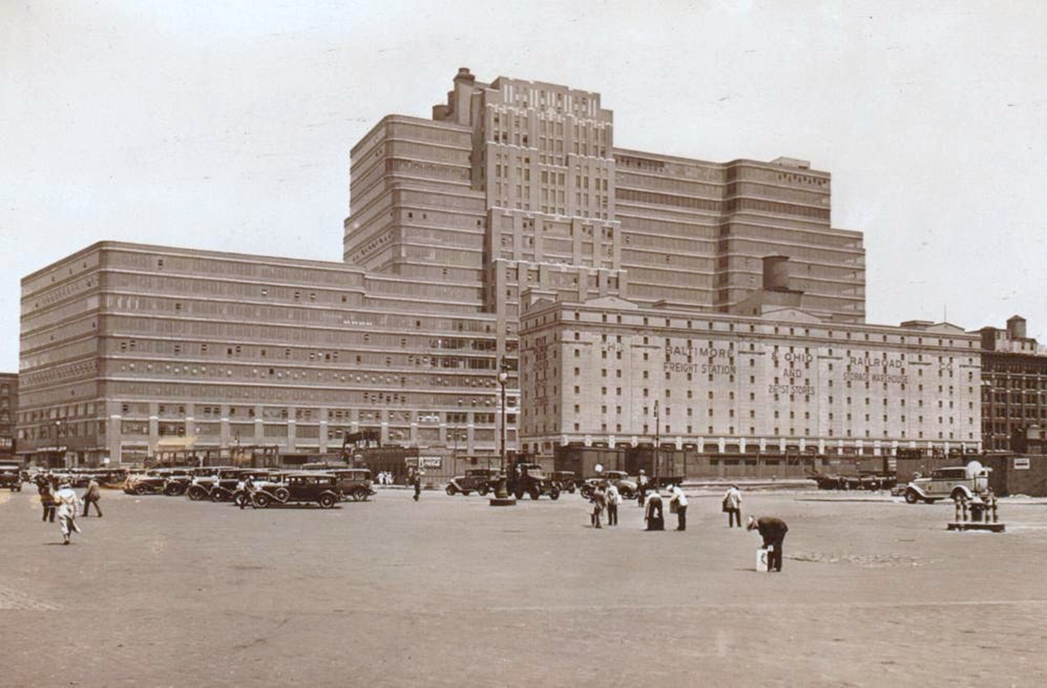
The Location!
Photo By Berenice Abbott March 1st, 1938

Slide 11
The Location!
LVRR Track Plan from Transfer #12

Slide 12
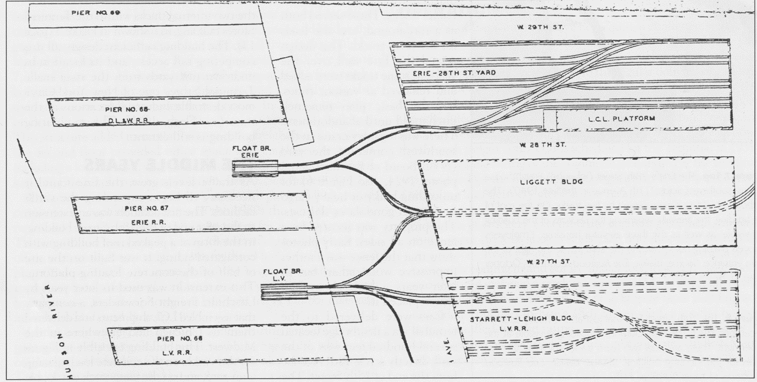
The Location!
Drawing from Transfer No. 39, page 15

Slide 13
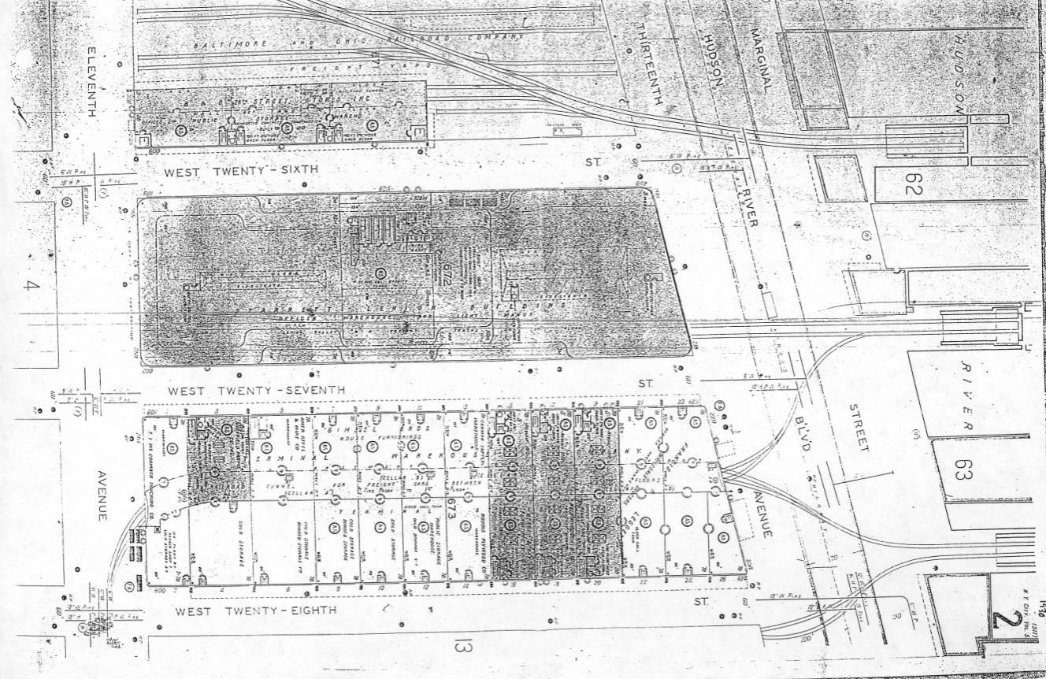
The Location!
Sanborn Map Provided by Vince Lee.

Slide 14
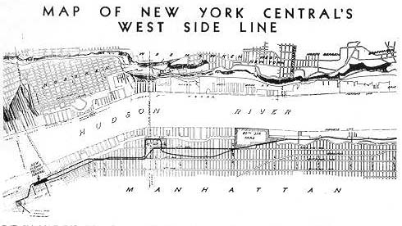
The Beginning!

Slide 15
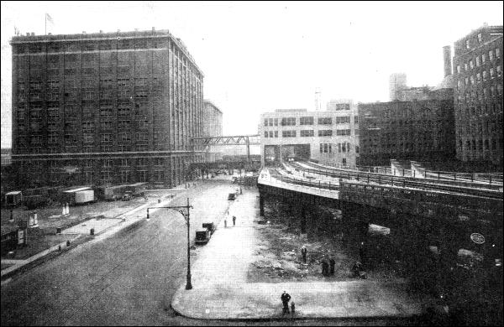
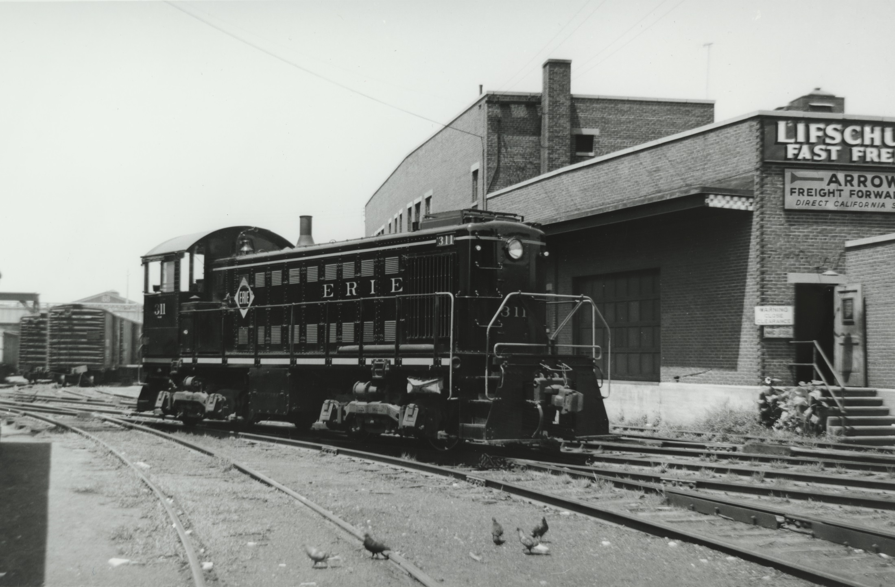
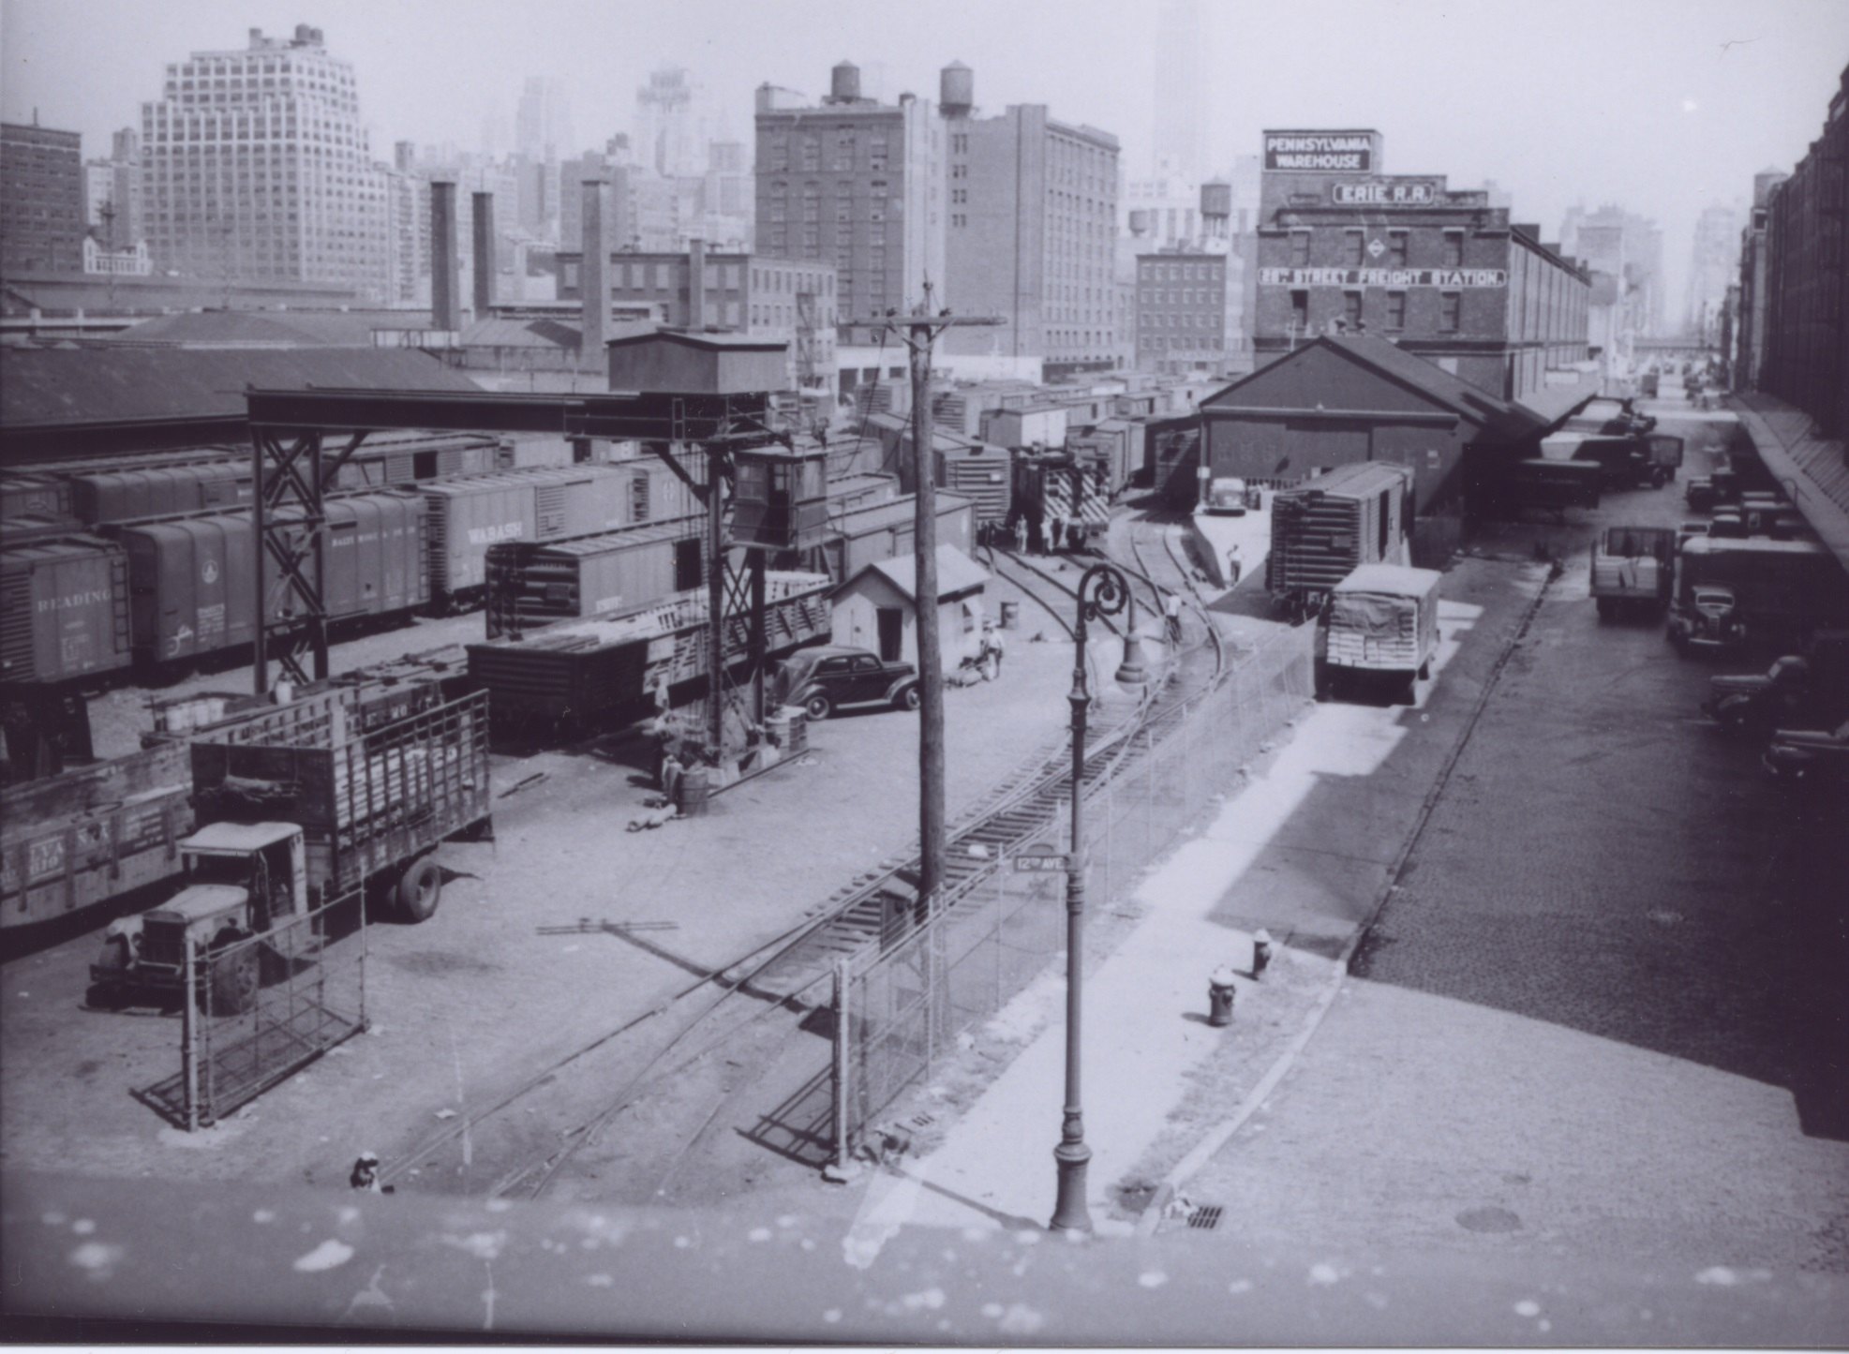
The Beginning!

Slide 16
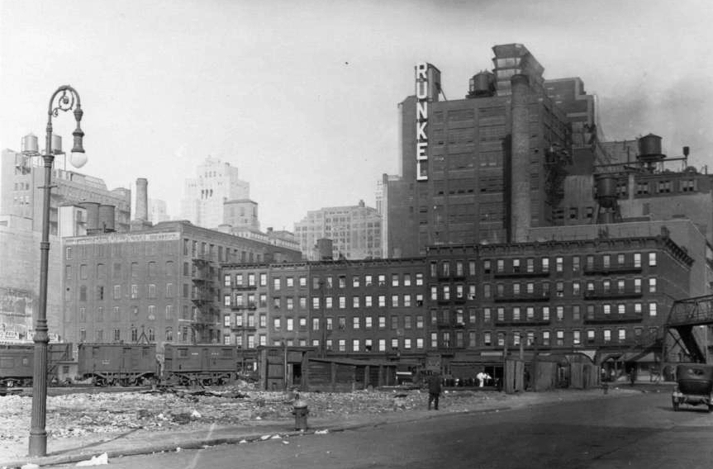
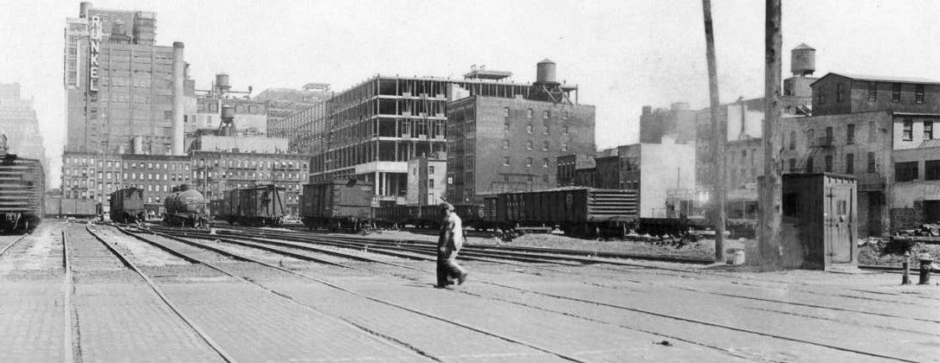
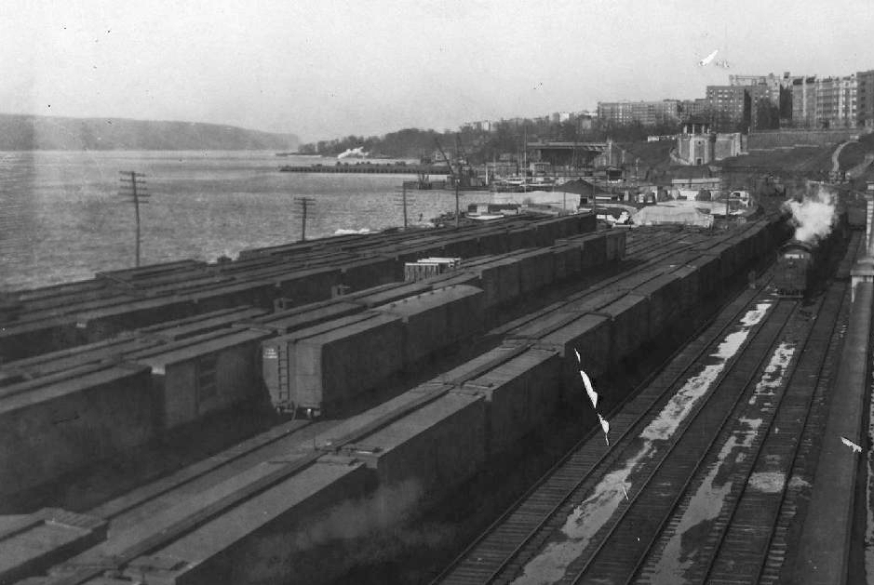
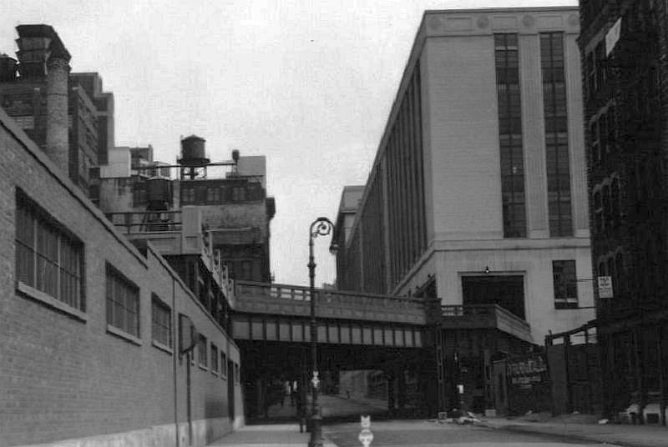
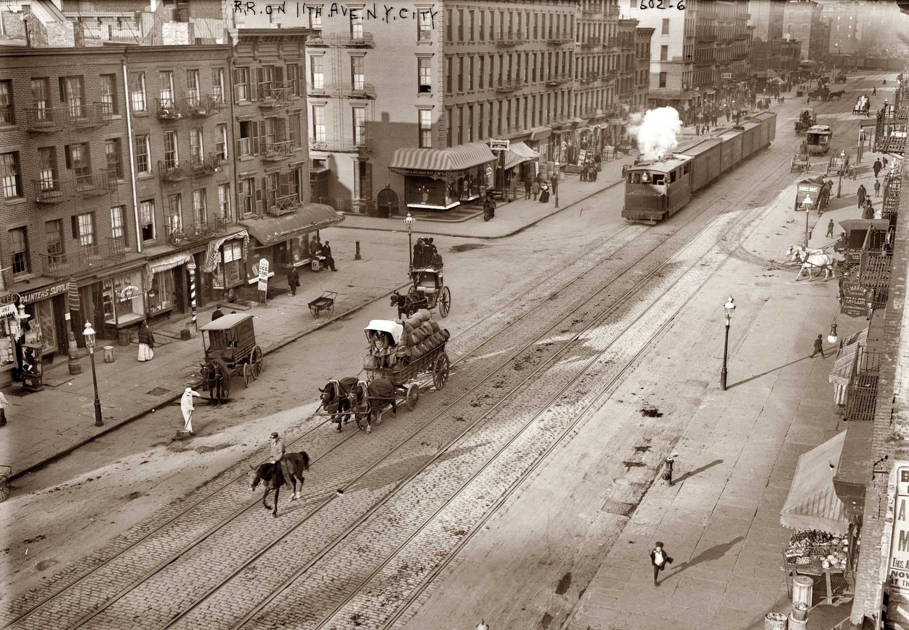
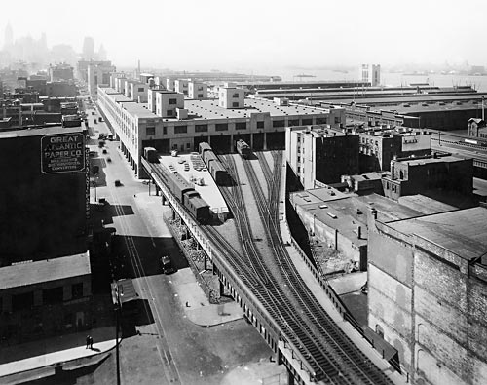
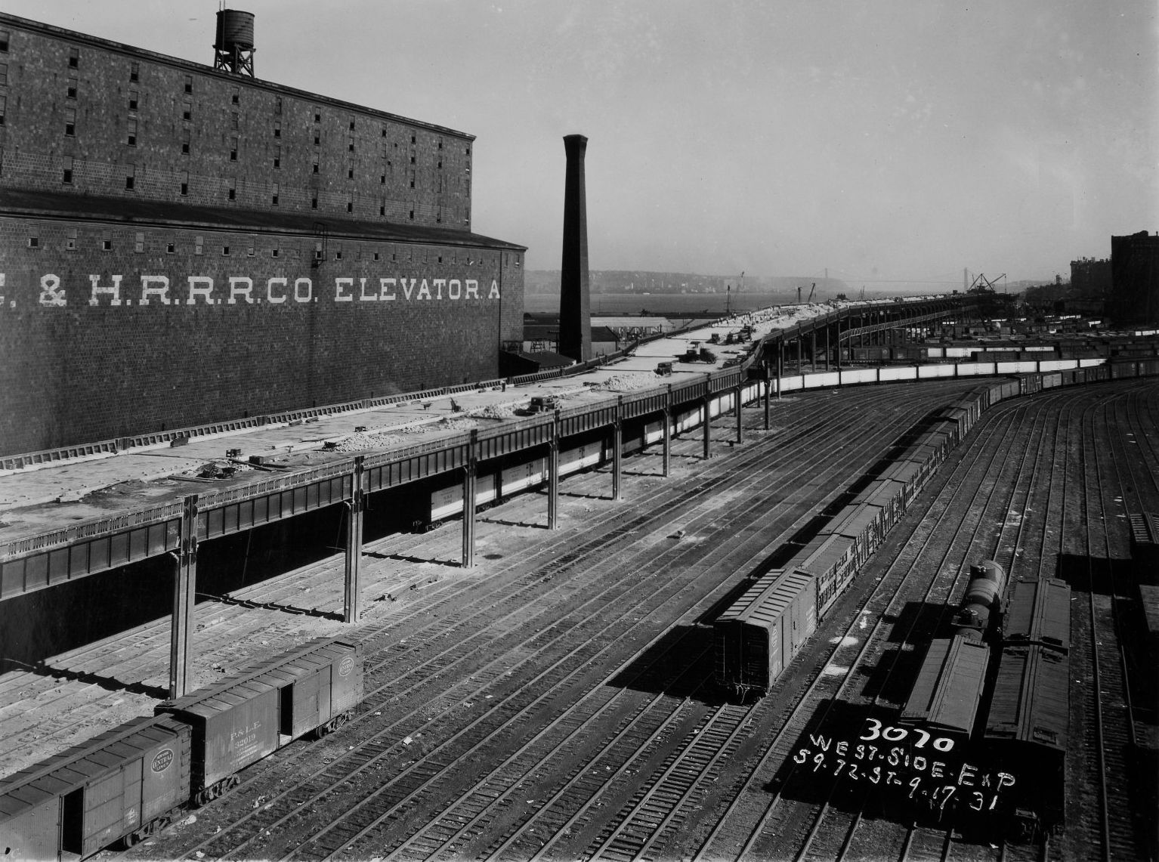
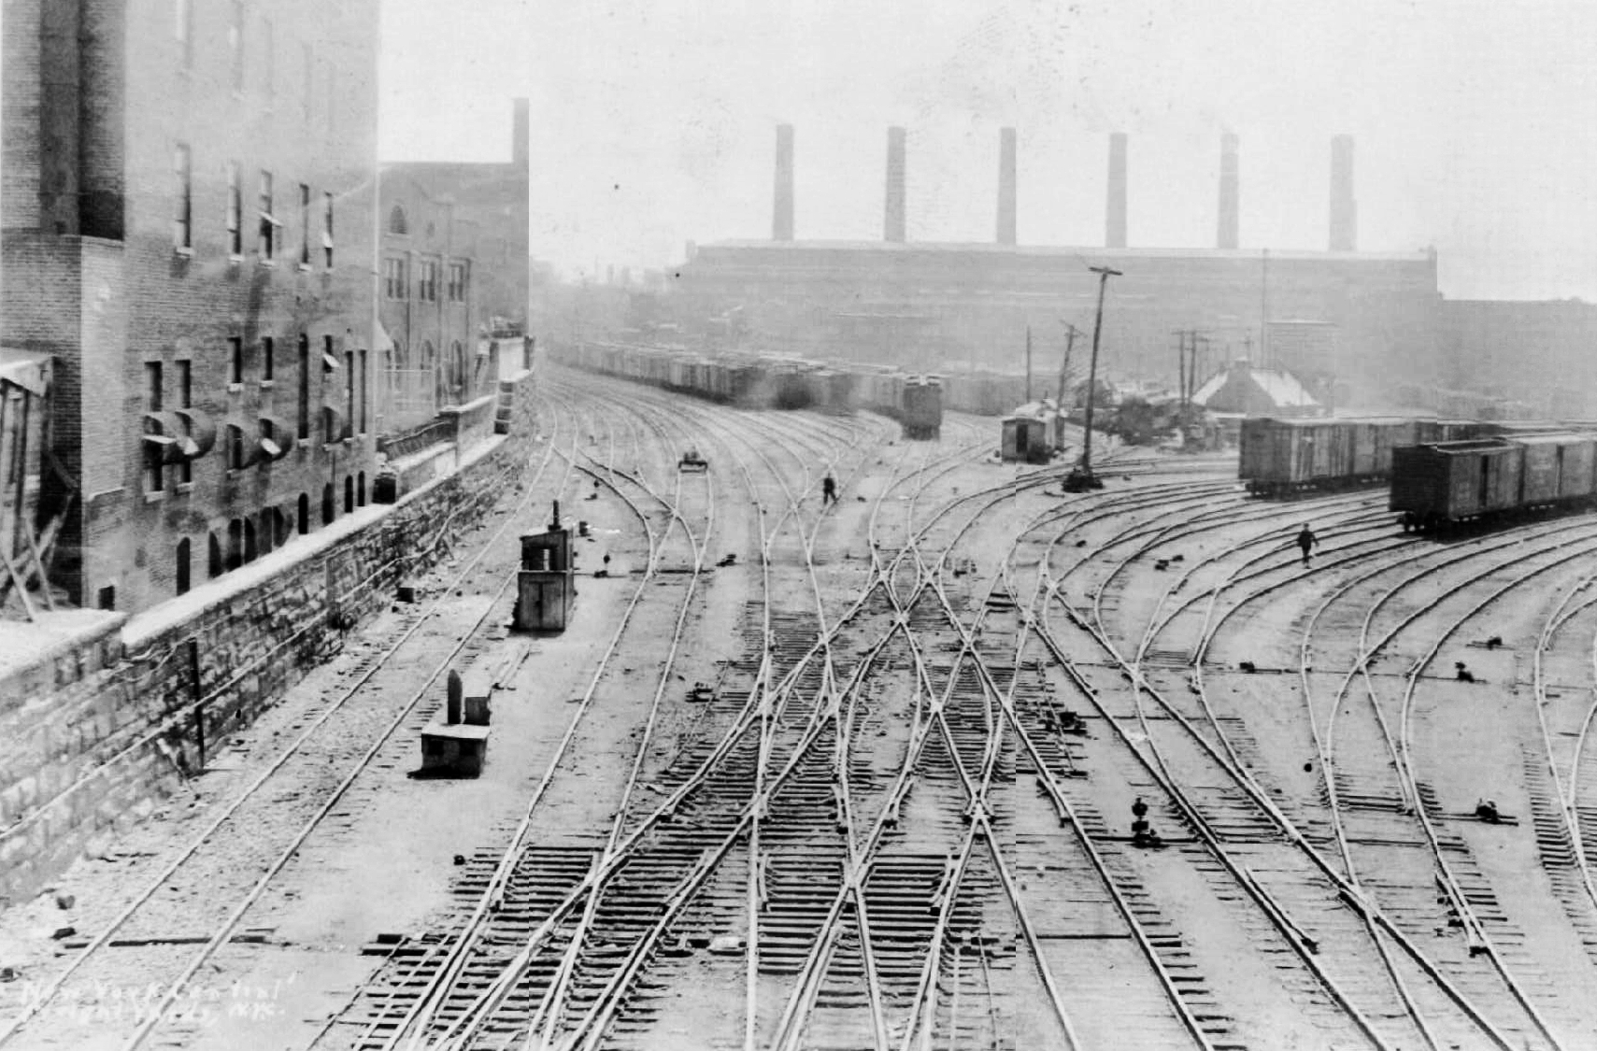
The Beginning!

Slide 17
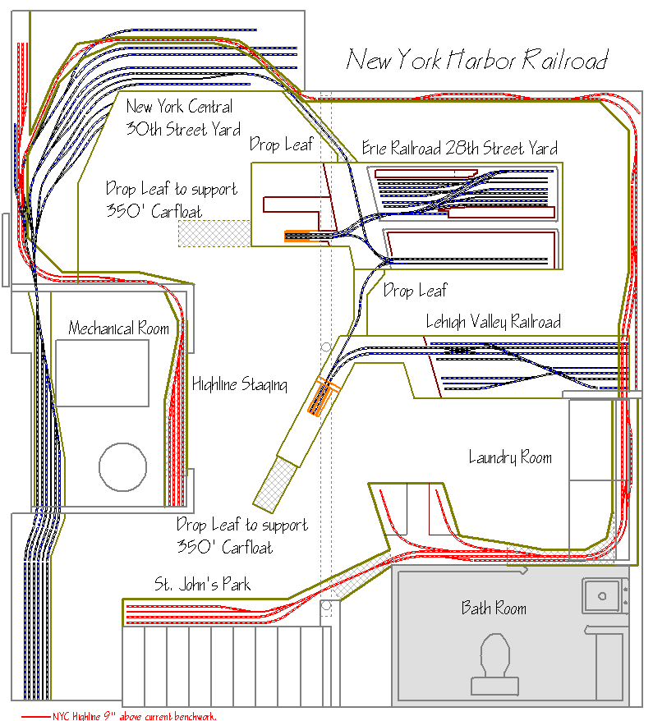
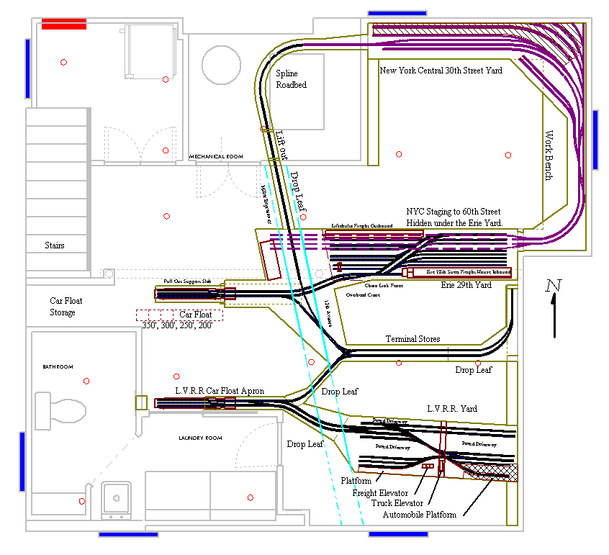
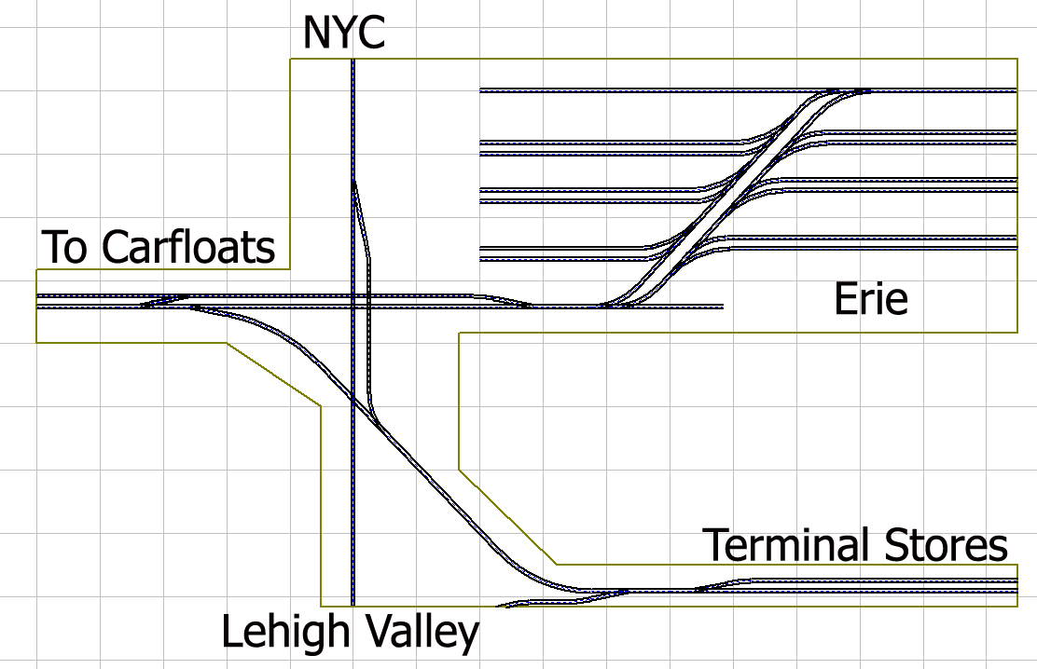
The Beginning!
Here is a brief look into the design process.

Slide 18
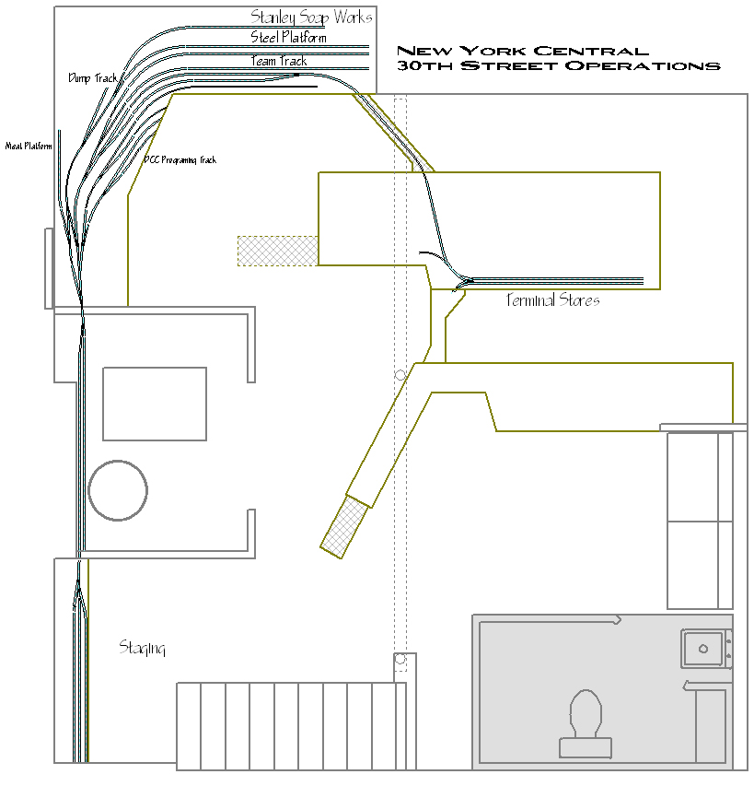
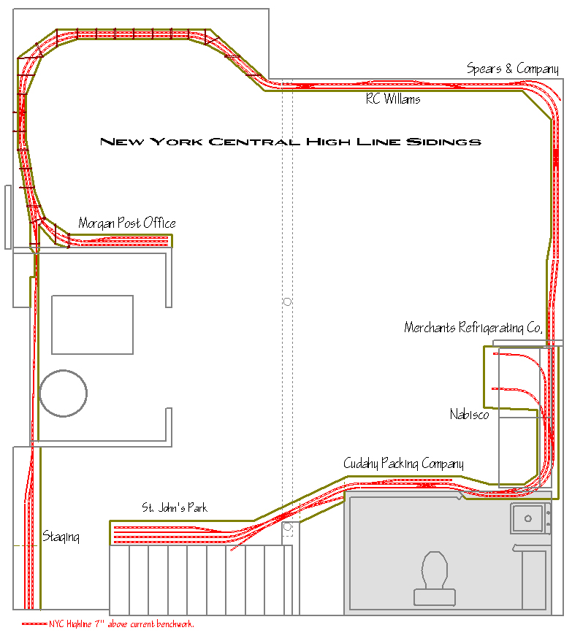
The Beginning!

Slide 19
Construction
February 20th, 2006
After many months of designing I make the first trip to Home Depot for to begin construction of the New York Harbor Railroad.
February 24th, 2006
The first section of bench work is started. This is the section that will support the 28th street section of the layout.

Slide 20
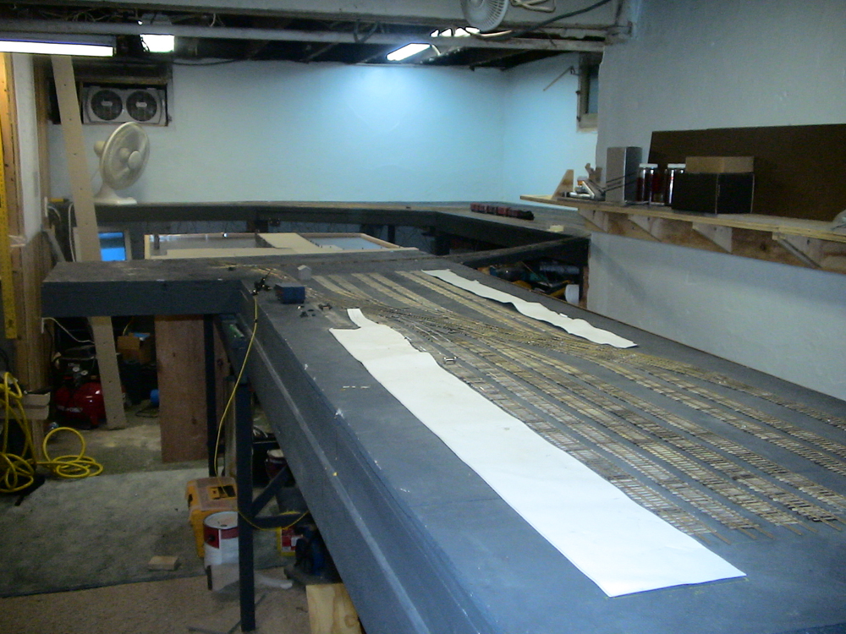
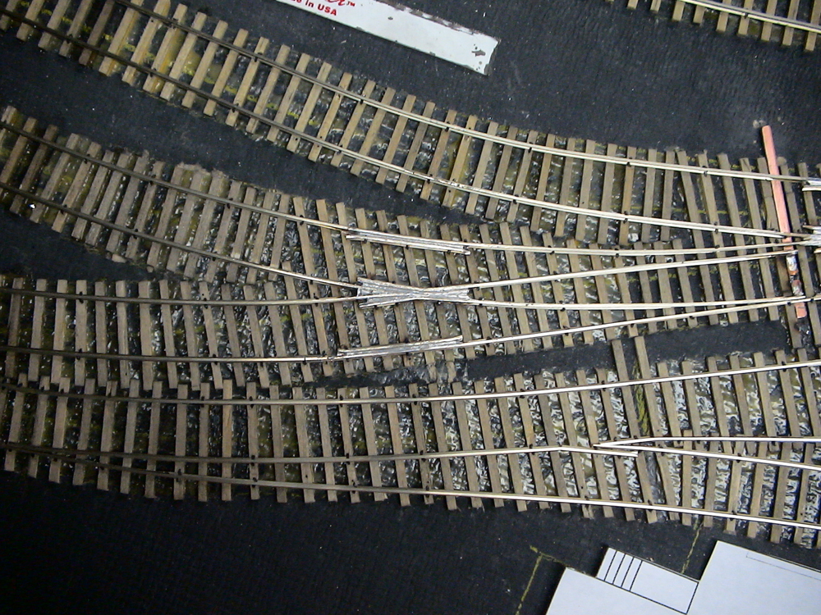
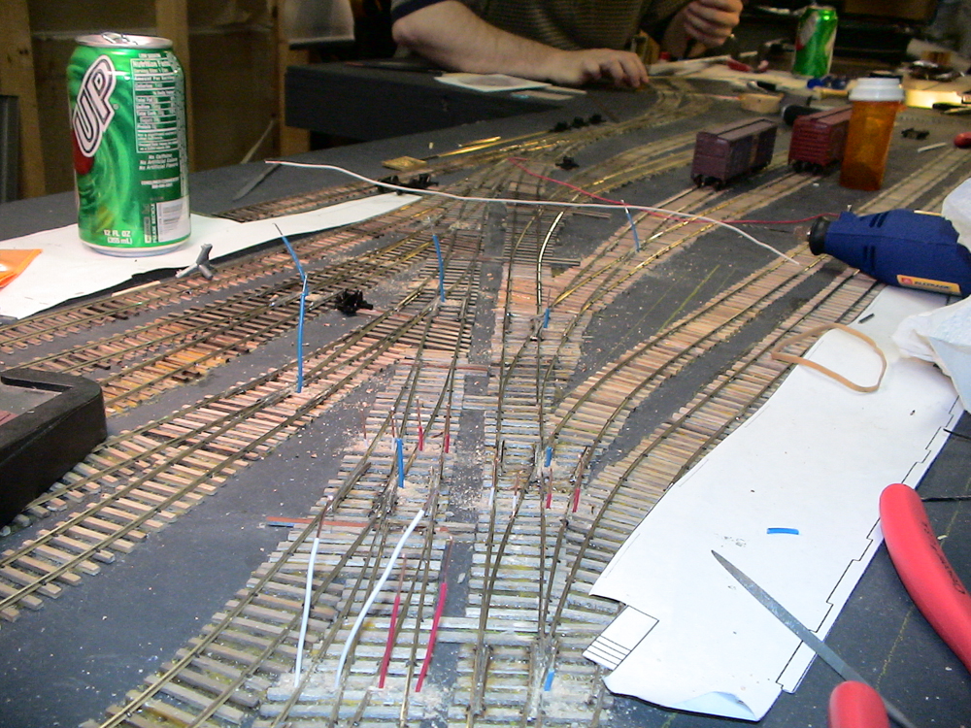
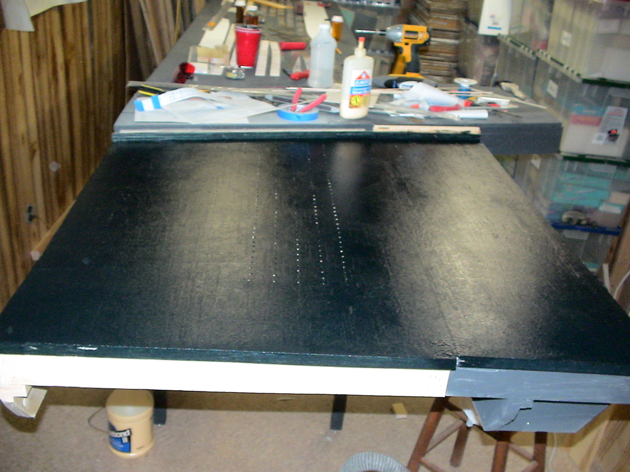
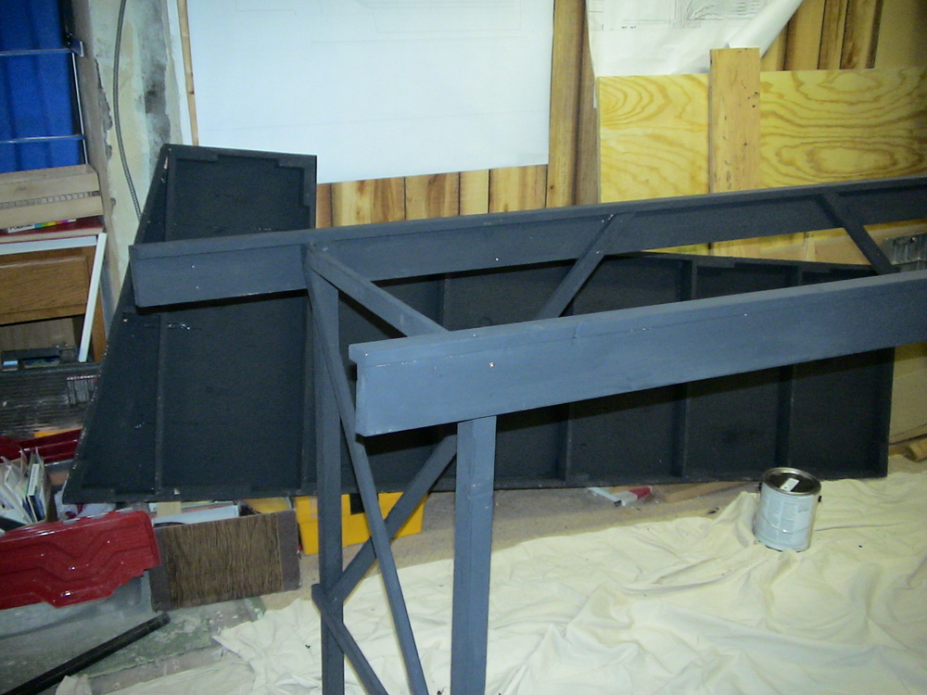
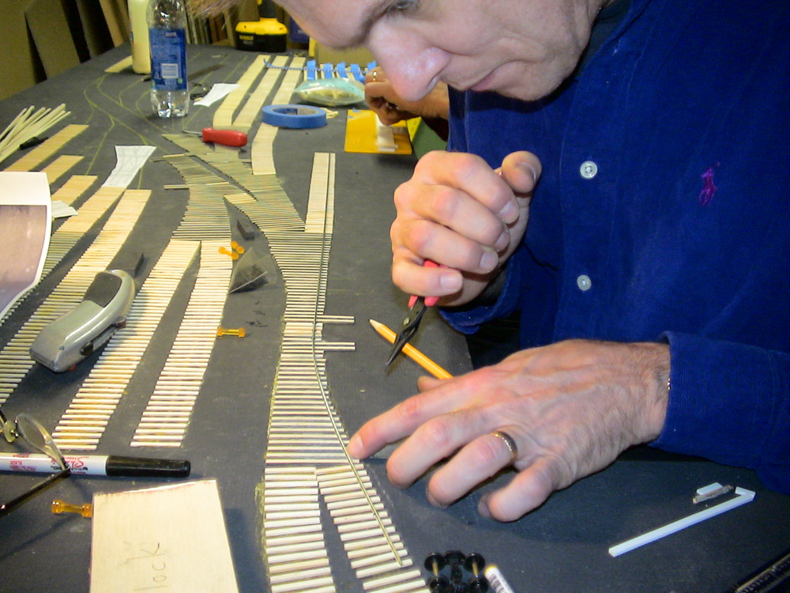
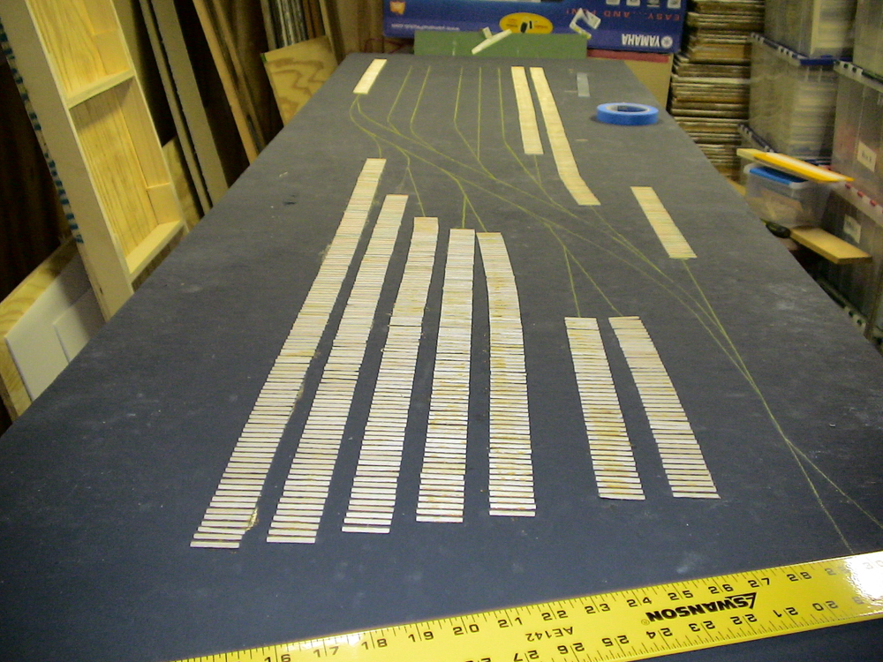
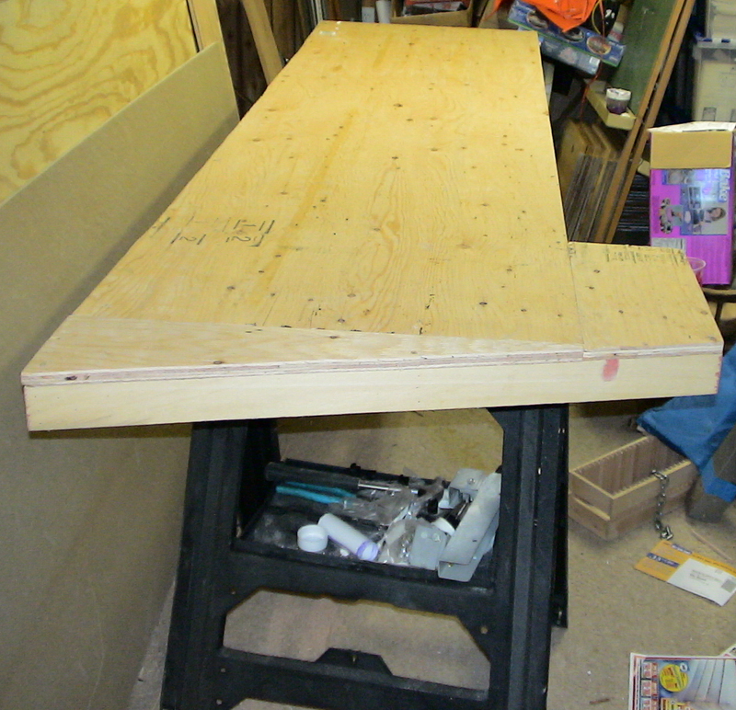
Construction!
February 24
through
July 6th
2006

Slide 21
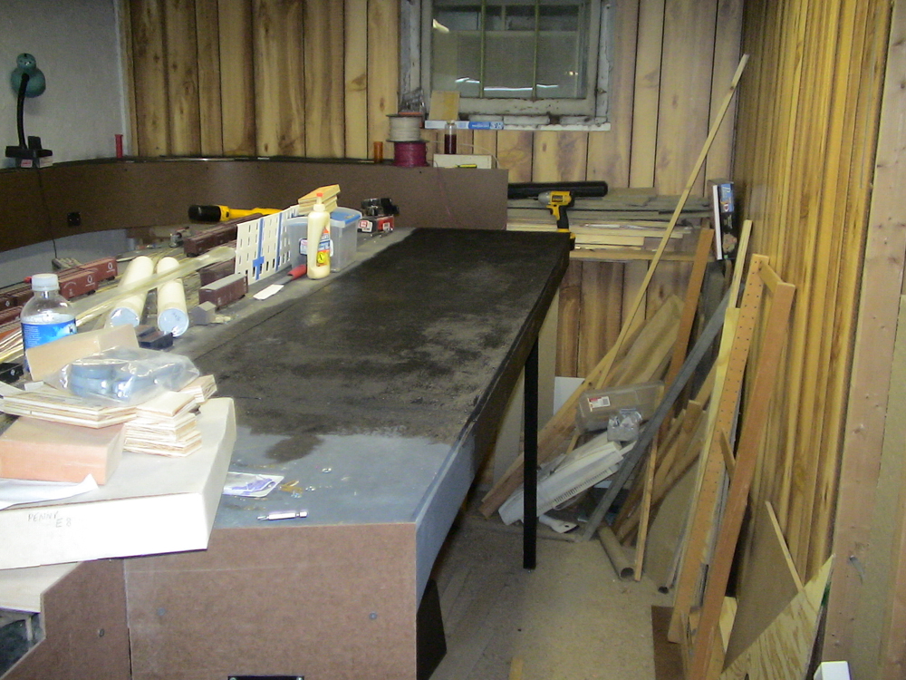
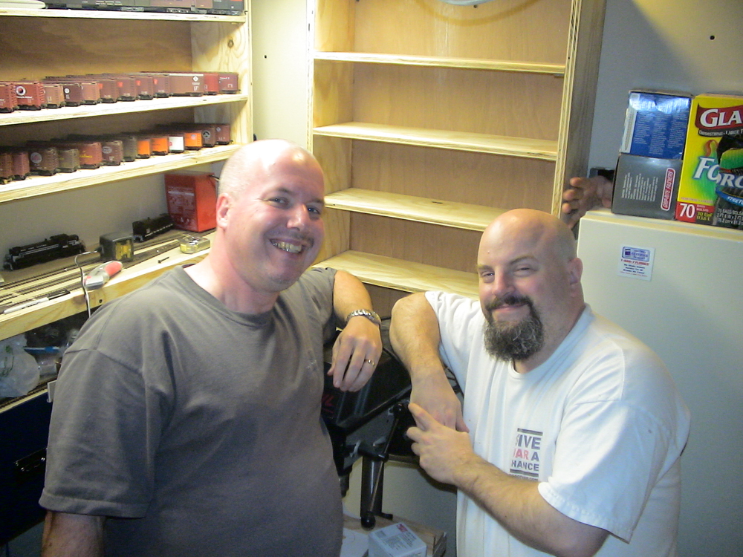
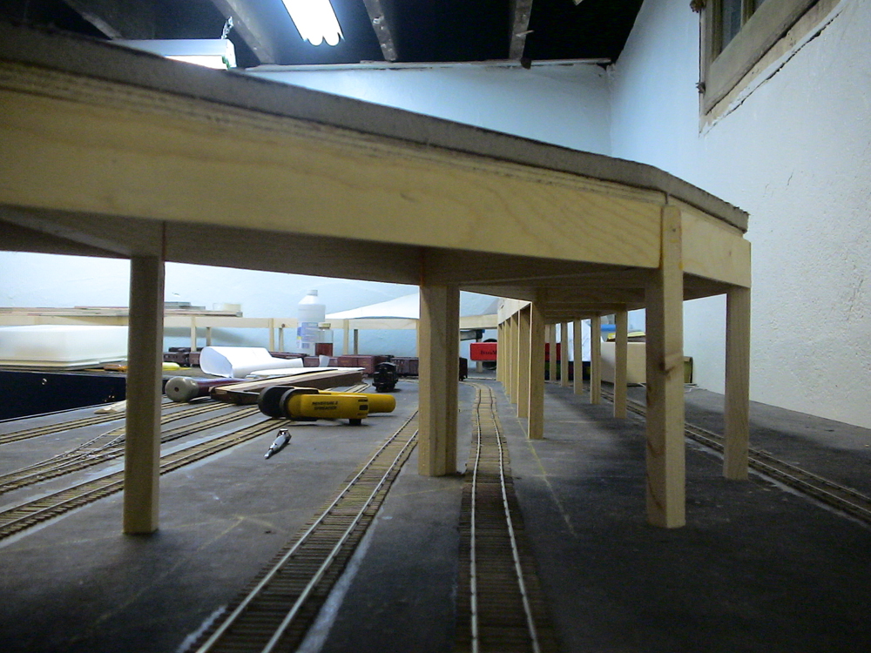
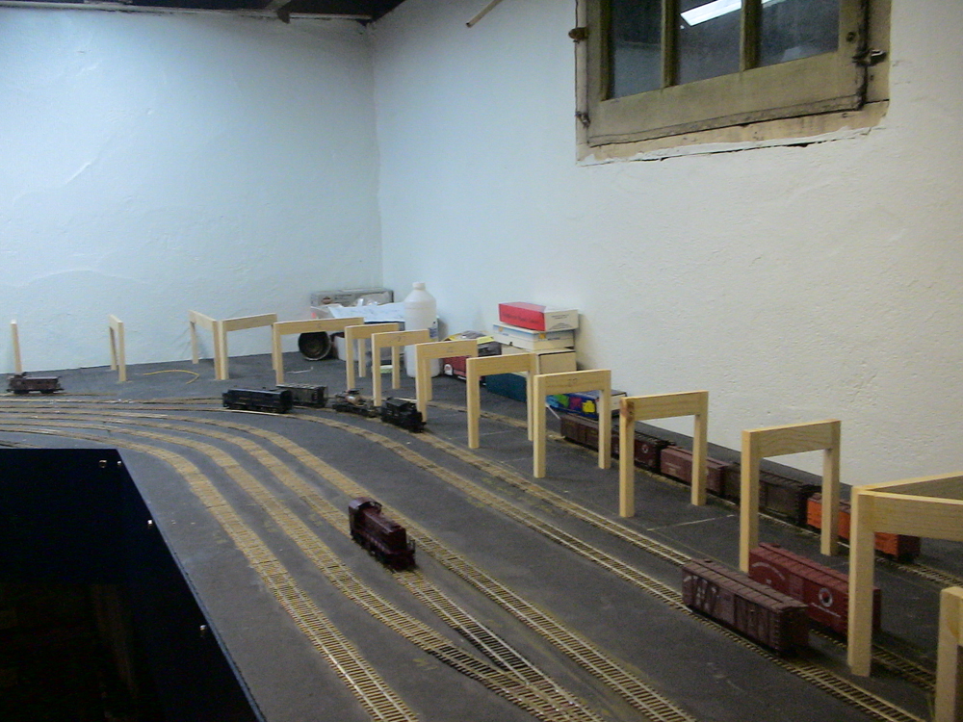
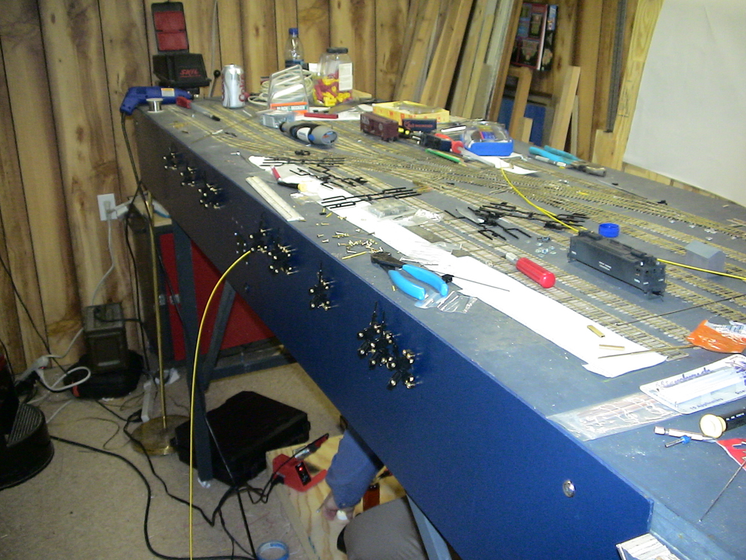
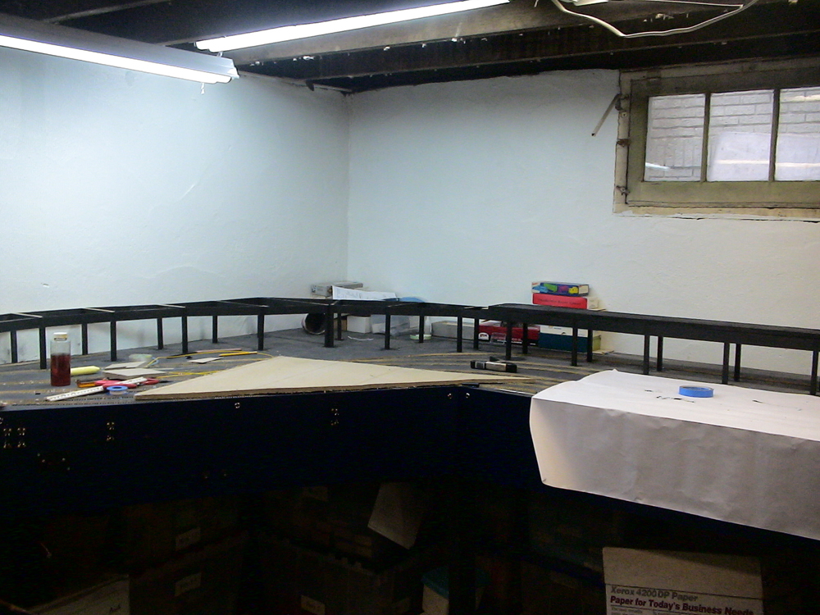
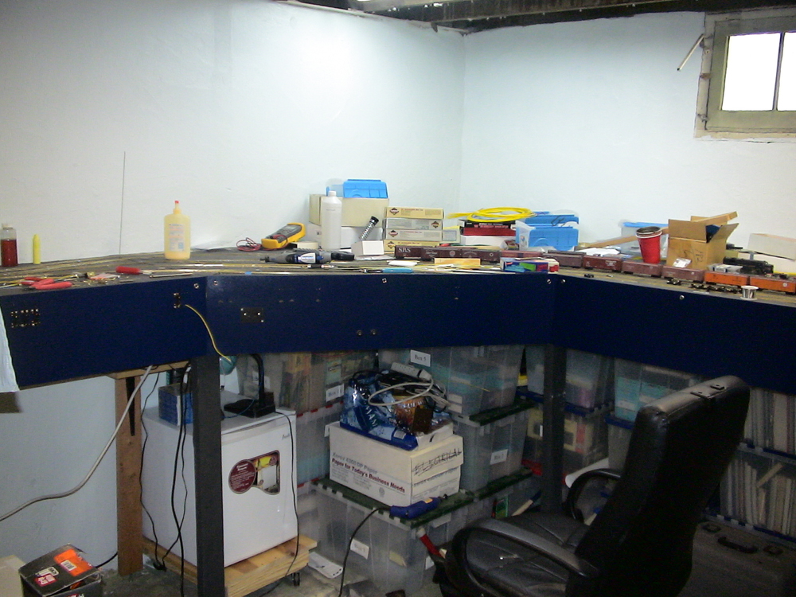
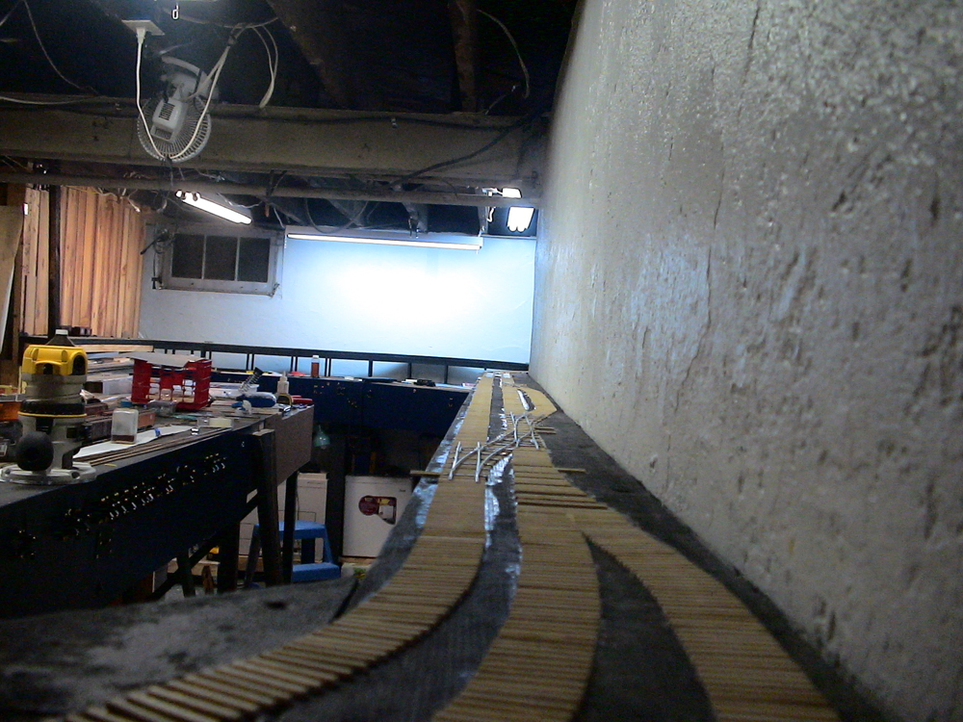
Construction!
July 28
through
December 1
2006

Slide 22
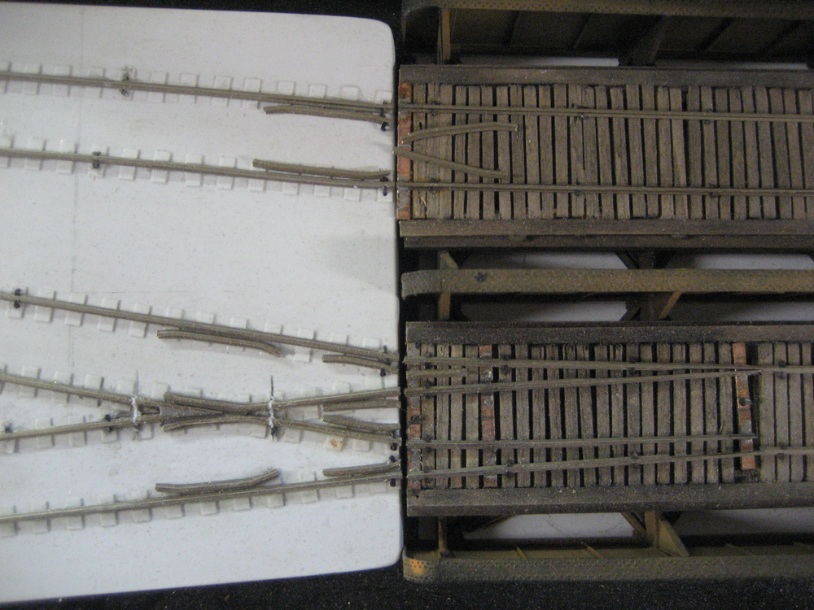
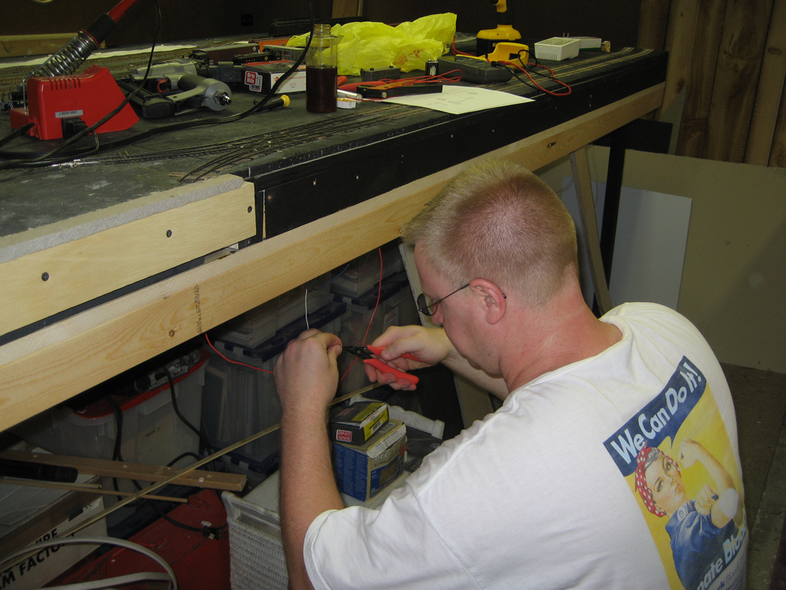
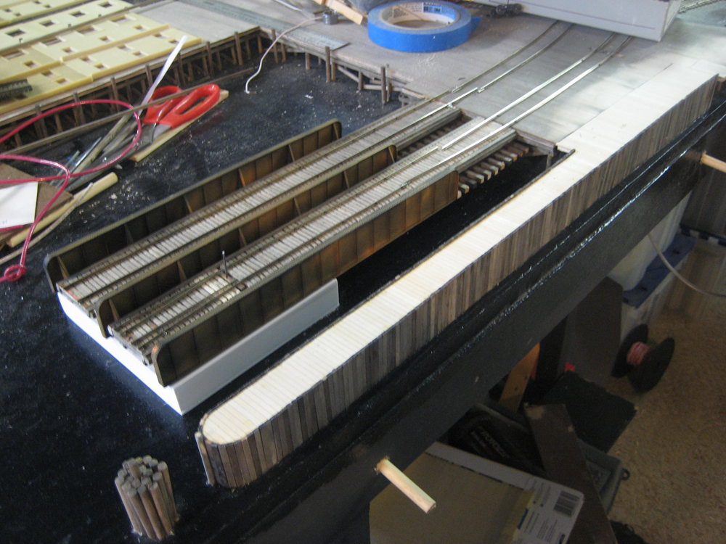
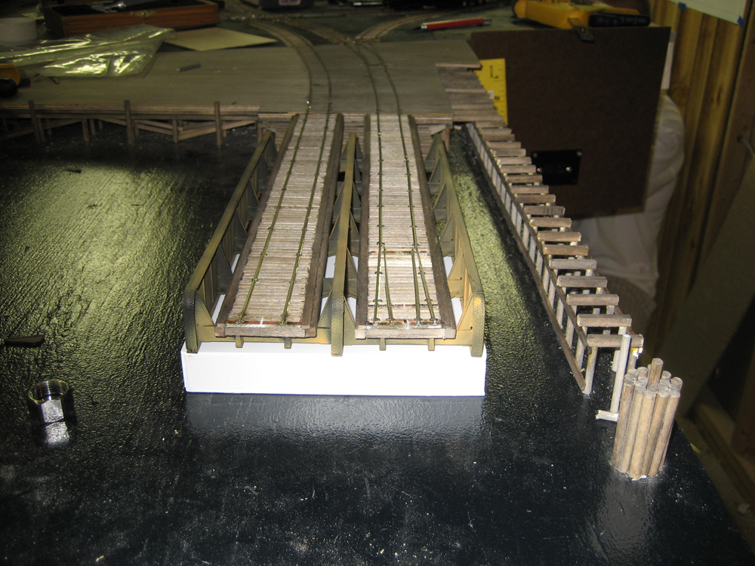
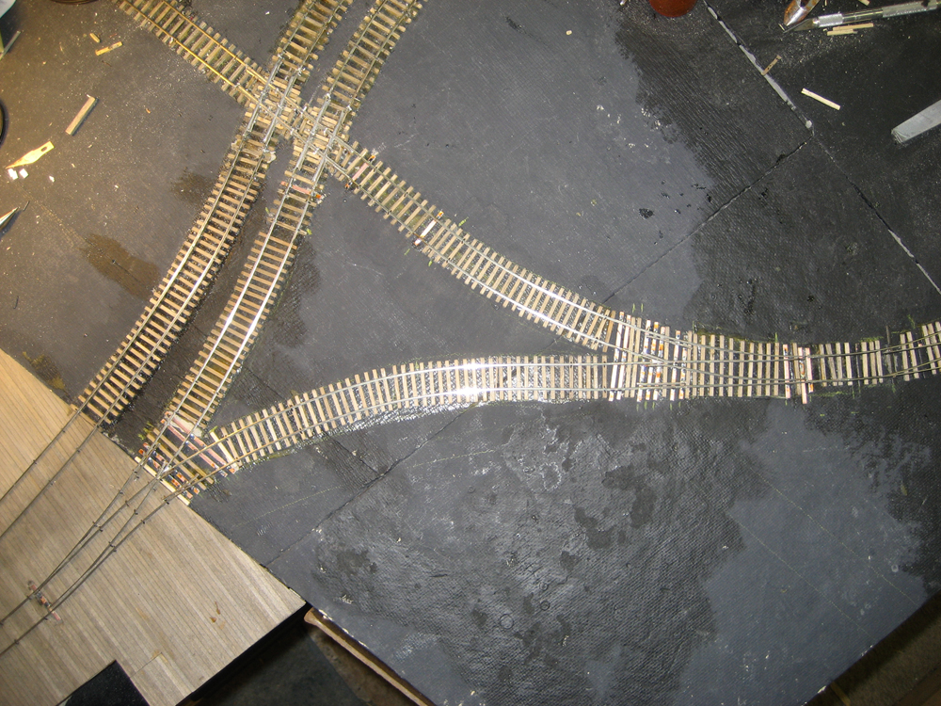
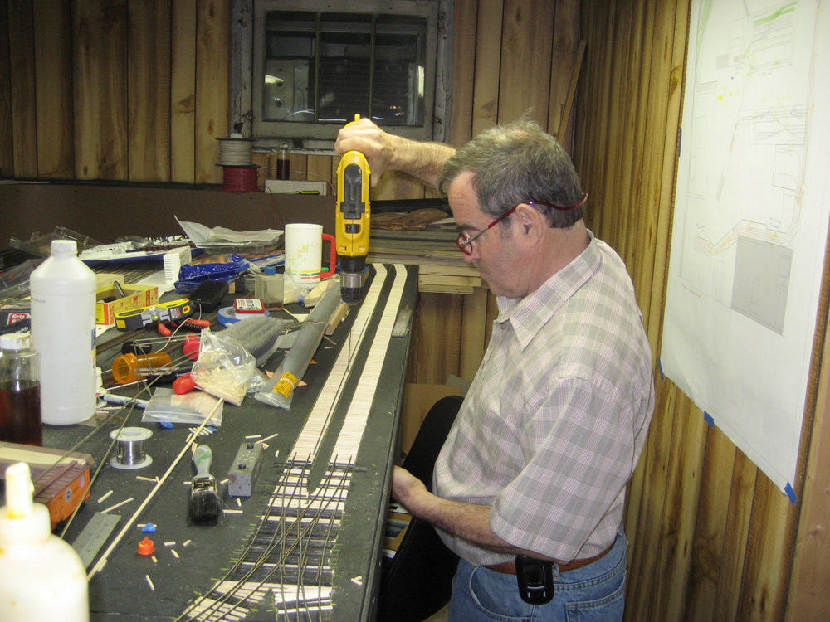
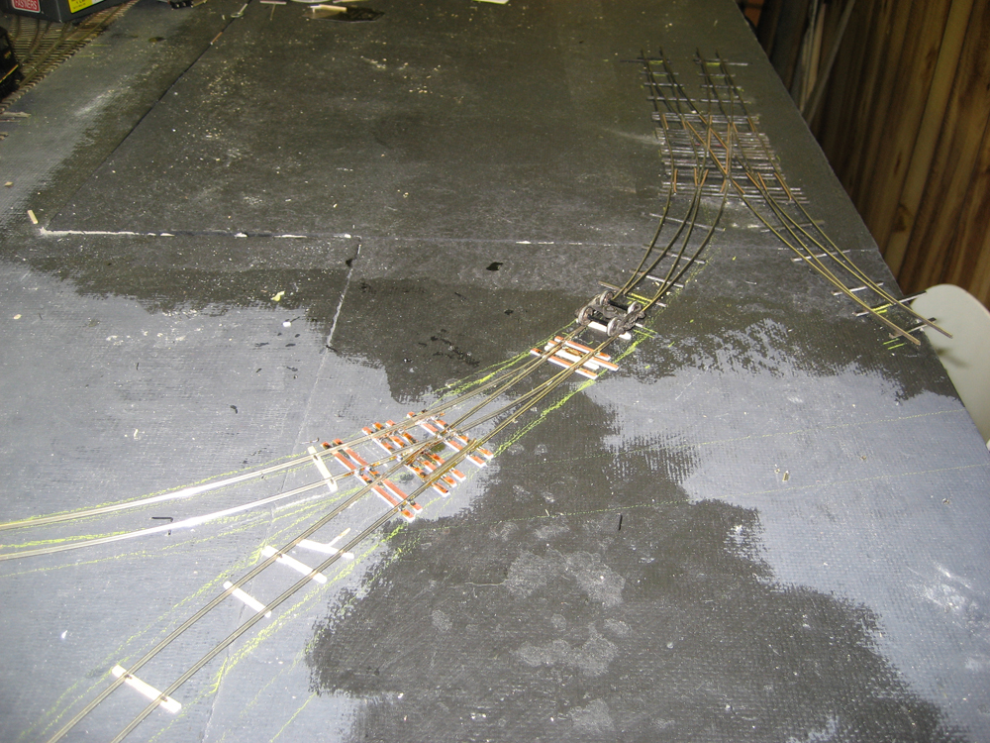
Construction!
2007

Slide 23
The First Shake Down:
February 16th, 2008
•Tom Callan
•Ralph Heiss
•Vince Lee
•Arthur Ross
•Neil Henning
• Ted Pamperin
• Jim Schweitzer
•Wayne Shortman

Slide 24
The First Shake Down:
February 16th, 2008

Slide 25
Milestones!
February 20th, 2006: First trip to get lumber for the Layout.
February 24th, 2006: Construction Begins
February 26th, 2008: First Shakedown Session
June 20th, 2008: Second Shakedown Session
August 1st, 2008: Third Shakedown Session
September 7th, 2008: Fourth Shakedown Session
February 6th, 2009: Fifth Shakedown Session – High Line First Operating Session
March 6th, 2009: First Regular Operating Session. Now running on the first Friday of the month.
52 Regular Operating Sessions March 6th 2009 to April 24th 2014!

Slide 26
Operations!
In the first few Shakedowns the New York Harbor used Card Cards and Waybills to determine car movements on the layout.

Slide 27
Operations!
By the fourth Shakedown I started using switch list for the Erie and Car Cards and Waybills for the New York Central.

Slide 28
Operations!
In the first regular Operating Session the Car Cards are gone and now the Staging Agent filled out blank waybills.

Slide 29
Operations!
December 4th 2009 Operating Session.
Last Session with Original High Line and 30th Street Yard. 30th Street damaged in boiler failure.
March 5th, 2010 Operating Session.
New 33rd Street Yard Opens and the Lehigh Valley’s 27th Street Terminals first Operating Session.

Slide 30
Operations!
March 5th Operating Session.

Slide 31
Operations!
December 3rd, 2009 High Line re-opens

Slide 32
Paperwork!
Switch List
And
Waybills!

Slide 33
Paperwork!
2009 Waybill
Late 2009 Waybill
2010 Waybill
2013 Waybill

Slide 34
Paperwork!
“A” Side
“B” Side
Alternate “A” Side

Slide 35
Paperwork!
In the Active Staging yard, the staging manager selects cars and assigns them to a waybill then assembles the train to go on to the railroad.
All of the waybills are pre-printed and are awaiting cars to be assigned.

Slide 36
Paperwork!
This waybill is waiting for a car to be assigned to it so it can be placed on either a scheduled train or a extra.
PRR
2319
With the assigning of this waybill to a Pennsylvania Railroad Mill Gondola Number 2319, it is placed on the active staging track and is ready to go out on Train JS-2 to 33rd Street Yard.
PRR 2319
Once the car is place at the Steel Platform the arrival time is noted on the waybill. Then the clock starts to when the waybills actions are completed.
This car was placed at the siding a 3:30 PM. After 6:00 PM or 2 ½ Hours later the car has been unloaded and this waybill has been completed. The waybill is crossed our and the car information is transferred to the “B” side.
3:30
x

Slide 37
Loads can be generated inside a Yard or industry that will need a car to pick it up. On the New York Harbor the “FOR LOADING” portion of the “B” side is then filed out and placed into a load’s waiting bill box.
Paperwork!
NYC 1642239
The Yard master will then assign a car to the waybill and maneuver the empty car to the appropriate location to be load or clean if needed so it can be loaded.
NYC 164239
Once the car is spotted at where it is to be loaded this side is crossed out and the car information is transferred to the other side.
With the car information transferred the time that the car was placed at the location is added and the clock starts for loading.
This car starts loading at 7:00 AM and will take 5 hours to load. This means that the car will be ready to send to Buffalo at 12:00 noon.
7:00
x

Slide 38
Paperwork!
Switch Lists used by both the Erie and the Lehigh Valley.
2009 - 2013v
2013 - Present

Slide 39
Paperwork!

Slide 40
Paperwork!

Slide 41
Paperwork!
Originally the agent would fill out by hand a two sided switch list. The yard crew would get the switch list. The A side of the switch list is for east bound cars off of the car float, and the B side is for yard moves including cars moving to the west bound car float.

Slide 42
Paperwork!

Slide 43
Paperwork!

Slide 44
Paperwork!
The new switch list is generated by the software and is printed out and handed to the yard crews.

Slide 45
Equipment and Traffic Flow
The Lehigh Valley’s 27th Street Station

Slide 46
Equipment and Traffic Flow
The Lehigh Valley’s 27th Street Station
Car Float: 14 Cars
Yard Capacity: 55 Cars
Services Terminal Stores: 12 Cars
2 – 3 Car Floats per Session: 56 – 84 Cars per session

Slide 47
Equipment and Traffic Flow
The Erie’s 28th Street Station

Slide 48
Equipment and Traffic Flow
The Erie’s 28th Street Station
Car Float: 17 Cars
Yard Capacity: 59 Cars
Services Terminal Stores: 12 Cars
2 – 3 Car Floats per Session: 68 – 102 Cars per session

Slide 49
Equipment and Traffic Flow
The New York Central’s 33rd Street Station

Slide 50
Equipment and Traffic Flow
The New York Central’s 33rd Street Station
Yard Capacity: 130 Cars
Services Terminal Stores: 22 Cars
6 - 20 Car East Bound Trains: 120 Cars per session
5 – 20 to 25 Car West Bound Trains: 120 Per Session

Slide 51
Equipment and Traffic Flow
The New York Central’s 30th Street Branch

Slide 52
Equipment and Traffic Flow

Slide 53
Equipment and Traffic Flow
The New York Central’s 30th Street Branch
Branch Capacity: 132 Cars
St. John’s Park Station: 71 Cars
6 - 20 Car East Bound Trains: 120 Cars per session
1 – 2 Mail Trains: 8 – 16 Cars Per Session
5 – 20 to 25 Car West Bound Trains: 120 Per Session

Slide 54
Equipment and Traffic Flow
The New York Harbor Railroad
Cars moved through out the session:
612 – 682 Per Session
1,224 – 1,364 Per 24 Hours (2 Sessions)

Slide 55
A Tour of The New York Harbor Railroad

Slide 56
Questions?

Slide 57
Questions?
Thank You!

